Slide 1
Reviving the St. Johns River to the Sea Loop Tour

Slide 2
It was a good idea then. It’s a better idea now

Slide 3
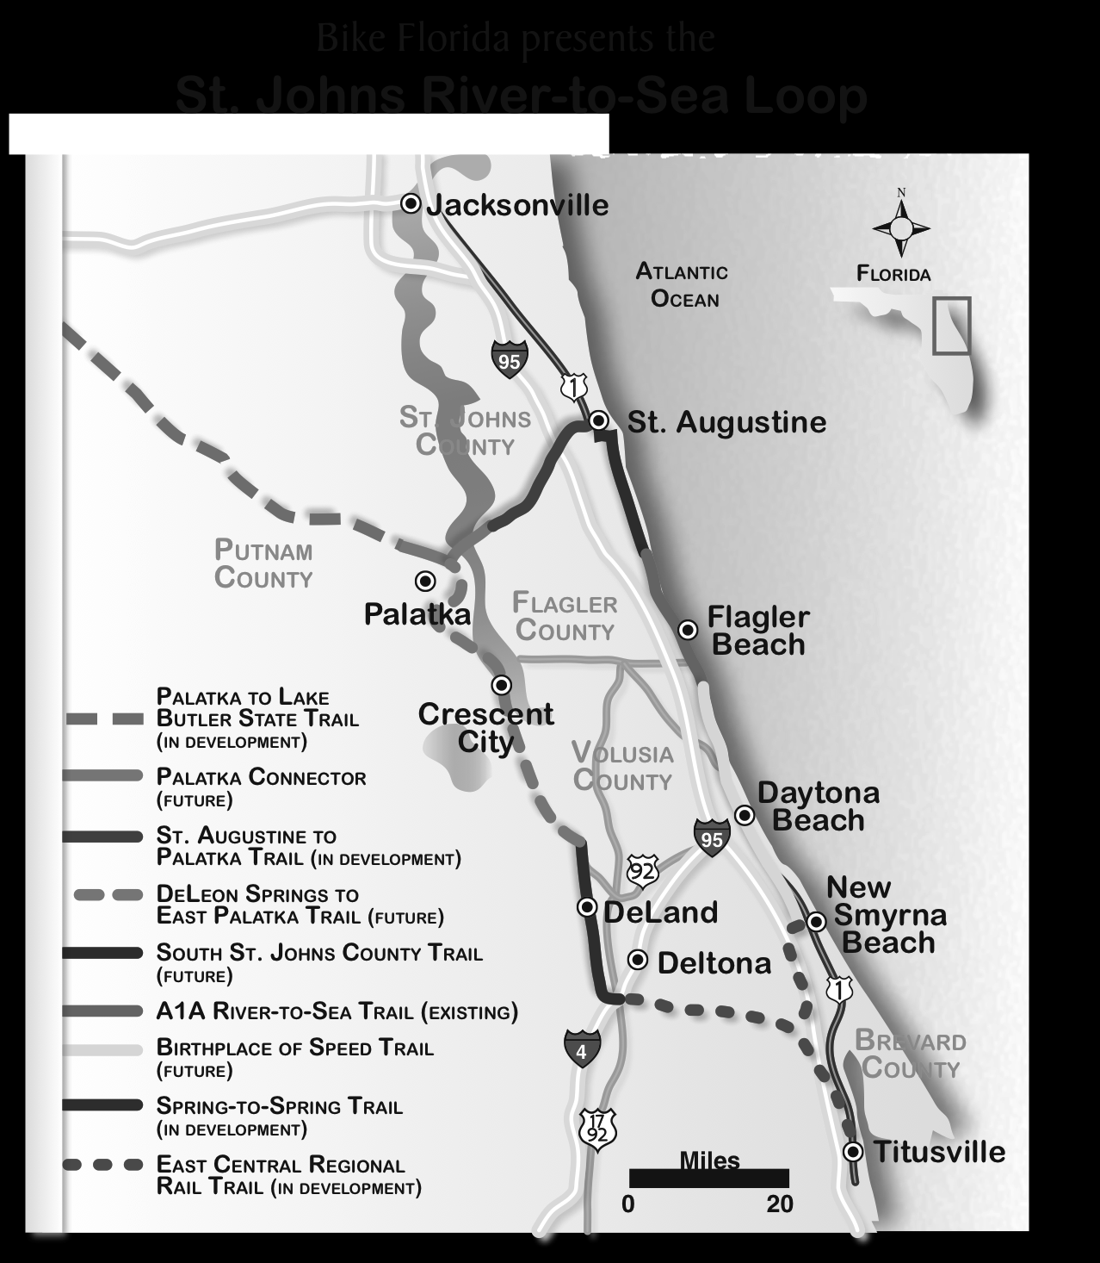
In the fall of 2008, Bike Florida organized the inaugural St. Johns River to the Sea Loop Tour. Sixteen cyclists participated.

Slide 4
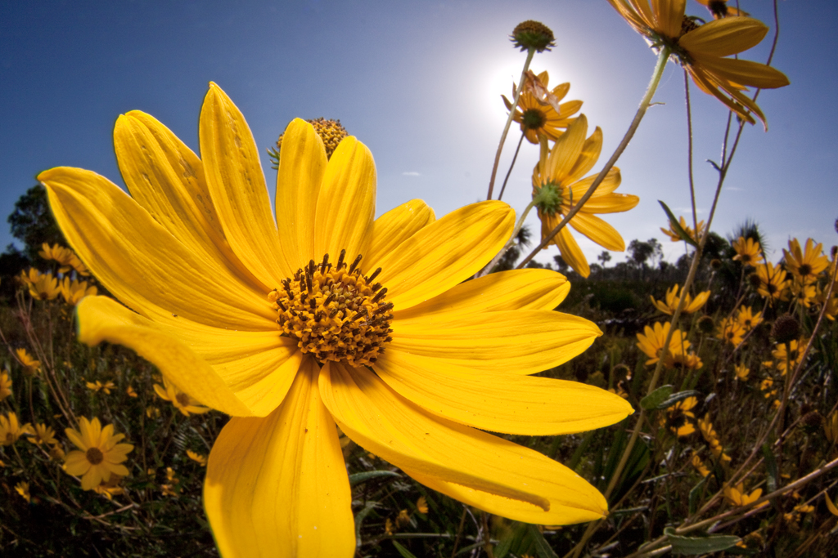
We partnered with the Florida Wildflower Foundation

Slide 5
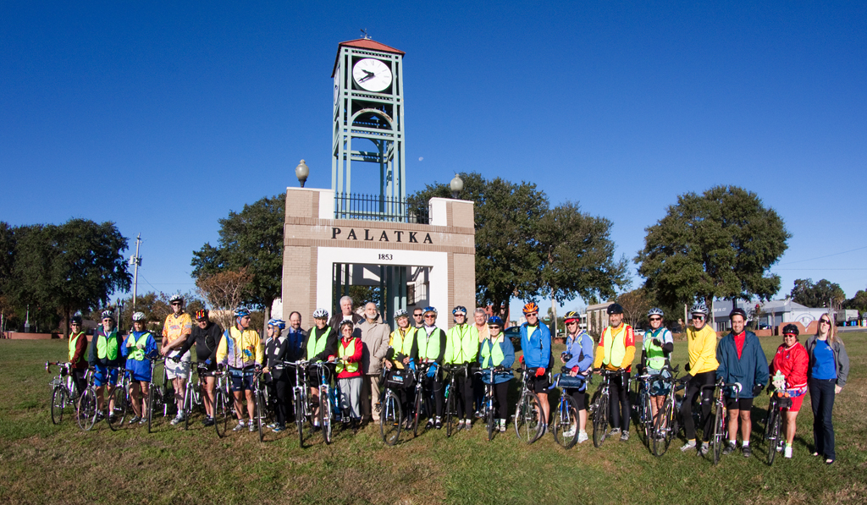
The tour began and ended in Palatka

Slide 6
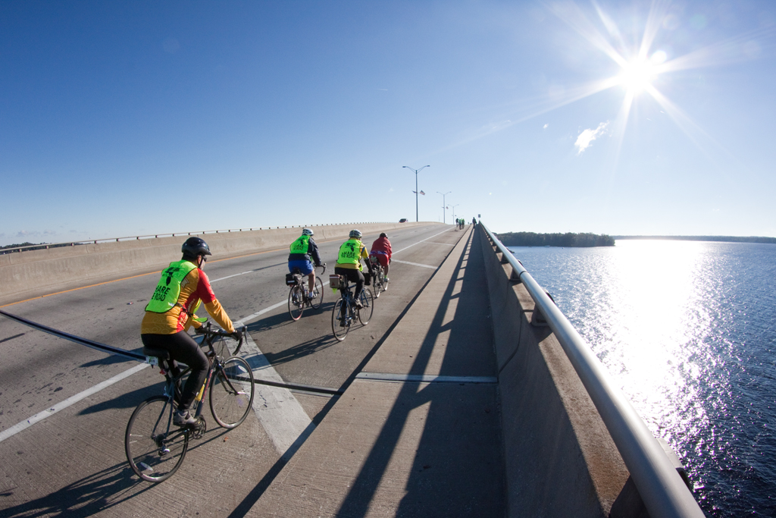
And we followed the sea to St. Augustine, Flagler Beach, Daytona Beach, New Smyrna Beach and Titusville before turning west again and following the St. Johns north through Deltona, DeLand, Crescent City and Welaka.

Slide 7
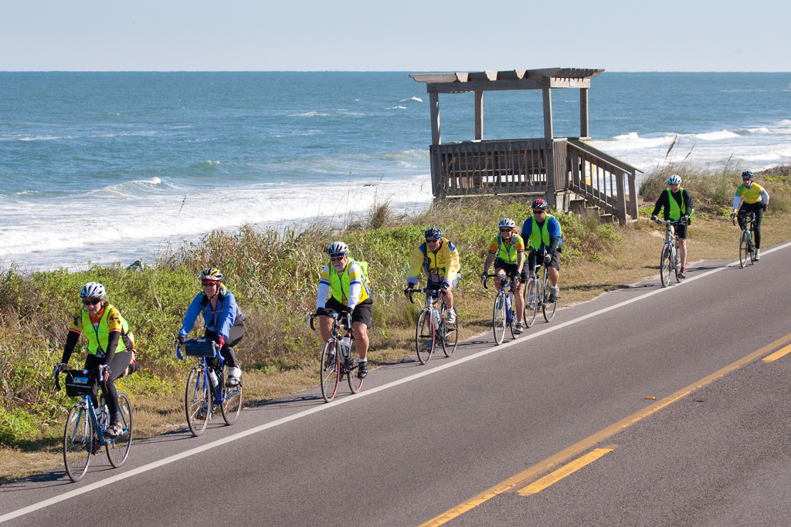
We journeyed through the heart of Florida’s First Coast

Slide 8
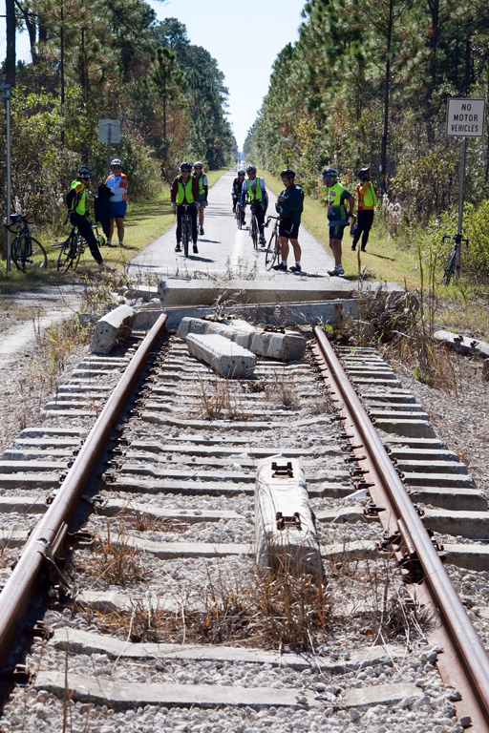
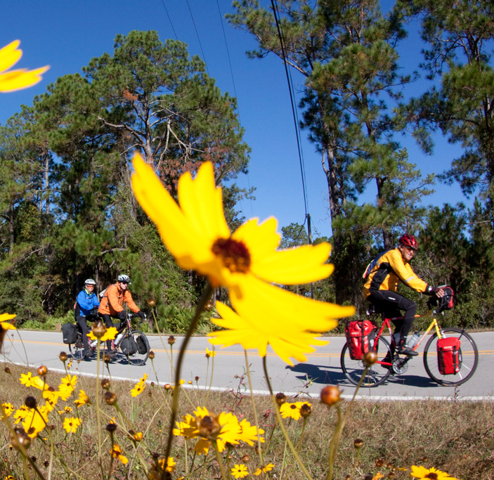
Seeking out scenic surface roads to fill in the gaps.
Taking advantage of existing trails where we could find them

Slide 9
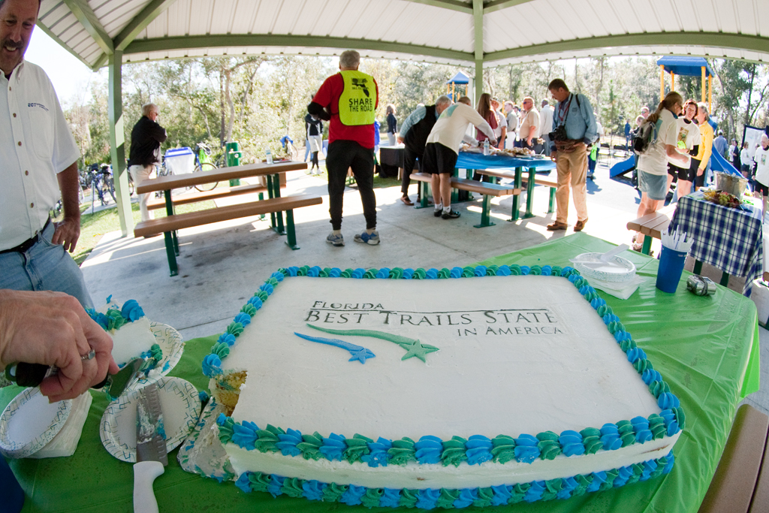
We celebrated Florida trails

Slide 10
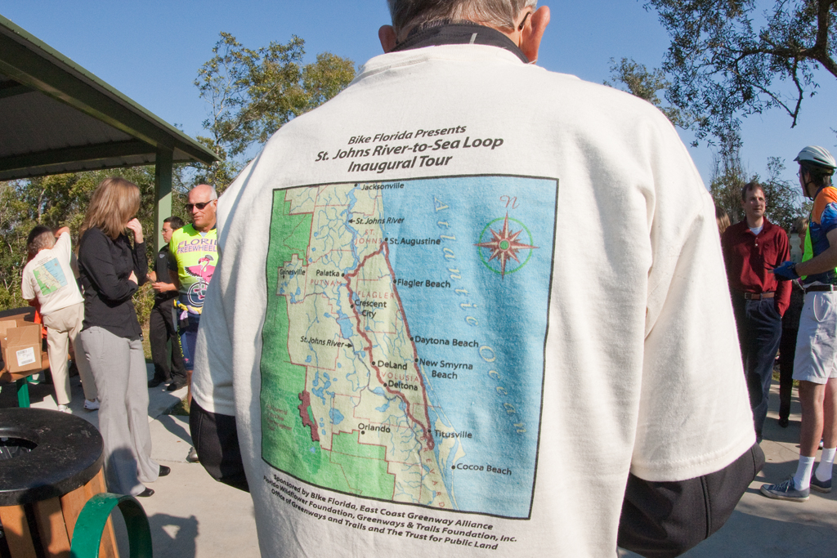
And found a new way to see old Florida

Slide 11
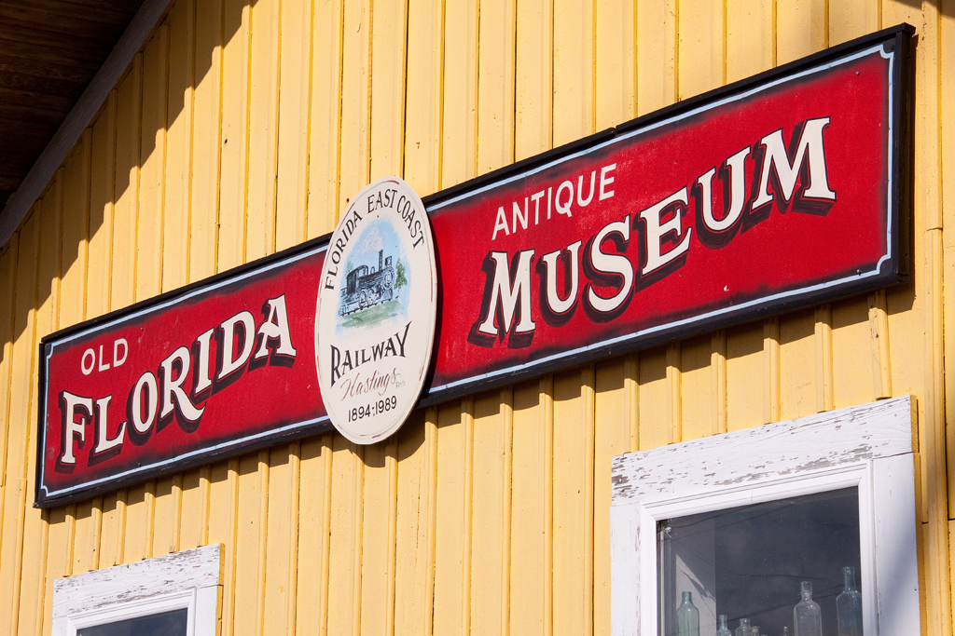
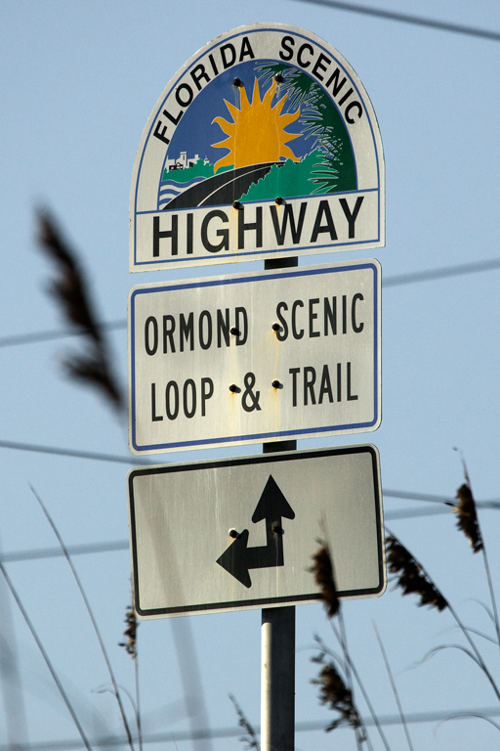
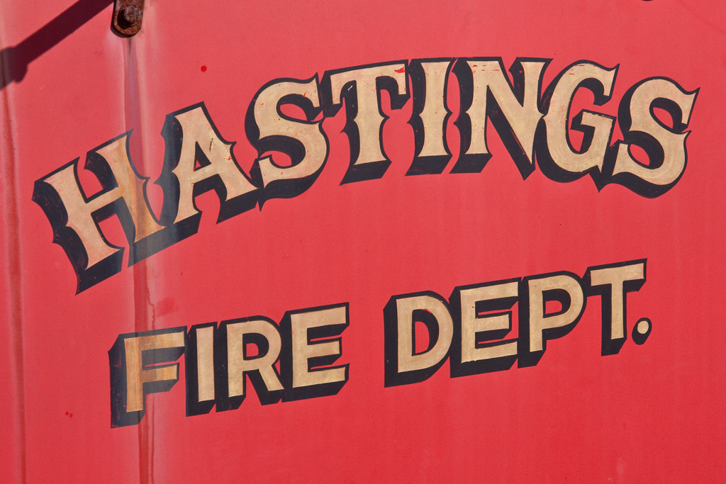

Slide 12
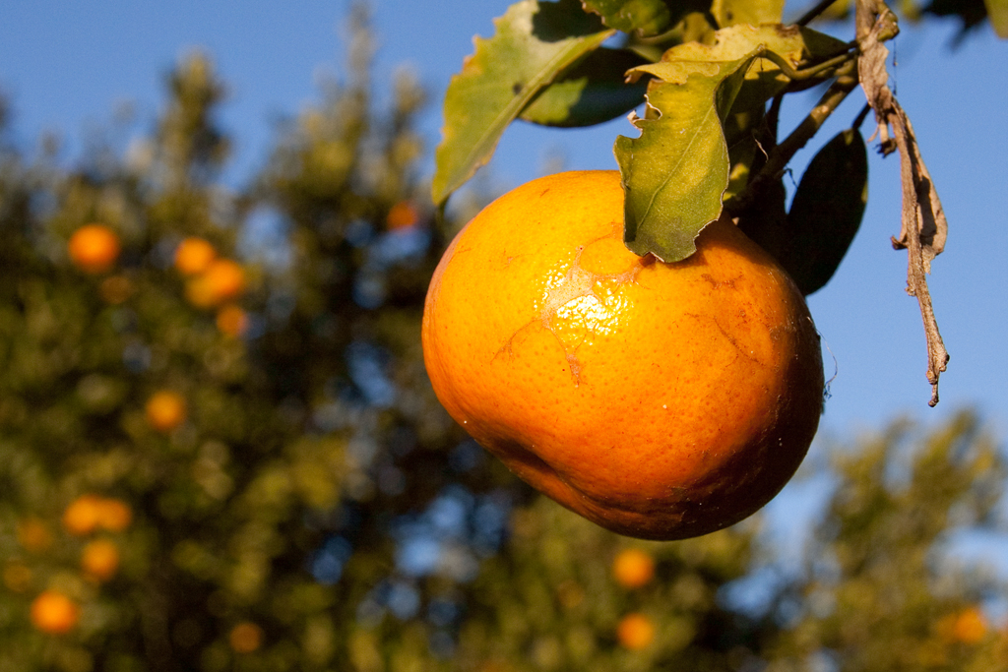
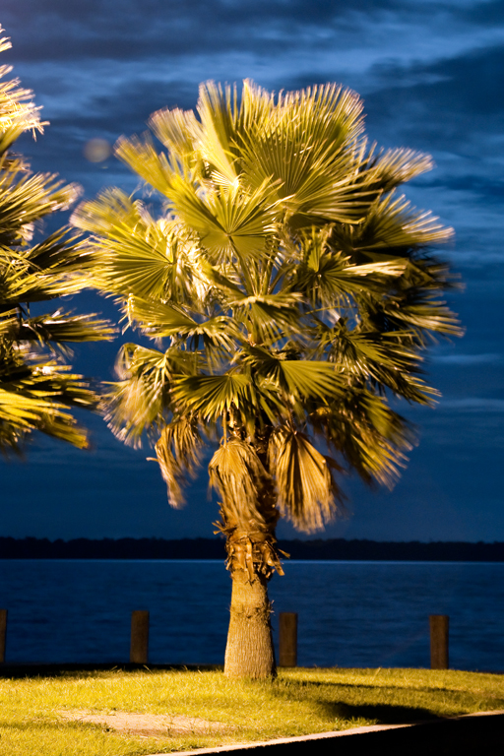
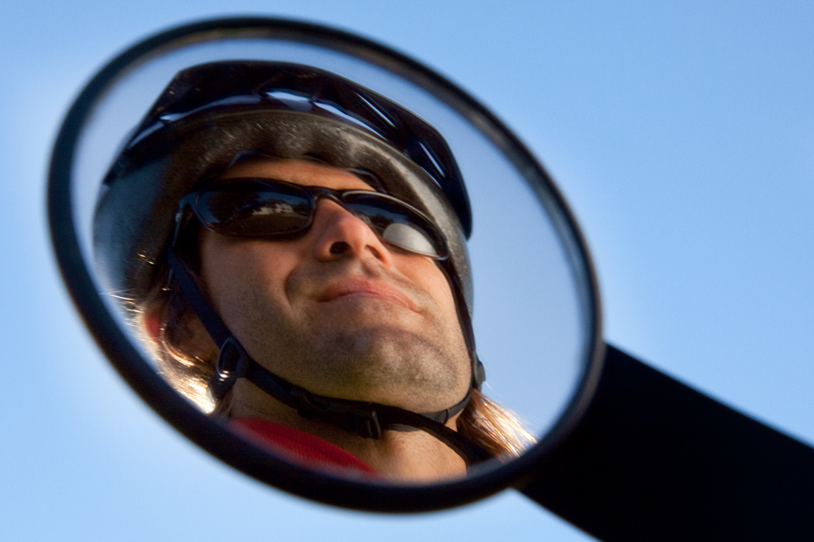

Slide 13
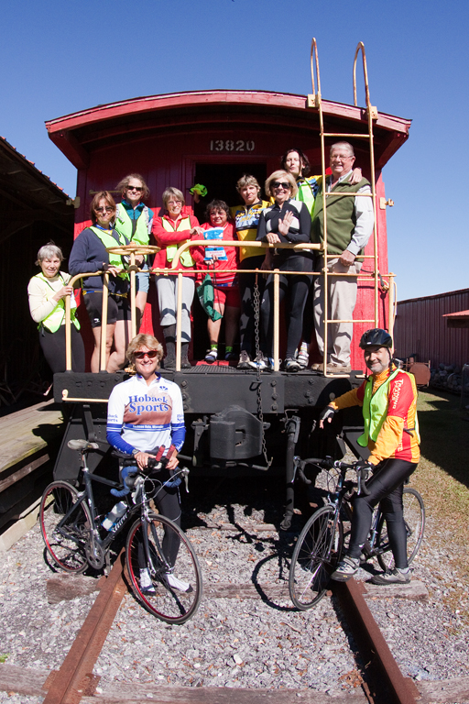
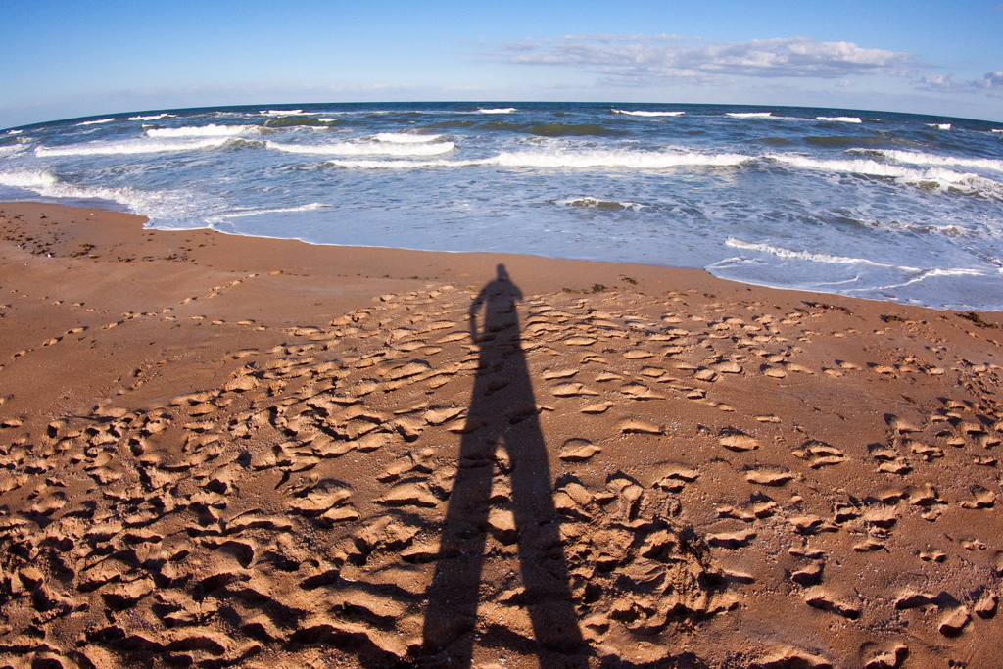
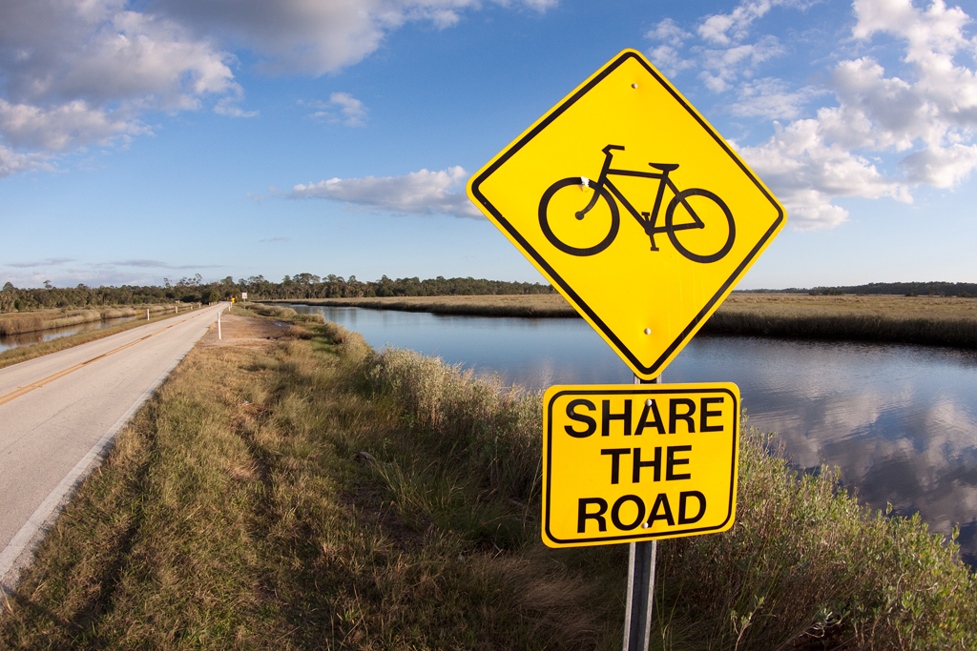
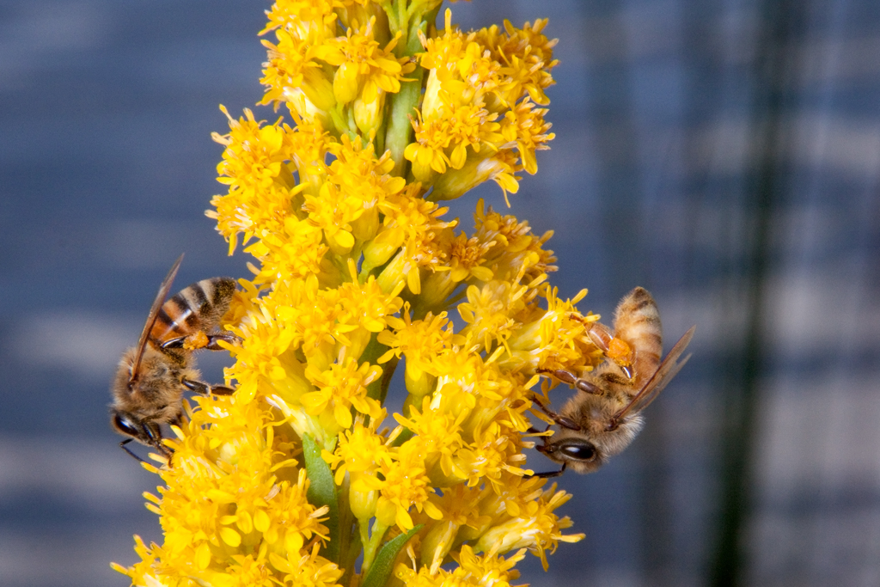

Slide 14
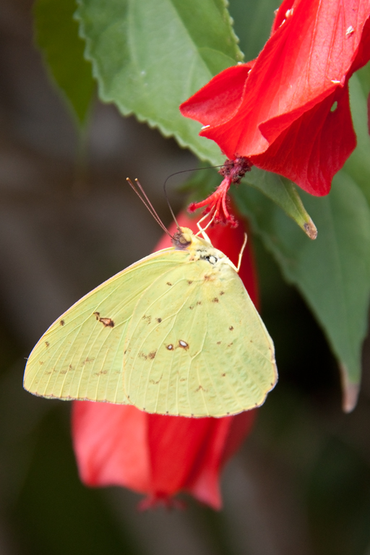
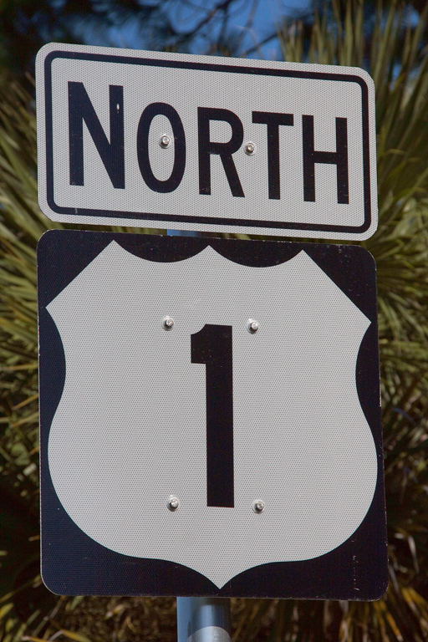
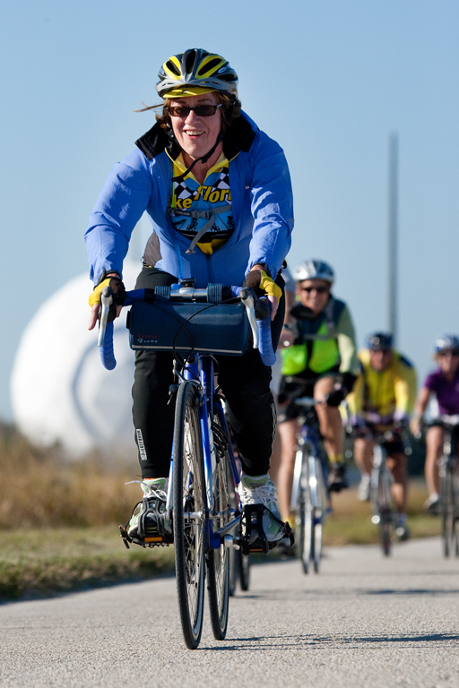
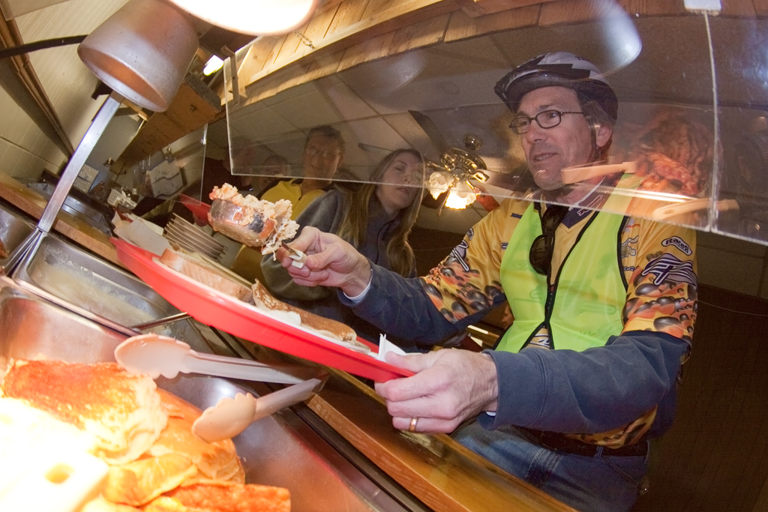

Slide 15
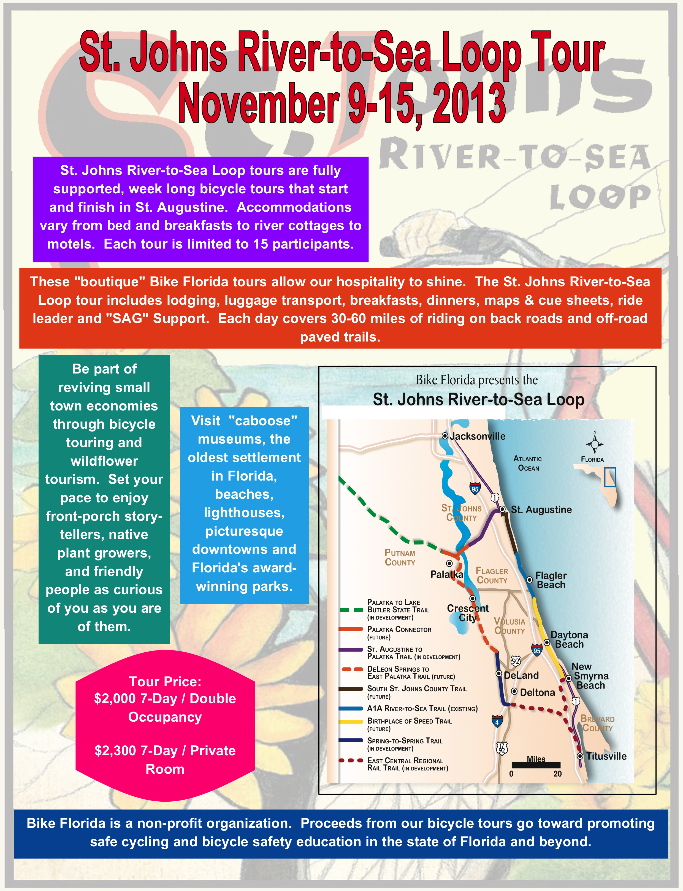
We are currently in the planning stages of a relaunch. The first tour is scheduled for the week of Nov. 9-15. Subsequent tours will be schedule in 2014 and beyond

Slide 16
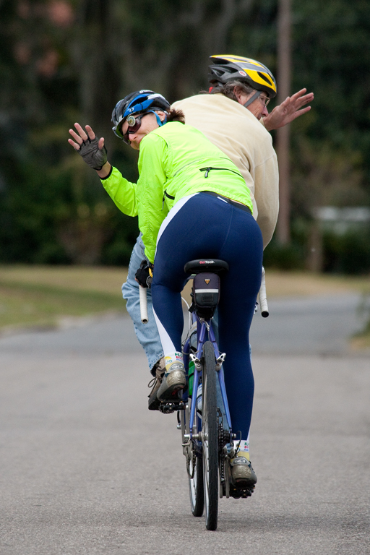
We will be back

