Slide 1
Office of
Greenways and Trails
Robin Birdsong Office of Greenways & Trails
Division of Recreation and Parks

Slide 2
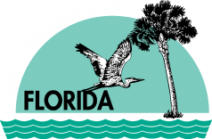
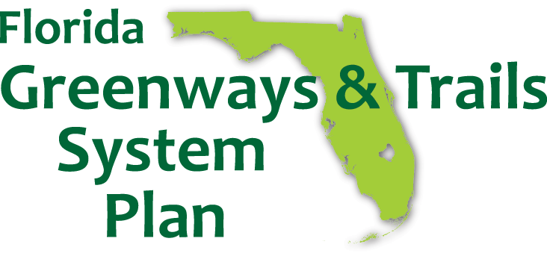
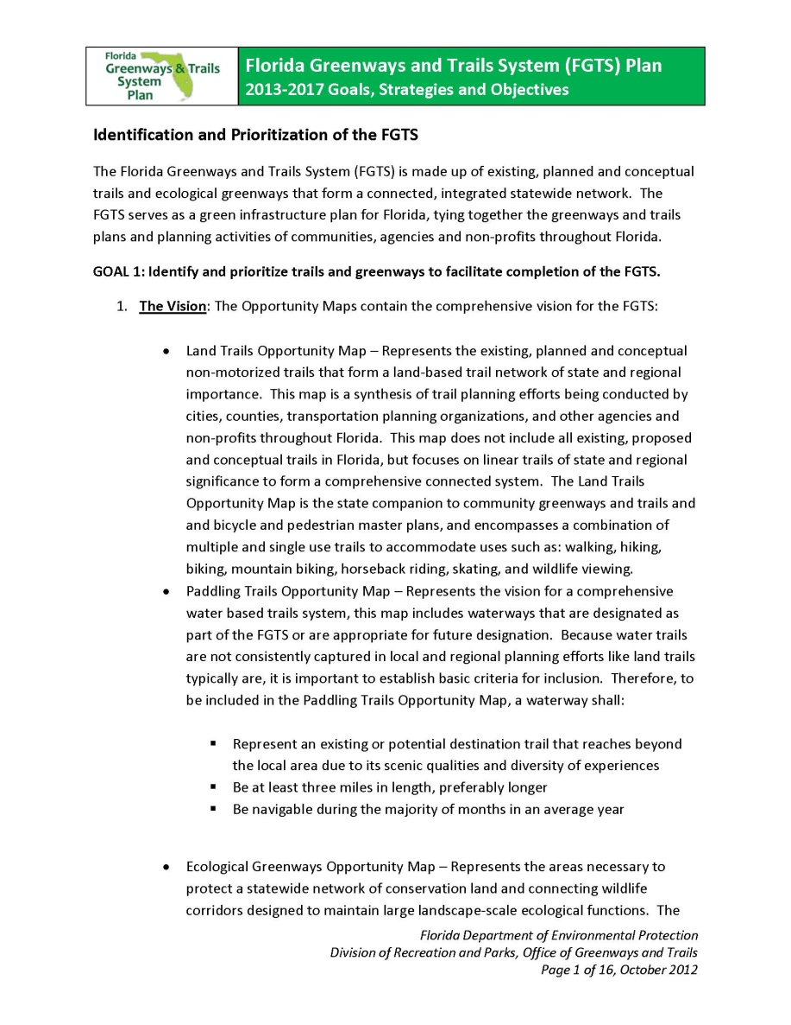
FGTS Plan

Slide 3
FGTS Planning Levels
Highest Needs
Level 3 - The Gaps: Priority Trail Gaps (2013)
Level 2 - The Priorities: Priority Trails (2012)
Level 1 - The Vision: Land and Paddling Trails Opportunities (2012)
Focused System
Complete System

Slide 4
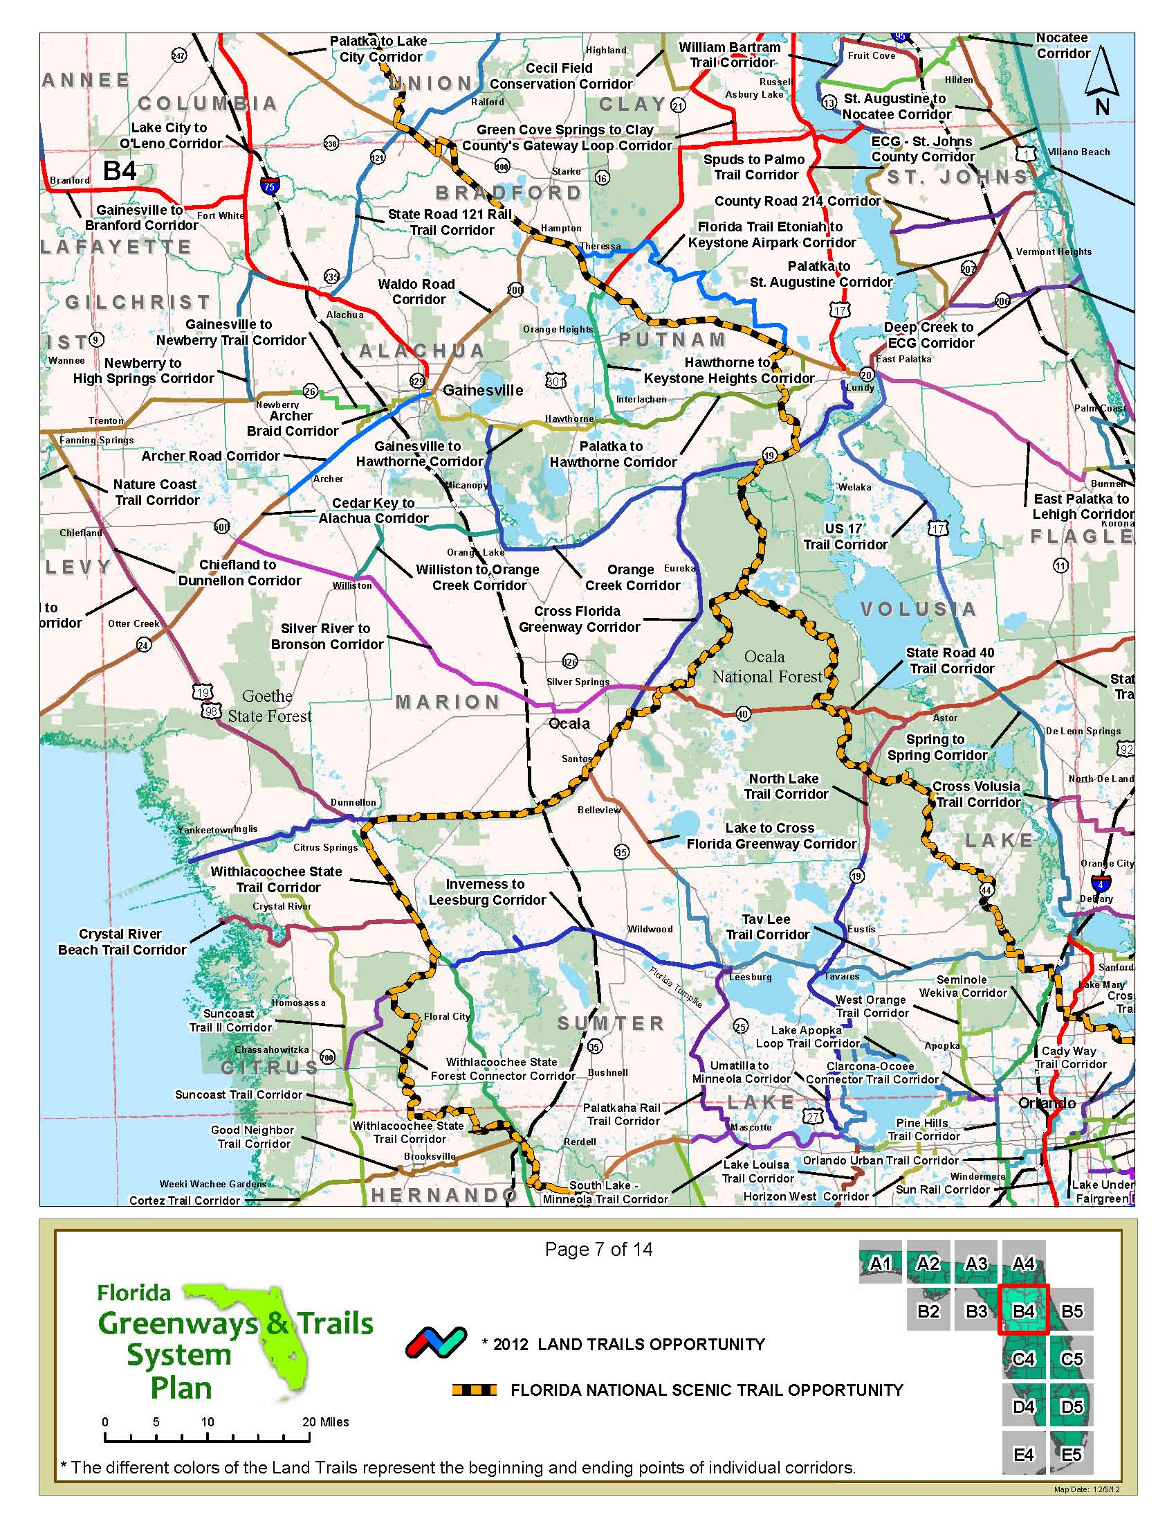
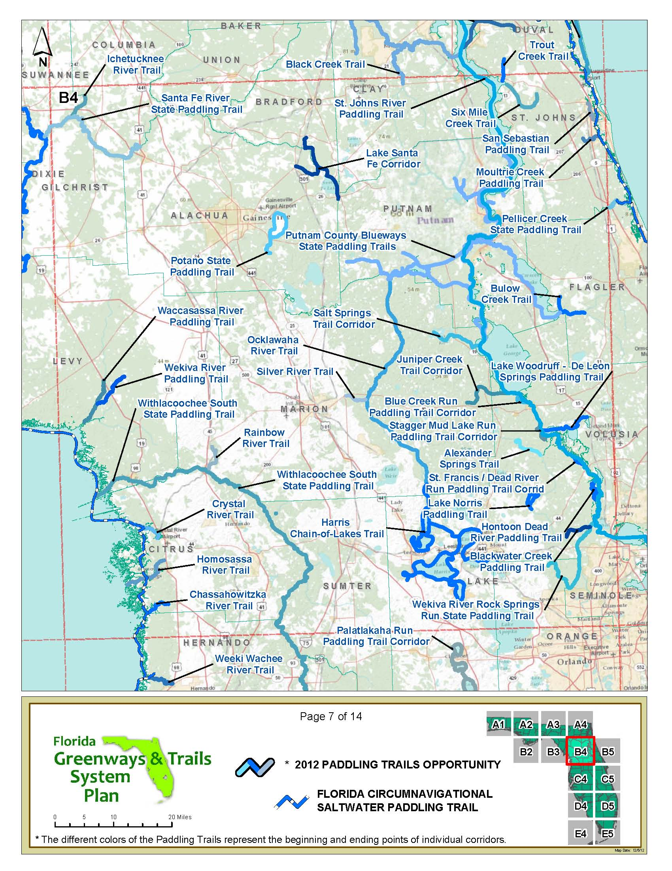
The Maps
Land Trails Opportunity Map
Paddling Trails Opportunity Map

Slide 5
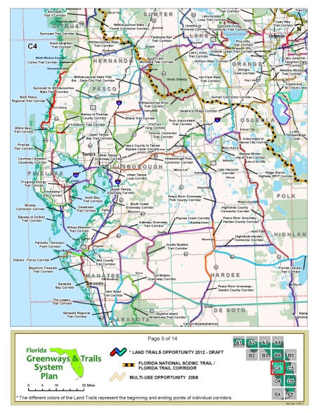
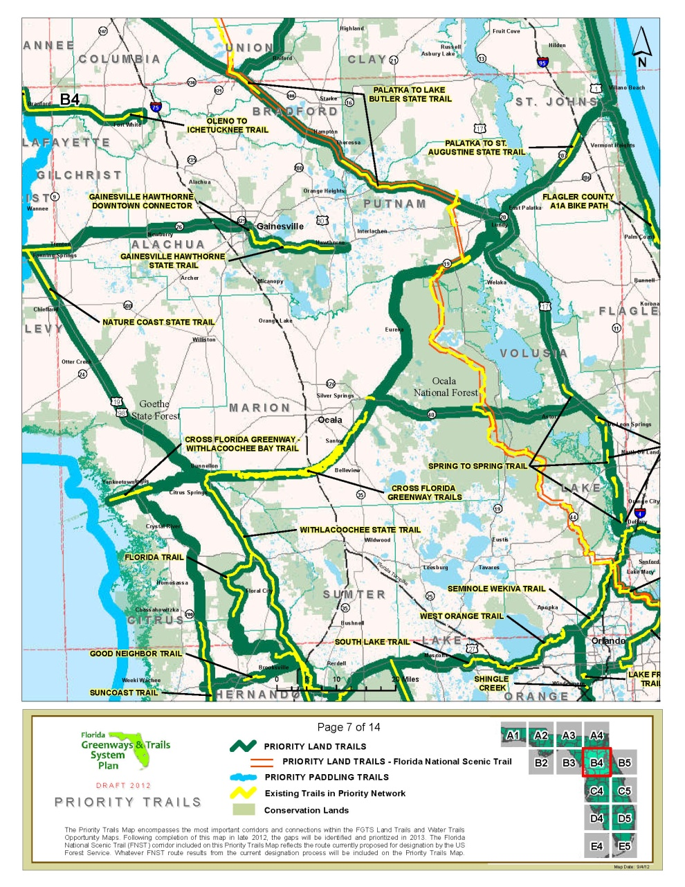
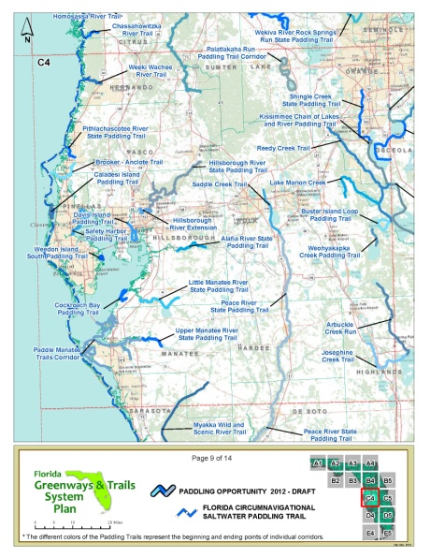
The Maps
Land Trails Opportunity Map
Priority Trails Map
Paddling Trails Opportunity Map

Slide 6
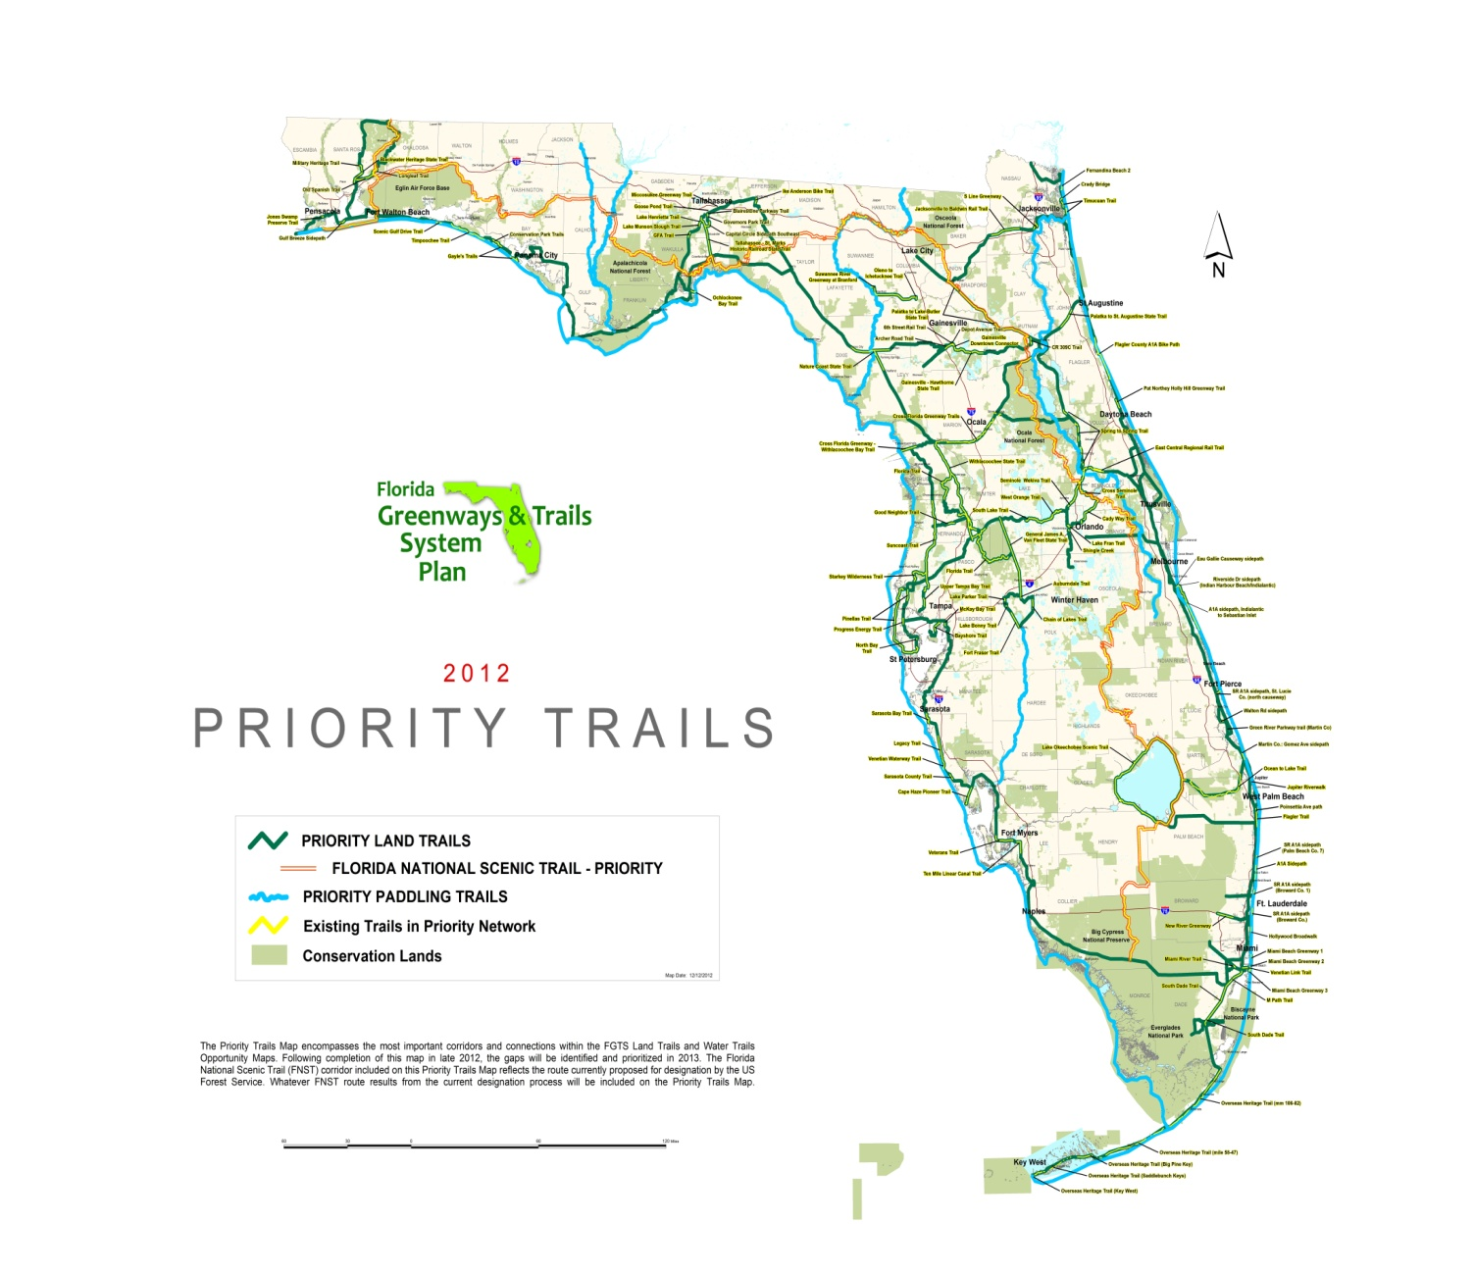
Priority Trails Map
Notes:
Priority Network is a centerpiece of the Florida Greenways and Trails System Plan.

Slide 7
Highlights
Establishes priorities to direct and focus resources
Provides a framework for
“closing the gaps”
to connect the FGTS

Slide 8
Highlights
Aligns the FGTS with complementary planning efforts
Economic Development – 5 Yr Strategic Plan for Economic Development
Tourism – VISIT FLORIDA Destination Marketing Plan
Health – State Health Improvement Plan (SHIP)
Transportation – Florida Transportation Plan (FTP) 2060
Recreation – Statewide Comprehensive Outdoor Recreation Plan (SCORP)
Conservation – Cooperative Conservation Blueprint & Wildlife Action Plan
Local & Regional Planning
Notes:
Implementing the FGTS plan advances Complementary Plans.
Florida continues provide leadership in:
enhancing the quality of life of its citizens and visitors
a forward-looking approach to eco-tourism to provide much-needed economic benefits
providing resources for to improve the overall health of the population
connecting trails to communities and helping develop alternative routes of transportation
Trails are helping change the landscape of tourism in today’s Florida as they create connections between the state’s natural beauty and the places people choose to live, work and play.

Slide 9
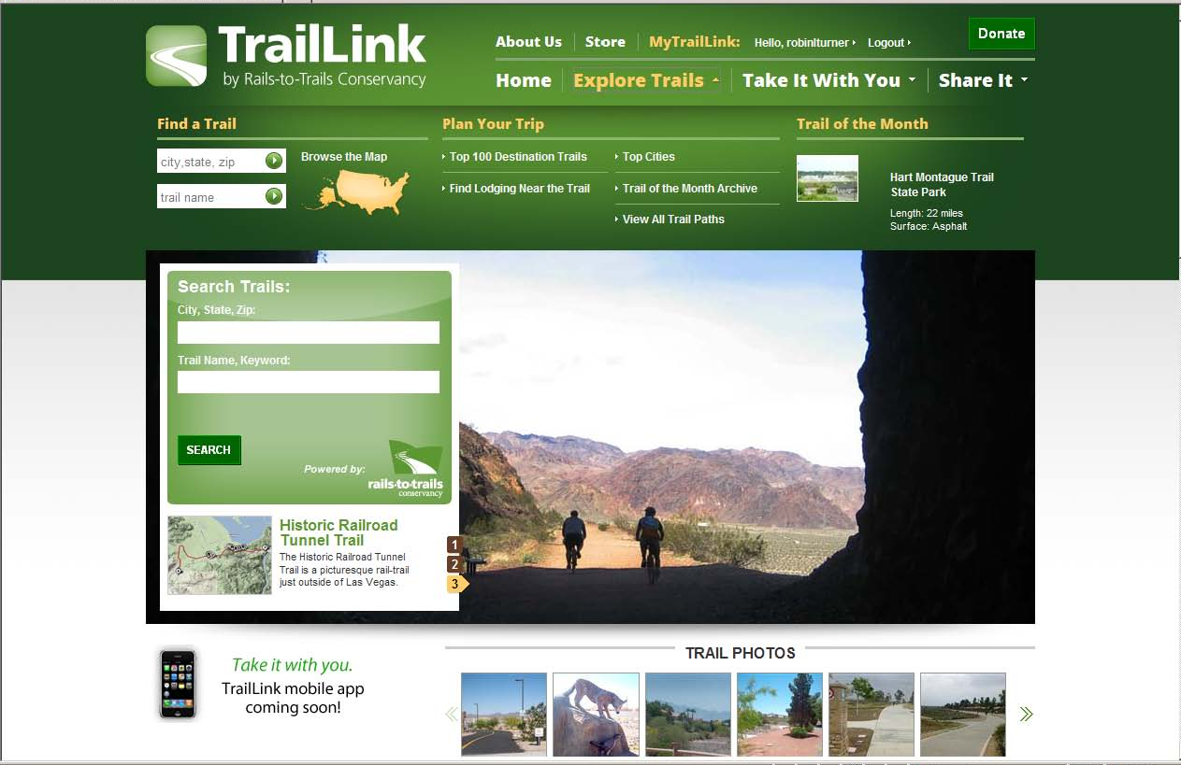
Demand for Trail Information

Slide 10
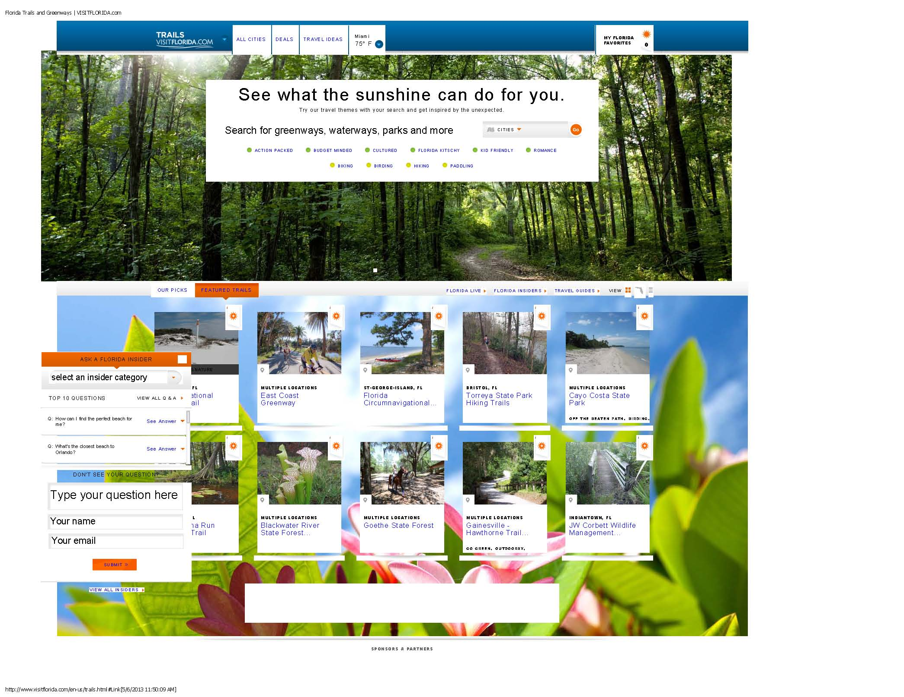
Demand for Trail Information
Notes:
One of the most frequent information requests at VISIT FLORIDA’s Welcome Centers

Slide 11
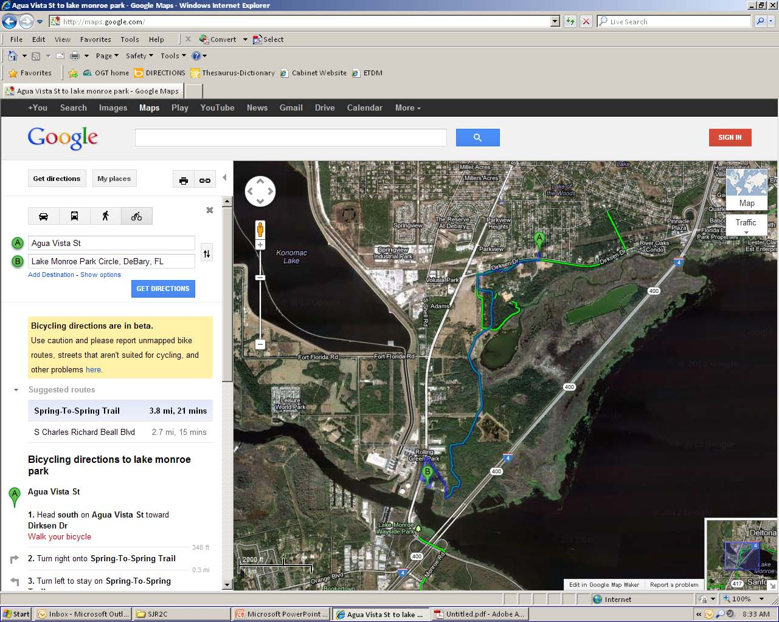
Mapping Routes with Trails

Slide 12
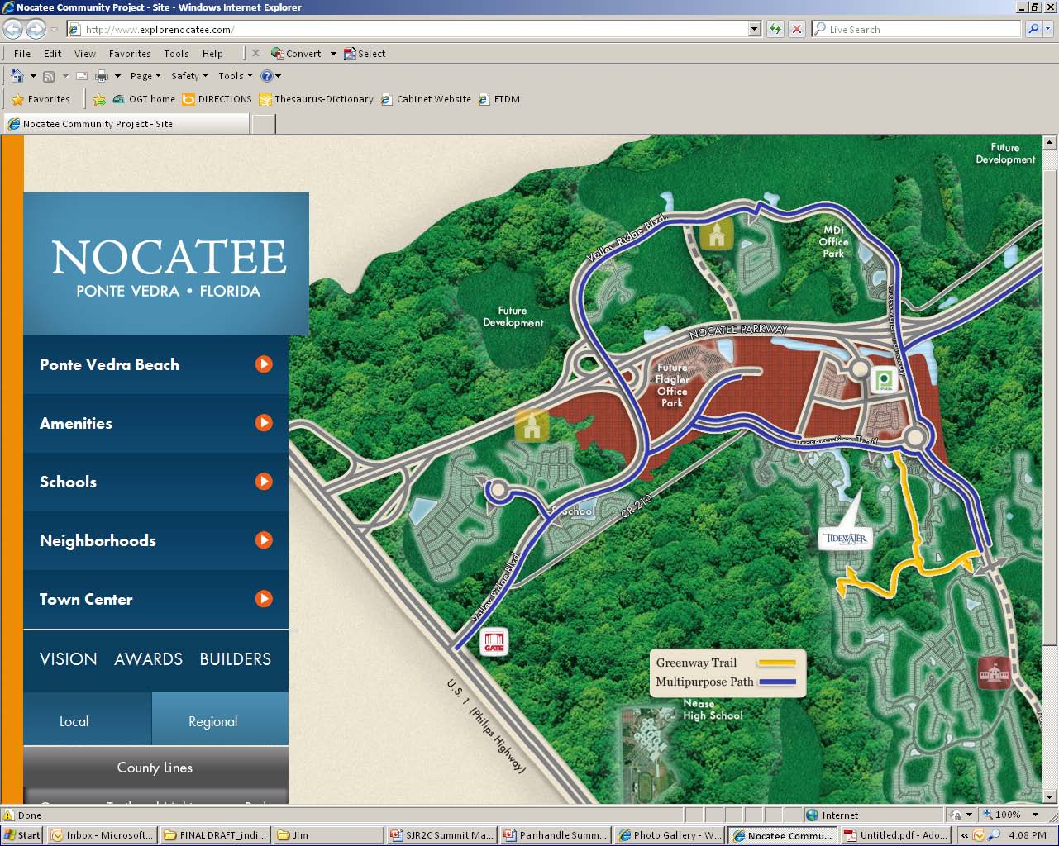
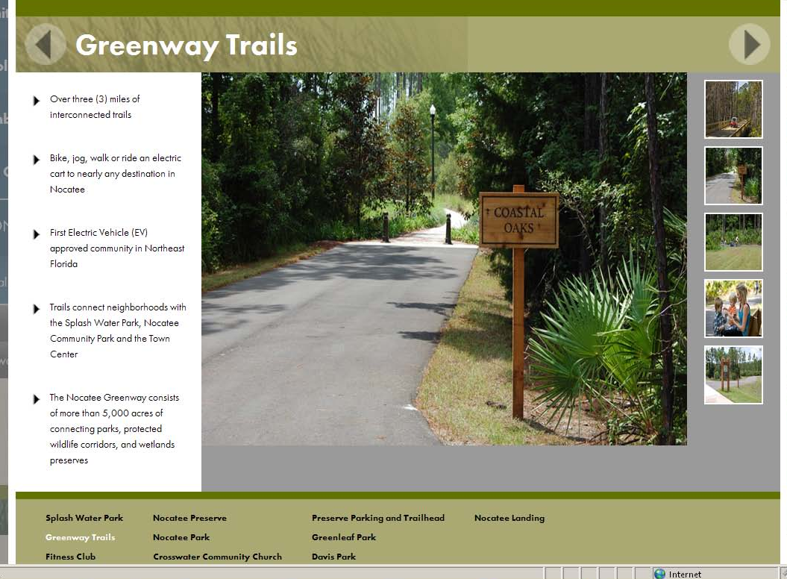
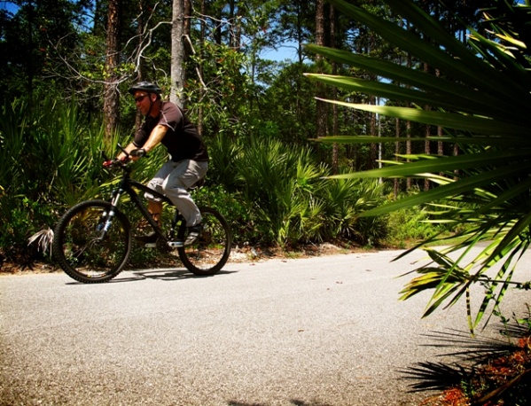
Homeowners Want Trails
Notes:
Trails are the most desired community amenity that homeowners seek when buying a home.
National Association of Home Builders, 2008

Slide 13
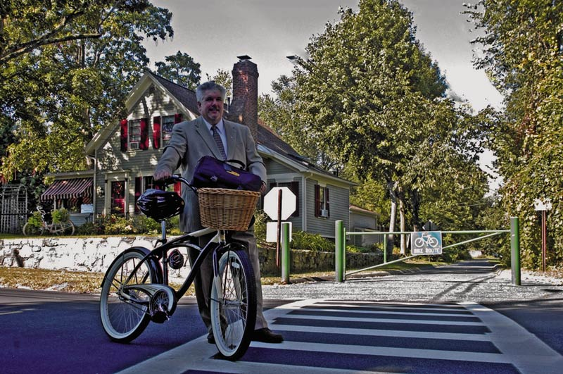
Property Values
Homes adjacent to rail-trails sell faster
and
closer to list price
than those that are not.
Craig Della Penna, Realtor

Slide 14
Economic Impact
Three trails
supported
$42 Million
516 Jobs
ECRRT study
Notes:
East Central Florida Regional Planning Council

Slide 15
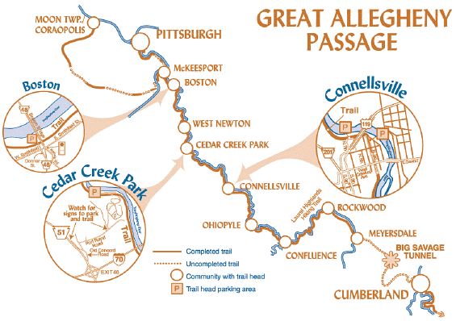
Tourism Destinations
Trail users that were surveyed represented nearly every state in the continental United States and parts of Canada

Slide 16
Tourism Destinations
Notes:
National – Merritt Island National Wildlife Refuges, Cape Canaveral National Seashore, John F. Kennedy Space Center, two National Monuments, the Ocala National Forest and numerous National Register Sites; Eight State Parks (Gamble Rogers, North Peninsula, Blue Springs, Deleon, Dunns Creek, Anastasia, Faver Dykes, Washington Oaks); Six Scenic Byways (River of Lakes, Black Bear, A1A, Ormond Scenic, Indian River Lagoon, Heritage Crossroads); and ?].

Slide 17
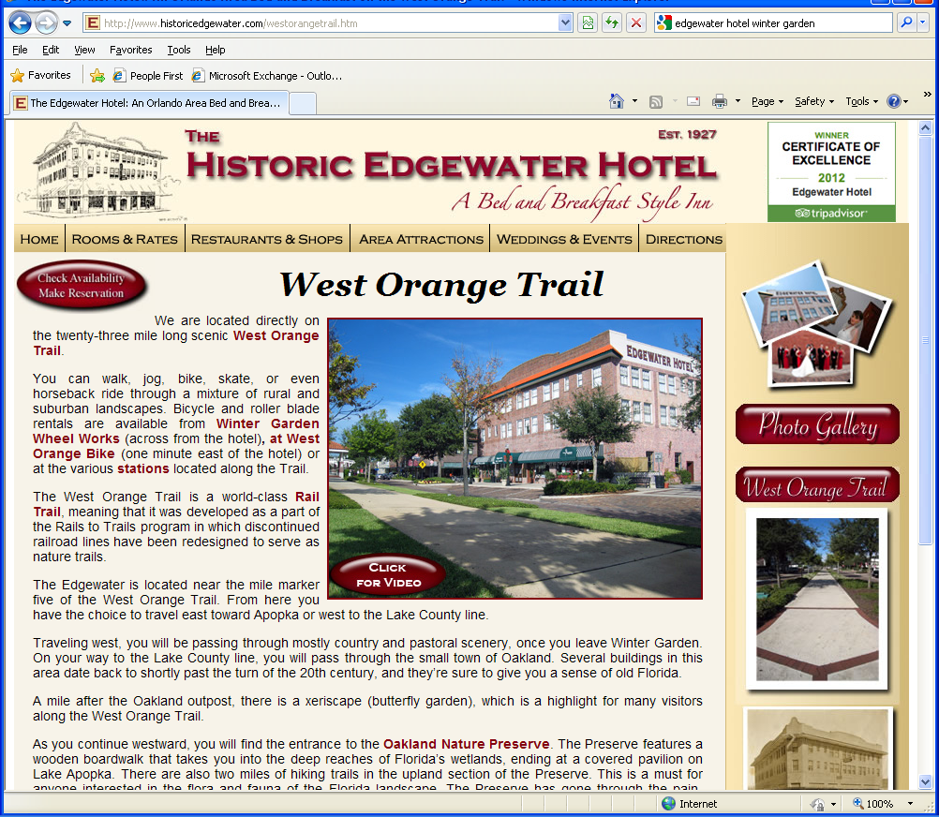
The Trail as Selling Point

Slide 18
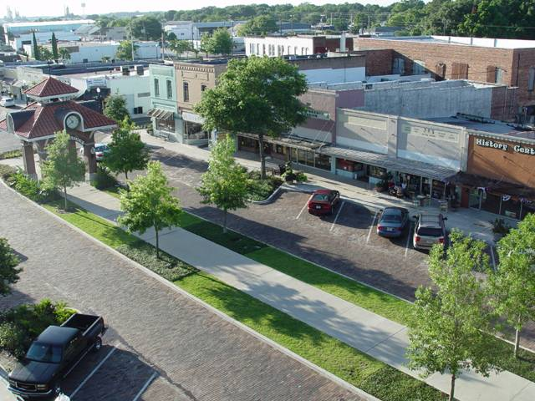
Florida Trail Town
City of Winter Garden
West Orange Trail
“Quality of life is one of our essential selling points and the Trail is an integral component of our quality of life.”
Mike Bollhoefer
Winter Garden City Manager

Slide 19
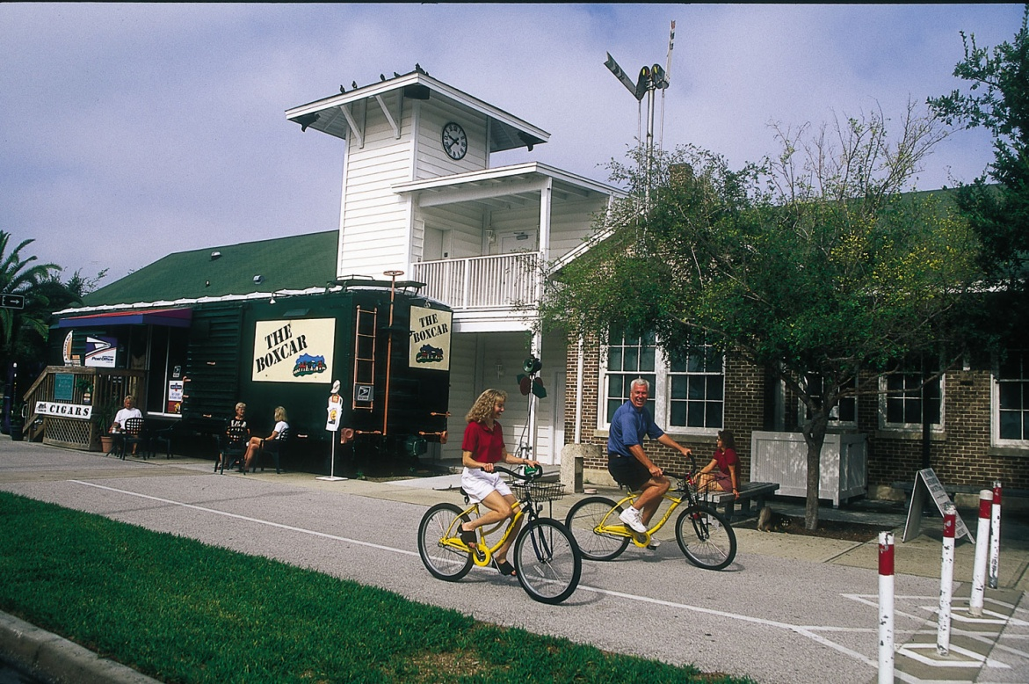
Florida Trail Town
The Pinellas Trail
is an
“economic engine.”
Bob Ironsmith
Dunedin Economic
Development Director
Downtown Dunedin business occupancy rates:
1980s (before the trail) – 30%
Today (with the trail) – 95%

Slide 20
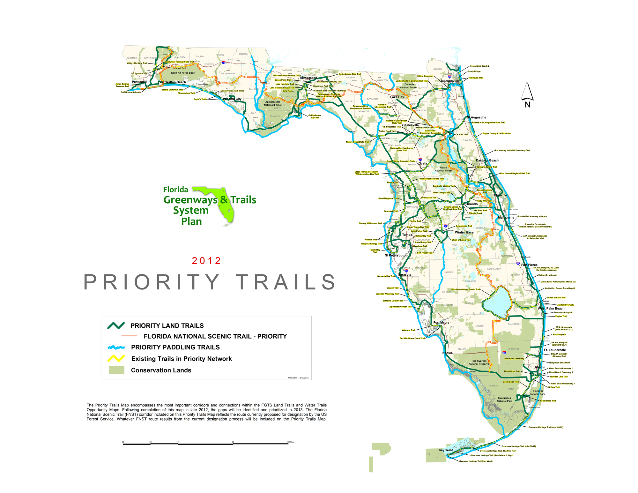
Centerpiece of Plan
Approved by the Florida Greenways and Trails Council - December 2012
Notes:
In 1991 the concept of the East Coast Greenway was first developed creating an off-road, 3,000-mile trail connecting major cities between Calais, Maine and Key West, Florida. The Florida segment is 600-miles and constitutes 20 percent
of the total system.

Slide 21
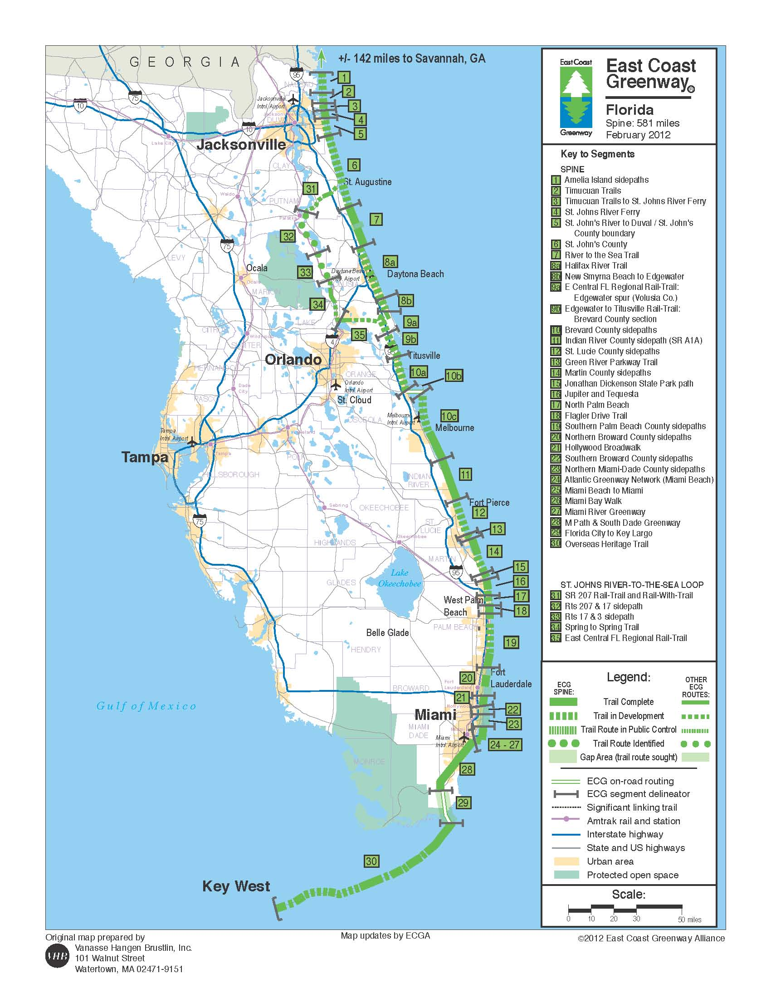
The Vision

Slide 22
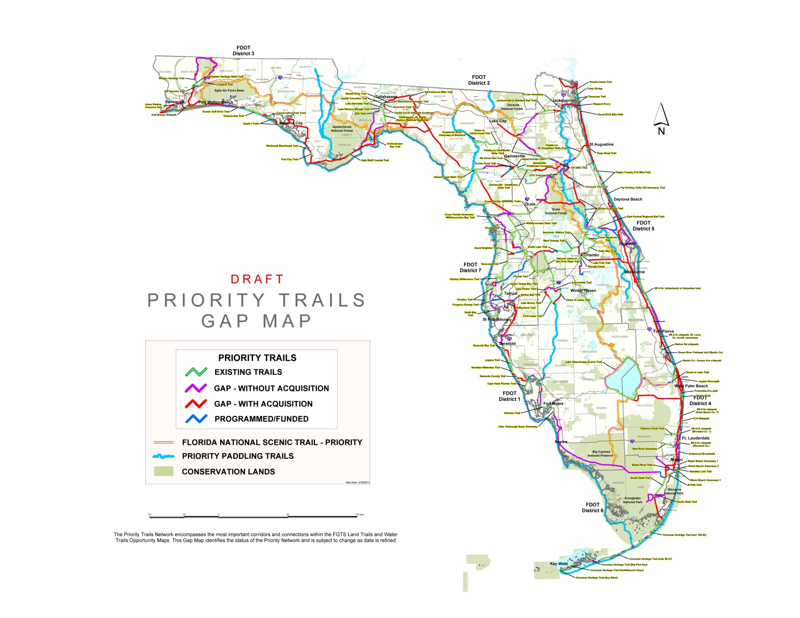
Gap Map
Notes:
This portion of the East Coast Greenway is a segment of the 260-mile St. Johns River-to-Sea Loop. The Johns River-to-Sea Loop was established in 2008 through a Memorandum of Agreement signed by 5-counties (St. Johns, Putnam, Flagler, Volusia and Brevard). Bike Florida hosted the inaugural tour. The Loop is being completed through the cooperation of non profits, municipalities, counties, state and federal agencies, and private sector entities.
The momentum behind the development of the East Coast Greenway and the St. Johns River-to-Sea Loop is continually growing and implements the Priority Network identified by the Florida Greenways and Trails System Plan. The Priority Network is a centerpiece of the Florida Greenways and Trails System Plan.

Slide 23
Gap Map
Notes:
This portion of the East Coast Greenway is a segment of the 260-mile St. Johns River-to-Sea Loop. The Johns River-to-Sea Loop was established in 2008 through a Memorandum of Agreement signed by 5-counties (St. Johns, Putnam, Flagler, Volusia and Brevard). Bike Florida hosted the inaugural tour. The Loop is being completed through the cooperation of non profits, municipalities, counties, state and federal agencies, and private sector entities.
The momentum behind the development of the East Coast Greenway and the St. Johns River-to-Sea Loop is continually growing and implements the Priority Network identified by the Florida Greenways and Trails System Plan. The Priority Network is a centerpiece of the Florida Greenways and Trails System Plan.

Slide 24
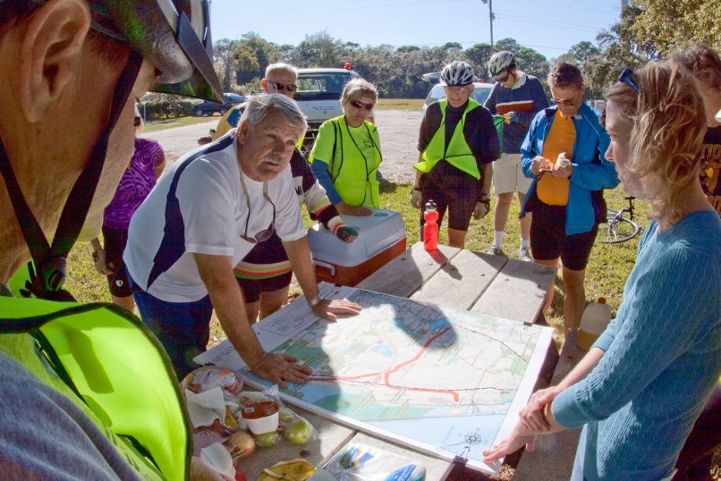
OGT Functions
Develop and Implement Plan
Identify and Prioritize FGTS
Coordinate Completion of FGTS Priorities
Promote the FGTS

Slide 25
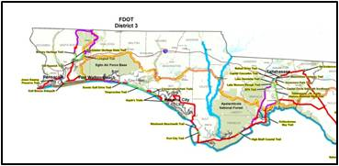
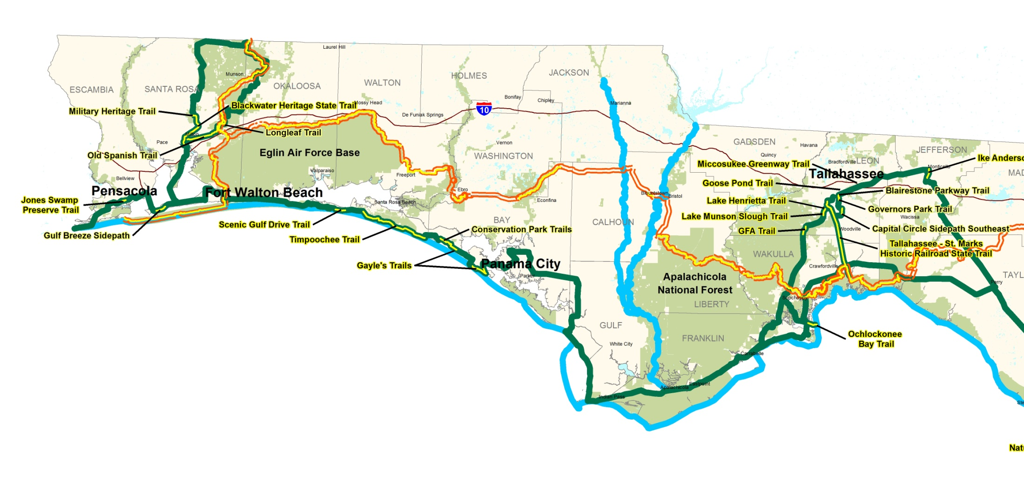
Closing Gaps in the FGTS
Florida Greenways and Trails System
Top Tier Projects
Gap Prioritization
Gap Identification
Priority Trails
TRAIL PROJECT | Sabal Palm Trail
SPONSOR(S) | East Regional MPO
ESTIMATED COST | $2.1 M
IDENTIFIED FUNDING | $1 M
NEEDED FUNDING | $1.1
TRAIL PROJECT | Ponce De Leon Trail
SPONSOR(S) | East Regional MPO
ESTIMATED COST | $2.1 M
IDENTIFIED FUNDING | $1 M
NEEDED FUNDING | $1.1
TRAIL PROJECT | Sunshine State Trail
SPONSOR(S) | West Regional MPO
ESTIMATED COST | $2.1 M
IDENTIFIED FUNDING | $1 M
NEEDED FUNDING | $1.1 M
statewide list by district/region
?
?
1
by district/region
?
by district/region
statewide
Notes:
Strategy 1.3: Evaluate and determine gaps within the Priority Trails Map to identify where to best target resources and funding.
Objective 1.3.1: OGT will, by December 2013, analyze the Priority Trails Map in coordination with partners, to identify all gaps.
Objective 1.3.2: OGT will, by December 2013, prioritize the Priority Trails gaps, in coordination with partners, to determine the relative importance of each gap.

Slide 26
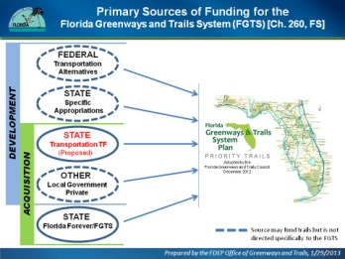
Process to Close Gaps
OGT Coordinates with Lead Entity
Lead Entity
DETERMINE
TOP TIER
PROJECT
READINESS
ACQUIRE
and/or
DEVELOP
IDENTIFY
FUNDING
TRAIL PROJECT | Sabal Palm Trail
SPONSOR(S) | East Regional MPO
ESTIMATED COST | $2.1 M
IDENTIFIED FUNDING | $1 M
NEEDED FUNDING | $1.1
EXTERNAL Lead
Local
State
Federal
Private
TRAIL PROJECT | Ponce De Leon Trail
SPONSOR(S) | East Regional MPO
ESTIMATED COST | $2.1 M
IDENTIFIED FUNDING | $1 M
NEEDED FUNDING | $1.1
TRAIL PROJECT | Sunshine State Trail
SPONSOR(S) | West Regional MPO
ESTIMATED COST | $2.1 M
IDENTIFIED FUNDING | $1 M
NEEDED FUNDING | $1.1 M
INTERNAL
Lead
DRP

Slide 27
Primary Sources of Funding for the
Florida Greenways and Trails System (FGTS) [Ch. 260, FS]
FEDERAL
Transportation
Alternatives
STATE
Specific
Appropriations
DEVELOPMENT
OTHER
Local Government
Private
Adopted by the Florida Greenways and Trails Council
December 2012
ACQUISITION
STATE
Florida Forever/FGTS
Source may fund trails but is not
directed specifically to the FGTS

Slide 28
Questions?
Robin Birdsong 850-245-2052
Robin.Birdsong@dep.state.fl.us

