Slide 1
2015 Votran Annual Update
River to Sea TPO Presentation
February 24, 2016

Slide 2
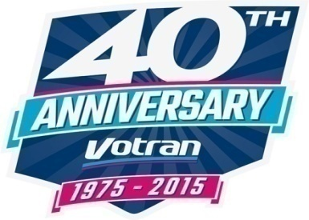
Contents
40th service anniversary
Ridership
Achievements
Budget
Challenges

Slide 3
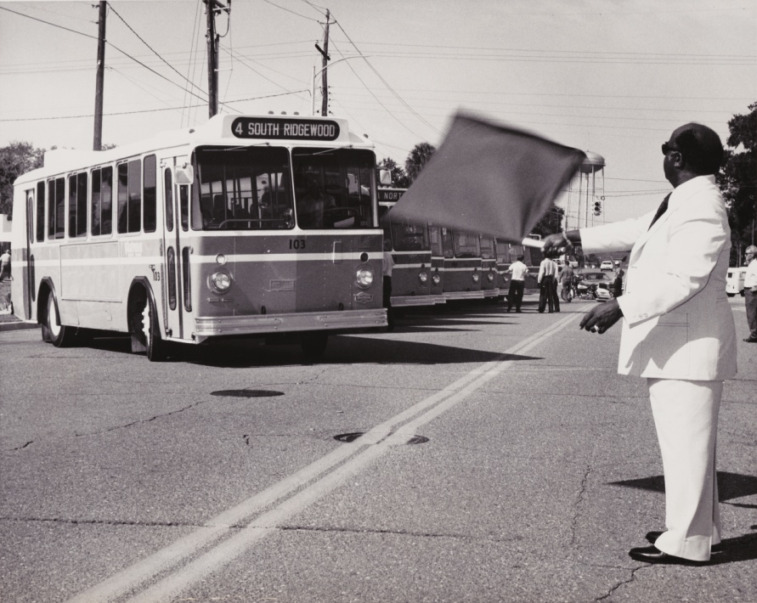
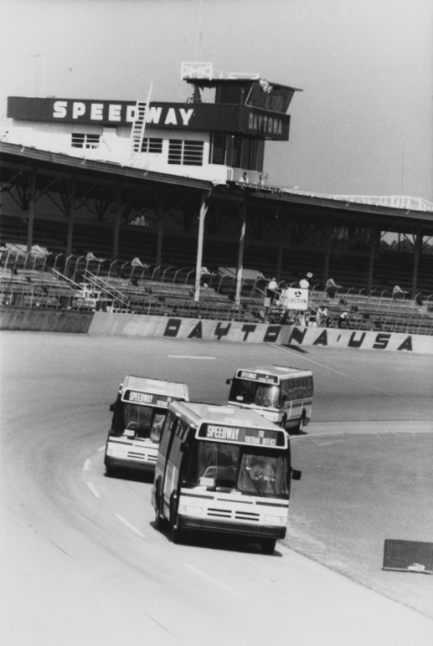
40-Year Service Anniversary
September 2015 marked 40 years of service to Volusia County!
Dr. James E. Huger – Volusia County Chairman – September 1975

Slide 4
System wide ridership
Notes:
In 1976, Votran’s first full year of operations, system wide ridership was 1.3 million. Ridership has increased 287%
Prior to 2014, last Votran fare increase was 2007 – Votran fares were found to be among the lowest among peer systems and in an effort to generate additional funding, fare increase occurred in February 2014 & February 2015 bringing cash fare up to $1.75.
The Simpson-Curtin rule of transit fare elasticity shows that generally, a fare increase of 10% will result in a reduction in ridership of 3%. Votran fares were increased 40% between 2014 and 2015. By the formula this would result in a 12% decrease. Votran experienced a 6% decrease.

Slide 5
2015 Achievements
Bus Stop Improvements - approximately 100 stops in unincorporated Volusia County
Hosted the first ever joint conference of the Florida Public Transportation Association and the Commission for the Transportation Disadvantaged
Passenger information – Vo to Go tags
Successful FTA Triennial review

Slide 6
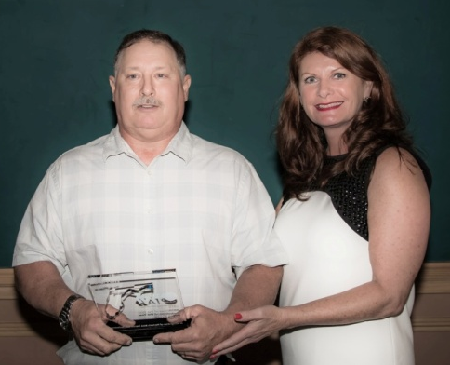
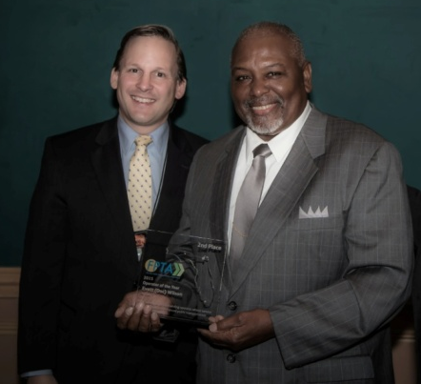
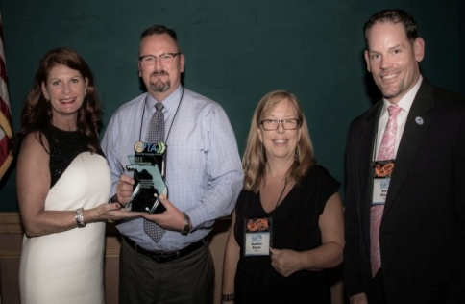
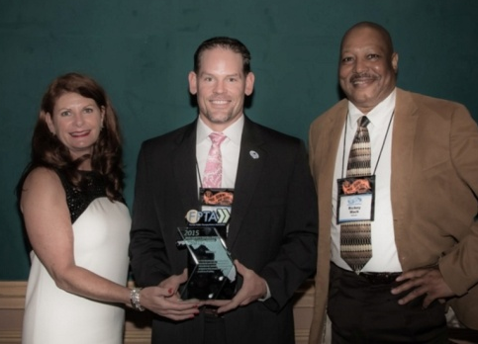
Florida Public Transit Association 2015 - a year of recognition -
Scott Groth
2nd place
“Transit Technician of the Year”
Doc Wilson
2nd place
“Bus Operator of the Year”
1st Place – People’s Choice Award – Aging Tree “Reclaim your Independence”
“Bus Safety Excellence Award”

Slide 7
2015 -2016 Budget
Notes:
Teamster’s labor contract finalized November 2015. In place through 10/2018

Slide 8
2015 Challenges
Capacity Issues
Reauthorization of Federal Highway and transit funding
Ongoing Traffic Challenges
The economic upturn has created a more competitive job market
New trip generators
Notes:
Capacity issues on routes 7, 11, 20 and 60 affect quality of service and on-time performance.
Reauthorization of federal highway and transit funding could affect compliance and funding
Ongoing traffic challenges along major corridors and during special events. With the enormous development at Daytona International Speedway and along International Speedway Boulevard, operating dependable service along the corridor will become even more challenging on a daily basis.
The economic upturn has created a more competitive job market reducing the job applicant pool. At current wages it is very challenging to attract and retain good employees.
Many new destinations have been created in the past year, among them the Trader Joe's Distribution Center. As commercial and residential development continues beyond the current Votran service area, a process for approving and funding new bus service should be adopted as a Volusia County transportation policy.

Slide 9
2015 Votran Annual Update
Thank you!
Steve Sherrer – General Manager
ssherrer@volusia.org

