Slide 1
Votran Fare Overview – FY 2013-14
A presentation to CAC / TCC
October 15, 2013

Slide 2
Background
March 2013 - Volusia County Council conducted a mini-budget workshop where the projected 2014 budget was discussed including the anticipation of a funding shortfall.
May 2013 - Volusia County Council reviewed Votran saving initiatives, the possibility of a fare increase, and other cost saving options including service cuts. Council members identified the need to invite municipal support for Votran.
June 2013 - Municipalities participated in a funding workshop presentation and discussion.
July 2013 - County Council members gave instruction for Votran to begin public participation for possible a fare increase to be effective February 2014.
The last Votran fare increase was January 2007.

Slide 3
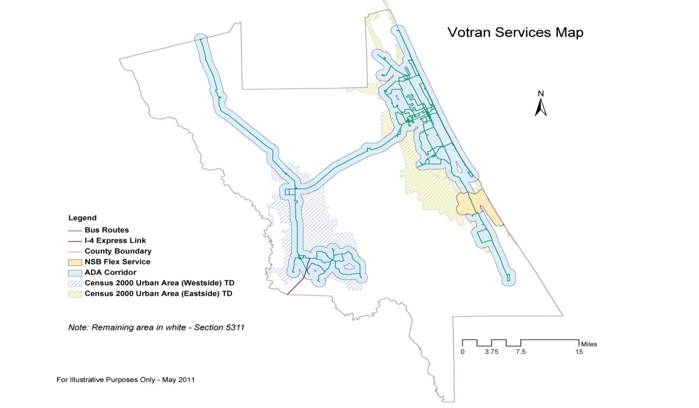
Votran services map
Votran services map
Seville
Ormond Beach
Holly Hill
Daytona Beach
Pierson
South Daytona
Indian Lakes Complex/Jail
Daytona Beach Shores
Port Orange
Deleon Springs
Ponce Inlet
New Smyrna Beach
DeLand
Edgewater
Orange City
Deltona
Bus routes
I-4 Express link
County boundary
NSB flex service
ADA corridor
Census 2000 urban area (westside) TD
Census 2000 urban area (eastside) TD
DeBary
Oak Hill
For illustrative purposes only

Slide 4
Rider profile
Average rider profile
Age: 16-24
Female
White
Earning under $10,000
85 percent of Votran riders earn an income of less than $29,000 annually.
Source: Votran Transit Development Plan (TDP) 2012-21

Slide 5
Fixed route ridership growth
5.8%
3.4%
5.2%
4.3%
1.2% Nationally Votran 5.8%
Votran has experienced a 20 percent increase in fixed route boardings since 2008

Slide 6
Paratransit ridership growth
Votran’s Gold paratransit service is a door-to-door service available to persons who, because of disability are unable to use fixed route bus service.
3.6% Nationally Votran 2.8%
Gold cost per rider $24.26 vs. fixed route cost per rider $3.23

Slide 7
Flex ridership growth
Flex service is a “call first” curb-to-curb, flexible transportation service which serves a dedicated area with limited timed stops.

Slide 8
Cost saving measures implemented
No debt and no unfunded liabilities
Eligible operating expenses are capitalized saving $1 million annually
Votran no longer coordinates Medicaid transportation
Route 24 (west-Pierson) – daily trips reduced from six to three
New Smyrna Beach flex service reduced operating cost by 30 percent
Wages and step increases frozen (consistent with county direction)
Employee health insurance switched to new carrier saving $500,000 annually

Slide 9
Cost saving measures implemented (cont.)
Fuel use reduced from 875,352 gallons in 2007 to 797,419 gallons in 2012
In 2007 the average cost per gallon was $2.58
In 2012 less fuel was used, but the average cost per gallon was $3.51
Seeking partnerships to assist in funding services (example: trolley partnership)
HVAC roof project saves $16,000 from general fund annually
Westside facility lease will save an estimated $35,785 from general fund annually
Restructured holiday service

Slide 10
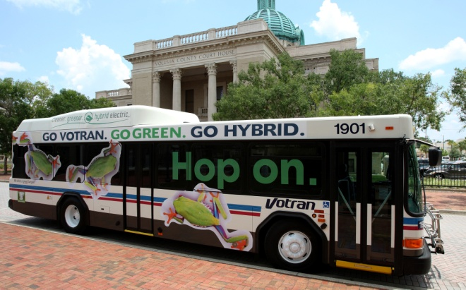
Reduce | Reuse | Recycle | Reward
Going GREEN helps Votran keep
operating costs down while reducing its carbon footprint.
Action | Annual cost savings | Annual revenue generated
Recycle water | $3,000
Recycle coolant | $25,000
Recycle refrigerant | $5,000
Recycle waste oil and filters |  | $7,100
Total | $33,000 | $7,100
Total savings | $40,100
Hop On hybrid buses

Slide 11
Votran funding 2012-13
Federal $ 4,769,004
State $ 3,076,326
Fares $ 2,830,066
Advertising revenue $ 250,000
Miscellaneous revenue $ 202,066
Volusia County general fund transfer $ 7,391,803
Fund balance carryover $ 1,551,551
Total budget $ 20,070,816
Note: Gold cost per rider $24.26 vs. fixed route cost per rider $3.23

Slide 12
Base fare without subsidy
Base fare with subsidy –
Current fare $1.25
Average fare collected
per boarding $ .67
Base fare without subsidy –
Base fare $5.00
Average fare collected
per boarding $2.68
* Assuming ridership remains the same
* All pass prices would also increase proportionately

Slide 13
Cost reduction considerations
Option | Description | General fund cost | Number of customers affected
Option 1 | Eliminate commuter van service | $120,451
Option 2 | Eliminate holiday service - Memorial Day, July 4th, Labor Day | $28,840 | 7,644
Option 3 | Eliminate one hour of night service (11 p.m. – 12 a.m.) | $101,846 | 21,215
Option 4 * | Eliminate trolley service | $81,501 | 39,000
Option 5 | Eliminate Sunday service | $192,881 | 114,214
Option 6 | Eliminate all night service | $450,084 | 196,965
Option 7 | System wide reductions (weekday service equal to Saturday) | $253,765 | 146,000
Option 8 | Route reductions (various options) | varies by route | varies by route
Option 9 ** | Implement fare increase - 25 cents (revenue after 12 months) | $231,292
Option 10** | Implement fare increase - 50 cents (revenue after 12 months) | $347,778
*Assumes funding partnership continues
** Fare increase will not cover shortfall
Notes:
NOTE:
This slide is provided earlier in the presentation (slide 3). Data is the same.

Slide 14
Comparison of fixed route fares
 | Full fare | One-day pass | 31-day pass
Lynx | $2.00 | $4.50 | $50.00
Dade County | $2.00 | n/a | $100.00
Tampa/HART | $2.00 | $4.00 | $65.00
Pensacola/ECAT | $1.75 | $5.25 | $47.00
Broward County | $1.75 | $4.00 | $58.00
Pinellas/PSTA | $2.00 | $4.50 | $65.00
Collier/CAT | $1.50 | $4.00 | $35.00
West Palm Beach | $1.50 | $4.00 | $60.00
Volusia County/Votran | $1.25 | $3.00 | $40.00
Space Coast/Brevard | $1.25 | n/a | $35.00
Manatee/MCAT | $1.25 | $3.00 | $30.00
Ft. Myers/LeeTran | $1.25 | $3.50 | $35.00
Tallahassee/StarMetro | $1.25 | $3.00 | $38.00
Polk County | $1.50 | $3.00 | $47.00
Jacksonville/JTA | $1.50 | $4.00 | $50.00
Sarasota/SCAT | $1.25 | n/a | $50.00
Average | $1.56 | $3.83 | $50.31
 | Reduced fare | One-day pass | 31-day pass
Lynx | $1.00 | $2.25 | $25.00
Dade County | $1.00 | n/a | $50.00
Tampa/HART | $1.00 | $2.00 | $32.50
Pensacola/ECAT | $0.85 | n/a | $35.00
Broward County | $0.85 | $3.00 | $29.00
Pinellas/PSTA | $1.00 (senior) $1.00 (students) | $2.25 | $35.00
Collier/CAT | $0.75 | $2.00 | $17.50
West Palm Beach | $0.75 | $2.75 | $45.00
Volusia County/Votran | $0.60 | $1.50 | $20.00
Space Coast/Brevard | $0.60 | n/a | $17.00
Manatee/MCAT | $0.60 | $1.50 | $15.00
Ft. Myers/LeeTran | $0.60 | n/a | $20.00
Tallahassee/StarMetro | $0.60 | n/a | n/a
Polk County | $0.75 | $1.50 | n/a
Jacksonville/JTA | $0.75 | $1.50 | $30.00
Sarasota/SCAT | $0.60 | n/a | $25.00
Average | $0.75 | $2.03 | $28.29

Slide 15
Comparison of paratransit fares
 | ADA | Outside ADA | TD
Lynx | $4.00 | $7.00 | Under 5 miles - $2.50 5 to 9.99 miles - $3.50 10 or more miles - $4.50
Pinellas/PSTA | $4.00 | $4.00 + additional charge depending on vendor | $3.00 + additional charge depending on vendor
Tampa/HART | $4.00 | n/a | $4.00
Ft. Lauderdale | $3.50 | $3.50 | $3.50
Pensacola | $3.50 | $3.50 | $3.50
Dade County | $3.00 | $3.00 | $3.00
West Palm Beach | $3.00 | $3.00 | $3.00
Volusia County/Votran | $2.50 | $2.50 | $2.50
Tallahassee/StarMetro | $2.50 | $2.50 | $2.50
Ft. Myers/LeeTran | $2.50 | $2.50 | n/a
Manatee/MCAT | $2.00 | $2.00 | $2.00
Polk County | $2.00 | $2.00 | $2.00
Collier/CAT | $3.00 | $3.00 | $1.00 - $7.00
Sarasota/SCAT | $2.50 | $2.50 | $2.50
Jacksonville/JTA | $1.25 - $5.62 | n/a | $1.25 - $5.62
Space Coast/Brevard | $1.25 | $1.25 | $1.25 - $2.50
Average | $2.88 | $2.94 | $2.85

Slide 16
Proposed Votran fares
Service Category | Current | Proposed $1.50 | Proposed $1.75
Base fare | $1.25 | $1.50 | $1.75
Reduced fare for elderly, handicapped and children under 18 years of age. | $0.60 | $0.75 | $0.85
Full fare tokens (minimum purchase of 10) | $11.00 | $13.50 | $16.50
Reduced fare tokens (minimum purchase of 10) | $5.50 | $6.50 | $7.50
Gold paratransit service | $2.50 | $3.00 | $3.00
Gold paratransit tokens (minimum purchase of 10) | $25.00 | $30.00 | $30.00
1-day pass | $3.00 | $3.50 | $3.75
Reduced fare 1-day pass | $1.50 | $1.75 | $1.85
3-day pass | $6.00 | $7.00 | $7.50
Reduced fare 3-day pass | $3.00 | $3.50 | $3.75
7-day pass | $12.00 | $12.75 | $13.00
Reduced fare 7-day pass | $6.00 | $6.35 | $6.50
31-day pass | $40.00 | $45.00 | $46.00
Reduced fare 31-day pass | $20.00 | $22.50 | $23.00
These changes in fare structure to $1.50 are projected to generate an additional $231,533 in fare revenues. The change of fare structure to $1.75 is projected to generate an additional $347,778 in fare revenues. A fare increase likely will reduce ridership for two-three years based on the past experiences. Generally, a fare increase of 10 percent will result in a ridership loss of 3 percent.

Slide 17
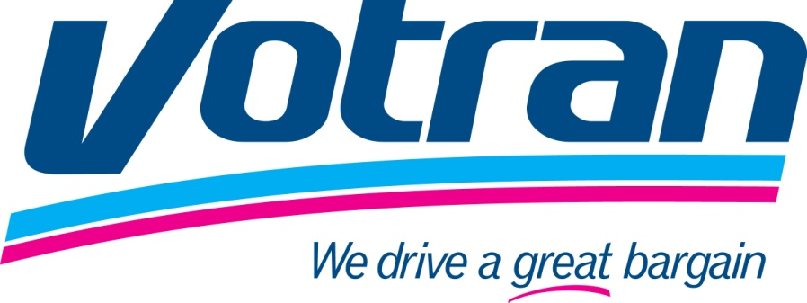
Questions / discussion

