Slide 1
A Presentation to:
River to Sea TPO Board
October 26, 2016

Slide 2
Agenda
Study Status
Refined Alternatives Analysis
Potential Implementation Strategy
Next Steps
Discussion

Slide 3
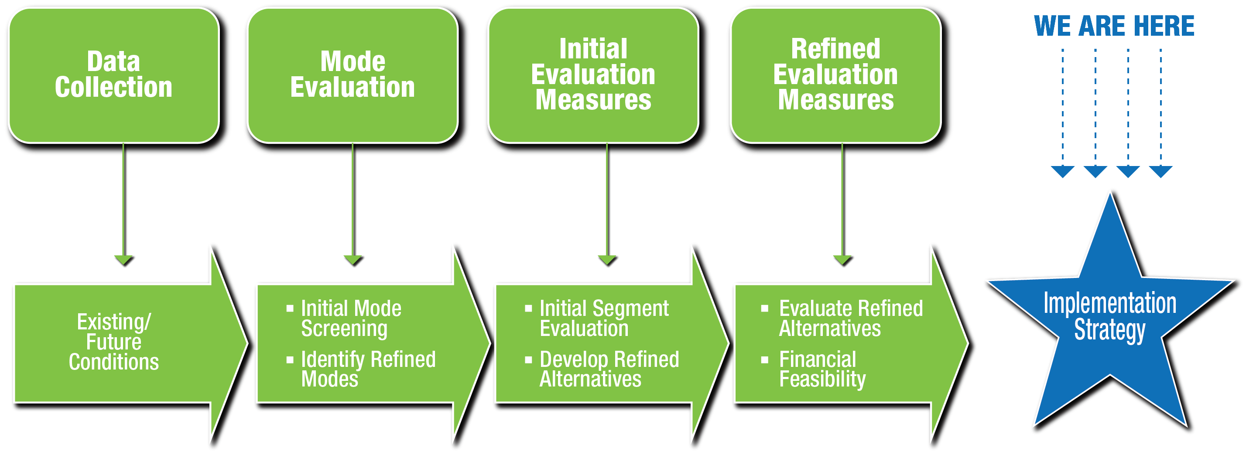
Study Process

Slide 4
Refined Alternatives Analysis

Slide 5
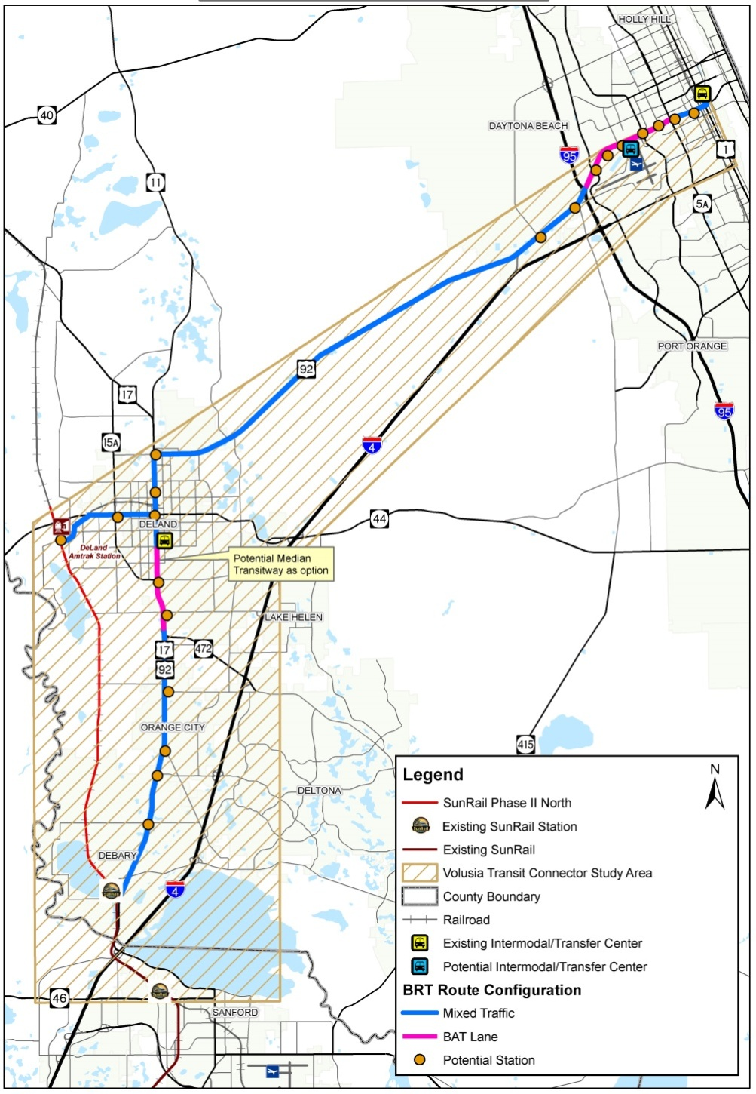
Bus Rapid Transit (BRT) Route Configuration
Potential Business Access and Transit (BAT) Lane
6-lane and 8-lane sections
Taylor Rd to Beresford Rd: roadway widening to create 6 lanes (median transitway option)
Mixed Traffic
2-lane and 4-lane sections

Slide 6
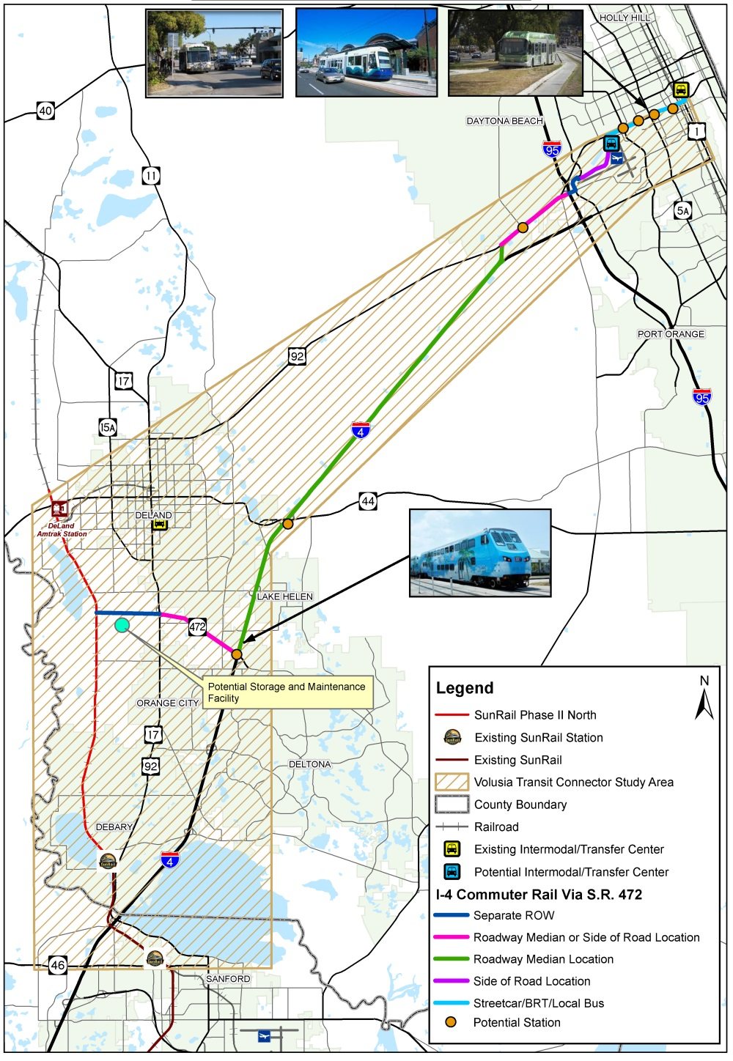
Rail Route Configuration
Separate right-of-way (ROW)
SunRail Phase 2 North to S.R. 472
I-95 to Williamson Blvd
Roadway median or side of road location
S.R. 472 and U.S. 92
Roadway median location
I-4
Side of road location
Midway Ave

Slide 7
Capital Cost Estimates in Millions
 |  | Alternative #4 BRT * | Alternative # 5 – Rail *
FTA SCC | Description |  | Baseline | S.R. 472 Alt | I-95 Undercrossing
10 | Guideway & Track Elements | $0.7 | $331.0 | $329.1 | $477.1
20 | Stations, Stops, Terminals, Intermodal | $6.5 | $25.1 | $25.1 | $25.1
30 | Support Facilities: Yards, Shops, Admin. Bldgs | $0.0 | $19.1 | $19.1 | $19.1
40 | Sitework & Special Conditions | $8.0 | 144.3 | $151.2 | $138.4
50 | Systems: Control Signals, Communications, Fare Collection | $2.0 | 159.4 | $159.4 | $159.4
60 | ROW, Land, Existing Improvements | $5.3 | $58.1 | $58.1 | $46.0
70 | Vehicles** | $32.0 | 51.0 | $51.0 | $51.0
80 | Professional Services | $6.1 | 217.2 | $218.9 | $262.1
90 | Unallocated Contingency | $0.4 | $67.9 | $68.4 | $81.9
Total |  | $61.1 | $1,073.1 | $1,080.3 | $1,260.2
* Cost estimates in 2015 dollars
** Vehicle cost include feeder bus service vehicle cost
FTA match (if eligible) 20% - 50%

Slide 8
O&M Cost Estimates in Millions
Alternative | Service Frequency | Annual Service Hours | No. of Vehicles /Train Sets Required | Annual O&M Cost** | Feeder Bus Cost* | Total O&M Cost**
Alternative #4 -to DeBary Station | 30 min, 14 hrs/day, 7 days/week | 53,000 | 18 | $4.3 | $11.5
Alternative #4 - to DeLand Station | 30 min, weekday peak | 7,600 | 5 | $0.6
Total BRT |  | 60,600 | 23 | $4.9 | $11.5 | $16.4
Alternative #5 - Main Line | Same as SunRail | 10,600 | 5 | $16.8 | $8.5
Alternative #5 - Shuttle to DeLand | Same as SunRail | 5,400 |  | $8.6
Rail Total |  | 16,000 | 5 | $25.4 | $8.5 | $34.0
* Feeder bus costs do not include costs for proposed TDP service improvements
** Cost estimates in 2015 dollars

Slide 9
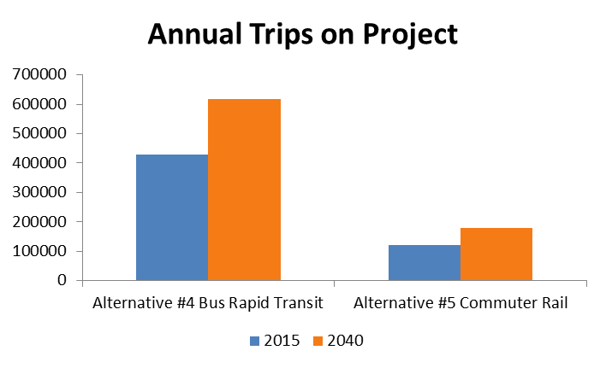
Ridership Projections
2050
618,500
428,500
725
179,000
475
119,700
Source: FTA STOPS model

Slide 10
New and Small Starts Project Evaluation and Rating
Individual Criteria Ratings
Summary
Ratings
Overall
Rating
Mobility Improvements
(16.66%)
Environmental Benefits
(16.66%)
Project Justification*
(50% of Overall Rating)
Congestion Relief
(16.66%)
Cost-Effectiveness
(16.66%)
Economic Development
(16.66%)
*Must be al least “Medium” for project to get “Medium” or better Overall Rating
Overall Project Rating
Land Use
(16.66%)
Current Condition
(25%)
Local Financial
Commitment*
(50% of Overall Rating)
Commitment of Funds
(25%)
Reliability/Capacity
(50%)
*Must be al least “Medium” for project to get “Medium” or better Overall Rating

Slide 11
FTA Project Justification Rating Assessment
Both build alternatives in general scored poorly against criteria
BRT more cost-effective than rail
Lack of development density and transit-oriented development results in poor land use score
Local financial commitment currently not in place to result in a medium to high rating
Conclusion: Neither alternative would achieve high enough rating to be competitive for federal funding.
Criterion | Alternative #4 - BRT | Alternative #5 - Commuter Rail
Mobility Improvements | Low | Low
Cost-Effectiveness | Medium | Low
Congestion Relief | Medium-Low | Medium
Environmental Benefits | Low | Medium-Low
Land Use | Low | Low
Economic Development | Low | Low

Slide 12
Where do We Go from Here?
Provide officials with road map on where we need to go to implement an enhanced transit system
Need to identify strategies and tools that we can start to put in place now
Conclusion: Develop an Implementation Strategy

Slide 13
Potential Implementation Strategy

Slide 14
Two-Component Strategy
Progressive transit service and facility improvements
Strategies and policies to foster transit-oriented development

Slide 15
Transit Improvement Strategy
ID strategy for added local transit O&M revenues
Implement bus service improvements related to new revenue sources
Integrate transit priority and stop improvements into roadway improvements
Develop new transit centers and initial park-n-rides
1
2
3
4
Potential rail extension toward Daytona Beach
Evaluate preservation of ROW for future premium transit corridor(s)
Potential BRT service in the US 92 and/or US 17/92 corridors, with added feeder bus connections improvements
7
6
5

Slide 16
Land Development Strategies
1
2
3
4
5
Growth management and land conservation policies focusing on development density and market trends supportive of transit
Develop conceptual plans for designated BRT and rail transit station areas
Implement zoning changes that support major transit investment in transit station areas
Implement strategies to promote transit-supportive planning and station area development
Develop affordable housing plans along transit corridors

Slide 17
Transit and Density Relationship
Population and employment densities affect the viability of transit mode
Higher population densities and/or employment centers help justify premium rail options
Higher densities help justify greater transit service levels

Slide 18
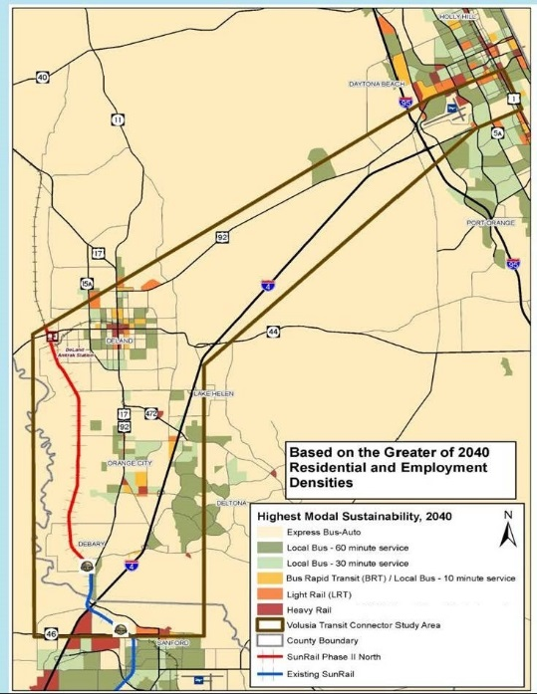
Mode Applicability Based on Densities in Study Area
Effects of population and employment
Highest-order mode to support future development density (year 2040)
Primarily support local bus options
Potential BRT/LRT options along ISB

Slide 19
Densities: Study Area vs. SunRail Stations
Area | 2010 Density (per sq.mi.) |  | 2040 Density (per sq.mi.)
 | Population | Employment | Population | Employment
Study Area | 200 | 270 | 640 | 740
Seminole County | 1,090 | 1,540 | 1,650 | 2,430
Downtown Orlando | 3,600 | 33,040 | 11,540 | 39,410
Orange County | 1,550 | 3,500 | 3,520 | 5,100

Slide 20
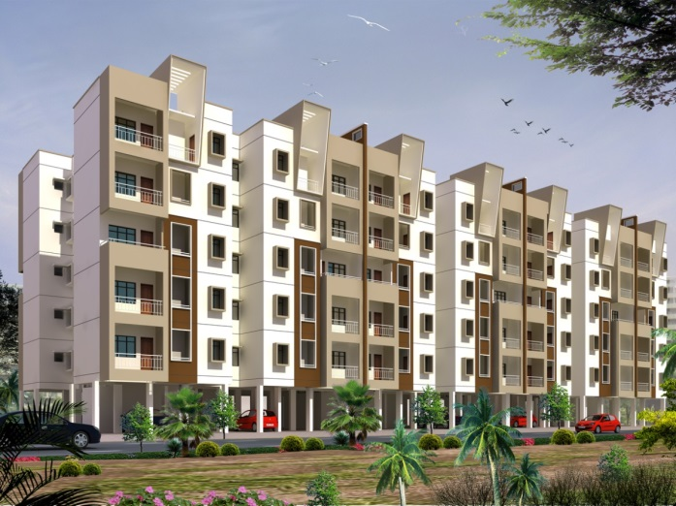
Transit Oriented Development (TOD) Assessment
Analysis of TOD potential conducted at ten potential premium transit stations
Particular focus at I-4/SR 472
Process
Stakeholder interviews
Application of FDOT TOD Readiness Tool
Strategy and policy recommendations

Slide 21
Next Steps

Slide 22
Remaining Schedule
Final Elected Official Briefings – September- October 2016
Issue Project Summary Report – December 2016

Slide 23
Discussion

Slide 24
General Discussion/Questions

