Slide 1
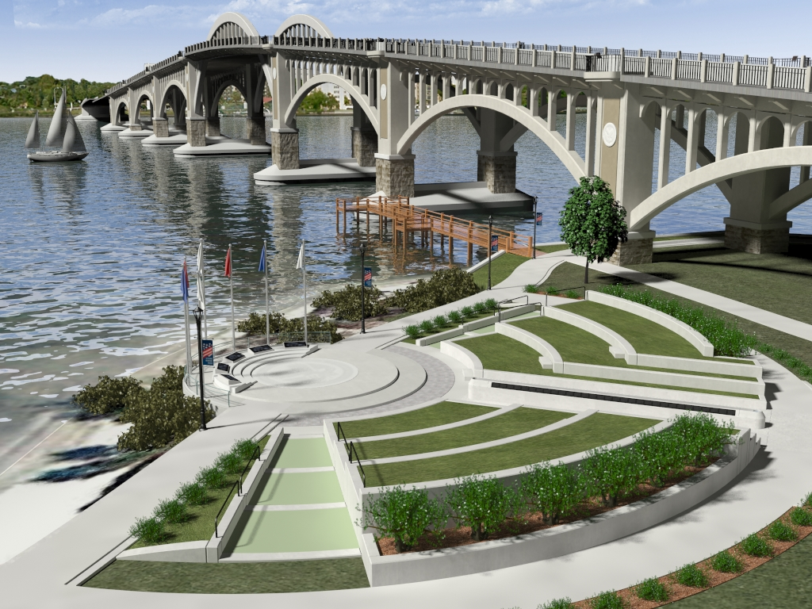
Veterans Memorial Bridge
East Orange Avenue/ Silver Beach Avenue over the Halifax River
County Project: P-5351-1 FDOT Project :242172-1-58-01

Slide 2
Technical Design Team
Volusia County
  Jim White, P.E.- Project Manager
Parsons Brinckerhoff, Inc.
  Tad Molas, P.E. - Design Project Manager
  Adrian Moon - Bridge Aesthetics & Memorial Park Design
Ghyabi & Associates, Inc.
  Justin Barton, P.E. - Roadway Project Manager
  Rebecca Zawadski, E.I. - Public Involvement Coordinator

Slide 3
Technical Design Team
Avcon, Inc.
McKim & Creed, Inc.
Ardaman & Associates, Inc.
Lotspeich & Associates, Inc.
Ocean Engineering Associates, Inc. (INTERA)
Dredging & Marine Consultants, LLC
Zev Cohen & Associates, Inc.

Slide 4
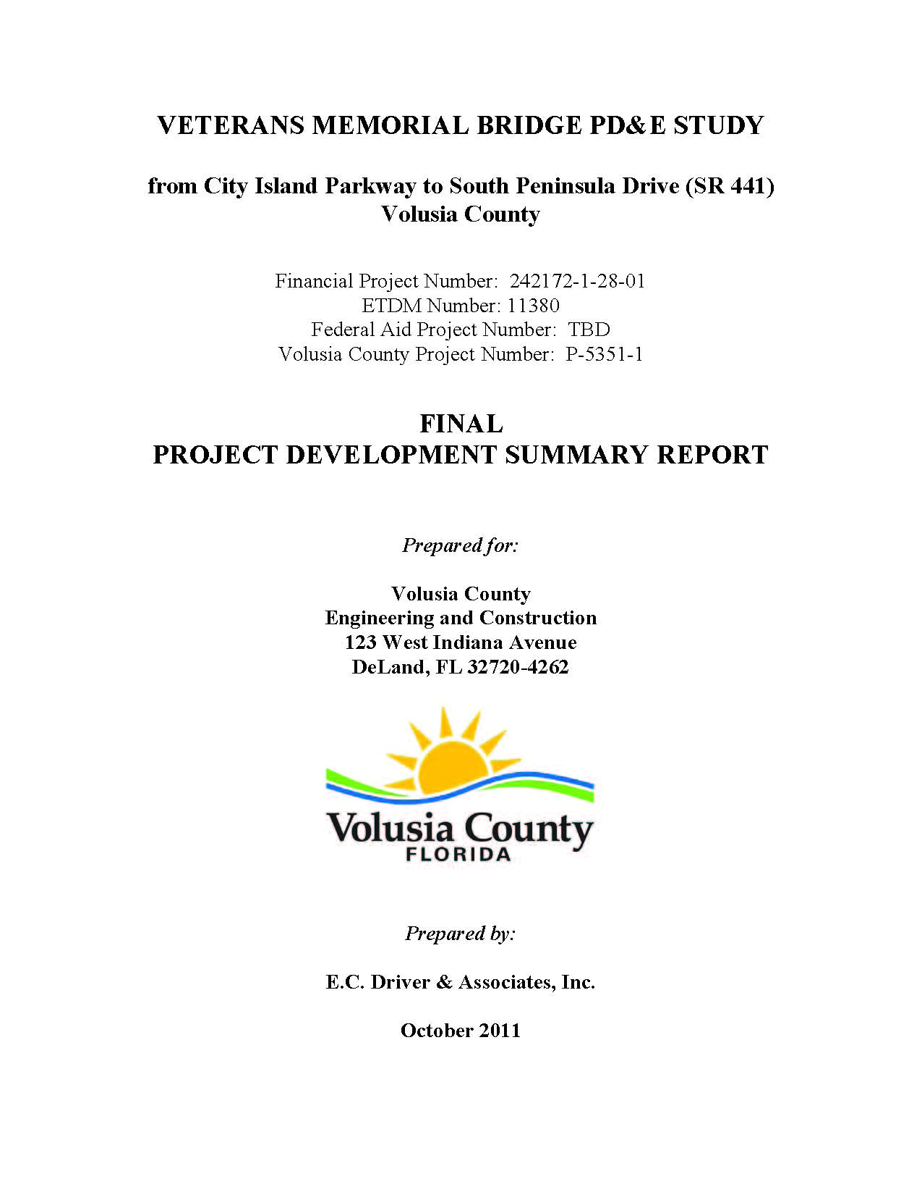
Project History
  Maintenance (Expensive)
    $300k-$400k annually
  Safety (Poor Structure Condition)
  Bridge deterioration
    Functionally Obsolete
      Minimum lane/shoulder widths
    Channel Clearance
      USCG standards not met

Slide 5
Public Involvement History
Alternatives Public Workshop | April 2010
County Council Selected High Level Bridge | January 2011
Public Hearing | June 2011
Final Project Development Summary Report | October 2011
Final Design Begins | February 2013
Project Advisory Committee Meeting # 1 | May 2013
Project Advisory Committee Meeting # 2 | June 2013
Project Advisory Committee Meeting # 3 & Subcommittee Meeting # 1 | July 2013
Project Advisory Committee Meeting # 4 | August 2013
Project Advisory Committee Meeting # 5 & Subcommittee Meeting # 2 | September 2013
Project Advisory Committee Meeting # 6 & Subcommittee Meeting # 3 | October 2013
Project Advisory Committee Meeting # 7 & Subcommittee Meeting # 4 | November 2013
Project Advisory Committee Meeting # 8 & Subcommittee Meeting # 5 & 6 | January 2013
Project Advisory Committee Meeting # 9 | February 2013
Public Meeting #1 | March 2013
Project Advisory Committee Meeting # 10 | April 2013

Slide 6
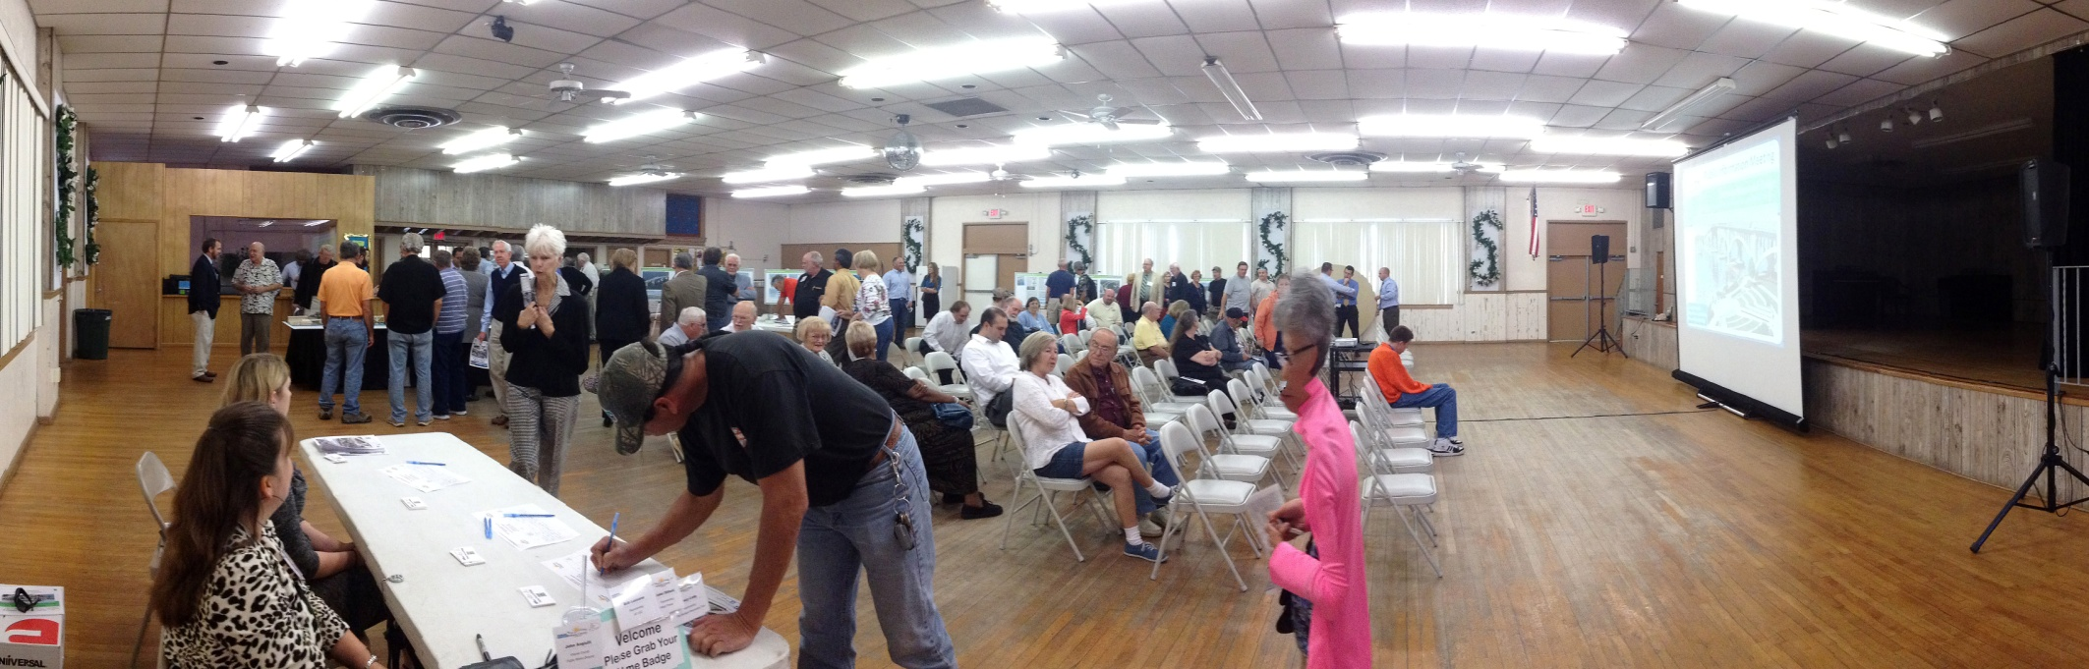
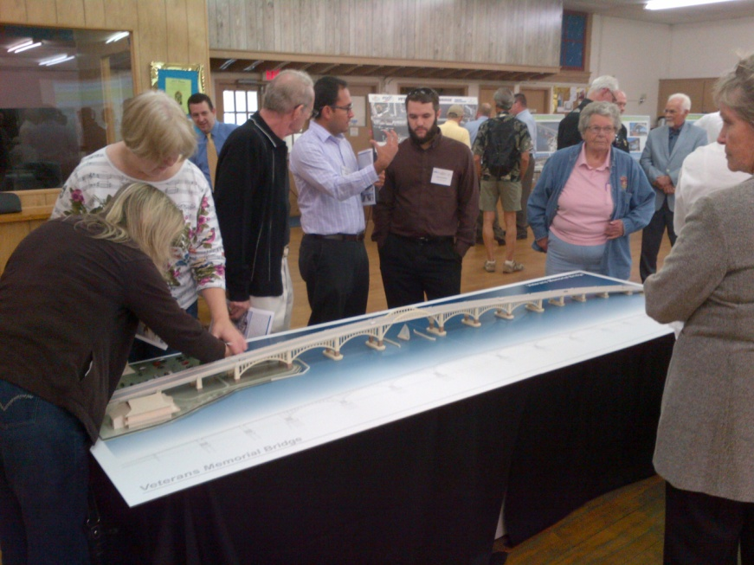
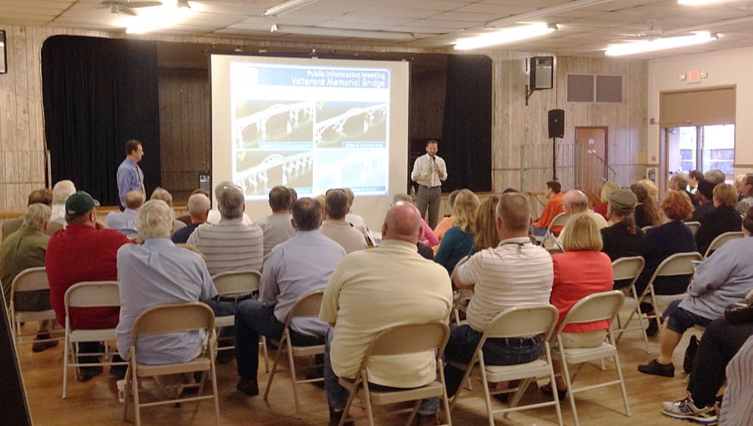

Slide 7
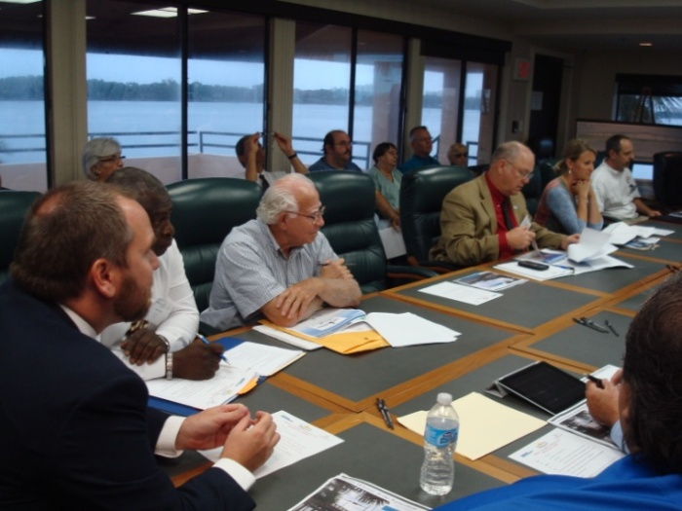
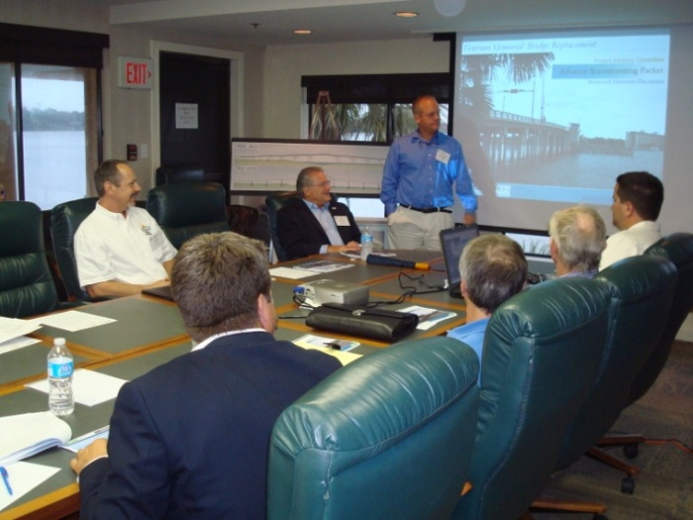
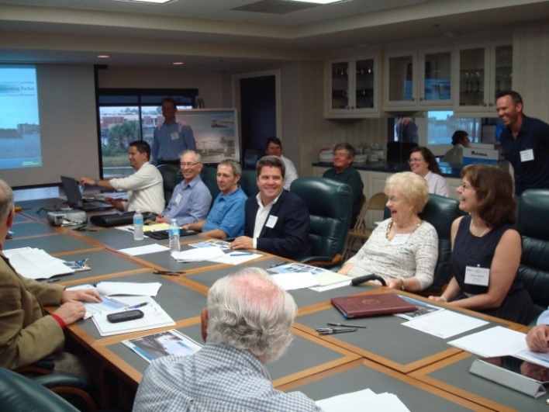
Project Advisory Committee (PAC)
Established as a commitment during the PD&E phase
Comprised of local residents, community and civic stakeholders
Meet monthly to discuss bridge aesthetic features
Meetings are open to the public
Meeting summaries and materials posted on the website

Slide 8
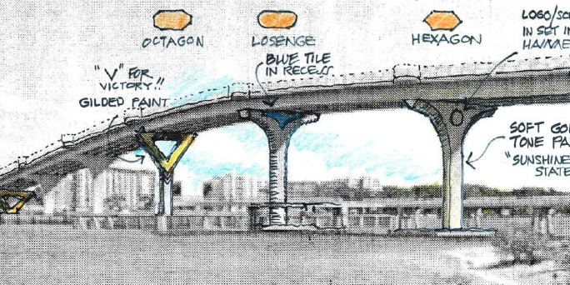
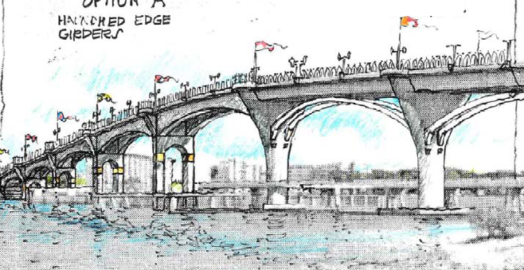
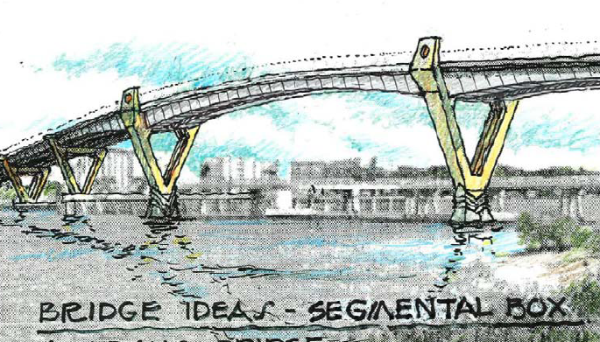
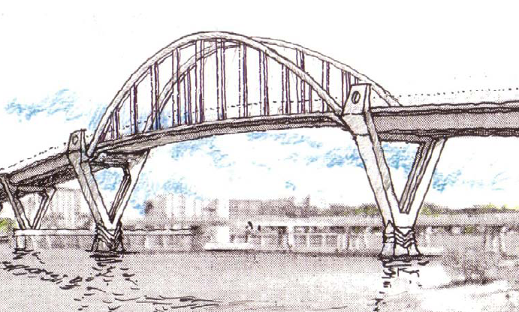
PAC #1: Bridge Types
Option 1: Conventional Concrete Beams
Option 2: Enhanced Concrete Beam
Option 3: Segmental Concrete
Option 4: Concrete Arch

Slide 9

PAC #1: Committee Selection
Thinnest Profile
Option 4: Concrete Arch

Slide 10
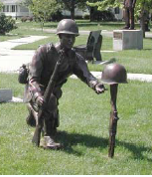
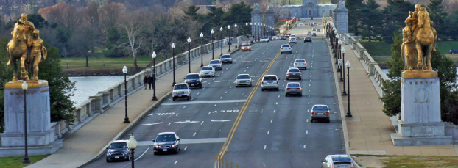
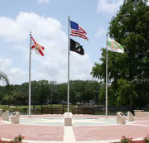
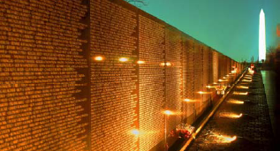
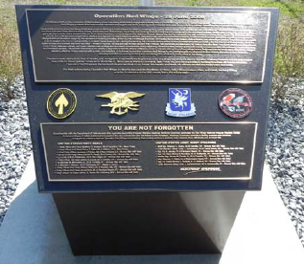
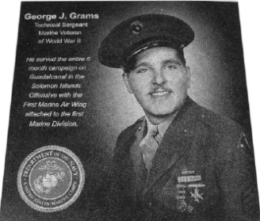
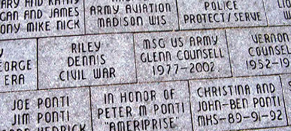
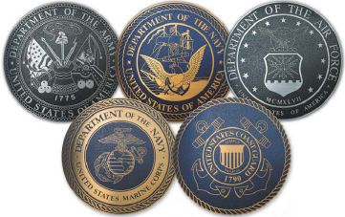
PAC #2: Veterans Memorial
Gateways
Statuary
Dedications
Historical Information
Flags & Banners
5 Military Branches
Long Lasting Materials

Slide 11
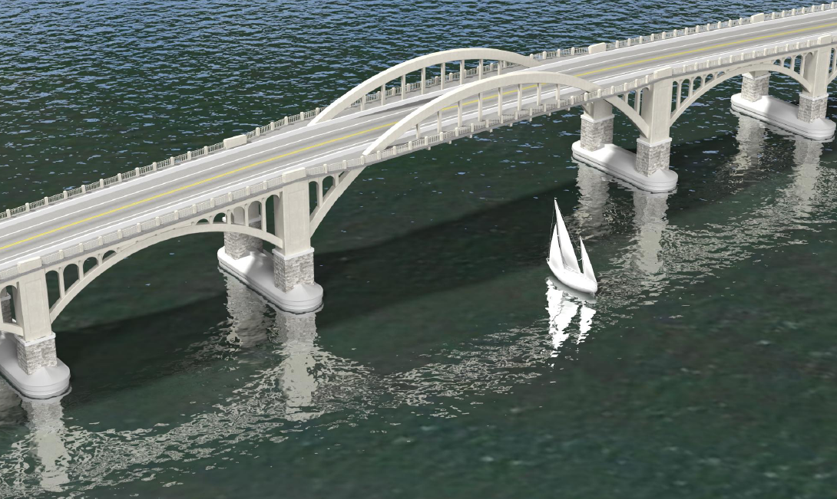
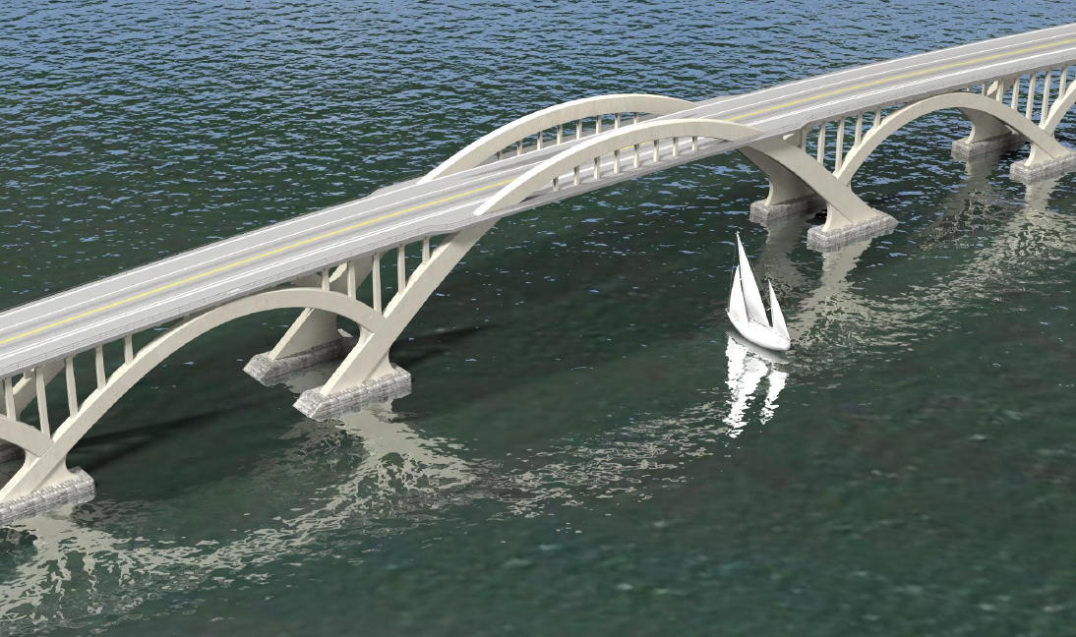
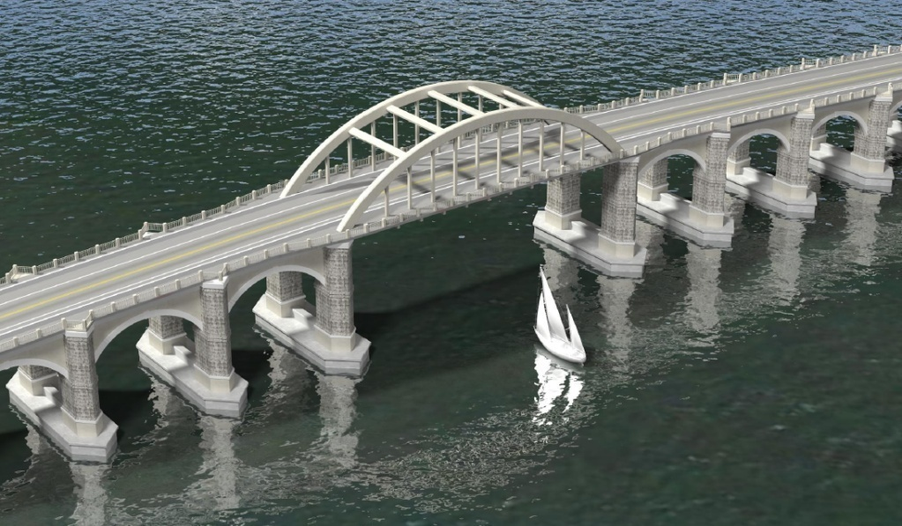
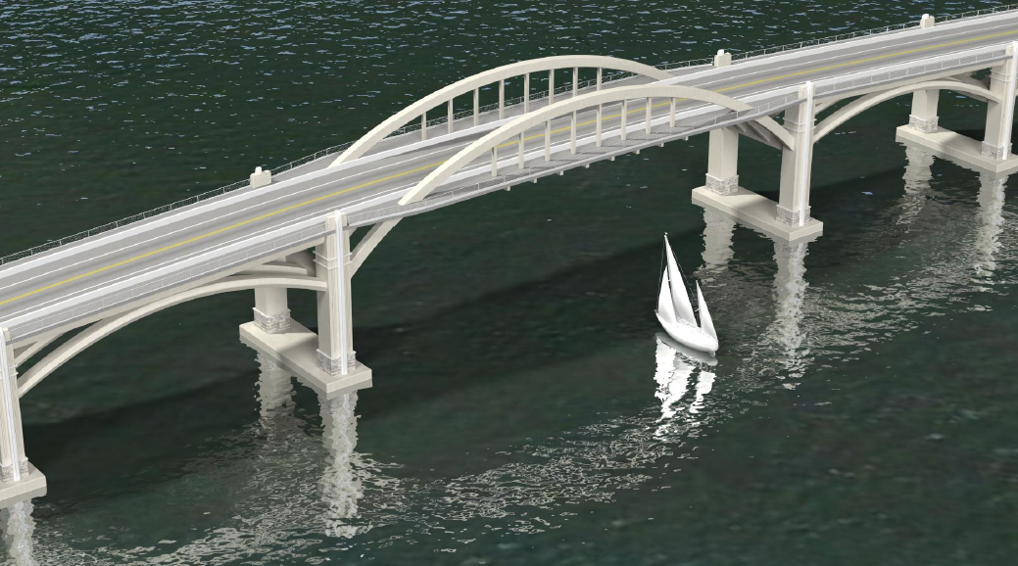
PAC #3: Arch Bridge Options
Option A: Historic Open Spandrel
Option B: Concentric Wave
Option C: Historic Tied Arch
Option D: Sky Arch

Slide 12
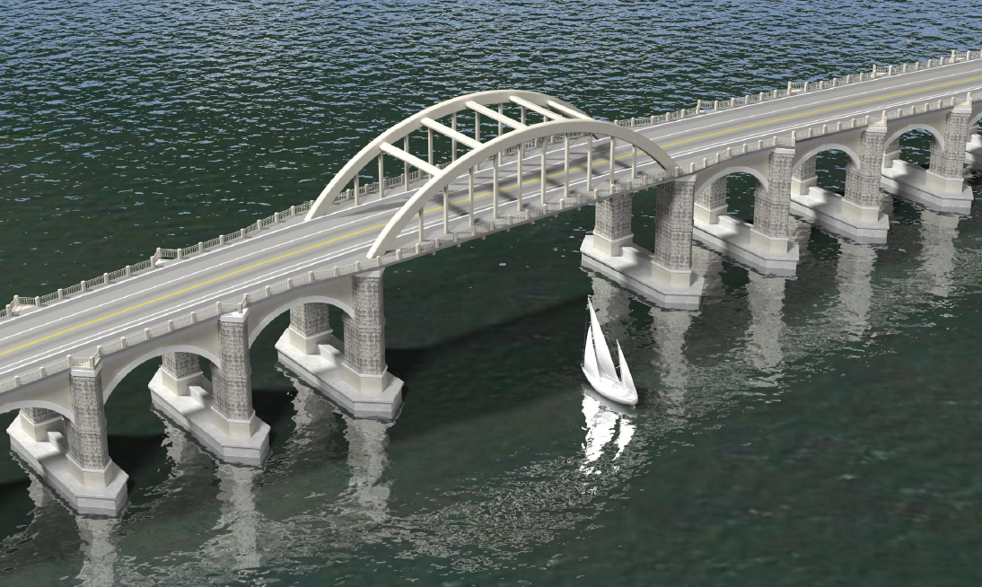
PAC #3: Committee Recommendations
Option A: Historic Open Spandrel
Option B: Concentric Wave
Option C: Historic Tied Arch
Option D: Sky Arch

Slide 13
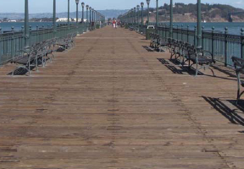
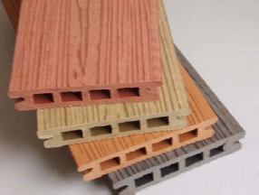
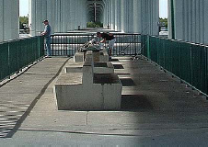
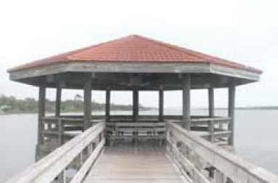
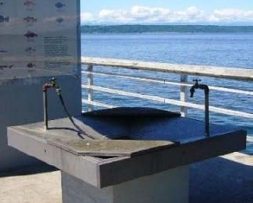
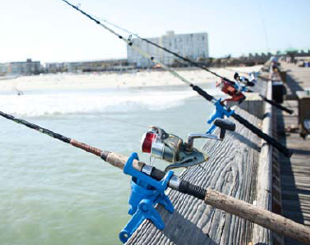
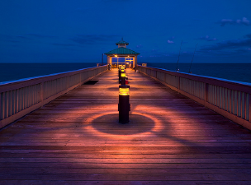
PAC #4: Fishing Piers
Materials:
Wood, Composite Wood, Concrete
Possible Amenities: Fish Cleaning Station, Rod Holders, Seating, Lighting, Shade Structures, Kayak Launch

Slide 14
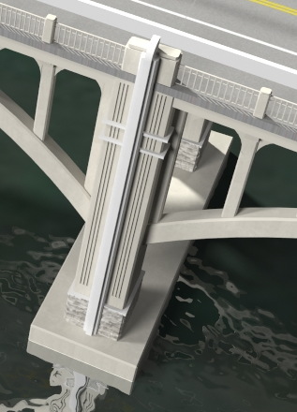
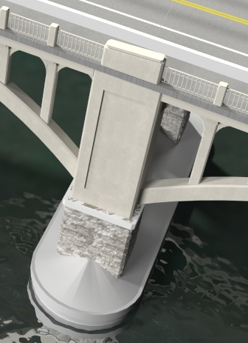
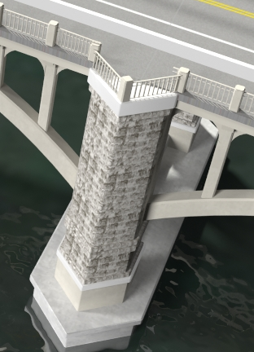
PAC #5: Status Update
Bridge Pier Styles
Fishing Pier Alignments
BDR Update

Slide 15
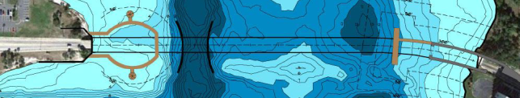
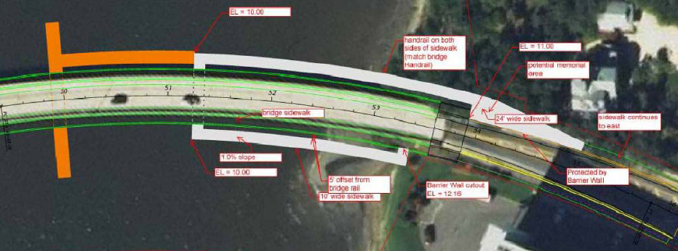
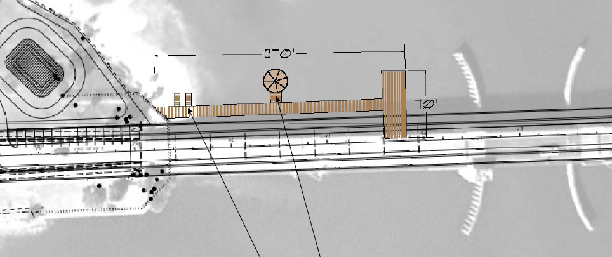
PAC #5: Status Update
East Pier Layout
Underpass over water
Access from bridge
Fishing area separate from walking area
“T-Shape” to reach old channel
West Pier Layout
Access from plaza
Fishing area reaches to main channel
Wide are to fish at end
“L-Shape” under bridge

Slide 16
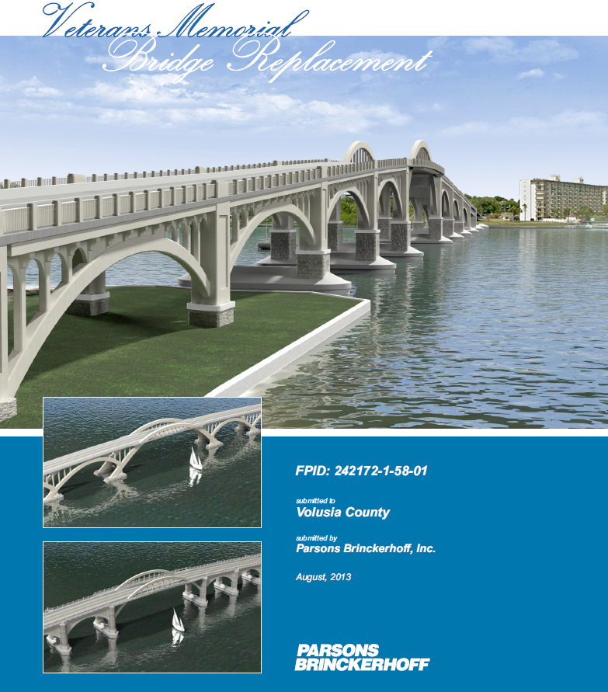
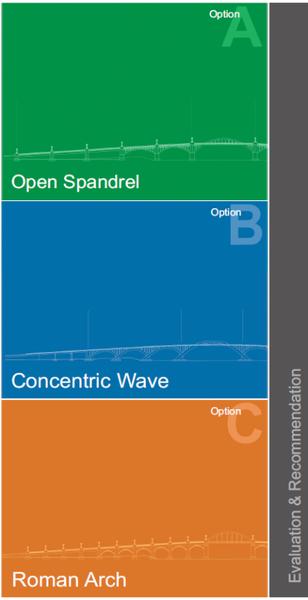
Bridge Development Report
1.0 Executive Summary
2.0 Introduction
3.0 Project Requirements
4.0 Structures Design
5.0 Alternatives
6.0 Evaluation

Slide 17
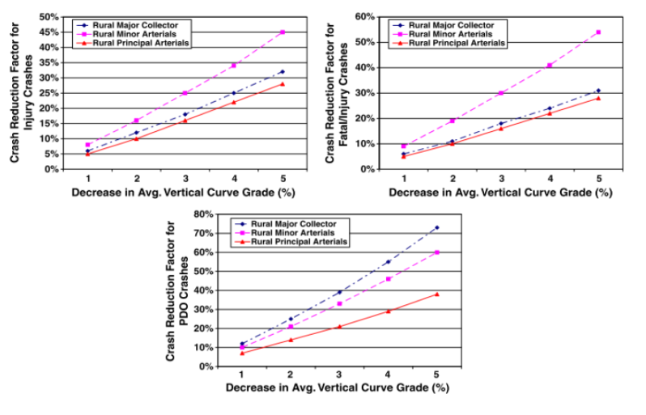
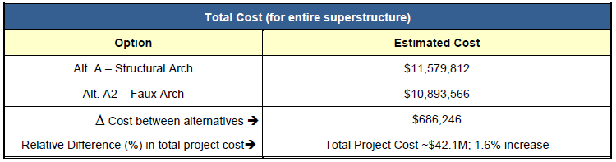
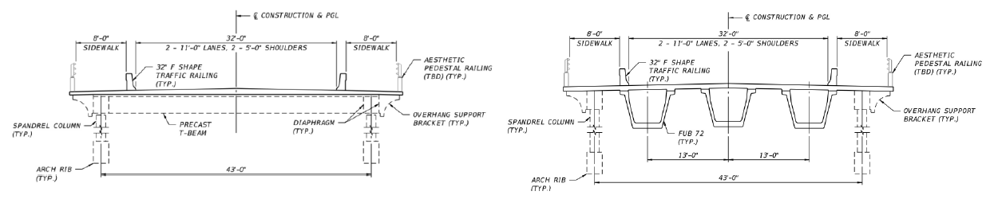
Bridge Development Report
Costs (Construction & Maintenance)
Aesthetics & Memorial Features
Safety, ADA Compliance & Accessibility
Constructability & Schedule
Hydraulics & Environmental

Slide 18
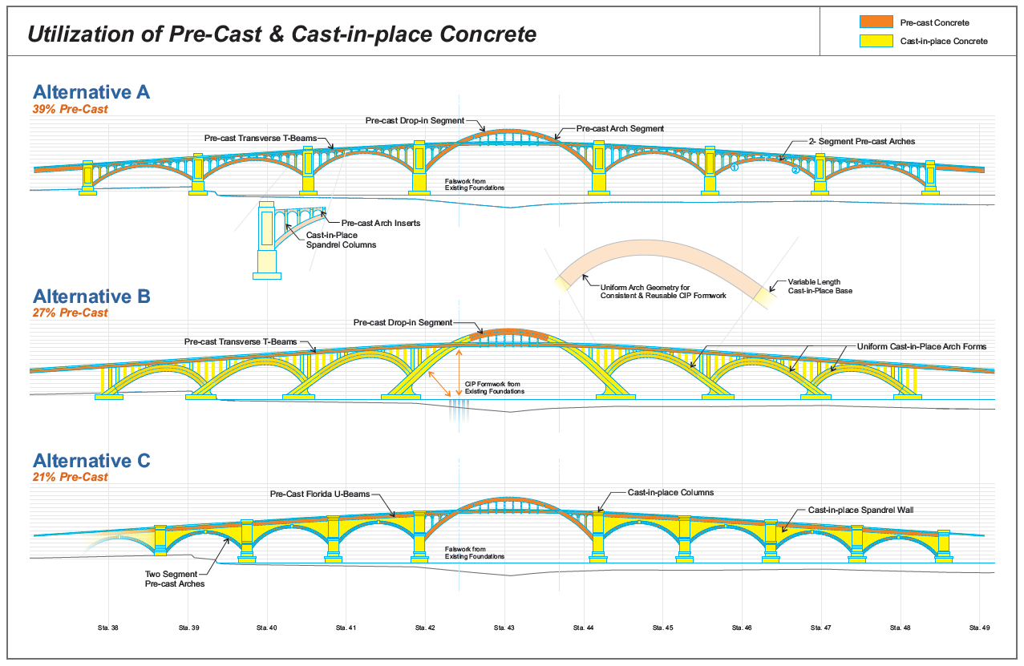

Slide 19
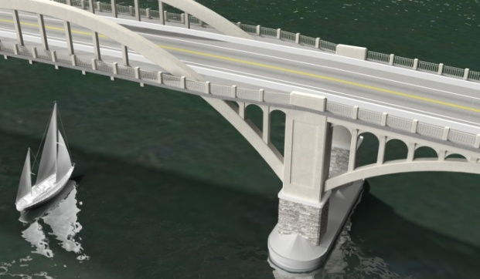
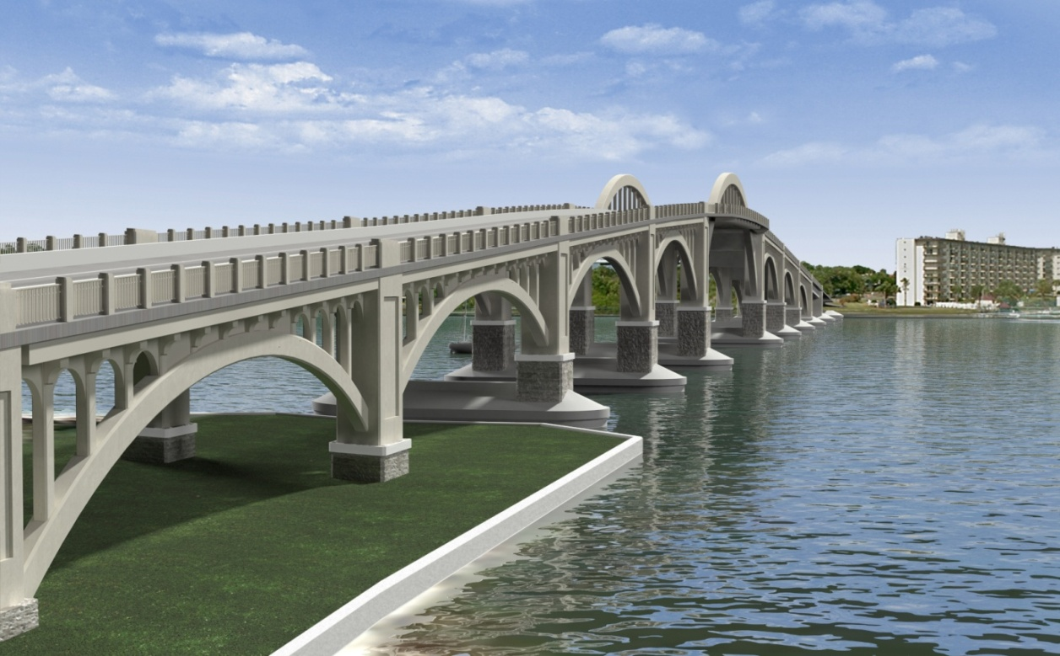
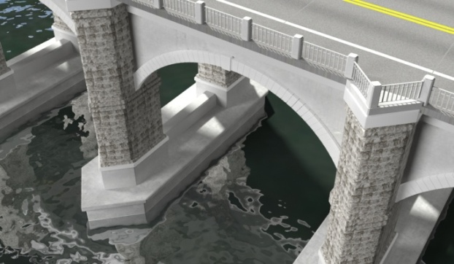
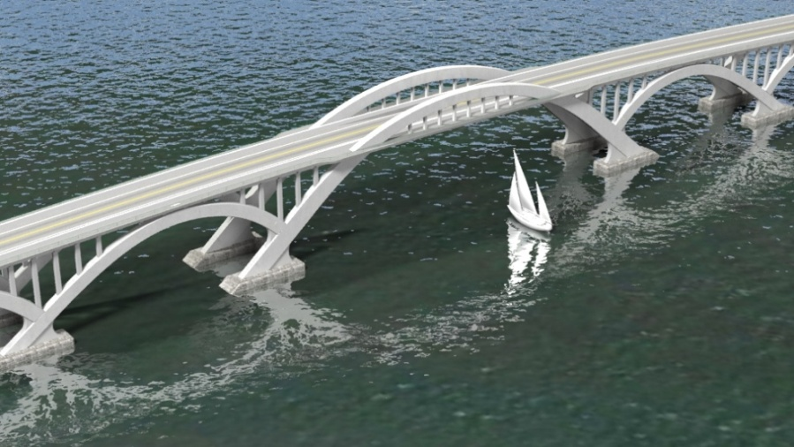
Aesthetics Considerations

Slide 20
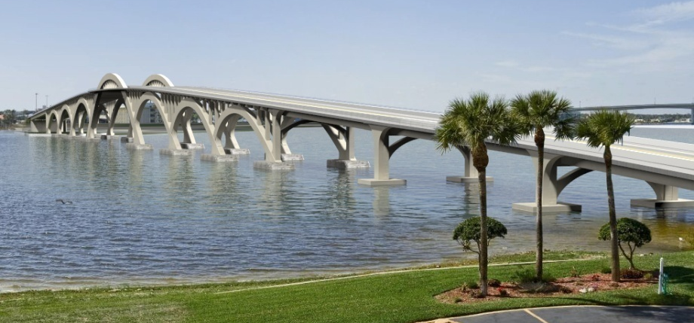
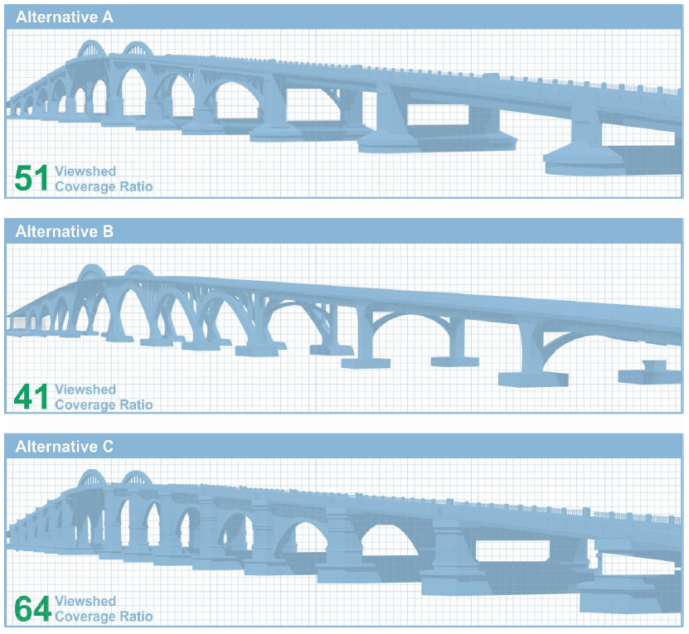
Viewshed Analysis

Slide 21


Slide 22

Bridge Development Report Analysis

Slide 23

Evaluation Matrix & Ranking

Slide 24

BDR - Bridge Type Recommendation

Slide 25







PAC #6: Lighting
Roadway & Bridge Lighting Options
Roadstar
UrbanScape
Leonis
Metroscape
Domus
Renaissance
Historic
Environmental
Lower Cost

Slide 26





PAC #6: Lighting
Light Color & Temperature Variations
Aesthetic Lighting Options
Option 1: Enhanced Columns
Option 3: Enhanced Columns & Defined Edge
Option 2: Enhanced Columns & Arches
Option 4: Enhanced Columns & Defined Face

Slide 27

Aesthetic Lighting
Option 4: Enhanced Columns & Defined Face with Amber Lights

Slide 28





PAC #7: Bridge Pier Styles
Option 1
Option 2
Option 3
Option 4
Option 5
A- Coquina Texture: (a) at the bottom of the pier or (b) all the way to the top of the pier
B- Pier Panels: (a) flat or (b) pointed
C- Overlook Shape: (a) rectangular (b) circular or (c) triangle

Slide 29



PAC #7: Overlook Shapes

Slide 30

PAC #7:
Committee
Selection

Slide 31


PAC #8: Memorial Plaza
Options A & B - Split Decision
Option A: Amphitheater
Option B: Trench/Spine

Slide 32

PAC #9: Committee Selection
Option D
Option D: Amphitheater with Spine

Slide 33
Summary of PAC Recommendations
Bridge Type | Concrete Arch
Bridge Style | Historic Open Spandrel
Fishing Pier Material | Wood
Fishing Pier Layout | T- Shape (East Bank), L- Shape (West Bank)
Bridge & Plaza Light Poles | Metroscape
Bridge Lighting Color & Temperature | Amber
Bridge Lighting Enhancements | Columns with Defined Face Arch
Bridge Pier Panel Shape | Flat
Bridge Pier Coquina Texture Location | Bottom Only
Overlook Shape | Rectangular
Memorial Plaza Layout | Amphitheater with Spine
Veteran Memorial Features | 7 Flag Poles at the Back of Center Circle 5 Angled Plaques at Back of Center Circle Field Stones (Arlington Stones) Brick Pavers Located Around Center Circle Front Eastern Underpass and Western Underpass for Circuitous Memorial Route 12”x18” Windows at Every Overlook Location Gateway Pilasters Pier Insignias on All Piers, and Main Channel Piers have Inscription

Slide 34

Construction Detour
International Speedway Boulevard
0.8 Miles
0.6 Miles
0.3 Miles
Orange Avenue
Silver Beach Avenue

Slide 35
Expressed Public Concerns
Bus Routes
  During Construction: VOTRAN coordination on-going
  After Construction: Continue normal routes. Bus Stops on west side will be relocated, but not removed.
Charging Stations for Motorized Wheelchairs
  Will be provided on ramps across bridge and on
  underpasses if the design permits

Slide 36
Expressed Public Concerns
Bicycle & Pedestrian Accommodations
  8 foot wide sidewalks across the bridge on both the north and south side
  Bicyclists also have a 5 foot wide shoulder on
  both sides of the bridge to use
Parking
  County courthouse parking lot is available for people utilizing the amenities of the bridge
Right-of-Way
  All work is being done within existing right-of-way. The only property affected is the Daytona Regional Chamber of Commerce.

Slide 37
Design Schedule
Design Begins | February 2013
Phase I Submittal – 30% Civil Plans | August 2013
Phase II Submittal – 60% Civil Plans & 30% Bridge Plans | February 2014
Aesthetic Elements Submittal – 30% Plans | April 2014
Phase II Submittal – 90% All Disciplines | June 2014
Phase IV Submittal – 100% All Disciplines | August 2014
Final Plans & Specifications | September 2014
Production Date | 10/30/14
Construction Begins | Early 2015

Slide 38






Project Resources
County Project Manager: Jim White 386.736.5967, ext 12511 or Jwhite@Volusia.org
Volusia County’s Website: www.volusia.org/services/public-works/engineering-and-construction
Project Website: www.VeteransMemorialBridge.com
Information Center (Kiosk): Located at the Daytona Regional Chamber of Commerce
Facebook: Tom Staed Veterans Memorial Bridge
Twitter: Veterans Bridge (@VMemorialBridge)

Slide 39

Thank You For Attending!
www.VeteransMemorialBridge.com

