Slide 1
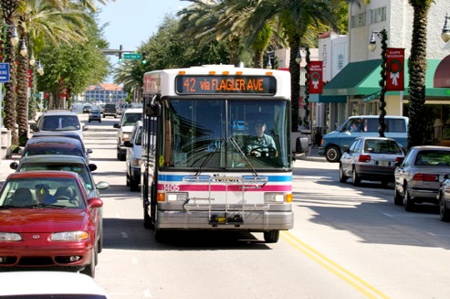
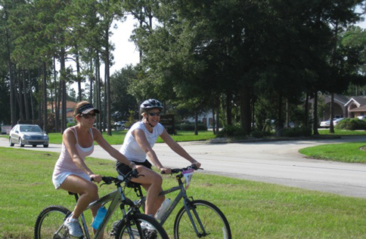
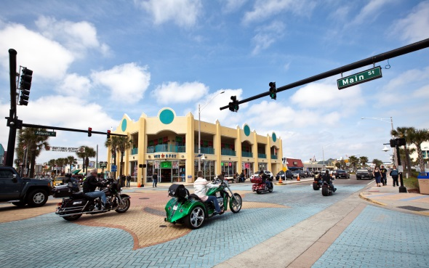
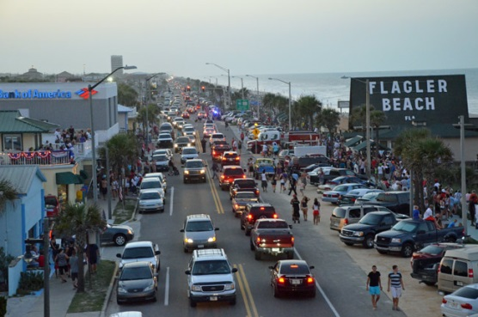



TELL THE TPO
RIVER TO SEA TPO
COMMUNITY TRANSPORTATION SURVEY
RESULTS SUMMARY
DRAFT
TPO Board/Committee Briefing
June 2016

Slide 2
“TELL THE TPO” GOALS
survey and public awareness campaign
Provide Research ON PUBLIC OPINION useful to TPO leadership and long range planning
1
4
Build Partnerships and Awareness
2
Effective Public Engagement Tool
5
Build database
3
Create a Buzz and Earned Media Opportunity
COMMUNITY TRANSPORTATION SURVEY
RIVER TO SEA TPO
DRAFT

Slide 3
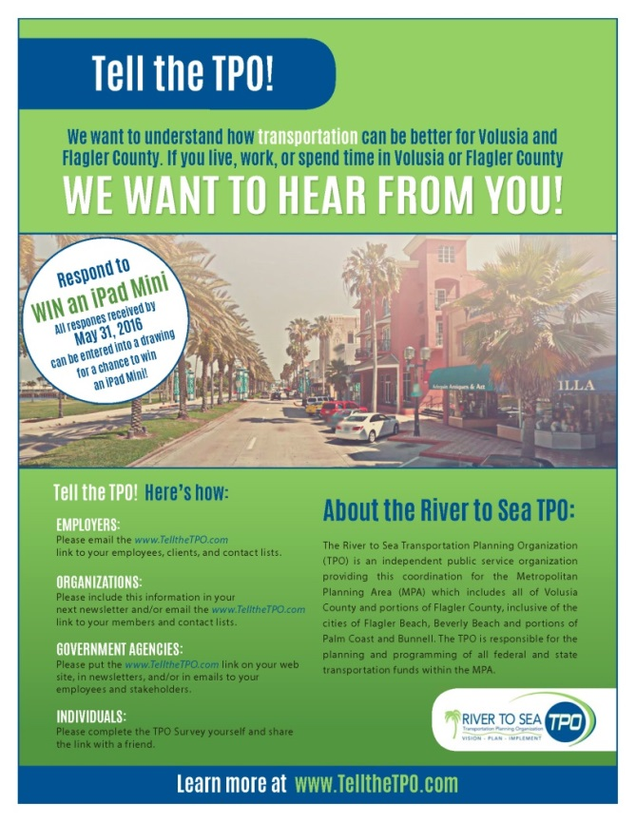
SURVEY HIGHLIGHTS
A few changes to the 2014 survey (ITS items, SunRail question)
Directly partnered with numerous community organizations (One Voice for Volusia, Volusia County Farm Bureau, and many others)
Broadcasted on more than 50 press and social media outlets
1,276 total responses – more than the 2014 survey effort!
COMMUNITY TRANSPORTATION SURVEY
RIVER TO SEA TPO
DRAFT

Slide 4
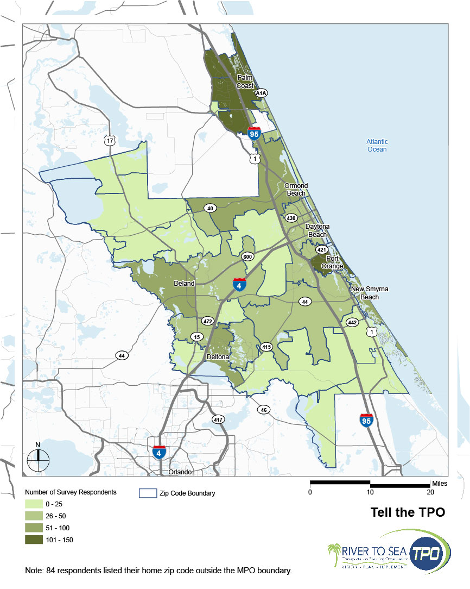

SURVEY RESPONSES
COMMUNITY TRANSPORTATION SURVEY
RIVER TO SEA TPO
DRAFT

Slide 5



BUILD DATABASE
264
84
135
273
COMMUNITY TRANSPORTATION SURVEY
RIVER TO SEA TPO
DRAFT

Slide 6
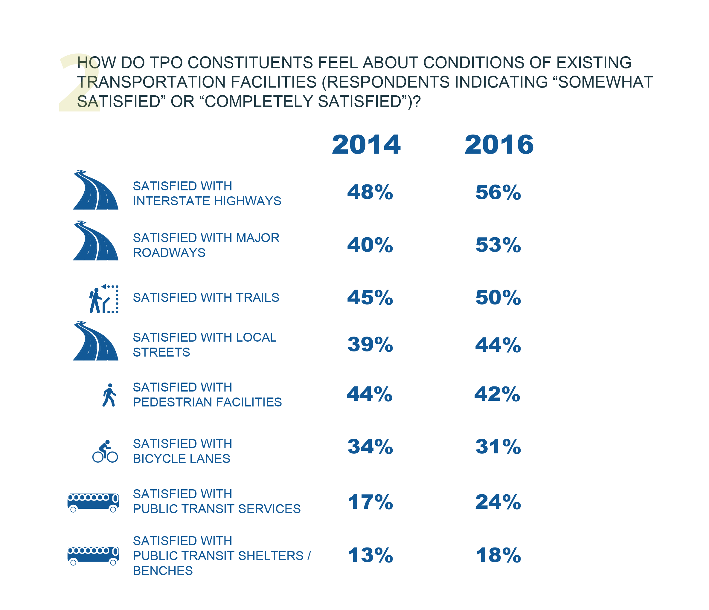

Slide 7
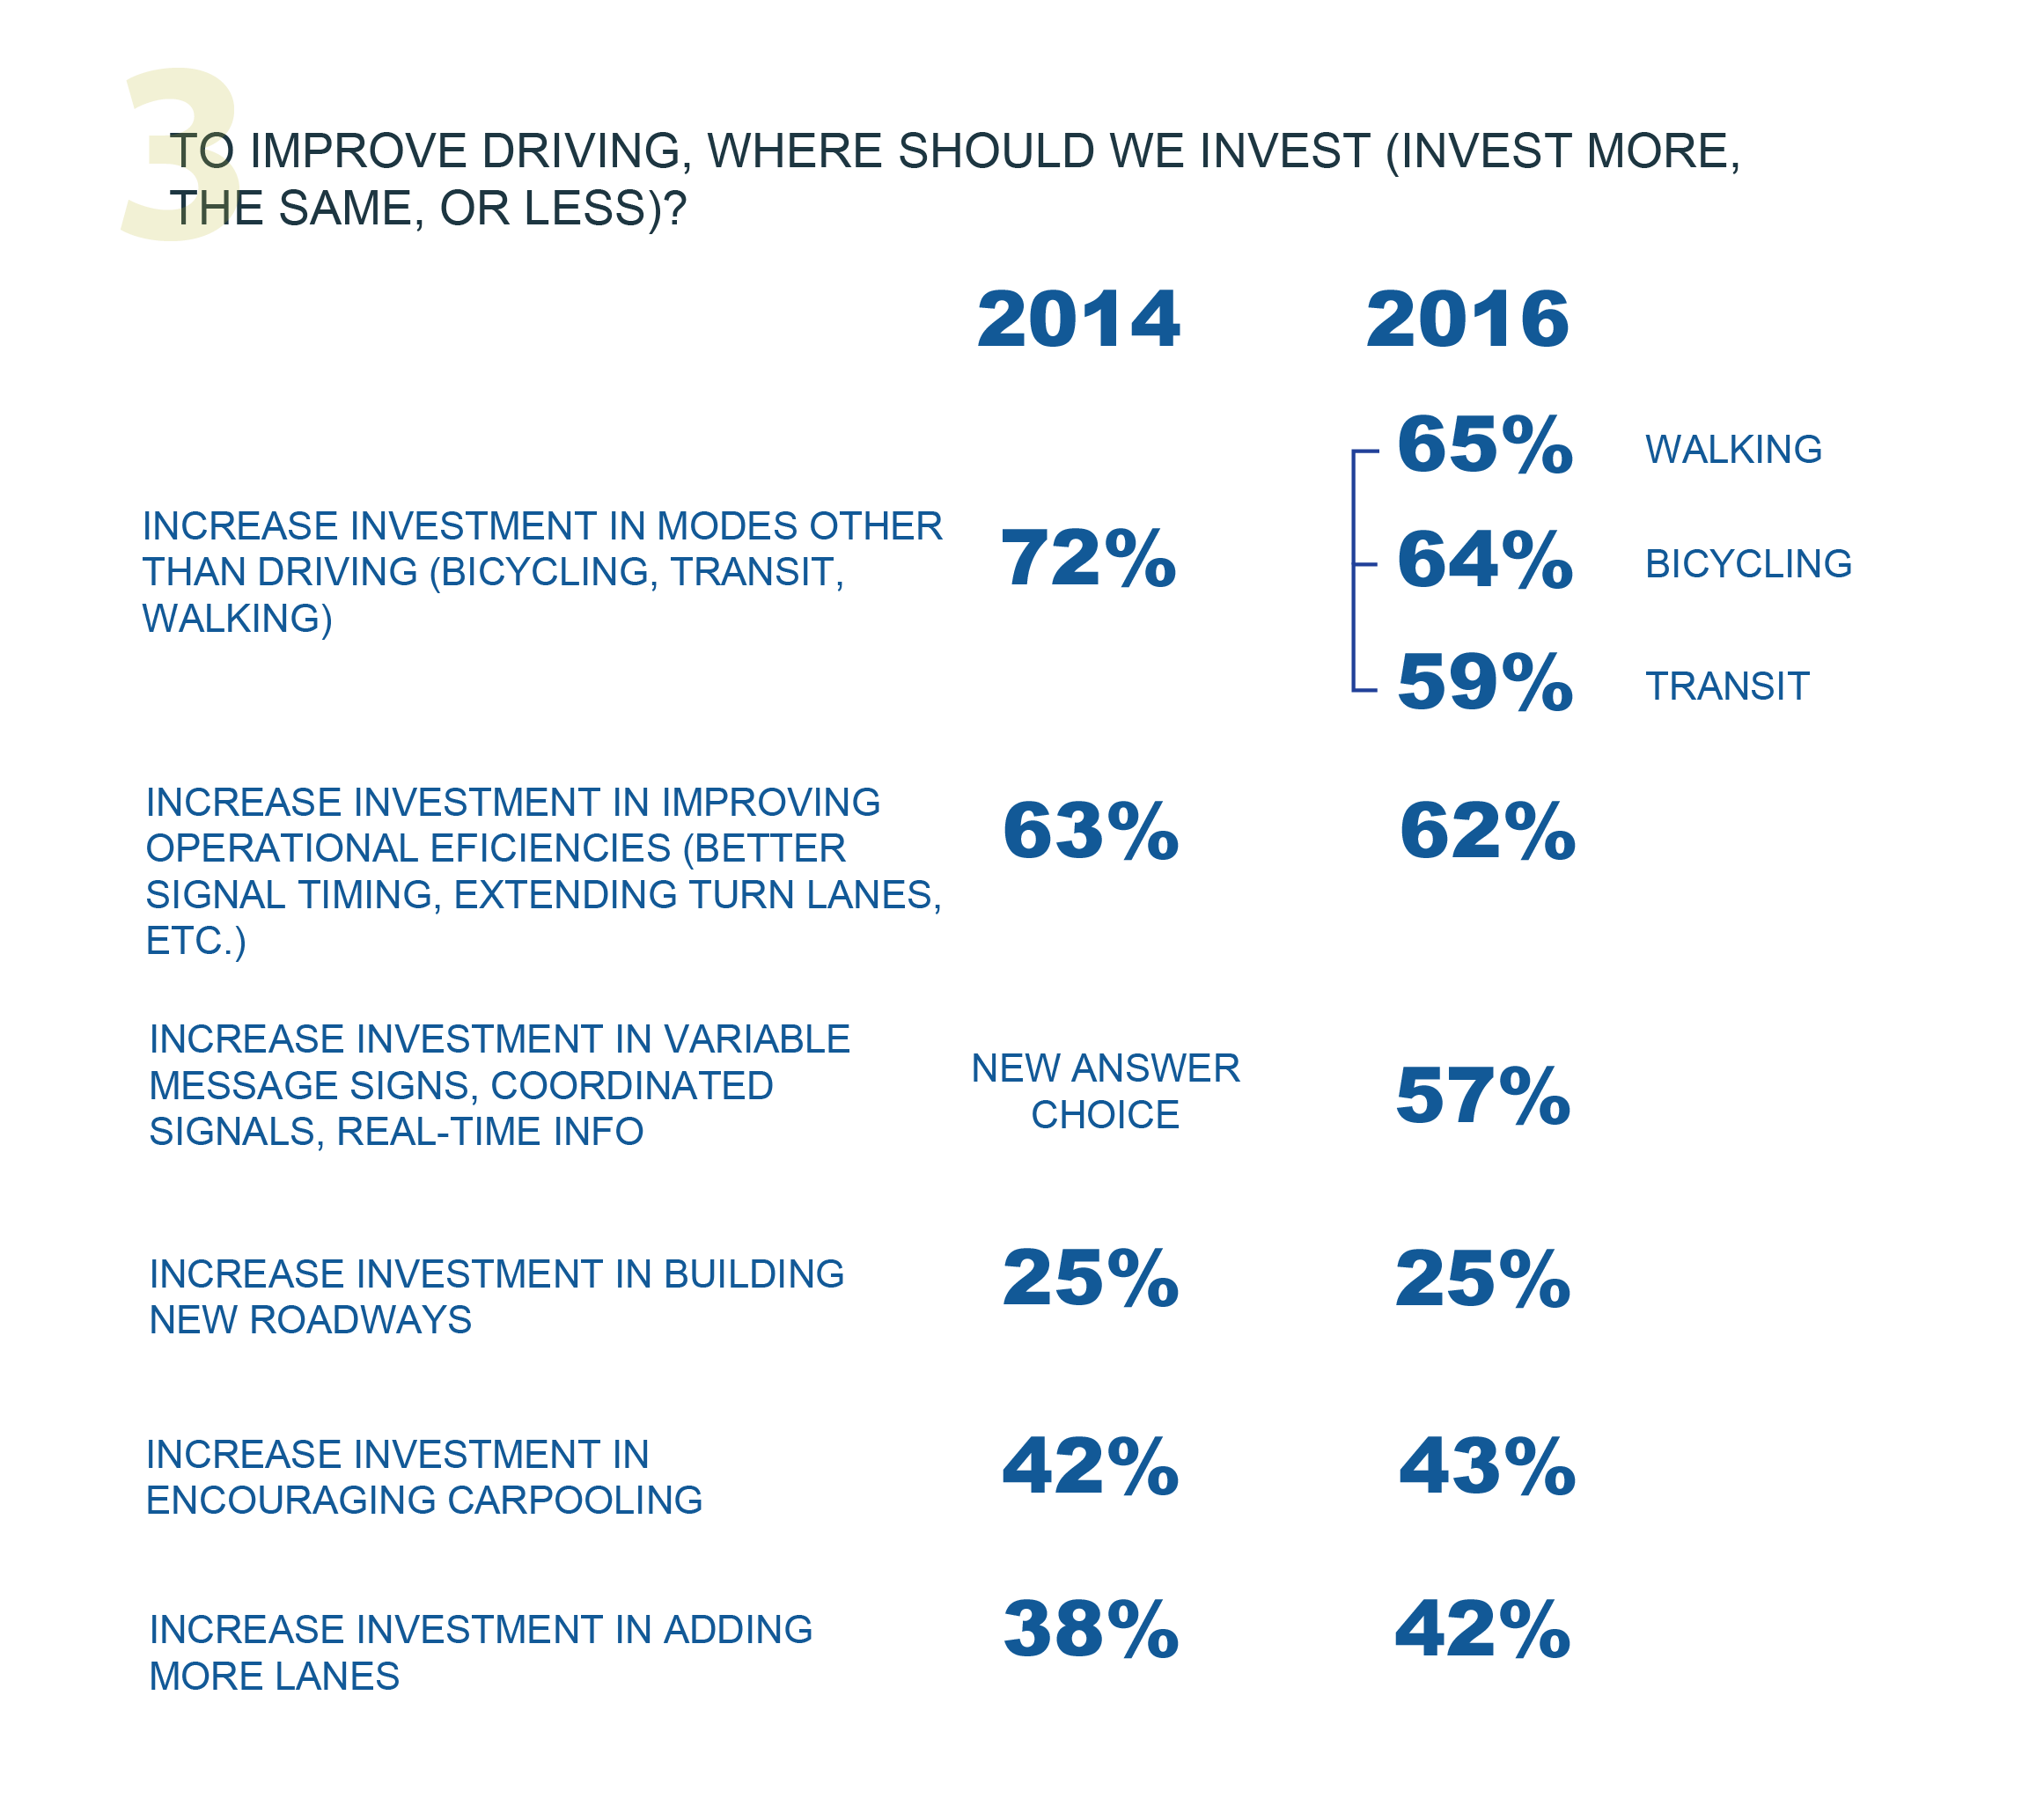
Notes:
These results are fairly consistent with last survey.

Slide 8
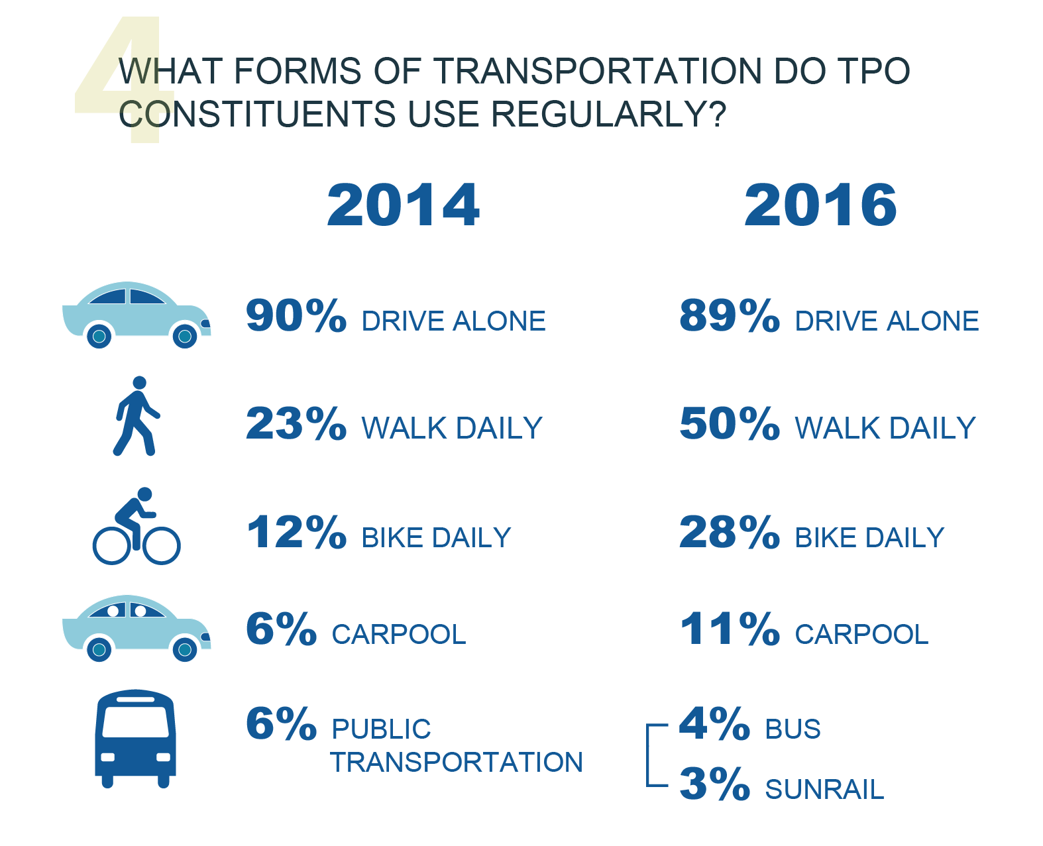
DRAFT
Notes:
Make clear that we suspect people interpreted the walk and bike answer choices differently this year.

Slide 9
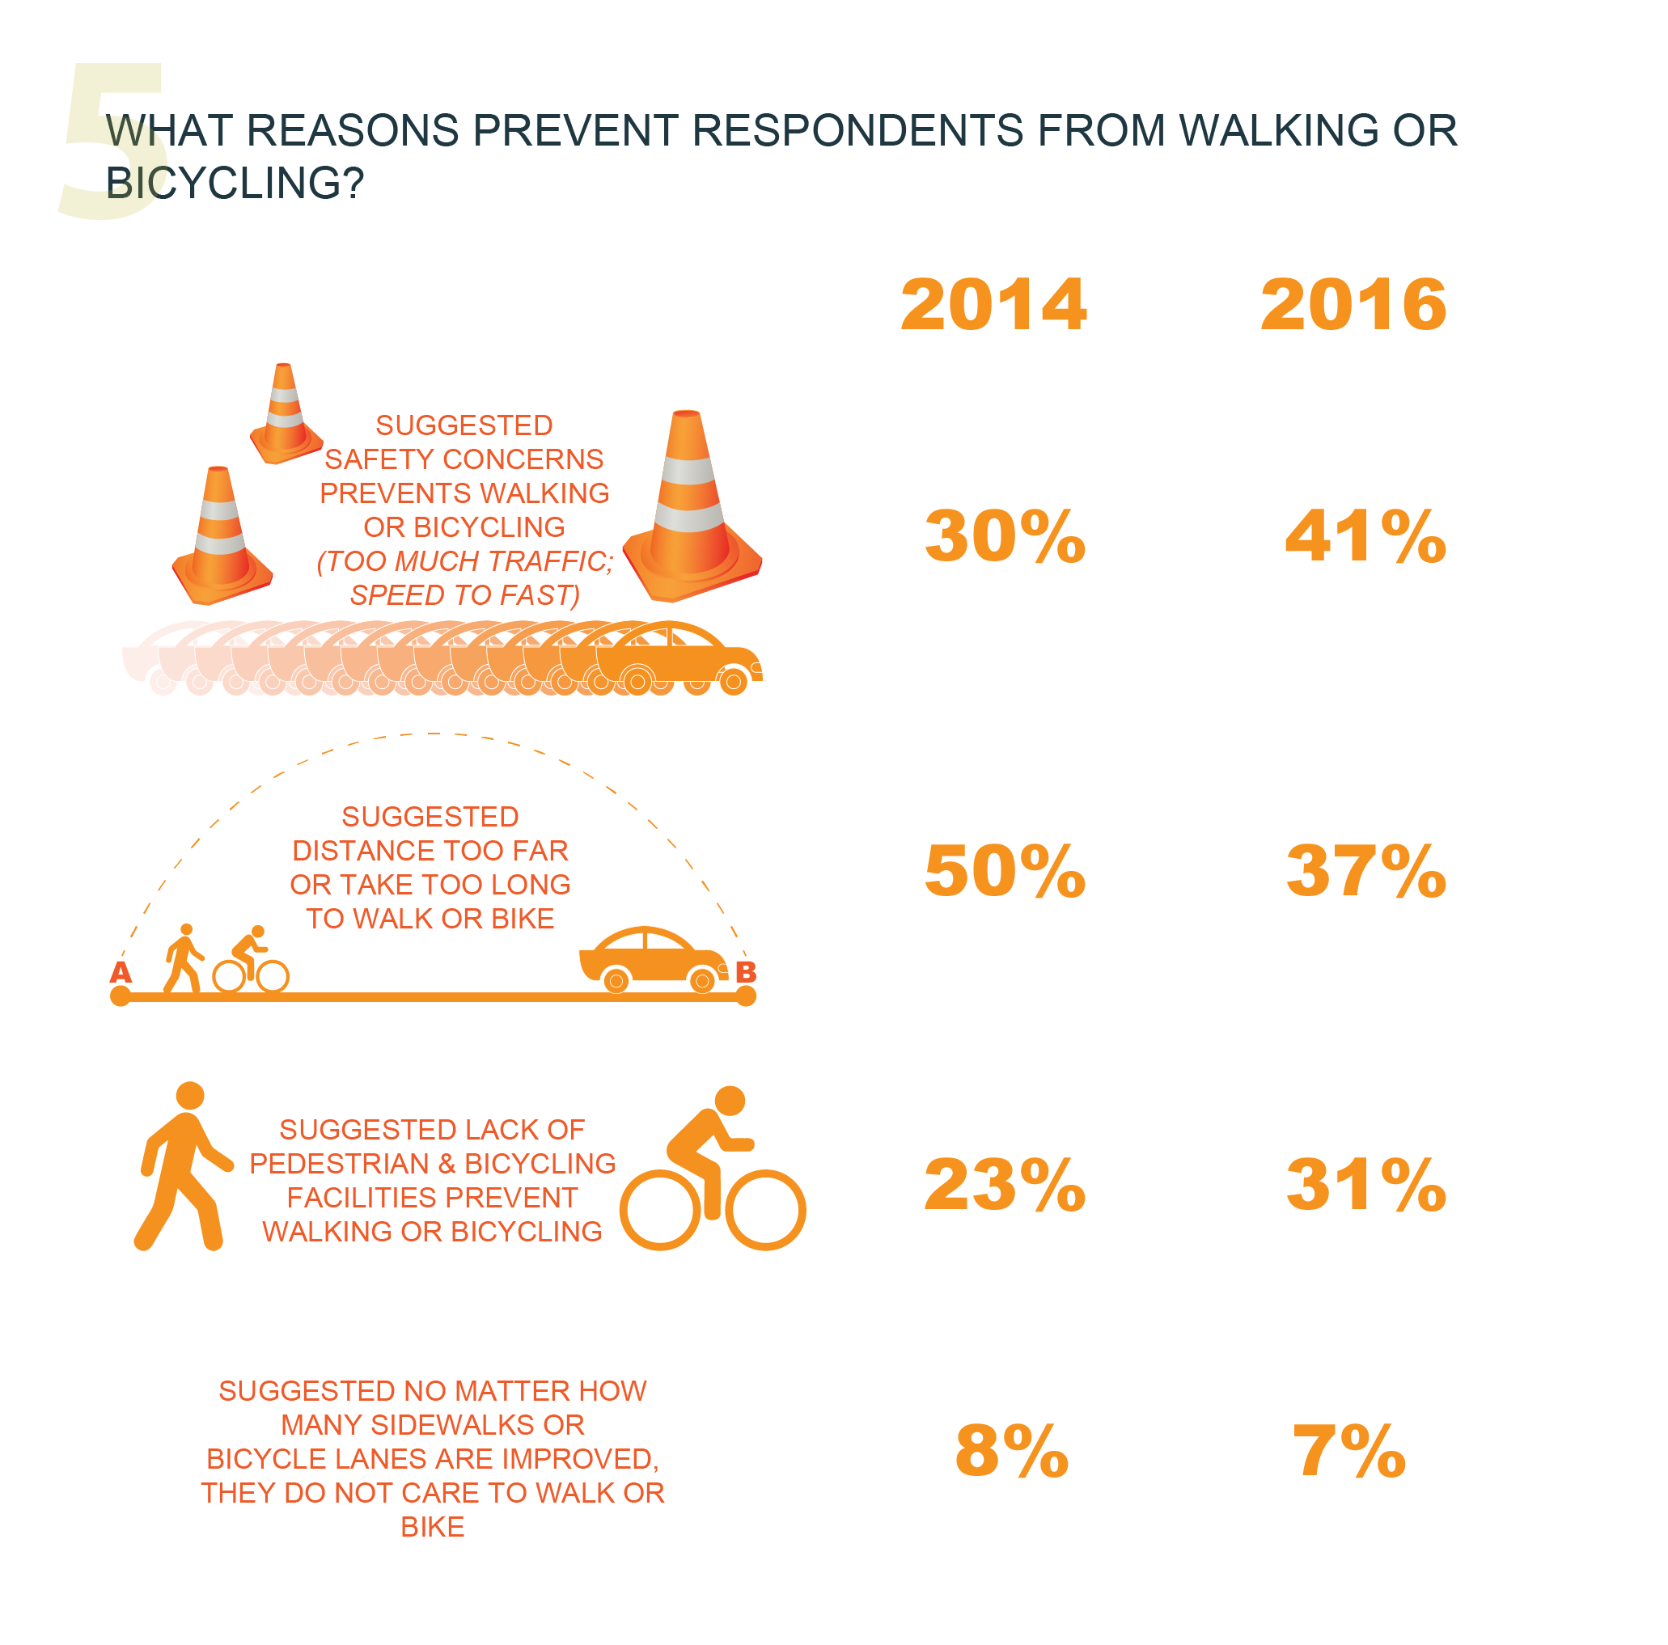
DRAFT

Slide 10
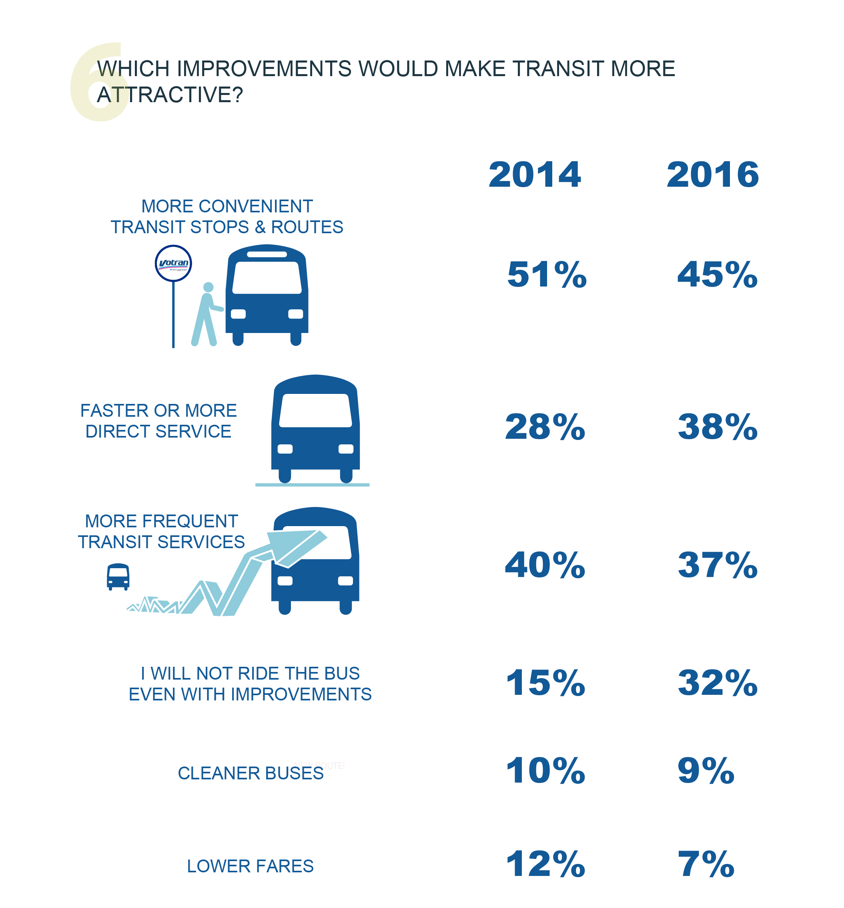
DRAFT

Slide 11
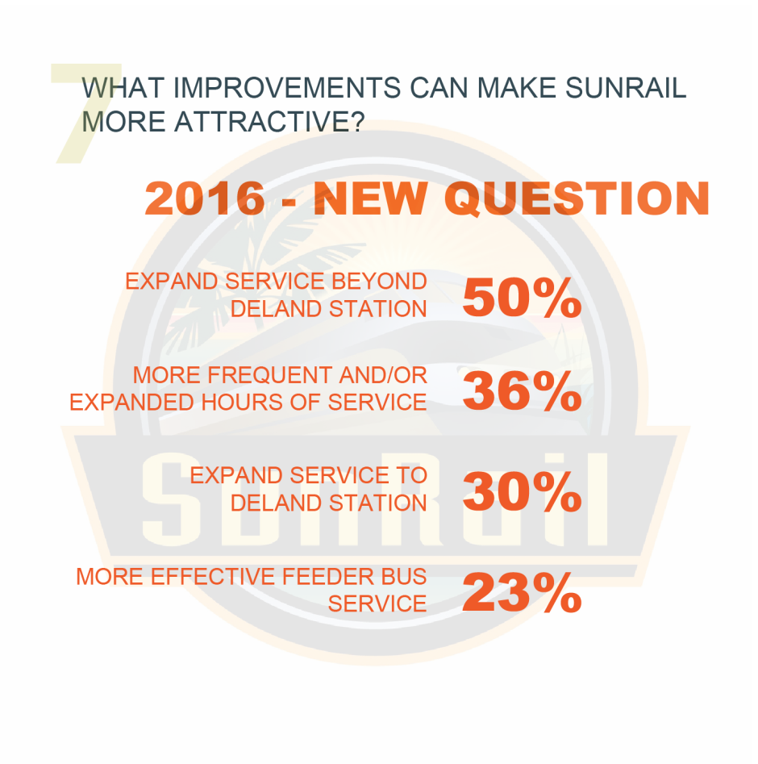
DRAFT

Slide 12
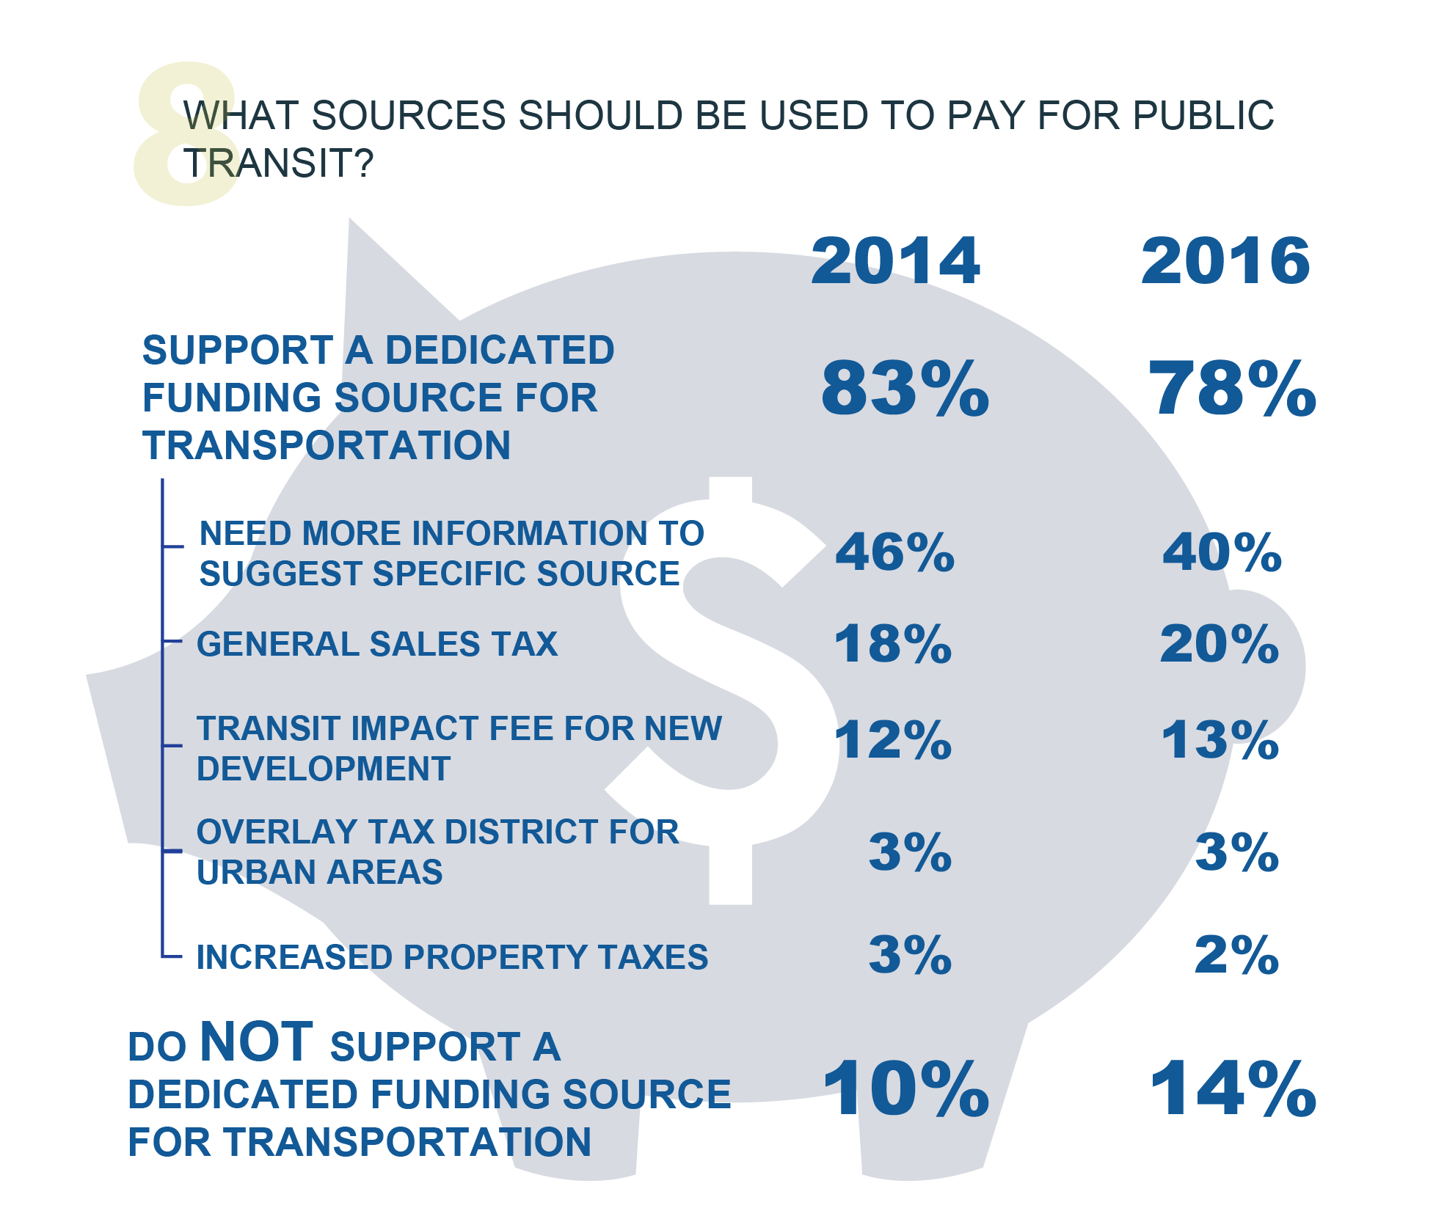
DRAFT
Notes:
“People consistently support some sort of dedicated funding source for transit but have differing opinions on how.”

Slide 13
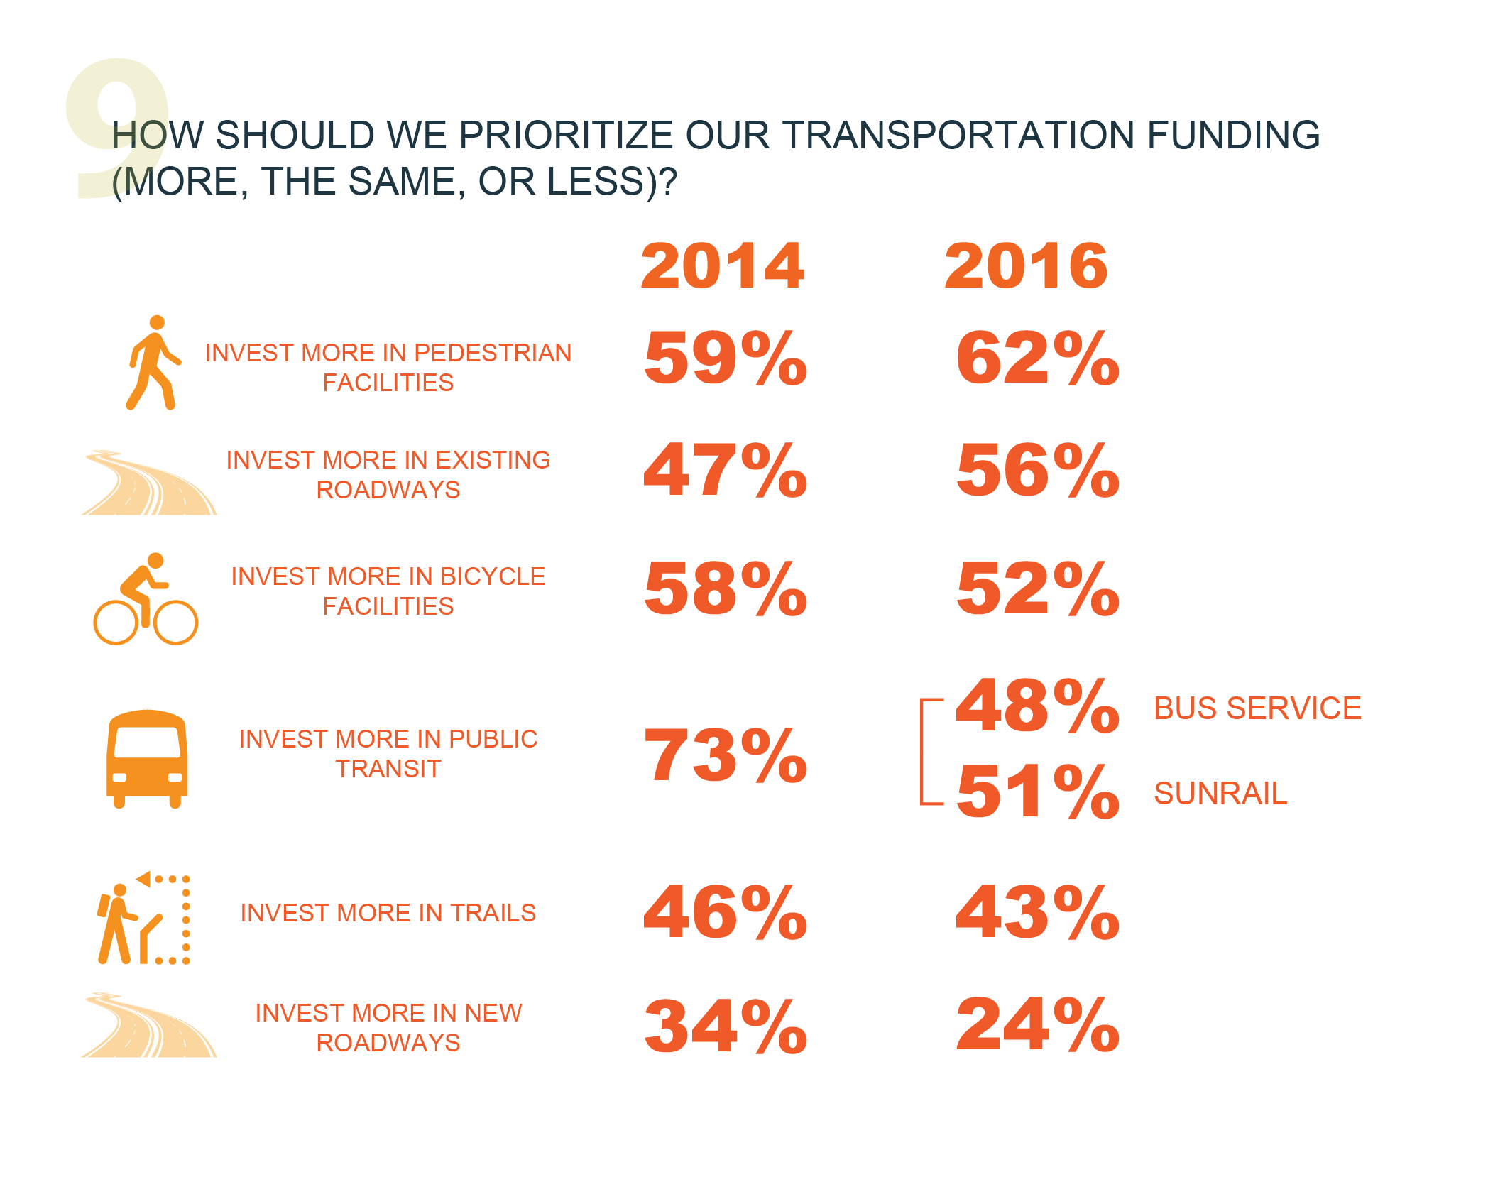
DRAFT

Slide 14
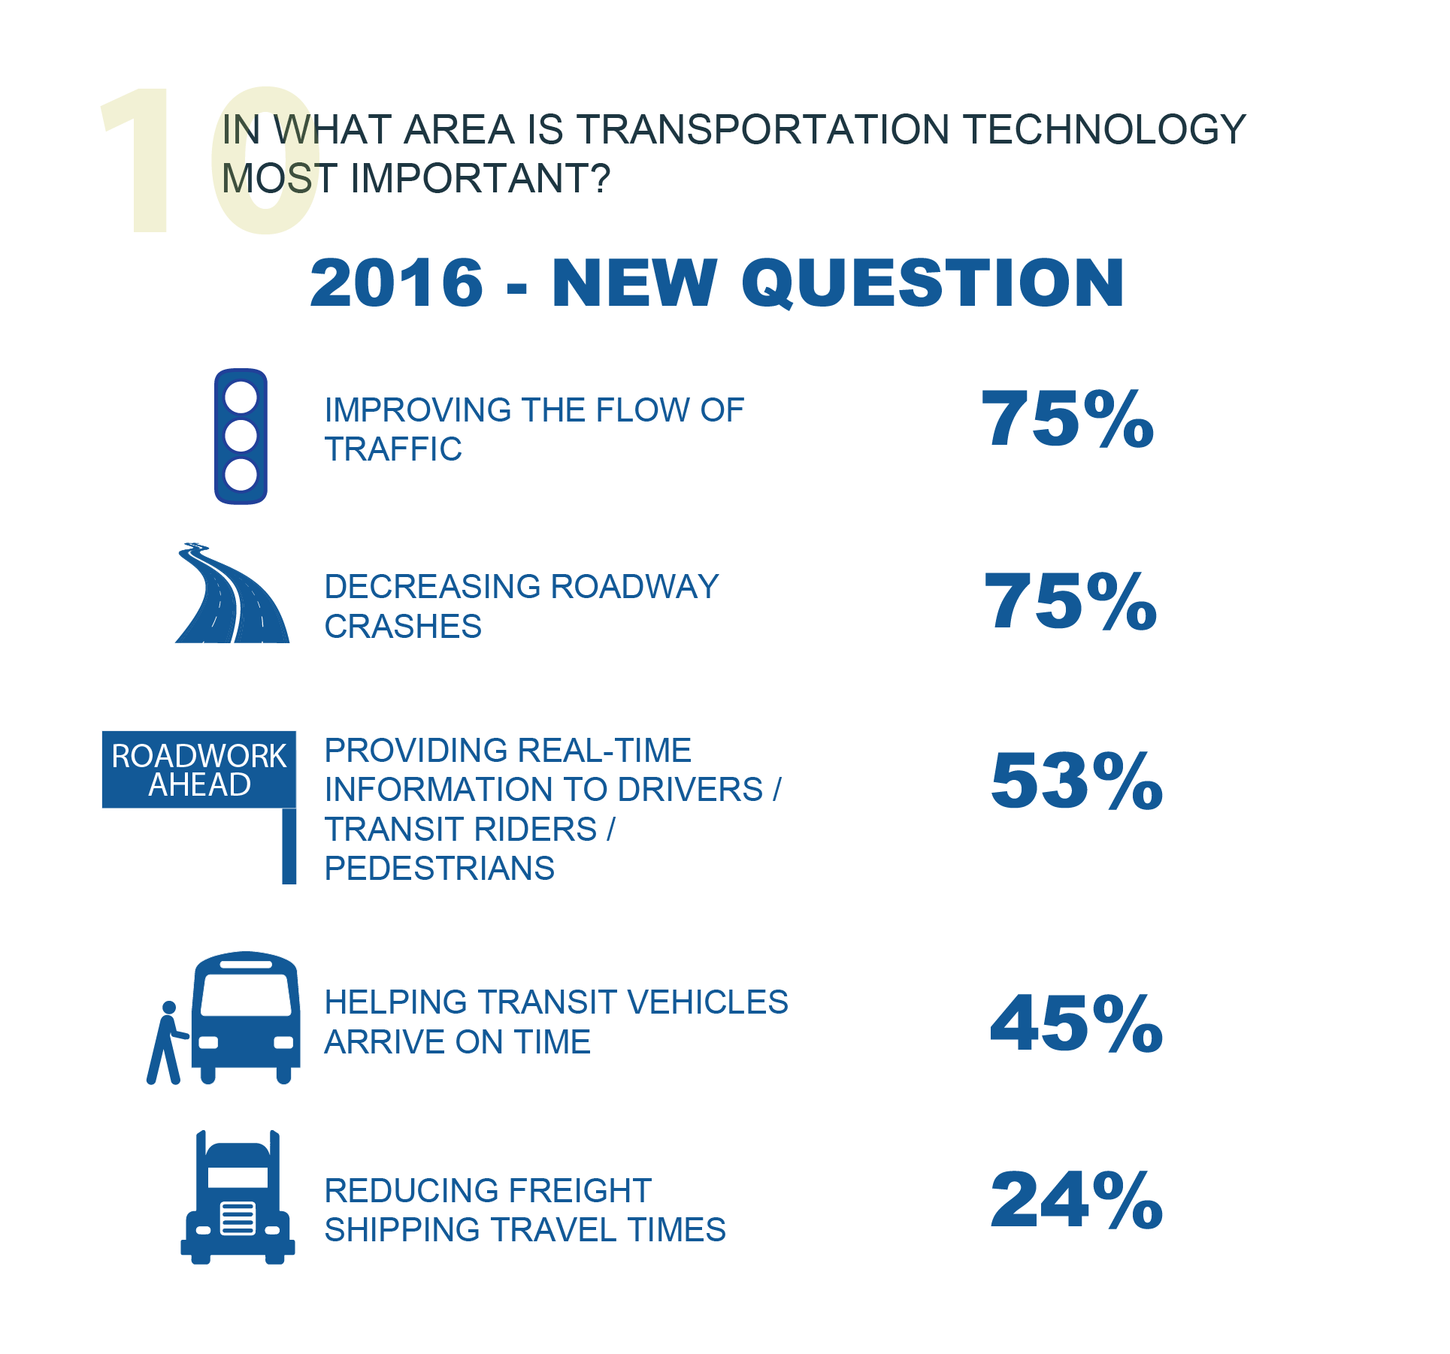
DRAFT
Notes:
People understand how ITS can improve someone’s driving experience.

Slide 15
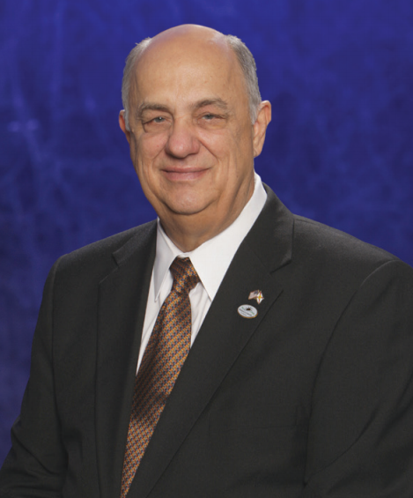
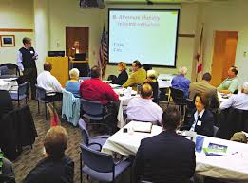
2016 SURVEY AMBASSADOR COMPETITION
This year, about 40% of the total responses came in through the boards and committees - congratulations to all Ambassadors!
And the winner is…
THE R2CTPO BOARD!
COMMUNITY TRANSPORTATION SURVEY
RIVER TO SEA TPO
DRAFT

Slide 16
ANY QUESTIONS?
WWW.TELLTHETPO.COM
COMMUNITY TRANSPORTATION SURVEY
RIVER TO SEA TPO
DRAFT

