Slide 1
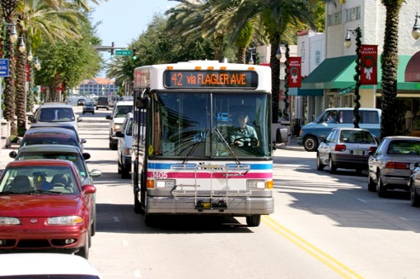
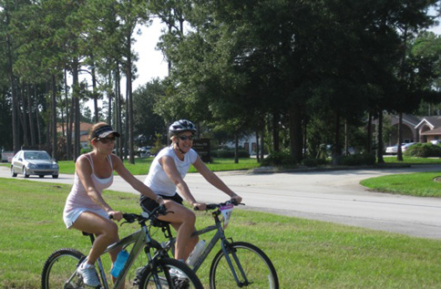
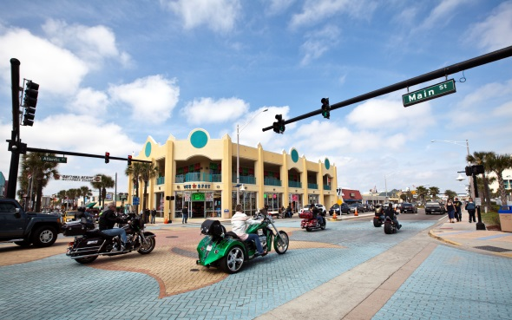
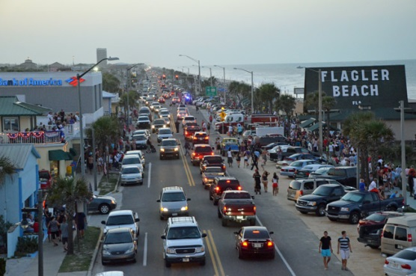



TELL THE TPO
RIVER TO SEA TPO
COMMUNITY TRANSPORTATION SURVEY
TPO Board/Committee Briefing
March 2016

Slide 2
“TELL THE TPO” GOALS
survey and public awareness campaign
1
Provide Research ON PUBLIC OPINION useful to TPO leadership and long range planning
4
Build Partnerships and Awareness
2
Effective Public Engagement Tool
5
Build database
3
Create a Buzz and Earned Media Opportunity
COMMUNITY TRANSPORTATION SURVEY
RIVER TO SEA TPO

Slide 3
APPROACH
Target everyone who lives, works, or visits the TPO region
Emphasis on maximizing public response… the longer the survey the less the response.
Target Goal: Thousands
The survey is radioactive, everyone taking it is exposed to transportation participation opportunities.
Primarily an online endeavor (www.tellthetpo.com), but with hard copies provided as a tool
Fun and Excitement: prizes-challenges
COMMUNITY TRANSPORTATION SURVEY
RIVER TO SEA TPO

Slide 4
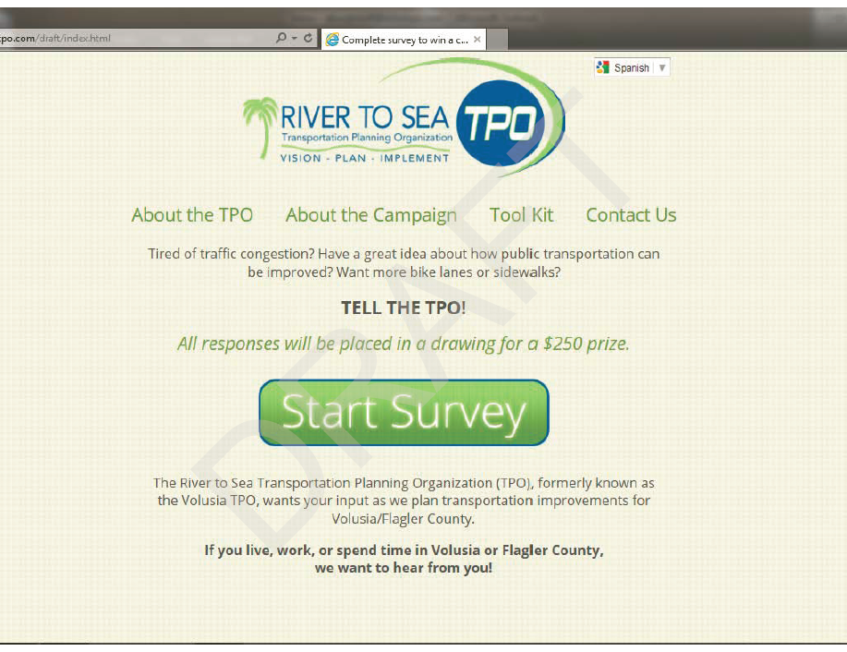
2014 SURVEY
COMMUNITY TRANSPORTATION SURVEY
RIVER TO SEA TPO

Slide 5

2014 SURVEY
1,263 TOTAL RESPONSES
Outreach featured creative teaming with government, business, and civic communities.
  Rethink reached out to major employers and 780 in rideshare database.
  Every Board Member was an Ambassador.
  Partnered with Team Volusia and various Chambers to reach business community.
  “One Voice for Volusia” helped us engage fifty different nonprofits reaching under-served community.
  Social Media included Facebook
  Media coverage included newspapers and radio.
COMMUNITY TRANSPORTATION SURVEY
RIVER TO SEA TPO

Slide 6

2014 SURVEY SUMMARY
http://www.r2ctpo.org/resources/survey-campaign/
COMMUNITY TRANSPORTATION SURVEY
RIVER TO SEA TPO

Slide 7
NEW SURVEY
CHANGES TO PREVIOUS SURVEY
Added Intelligent Transportation Systems (ITS) answer choice to “Where should we invest in order to improve driving” (Question 3)
Added an ITS funding question to understand preference of priority (Question 10)
Other minor wording/text changes for clarification
COMMUNITY TRANSPORTATION SURVEY
RIVER TO SEA TPO

Slide 8
MARKETING PLAN
PARTNERSHIPS
CHAMPIONS
FUN
Team with chambers to reach their businesses
Team with businesses to reach their employees
Team with organizations to reach their members
TPO Board and Committees being challenged to disseminate the survey to their stakeholders. Each group given a unique survey link to measure success.
Keep it fun with prizes and incentives
COMMUNITY TRANSPORTATION SURVEY
RIVER TO SEA TPO

Slide 9

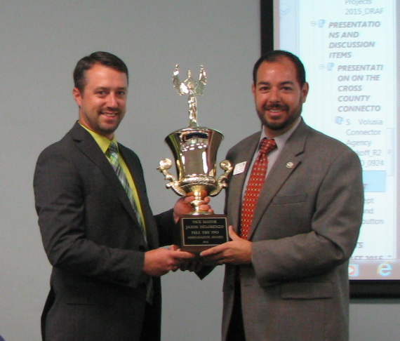
FRIENDLY CHALLENGE
EACH BOARD/Committee IS AN AMBASSADOR
Each given a unique survey link to measure success.
We invite each to send your link to your stakeholders, contact lists, e-newsletters, etc.
Coveted trophy awarded to most successful Ambassador
2014 Survey: A third of responses came in through Ambassadors
WE NEED YOU!
2014 winner: Vice Mayor Jason DeLorenzo
COMMUNITY TRANSPORTATION SURVEY
RIVER TO SEA TPO

Slide 10
SCHEDULE AND NEXT STEPS
MARCH
APRIL
MAY
JUNE
JULY
AUGUST
TPO BRIEFINGS & SURVEY LAUNCH –
MAR 31st!
SURVEY OPEN
COMPILE DATA & ANALYZE
SUMMARY REPORT
ADOPT SUMMARY AT COMMITTEE & BOARD MEETINGS
COMMUNITY TRANSPORTATION SURVEY
RIVER TO SEA TPO

Slide 11
ANY QUESTIONS?
WWW.TELLTHETPO.COM
COMMUNITY TRANSPORTATION SURVEY
RIVER TO SEA TPO

