Slide 1
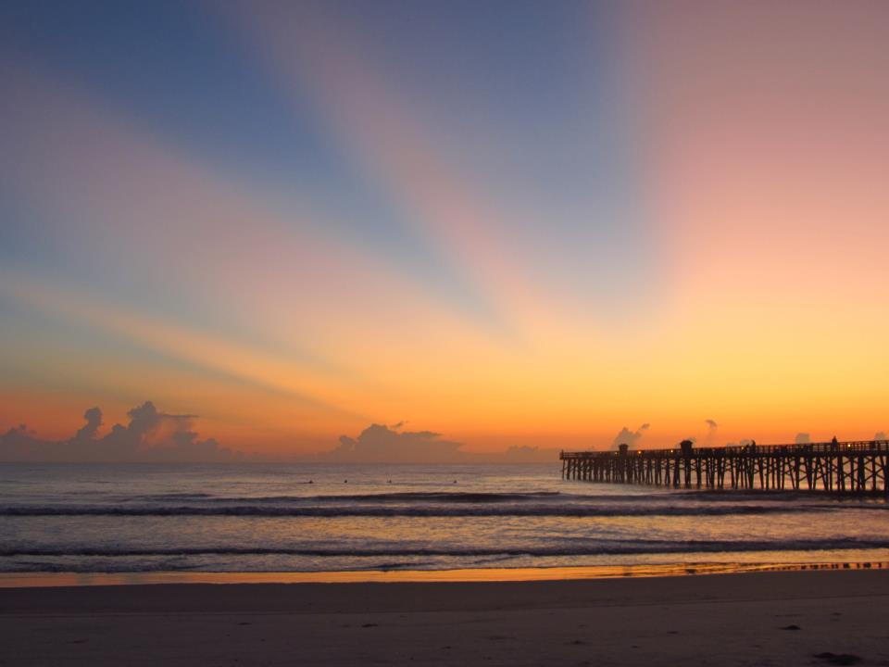
2013 Retreat Volusia Transportation Planning Organization (TPO) February 8, 2013
Craig Coffey,
County Administrator

Slide 2
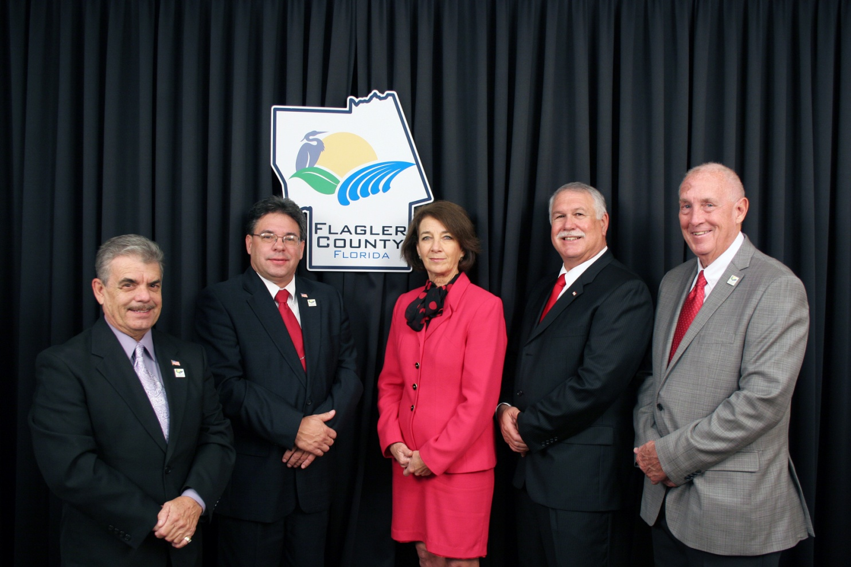
Flagler County Commission
Vice Chair George Hanns, Chair Nate McLaughlin, Barbara Revels, Frank Meeker, Charles Erickson

Slide 3
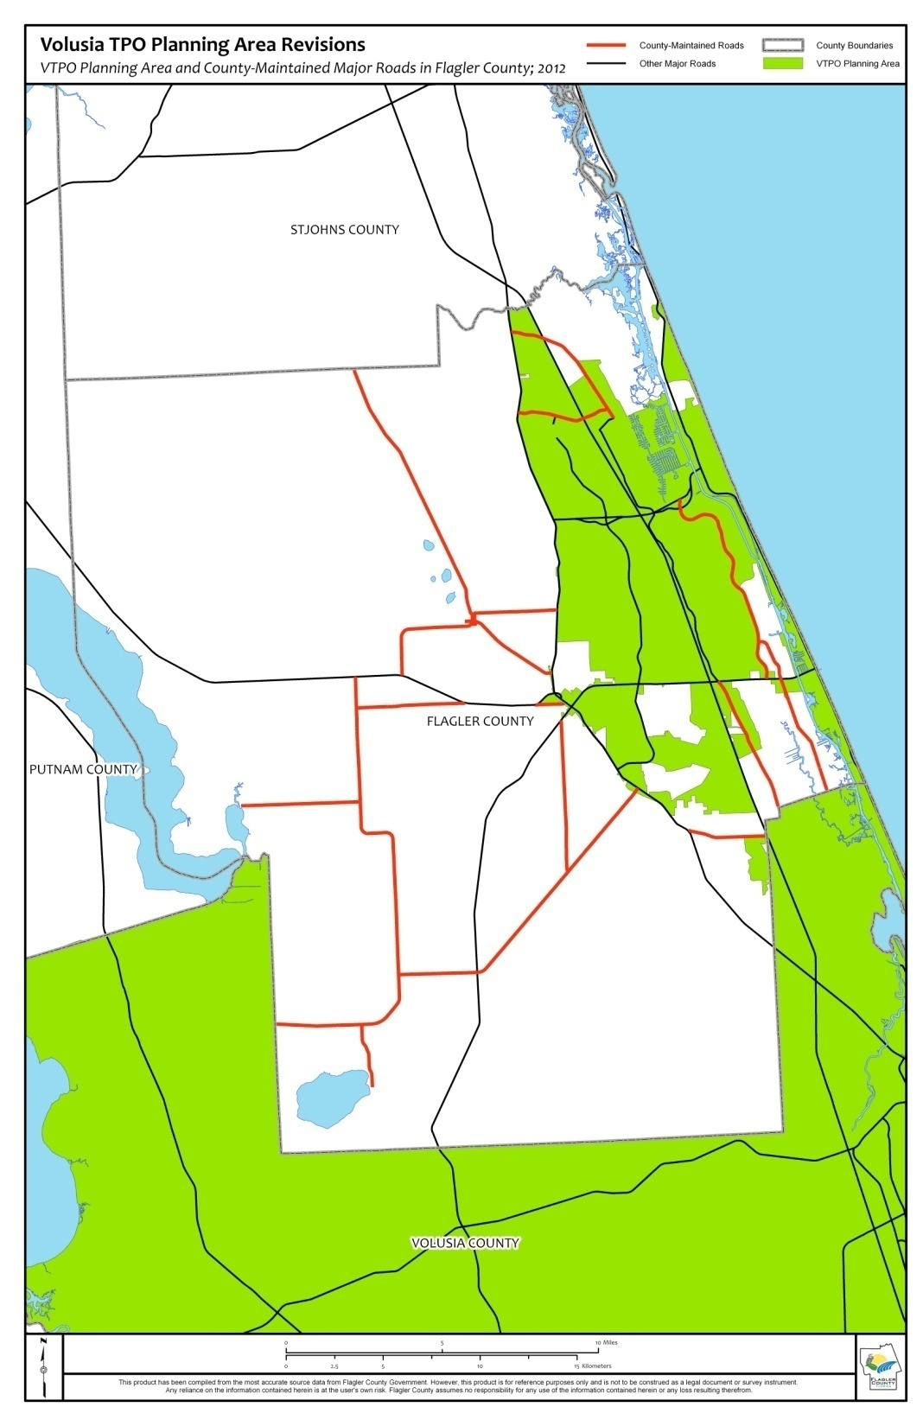
COUNTY ROADS
Flagler County is responsible for many County-owned and maintained roads.

Slide 4
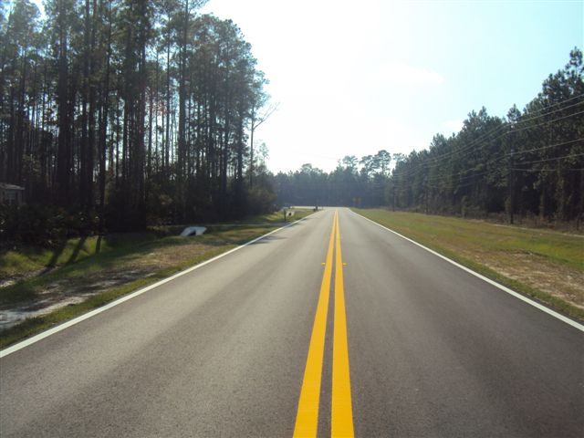
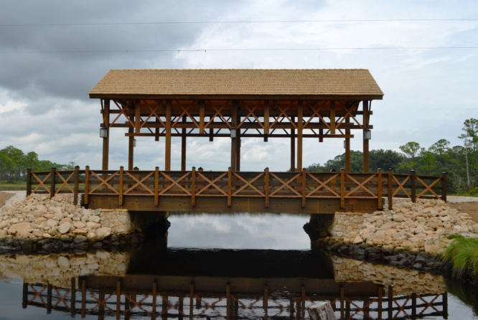
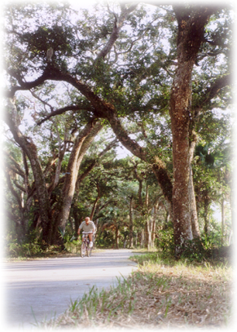
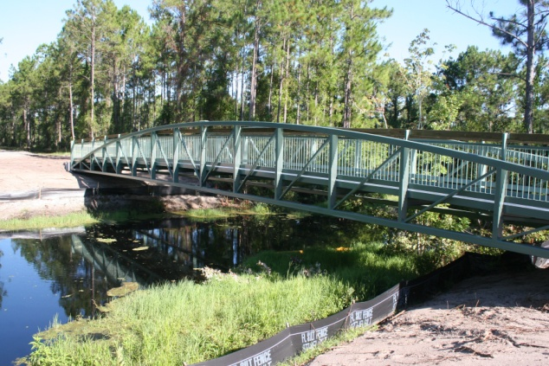
Transportation Funding Sources
Roads, Trails and Sidewalks
Federal Funding
County Incentive Grant Program – CIGP
Small County Outreach Program – SCOP
Small County Road Assistance Program-SCRAP
Safe Routes to Schools
Transportation Enhancement Funds
Gas Tax

Slide 5
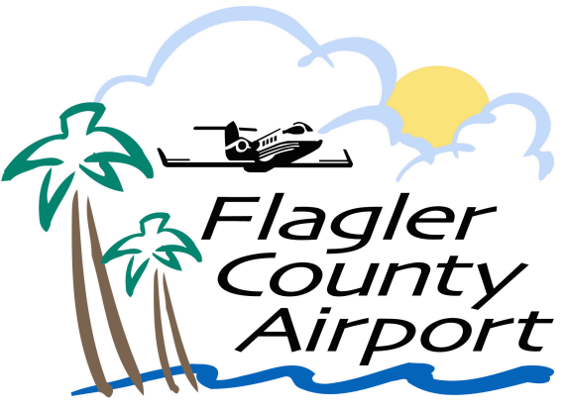
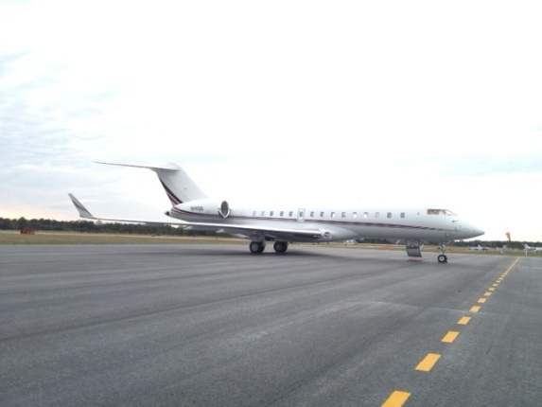
Transportation Funding Sources
Aviation
Federal Aviation Administration - FAA
Florida Department of Transportation – FDOT
Self-supporting Enterprise Fund
No local tax funding is used to
support aviation operations

Slide 6
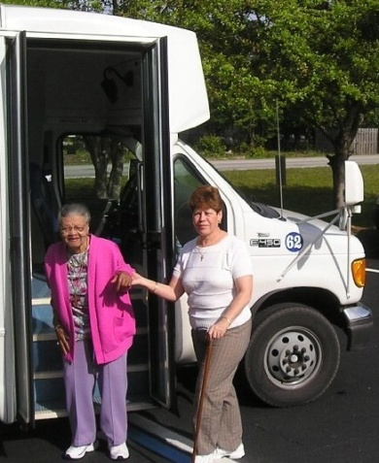
Transportation Funding Sources
Transit
Pre-scheduled, Demand-response, Para-transit
FDOT – Operation Assist Grant
SCTD – Operating Assistance Grant
SCTD – Capital Assistance Grant
FDOT – Federal State Of Good Repair Capital Assistance Grant
Client Bus Fares
Senior Services Older Americans Act Grant

Slide 7
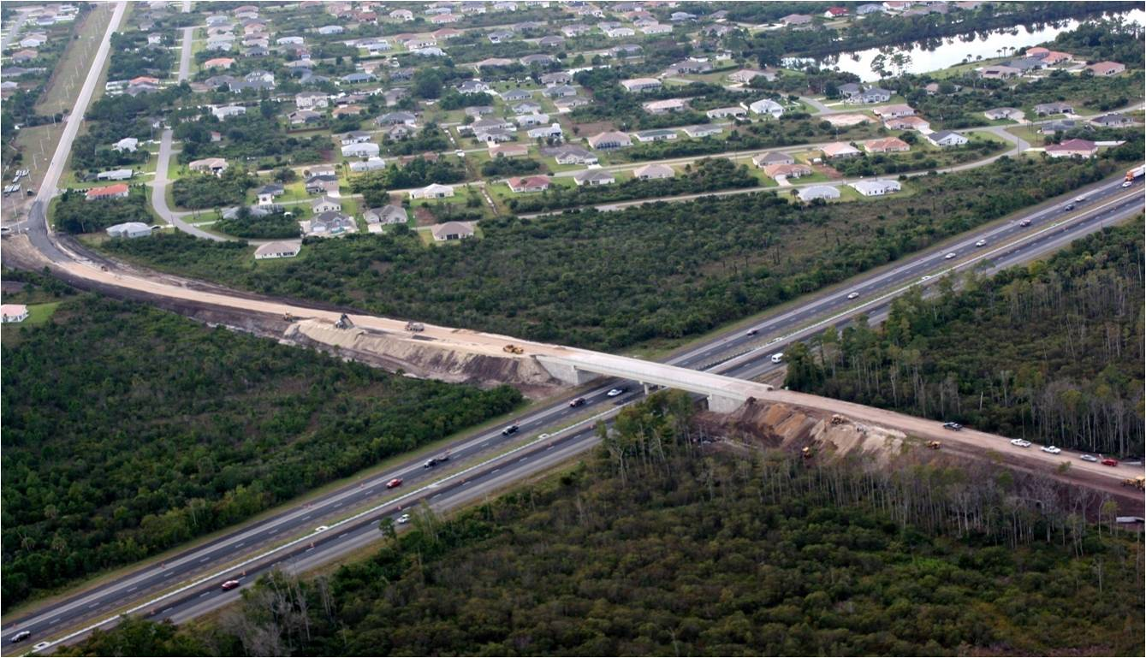
Funding County Road
Annual Coordination w/Cities of Bunnell, Palm Coast and Town of Marineland (Beverly Beach and Flagler Beach projects go through VTPO)
No limit on the number of projects that can be submitted – Limitation on available Funds

Slide 8
Long Range Planning vs. Funding Limitations
No Easy Solution
Coordination at the state and local levels.
Explore alternative options for local funding

Slide 9
Thank You

