Slide 1

Votran Transit Development Plan (TDP)
River To Sea TPO Committees
September 2016

Slide 2
Agenda
What is a TDP?
Baseline Conditions
Public Involvement
Peer and Trend Review
Situation Appraisal
Goals
Proposed Alternatives
Next Steps

Slide 3
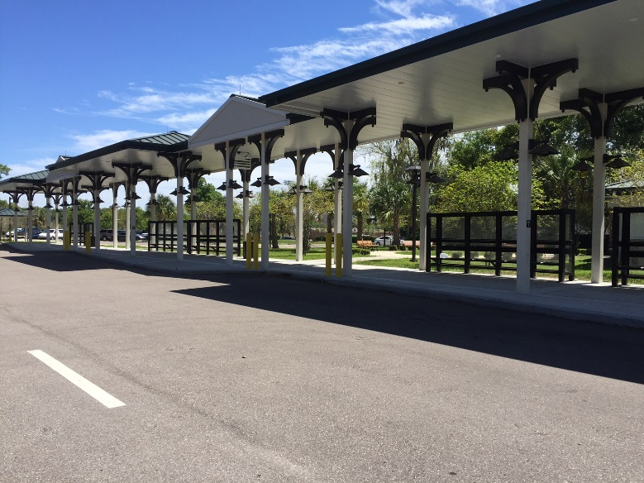
What is a TDP?
10-year Strategic Plan for Transit Service
  FDOT requirement
  Transit agency guidance document
  Identify public transportation needs
  Define alternative solutions
  Sets the vision…
Difference from Prior TDPs
  Corridor approach
  Focus on improving existing services performance

Slide 4
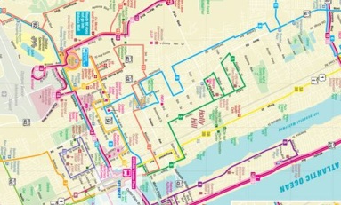

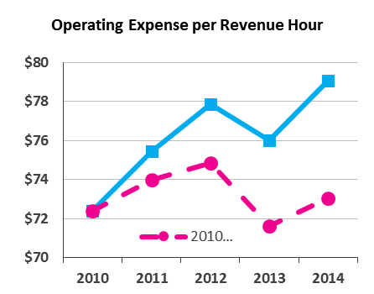
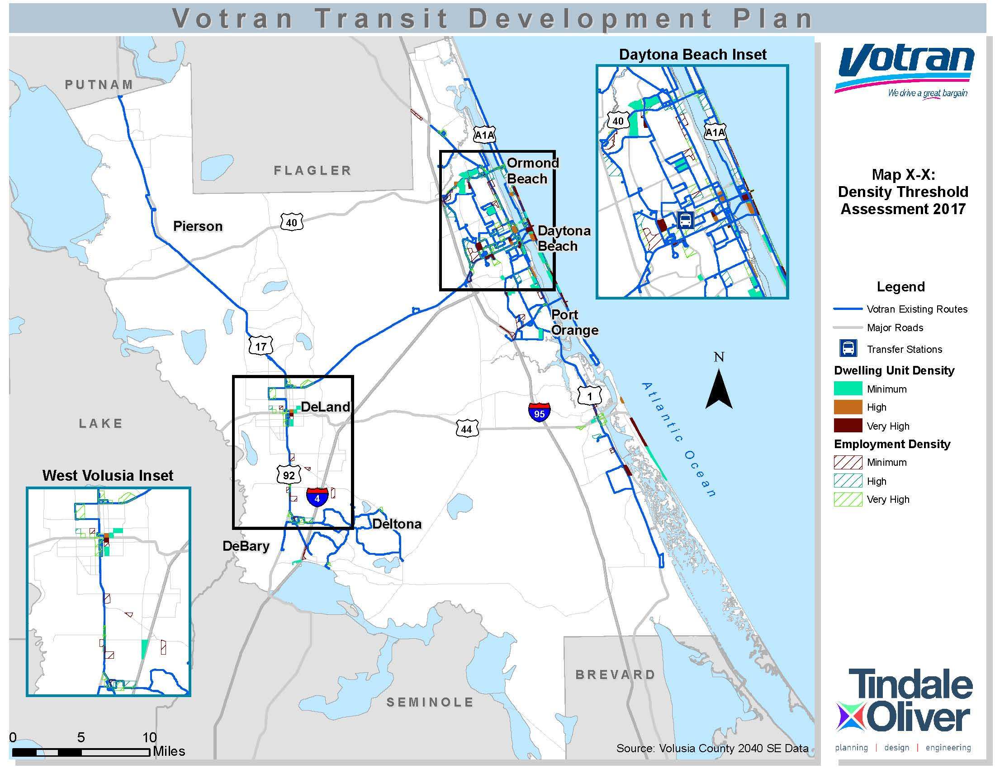


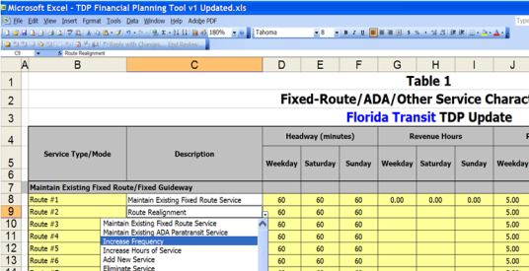
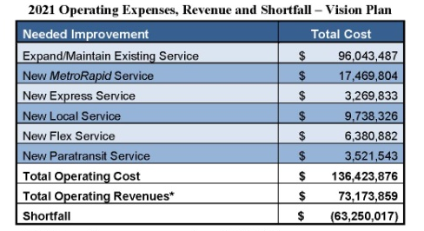
Key Elements of the TDP Process
Condition Analysis
Public Outreach
Evaluation of Services
Needs Assessment
Goals & Objectives
Resource Assessment
Final Plan: Phasing & Finances

Slide 5
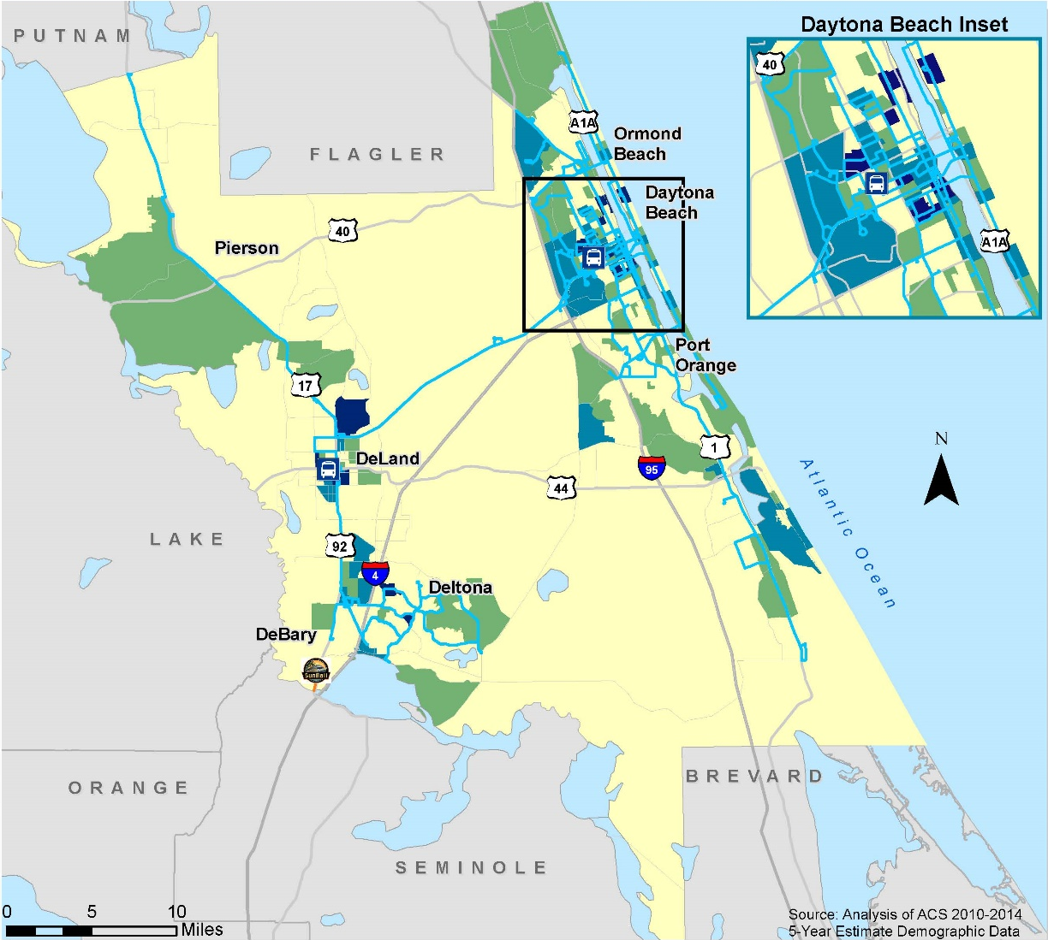

Traditional Markets
Analyzed
  Older adults 65+ years
  Youth < 15 years old
  Households below the poverty level
  ($25,000 for 4-person household)
  Zero vehicle households

Slide 6
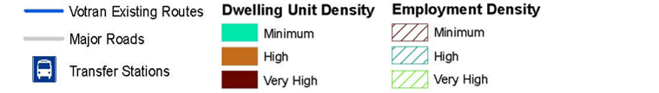
Discretionary Market
Density Threshold Assessment based on industry thresholds
Level of Transit Investment | Dwelling Unit Density Threshold | Employment Density Threshold
Minimum Investment | 4.5-5 dwelling units/acre | 4 employees/acre
High Investment | 6-7 dwelling units/acre | 5-6 employees/acre
Very High Investment | ≥8 dwelling units/acre | ≥7 employees/acre

Slide 7
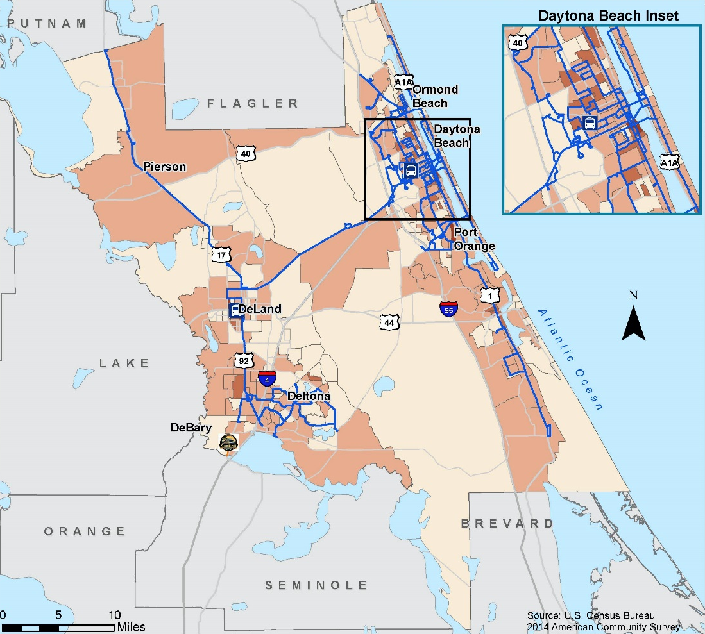
Population Distribution
Persons with a Disability Population

Slide 8
Public Involvement
Public Outreach Process Completed
  On-board survey
  Stakeholder interviews
  Discussion groups
  Public workshops
  Gold users survey
Activity | Date | Approximate # of Participants
On-Board Survey | May/June 2016 | 1,794
Stakeholder Interviews | June 2016 | 19
Discussion Groups | August 8-9, 2019 | 27
Public Workshops (Round 1) | August 9-10, 2019 | 20
Comment Cards/E-mails | August 2016 | 8
Gold Users Survey | August 2016 | 50
Total To-Date |  | 1,918

Slide 9
On-Board Survey
30 questions under 3 major categories:
  Travel characteristics
  Rider demographics
  Customer service/satisfaction
1,794 respondents
Most trips home to work
85% walk to access bus
Safety highest area of passenger satisfaction 4.4 out of 5
Sunday service lowest area of passenger satisfaction 2.5 out of 5
Typical Rider Characteristics
Category | Average Rider Demographic (2006) | Average Rider Demographic (2011) | Average Rider Demographic (2016)
Gender | Female | Female | Male
Ethnic Origin | White | White | White
Age | Under 24 | Under 24 | 25-44
Annual Household Income | <$10,000 | <$10,000 | <$10,000
Regular Votran User? | Yes | Yes | Yes
Notes:
Underlined changes in rider profile

Slide 10
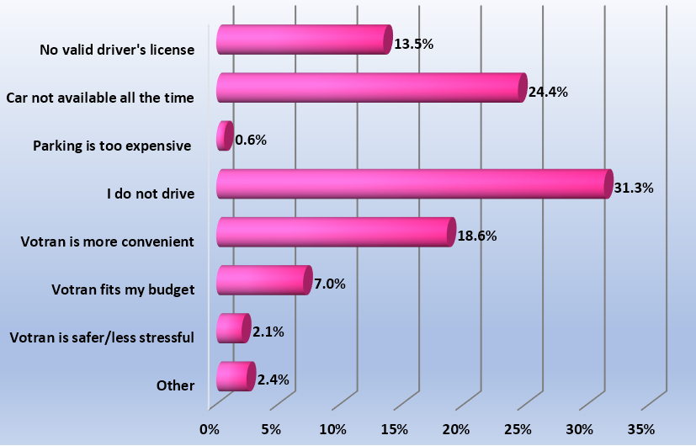
On-Board Survey
Reasons to Ride Votran
Aspects Least Liked
  Other passengers 23%
  Wait time/Infrequency of service 14%
  Weekend service 13%
  Limited service hours 9%

Slide 11
Stakeholder Interviews
Perception of Transit:
  Existing service is satisfactory and meets the needs of transit-dependent riders
Future Role of Transit:
  Increase frequency of service, service needed in Lake Helen, trolley service, add bus shelters
  Demographic change will have an impact
Technologies
  Improved over time, but need to continue advancing
Funding
  Split decision on use of local funding
Marketing and Branding
  Reasonable, need more bus stop schedules posted, TV ads
  Focus more on educational marketing more than branding

Slide 12






Performance Peer Group
Capital Area Transit System – Baton Rouge, LA
Charleston Area Regional Transportation Authority – Charleston, SC
Chatham Area Transit Authority – Savannah, GA
Lee County Transit – Fort Myers, FL
Pasco County Public Transportation – Port Richey, FL
Sarasota County Area Transit – Sarasota, FL

Slide 13
Peer & Trend Review Overview
FY14 data for all peer agencies accessed from National Transit Database
Metric | Performance Measure | Findings
Performance | Passenger fare revenue | Trend: + 17% (strength)
 |  | Peer: *-55% below peer group mean
Effectiveness | Passenger trips per revenue hour | Trend: +11% (strength)
 |  | Peer: + 20.4% above peer group mean (strength)
Efficiency | Operating expense per passenger trip | Trend: -1% (neutral)
 |  | Peer: -22% below peer group mean (strength)
 | Operating expense per revenue mile | Trend: +10% (challenge)
 |  | Peer: -10% below peer group mean (strength)
*Removal of CARTA places Votran 48% above peer group mean

Slide 14
Situational Appraisal
Provides an evaluation of the local environment
Assesses the factors that could impact programs over the next decade
  Political
  Economic
  Environmental
  Technology
  Policy
  System

Slide 15
Goals
Six goals
Focused on the following:
  Superior service delivery
  Excellent customer service
  Fiscal responsibility
  Environmentally-friendly
  Technologically sound based on industry standards
  Quality leadership focused on the community’s mobility goals

Slide 16
Proposed Service Alternatives
Increase service on existing routes (30 minutes or better by 2026)
Expand service to Lake Helen, Port Orange, and Holly Hill
International Speedway Blvd (ISB) express service
Trolley service along A1A and ISB and within various municipalities
Connection to beaches from west side
Downtown circulator service in Ormond Beach and DeLand
Improved or new feeder bus for SunRail Phase I and II and/or All Aboard service connections
Expanded service for non-traditional work hours in service hubs
Increased service connections from DBIA during peak season

Slide 17
Proposed Capital Improvements
Technology-based:
Wi-Fi on buses
Real-time bus arrival information and applications
Interactive Voice Response (IVR) for convenient paratransit bookings
Transit Signal Priority (TSP) to provide bus priority at traffic signals in congested areas
Reloadable fare cards and mobile fare payment for convenience

Slide 18
Proposed Capital Improvements
Other capital:
Facility expansion
ADA improvements (e.g., landing pads and curb ramps)
Bus stop amenities (shelters, benches, bike racks, etc.)
Safety/access (pedestrian signals at stops, lighting, landscaping)
Vehicle replacement/expansion – fixed-route bus and Gold service
Notes:
Permitting and maintenance

Slide 19
Financial Plan
Status quo services funded with inflationary increases
Operating and Capital improvements beyond existing levels will require new funding sources
Estimated cost for each alternative will be provided
Improvements identified based on need, actual implementation will be determined by funding availability
Potential future revenue sources will be identified
Notes:
Dedicated funding challenge

Slide 20
Next Steps
Finalize draft TDP document
R2C TPO Committee presentation – September 20, 2016
Public Workshops (round 2) – September 2016
Volusia County Council presentation– October 2016
Submittal to FDOT – November 1, 2016

Slide 21

Feedback and Input

