Slide 1
PEDESTRIAN BRIDGE ALTERNATIVES
August 12, 2015
Spring to Spring Trail Alternatives Presentation
Seminole & Volusia County

Slide 2
Purpose and Need
To provide a link to bridge the Seminole/Volusia Gap in the Coast-to-Coast Connector Trail

Slide 3
Alternative 1
Proposed design
Potential connection
Lake Monroe Park
Wayside Park
Construction: $1.1 million

Slide 4
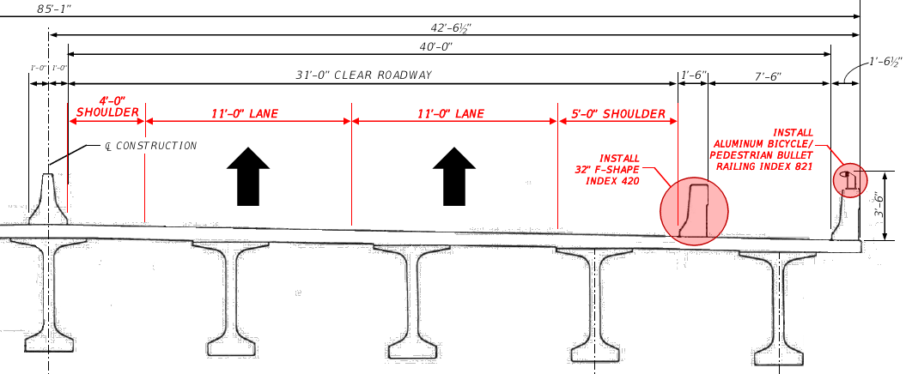
Alternative 1
6’-0” SHOULDER
12’-0” LANE
12’-0” LANE
10’-0” SHOULDER
1’-6”
7’-6” TRAIL
Design SSD = 425 ft.
Proposed SSD = 383 ft.
Diff = 42 ft.
EXISTING TYPICAL
PROPOSED TYPICAL
Construction: $1.1 million

Slide 5
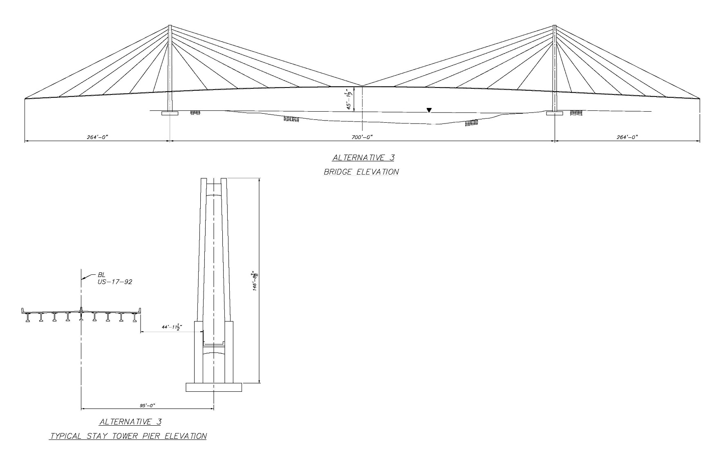
Alternative 1a
Construction: $6.8 million

Slide 6
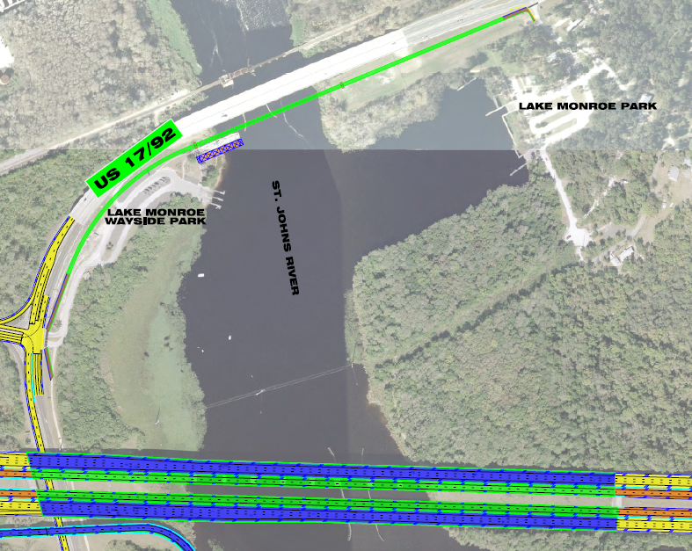
Alternative 1a
Construction: $6.8 million

Slide 7
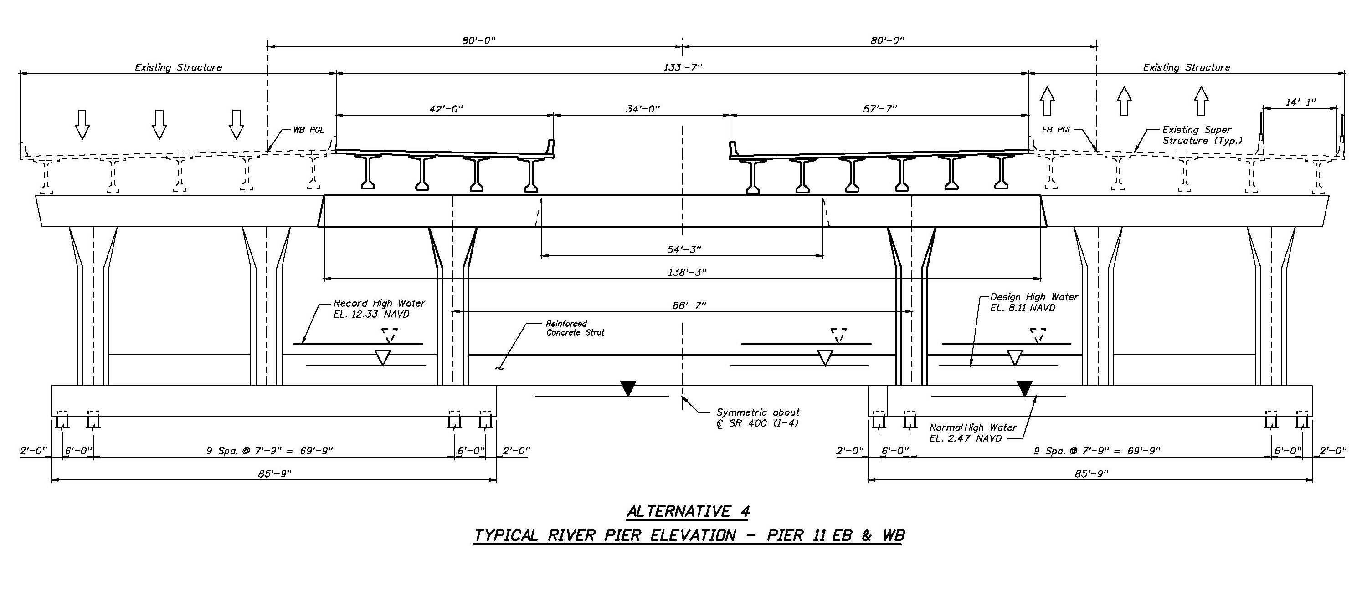
Alternative 1b
Construction: $2.5 million

Slide 8
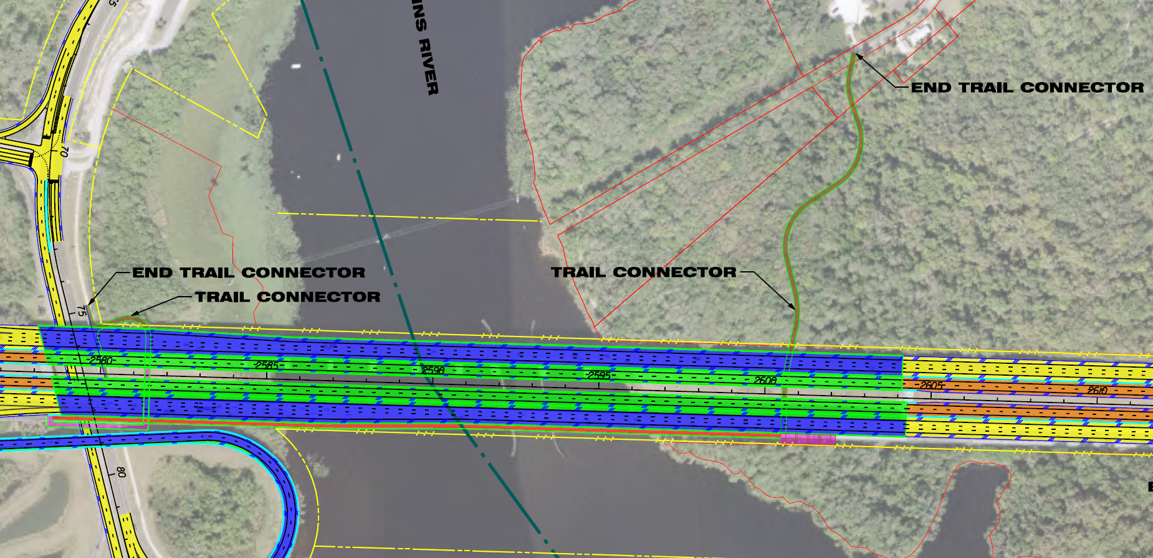
Alternative 1b
Construction: $2.5 million

Slide 9
Alternative 2
Proposed design
Potential connection
Lake Monroe Park
Wayside Park
Construction: $3.0 million

Slide 10
Alternative 2
6’-0” SHOULDER
12’-0” LANE
12’-0” LANE
10’-0” SHOULDER
1’-6”
10’-0” TRAIL
7’-0” SHOULDER
Design SSD = 425 ft.
Proposed SSD = 339 ft.
Diff = 86 ft.
EXISTING TYPICAL
PROPOSED TYPICAL
Construction: $3.0 million

Slide 11
Alternative 2
6’-0” SHOULDER
12’-0” LANE
12’-0” LANE
10’-0” SHOULDER
1’-6”
10’-0” TRAIL
7’-0” SHOULDER
SB Inside shoulder = 6’
SB Lanes = 11’ each
SB Outside Shoulder = 7.5’
Design SSD = 425 ft.
Proposed SSD = 339 ft.
Diff = 86 ft.
Construction: $3.0 million

Slide 12
Summary of Impacts | Two Phase Construction |  |  | One Phase Construction
 | Alt. 1 Interim 7’6” | Alt. 1a US 17/92 Signature Structure | Alt. 1b EB I-4 via Lane Shift | Alt. 2 Permanent 10’ on 17-92
Environmental Impacts | •None | •None | •Wetland impacts | •None
Pros | •Cost effective | •Signature Structure •12’ trail width | •Cost effective •Viewpoints • 14’ trail width | •Cost effective
Cons | •Reduced trail width (short term) •Reduced sight distance (short term) | •Cost prohibitive • Maintenance responsibility for local agency | •Trail adjacent to interstate traffic | •10’ trail width •Reduced vehicular sight distance (permanent) •Permanent shoulder reduction (permanent)
Construction Costs | $1.1 M + Alt 1a or Alt 1b | $6.8 M + Alt 1 ($7.9 M total) | $2.5 M + Alt 1 ($3.6 M total) | $3.0 M total

