Slide 1
River to Sea Transportation Planning Organization
Sea Level Rise
Vulnerability Assessment
Presentation to the CAC & TCC September 20, 2016

Slide 2
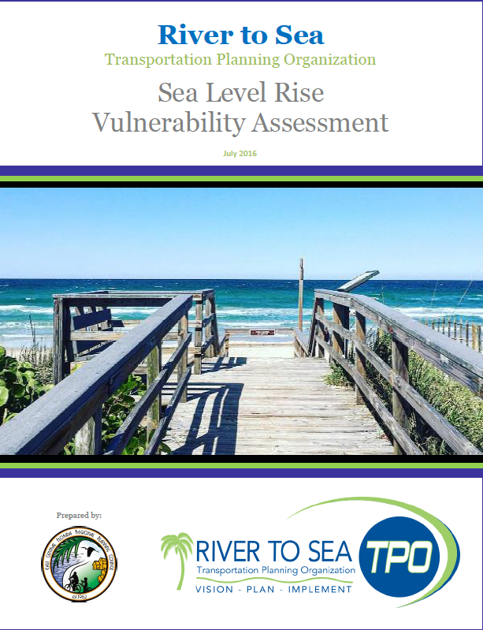
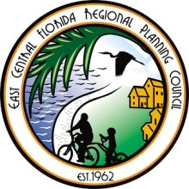
Importance to River to Sea TPO
Increased flooding of transportation infrastructure (tidal and heavy rainfall)
Loss of roadway capacity
Loss of evacuation routes
Degradation of infrastructure
Loss of access to/utilization of facilities (fleet fueling/storage; evac centers)
Compromised stormwater systems
Limited stormwater storage (ponds and groundwater)
Malfunctioning canals and drainage
Solutions and planning take time.

Slide 3
Areas of Analysis
Designated evacuation routes
Major roadway network
Fleet storage facilities
Public Works Facilities
Emergency Management Centers
Other storage facilities necessary for transportation or evacuation purposes
Sidewalks and Trails

Slide 4
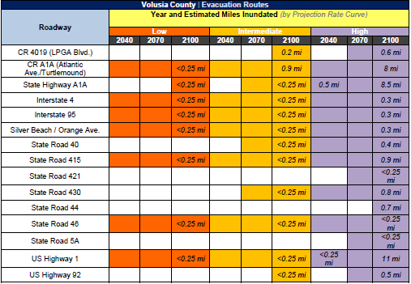
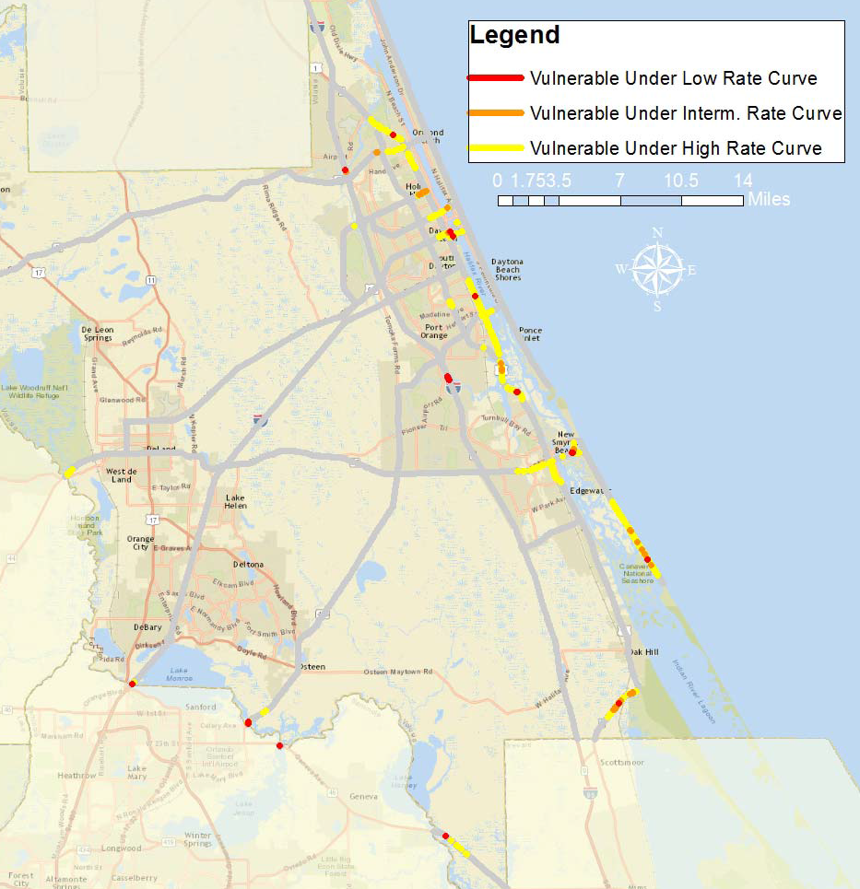

Slide 5
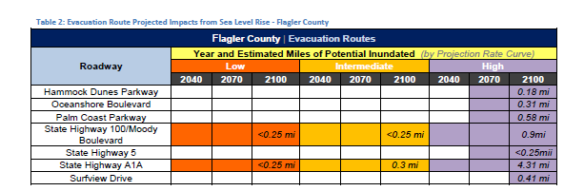
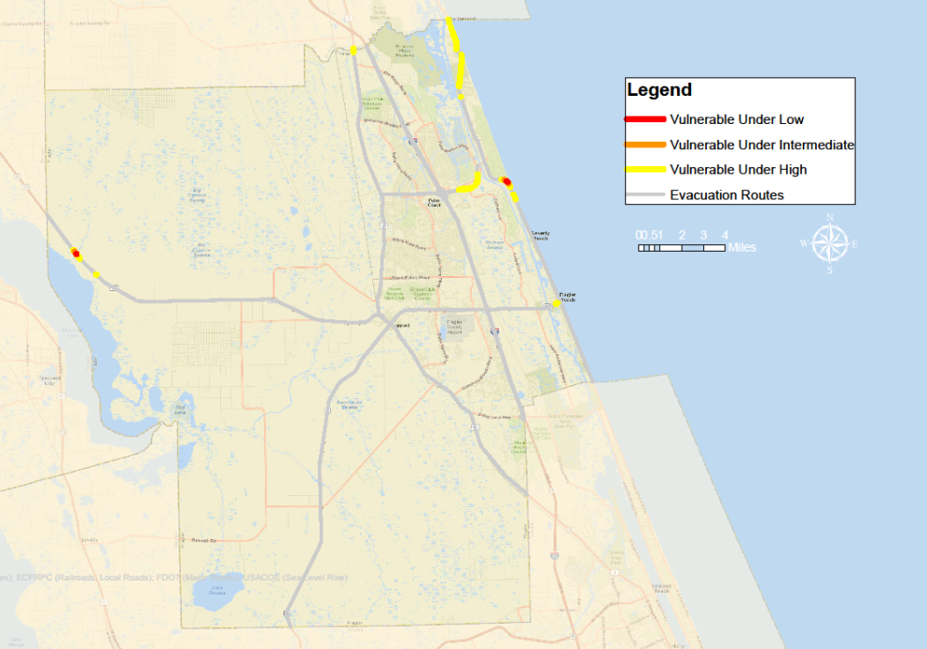

Slide 6
Contact Information: Tara McCue Tara@ecfrpc.org East Central Florida Regional Planning Council Stephan Harris SHarris@r2ctpo.org River to Sea TPO
Next Steps
Adopt a standard for modeling the impacts of sea level rise
Incorporate transportation system resiliency and reliability into TPO plans and priorities
Continue to assess impacts to include storm surge

