Slide 1
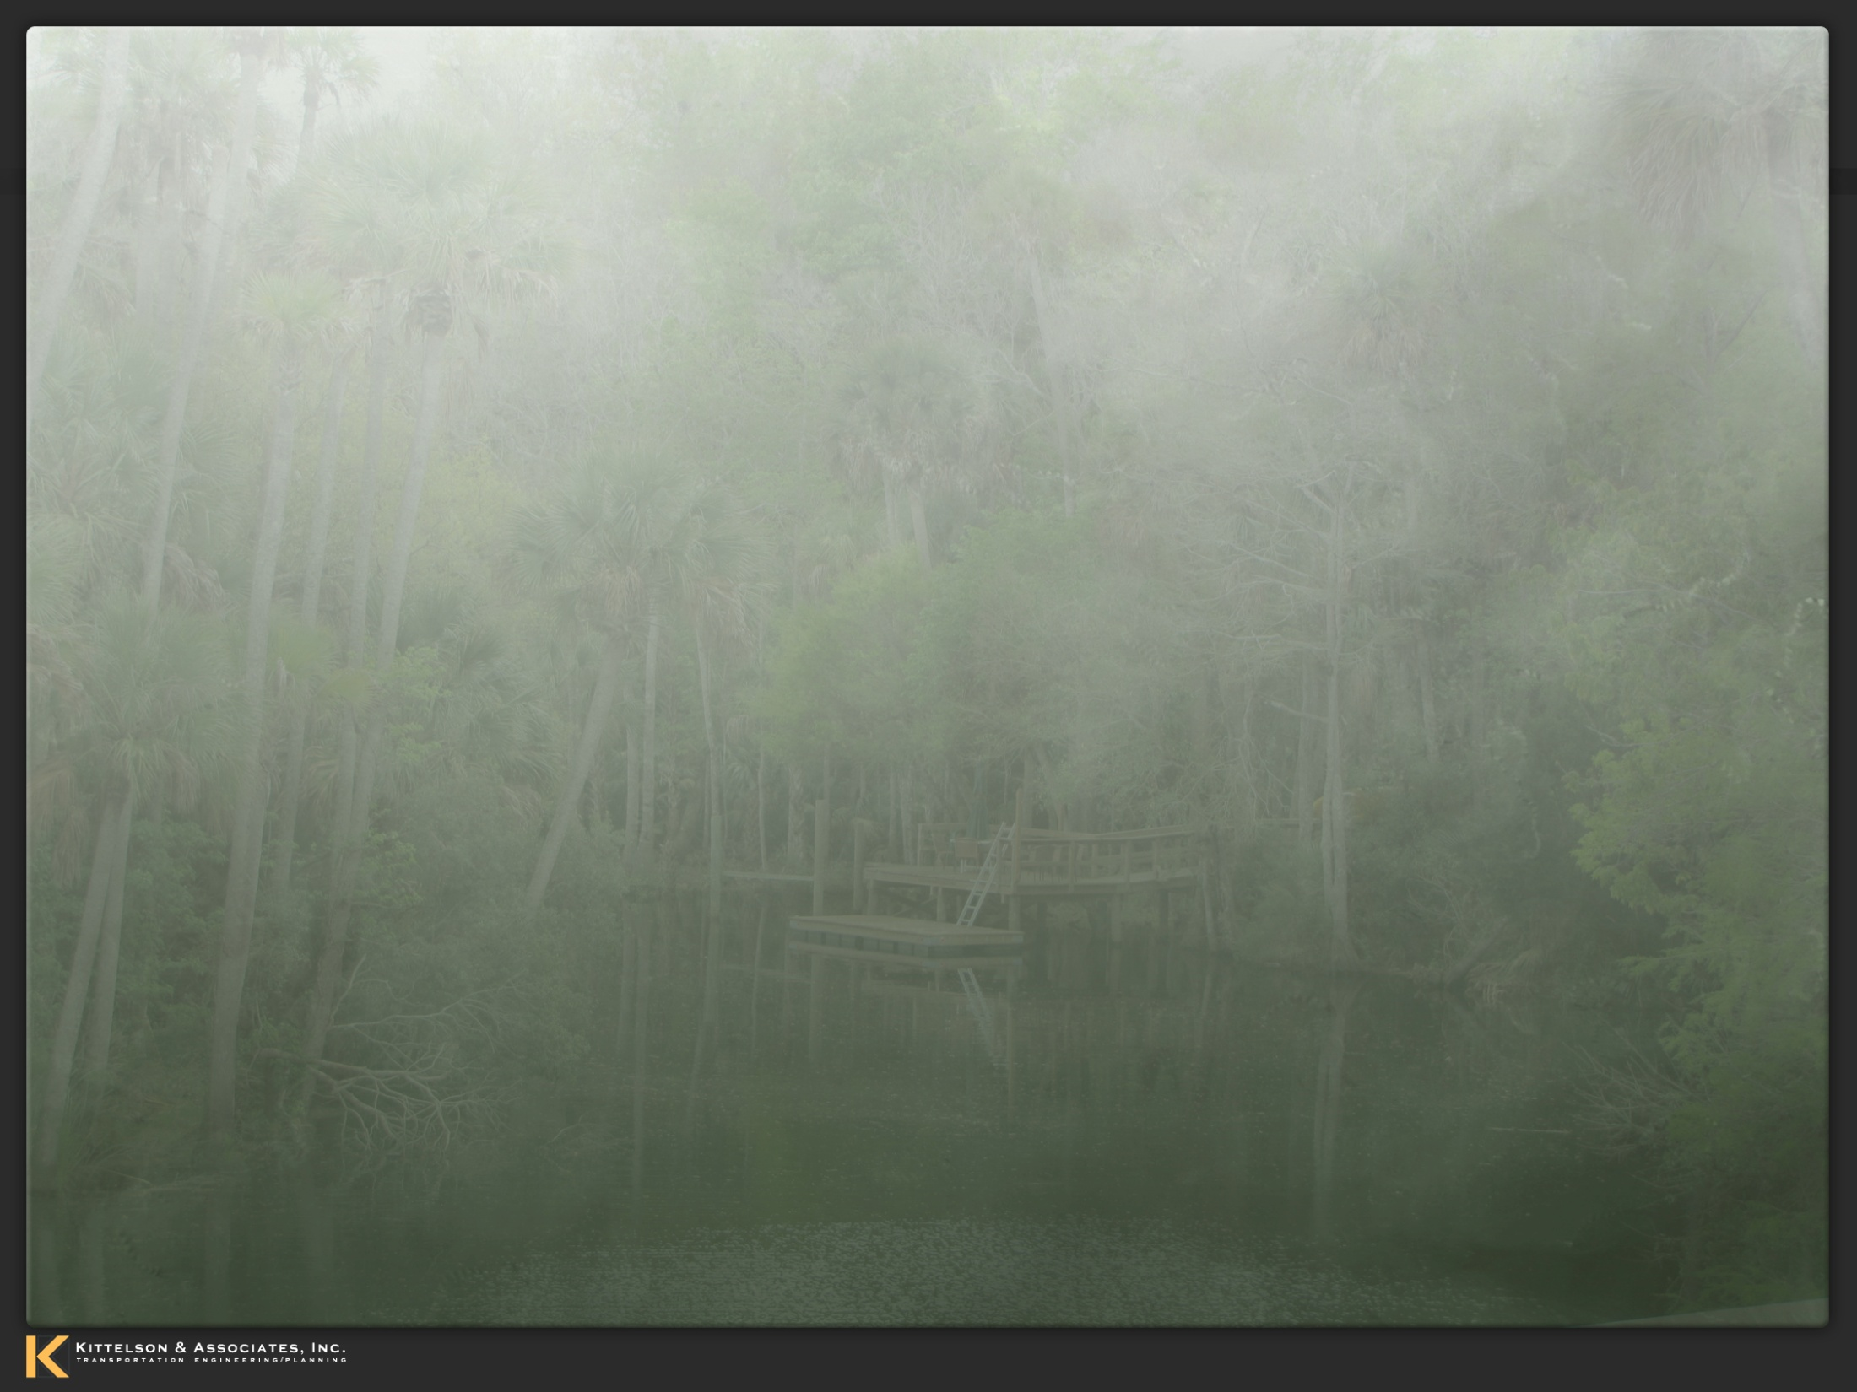
SR 40 Project Development and Environment Study
SR 40 from Breakaway Trail to Williamson Boulevard
Volusia Transportation Planning Organization BPAC Project Update
Wednesday, June 12, 2013
Notes:
1
1

Slide 2
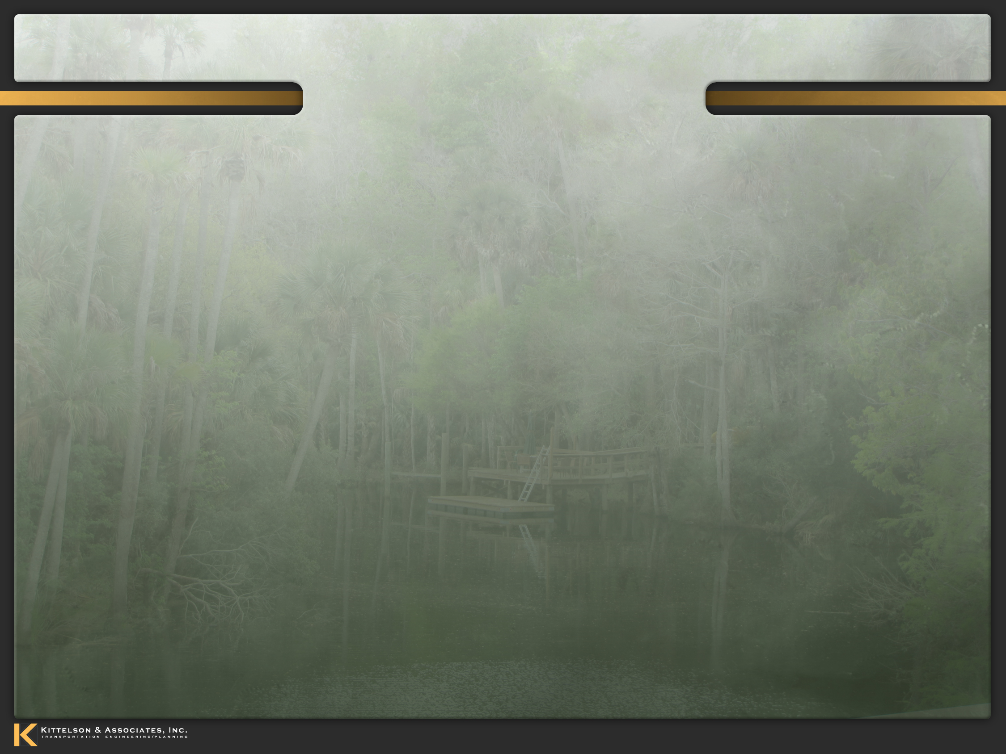
Presentation Outline
PD&E Study Process
Project Overview
Proposed Alternatives & Evaluation
Schedule
Contact Information

Slide 3
PD&E Study Process
Establish Purpose
& Need
Public Involvement
ETDM
Summary
Report
Engineering Analysis
Public
Hearing
Data
Collection
Traffic
Analysis
Concept Development and Evaluation
Concept Refinement
PDSR / SEIR
Environmental Analysis
Approval

Slide 4
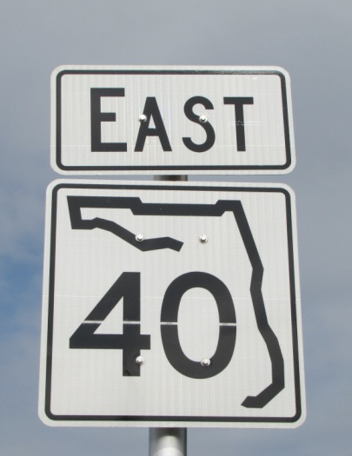
Project Overview
Breakaway Trail to Williamson Boulevard
Approximately 2 miles
4 to 6 Lane Widening
Enhanced Bicycle and Pedestrian Facilities
State Environmental Impact Report
No Federal Funds
PD&E Complete Fall 2013
No Future Phases Currently Programmed

Slide 5
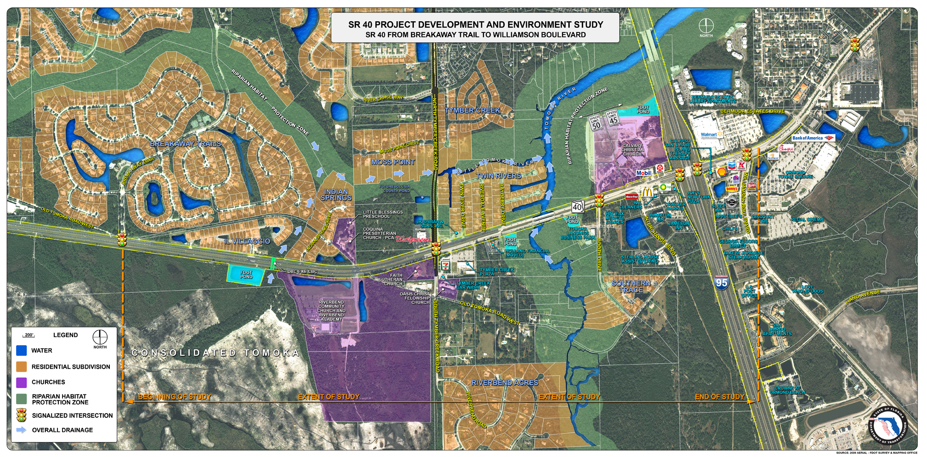
Project Overview

Slide 6
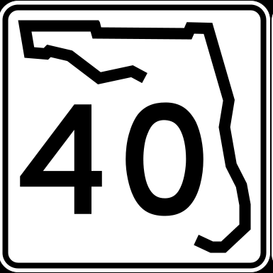
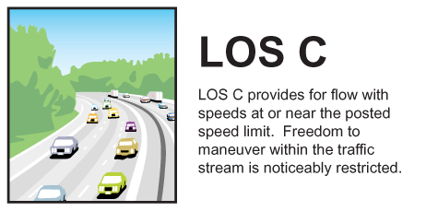
Purpose and Need
Principal Arterial
- Regional Transportation Facility
Emerging Strategic Intermodal System (SIS) Facility
- Maintain Level of Service “C”
Designated Hurricane Evacuation Route
Freight Goods & Movement Along Corridor from I-95 to I-75

Slide 7
Purpose and Need
Ongoing Projects
SR 40 Widening Plans West of Breakaway Trail
- 4-Lanes from US 17 to SR 11 / Design 2014
- 4-Lanes from SR 11 to Cone Road / Design (On-going)
Resurfacing SR 40
- Tymber Creek Road to Perrott Drive / Construction 2013-2014
Widening Plans for Tymber Creek Road (SR 40 to Airport Road)
- Constructed in 2 Phases
- South of SR 40 to North of Peruvian Lane
- Construction On-going 2012 / 2013
PD&E Study Approved – 2 to 4 Lane Widening
SR 326 (Marion County) to US 17 (Volusia County)

Slide 8
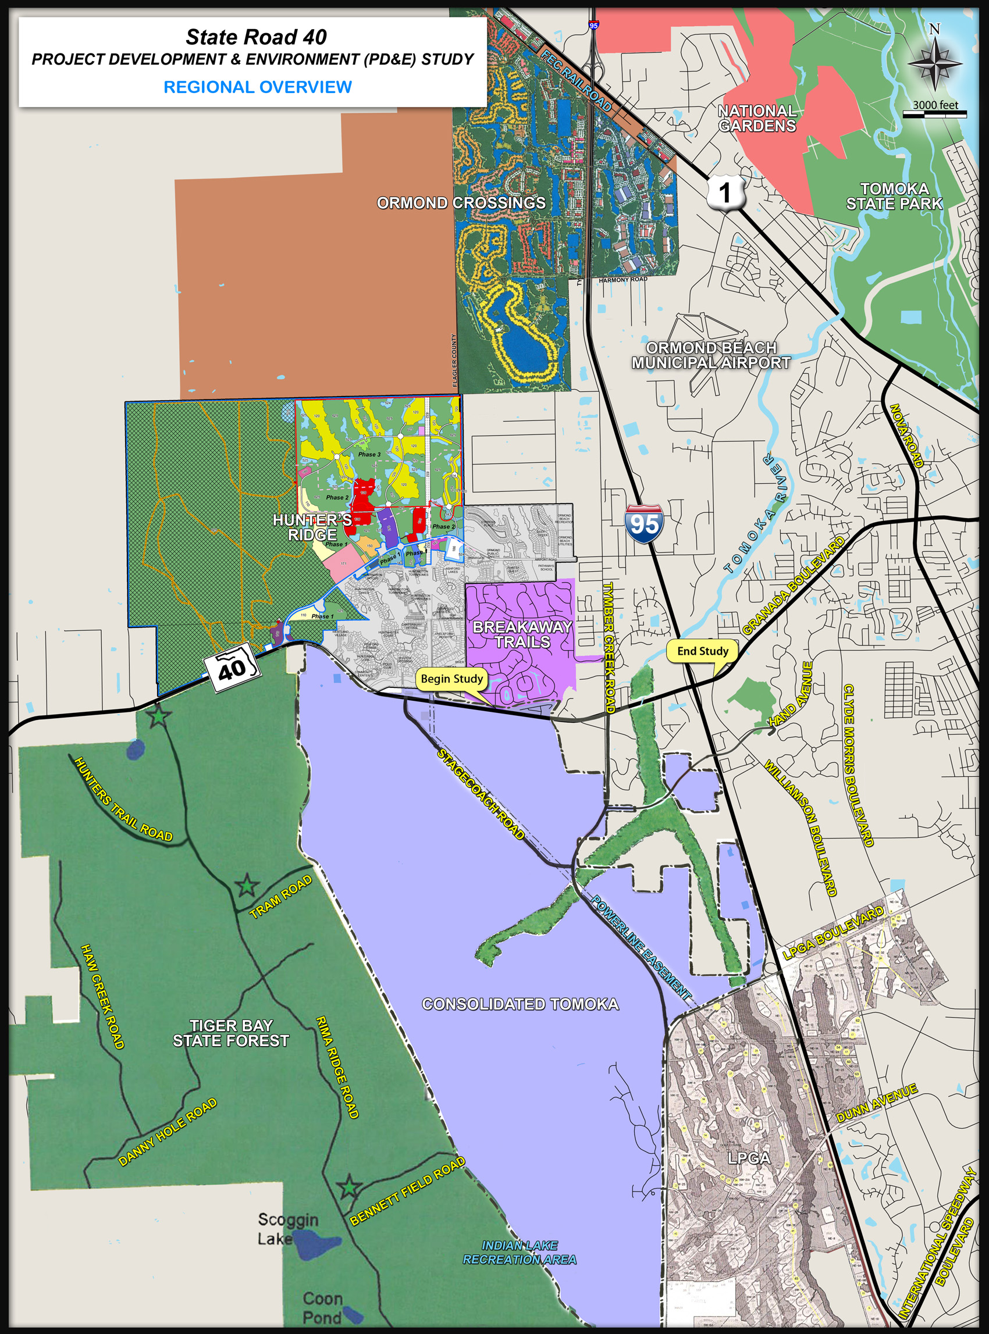
Purpose and Need
Future Development
Consolidated Tomoka - Daytona Beach
Hunter’s Ridge DRI - Ormond Beach & Flagler County
Ormond Crossings - Ormond Beach & Flagler County
County Thoroughfare Plan
Tymber Creek Road Extension

Slide 9
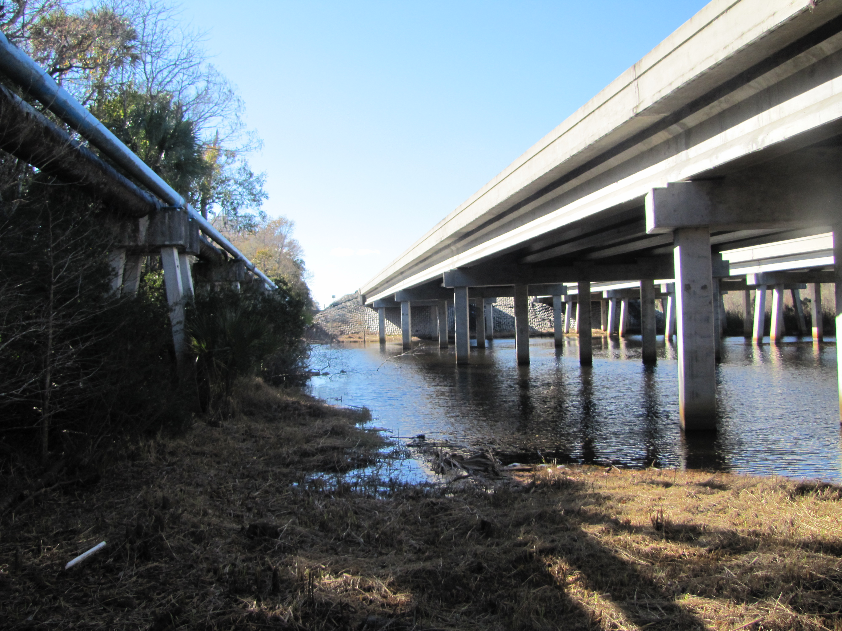
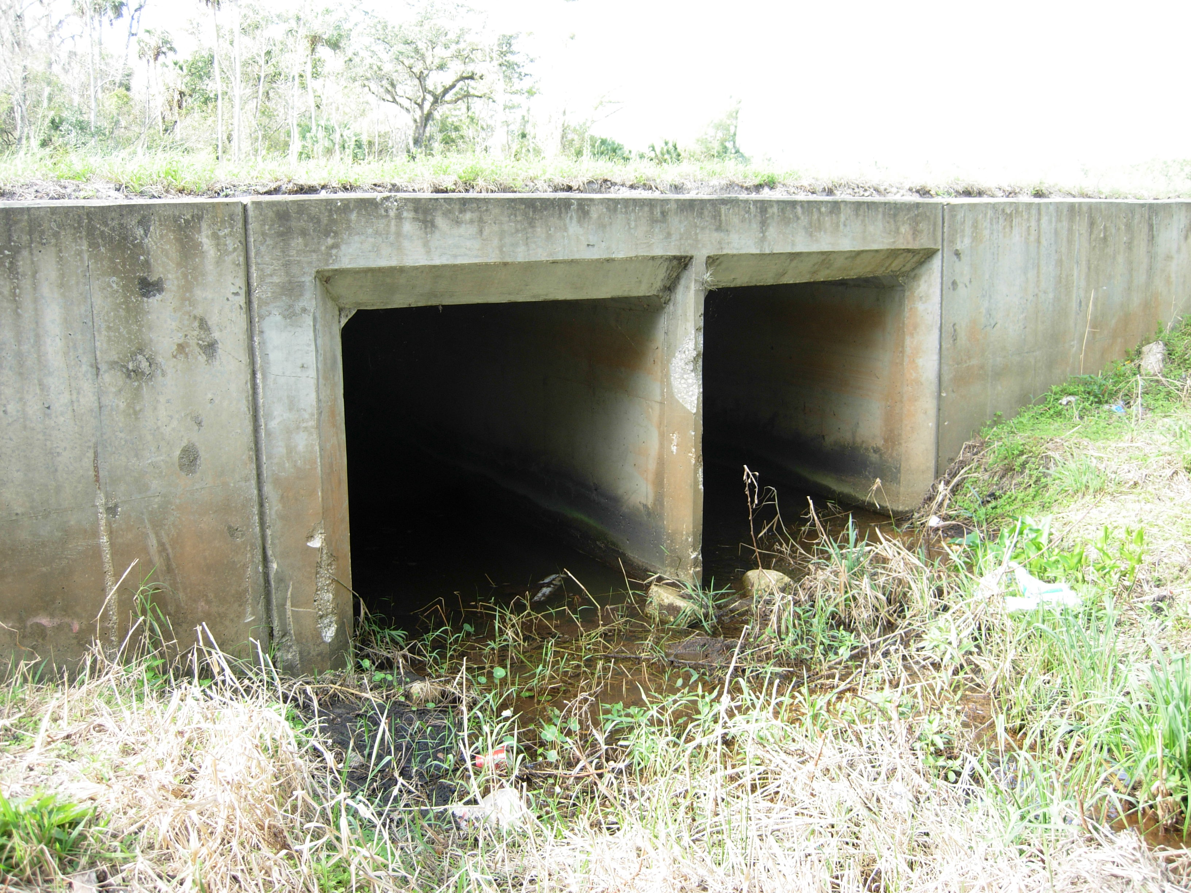
Engineering Analysis
Traffic Projections
Roadway Concepts
Widen Inside or Outside?
Intersections
Bridge over Tomoka River
Access Management Considerations
Traffic Operations / Safety
Enhanced Bike / Pedestrian Facilities
Stormwater Management
Right of Way

Slide 10
Future Traffic Demand – SR 40 4 Lanes
(No-Build)
29,700 / D
45,900 / E
57,500 / F
North
I-95
Breakaway Trail
23,400 / C
42,900 / E
54,200 / F
11,800 / B
32,700 / C
47,700 / D
Tymber Creek Rd
17,500 / C
28,300 / C
36,000 / C
SR 40
Williamson Blvd
By 2025
LOS ‘E’ east of Tymber Creek Rd.
By 2035
LOS ‘D’ from Breakaway Trail to
Tymber Creek Rd.
Legend
11,800/C – Daily Volume/Level of Service
0 – Existing
0 – SR 40 4-laned (2025)
0 – SR 40 4-laned (2035)

Slide 11
Future Traffic Demand – SR 40 6 Lanes
(Build Alternative)
50,900 / D
66,000 / D
North
Breakaway Trail
48,500 / C
63,900 / C
I-95
34,600 / B
50,800 / B
Tymber Creek Rd
30,000 / B
39,000 / B
SR 40
Williamson Blvd
2035
LOS ‘B’ Breakaway Trail to Tymber Creek Rd.
LOS ‘C’ Tymber Creek Rd. to I-95
LOS ‘D’ from I-95 to Williamson Blvd.
Legend
11,800/C – Daily Volume/Level of Service
0 – SR 40 6-laned (2025)
0 – SR 40 6-laned (2035)

Slide 12
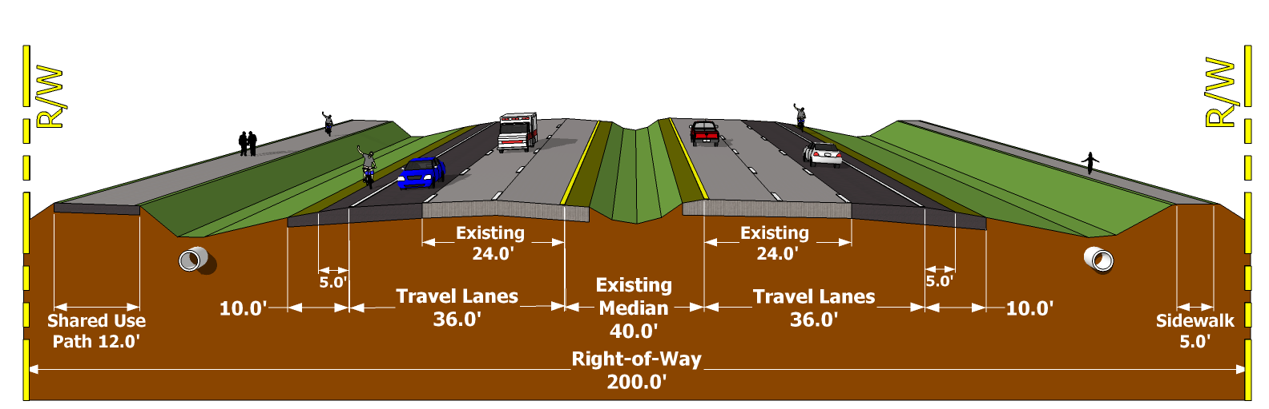
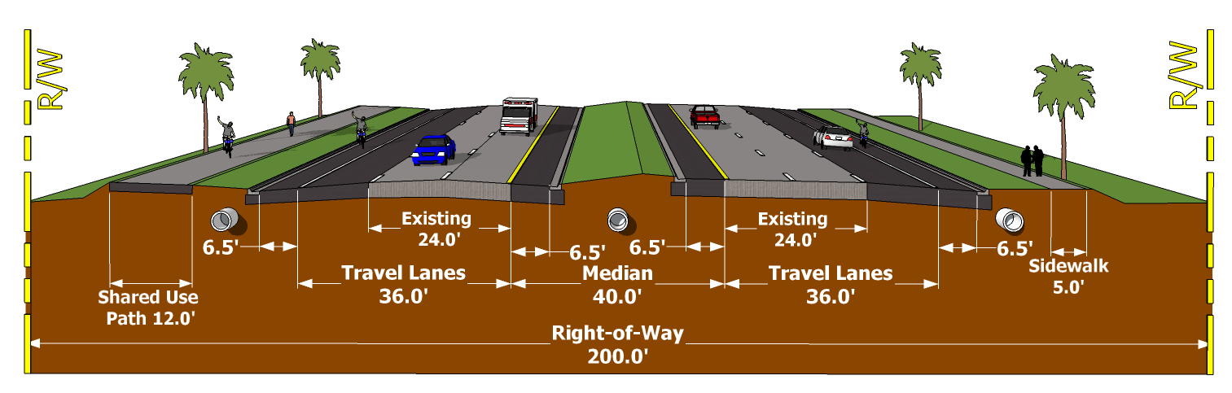
Roadway Concepts – Breakaway Trail to Tymber Creek Road
Rural Typical Section with Wide Median (50 mph Design Speed)
High Speed Urban Typical Section (50 mph Design Speed)

Slide 13
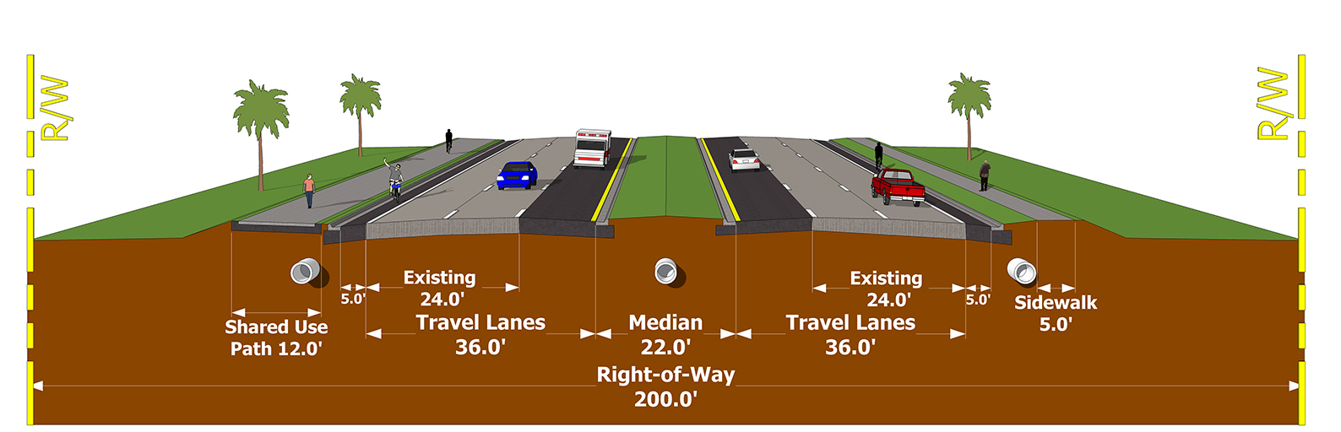
Roadway Concepts – Tymber Creek Road to I-95
High Speed Urban Typical Section (50 mph Design Speed)
Urban Typical Section (45 mph Design Speed)

Slide 14
Tomoka River Bridge Typical Sections
High Speed Suburban Typical Section (50 mph Design Speed)
Urban Typical Section (45 mph Design Speed)

Slide 15
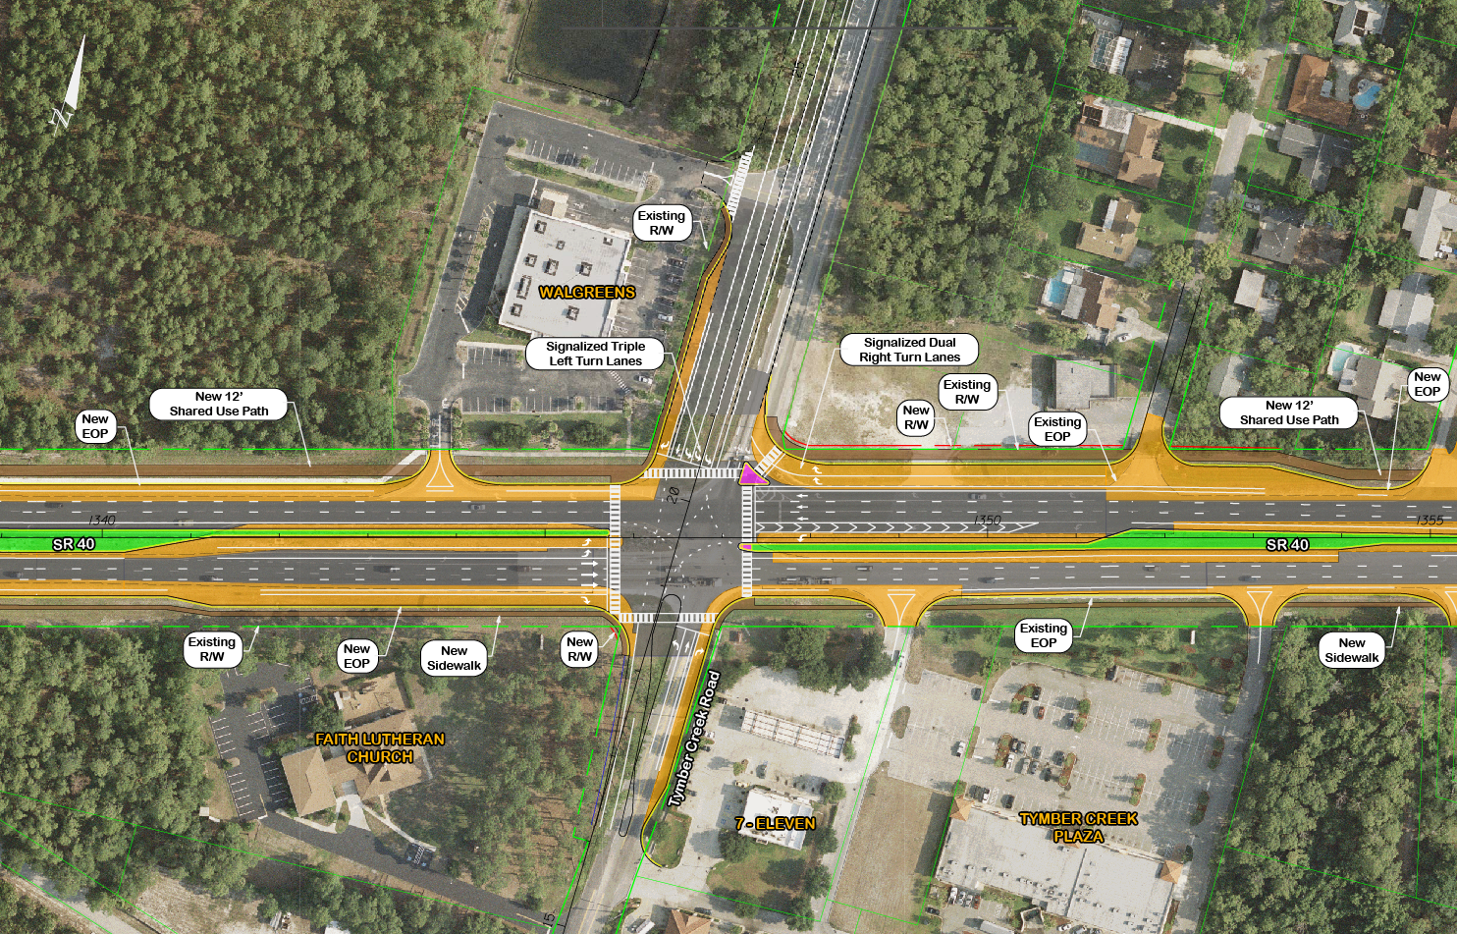
Tymber Creek Intersection

Slide 16
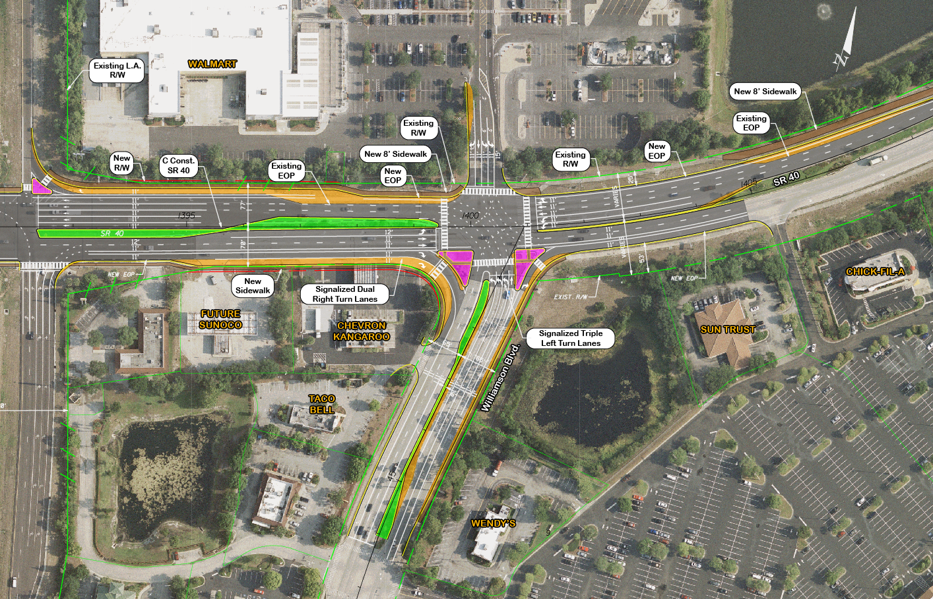
Williamson Intersection

Slide 17
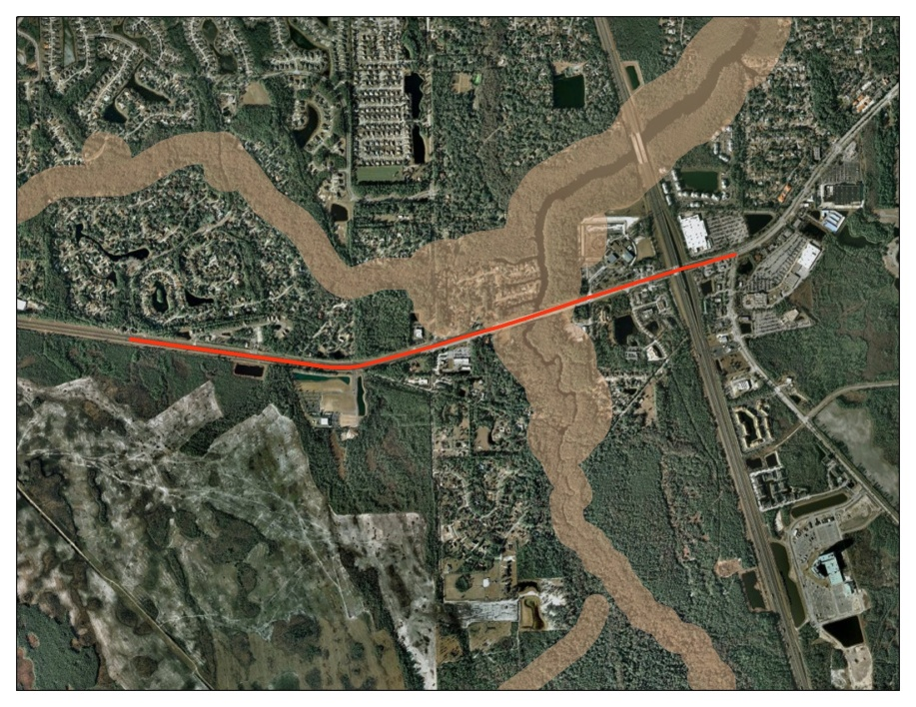
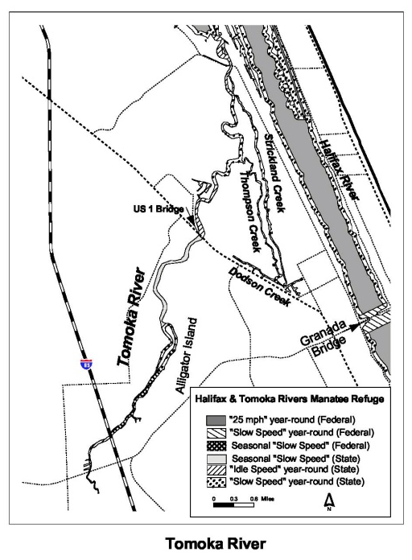
Environmental Evaluations
Wetlands & Wildlife
Riparian Habitat Protection Zone
Cultural & Historic Resources
Floodplains
Noise Impacts
Contamination
Secondary & Cumulative Impacts
Others

Slide 18
Roadway Alternatives Description

Slide 19
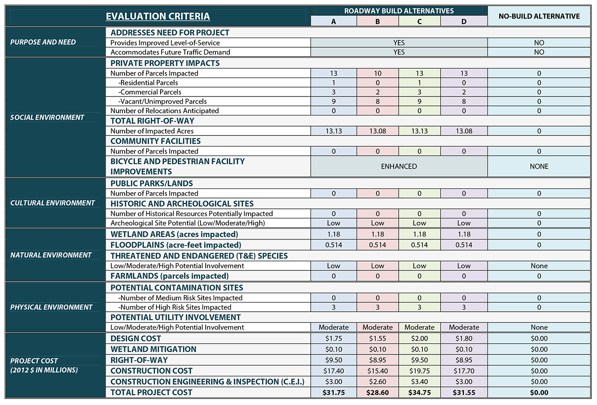
Comparative Evaluation Matrix

Slide 20
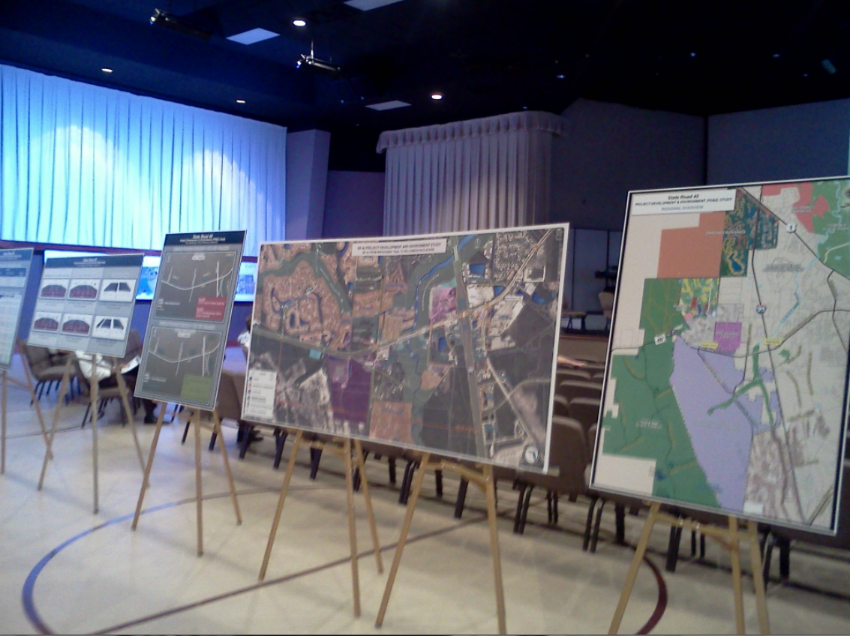
Recommended Preferred Alternative
Engineering Analysis
Right-of-way (ROW) mostly for ponds
Roadway widening is within existing ROW
All Alternatives have enhanced pedestrian and bicycle facilities
Alternative “B” is least costly
Traffic Operations same for all alternatives
Alternatives “B” & “D” reduce posted speed
Tymber Creek Road to I-95 (50 MPH to 45 MPH)

Slide 21
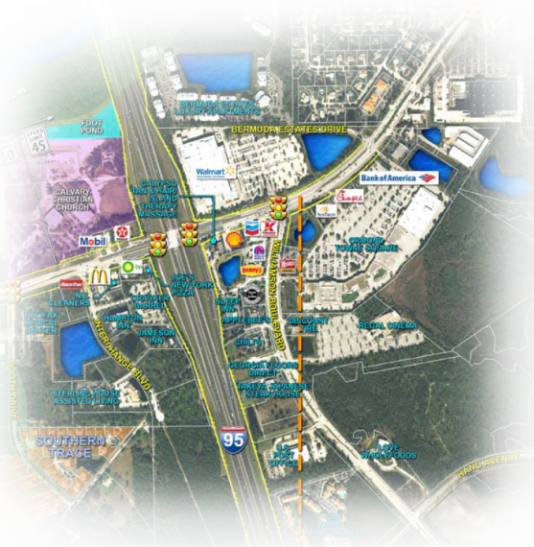
Recommended Preferred Alternative
Environmental Analysis
Social Impacts
Alternatives “B” & “D” fewest parcels
Cultural Environment
All Alternatives no impact
Natural Environment
Wetland & floodplain impacts similar for all Alternatives
Physical Environment
Similar impacts for all Alternatives
Evaluated Noise Impacts at four (4) locations
None reasonable for Noise Barriers

Slide 22
Recommended Preferred Alternative
Selection
Alternative “B”
10% lower cost than next closest Alternative
$28.6 Million
Accommodates future traffic
Meets Purpose & Need
Minimal Environmental Impacts

Slide 23
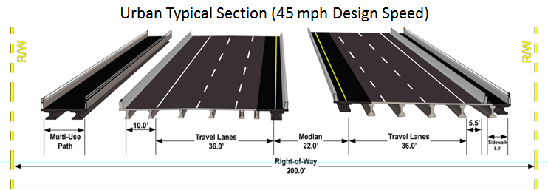
Recommended Preferred Alternative

Slide 24
Public Involvement / Outreach
Project Website
StateRoad40.com
Study Schedule / Contact Information / Public Involvement / Study Materials
Presentations to Volusia TPO
Public Hearing
Tuesday, June 25th at 5:00 pm
Riverbend Community Church on State Road 40

Slide 25
Schedule
May ’11 July Sep Nov Jan ’12 Mar May July Sep Nov Jan’13 Mar May July Aug
Data Collection Traffic Analysis Engineering Analysis Environmental Evaluations Public Meetings / Hearing Finalize Project Concepts Documentation Study Approval
We are here

Slide 26
Contact Information
Mary McGehee
719 S. Woodland Boulevard
DeLand, Florida 32720
386-943-5063
Mary.McGehee@dot.state.fl.us.com

Slide 27
Contact Information
John R. Freeman, Jr.
225 E. Robinson Street, Suite 450
Orlando, FL 32801
407-540-0555
1-866-286-2254
jfreeman@kittelson.com

