Slide 1
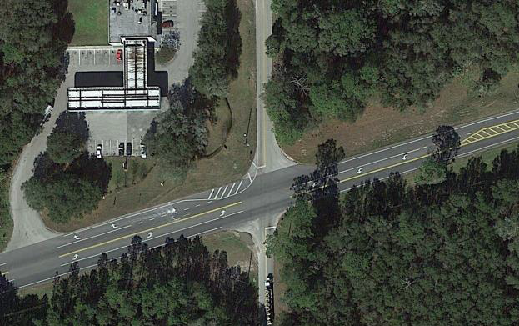
SR 44 at Grand Avenue
Volusia County, FL
River to Sea CAC/TCC Meetings
May 17, 2016

Slide 2
Agenda
Overview of Existing Conditions
Roundabout vs Signal Comparison
  Operations
  Safety
  Other Considerations
  Benefit-Cost
Overview of Current Concept
Next Steps

Slide 3
Existing Intersection Configuration
Grand Ave
SR 44
BP Gas Station

Slide 4
2014 Annual Average Daily Traffic
4
2,300
AADT
9,800
AADT
1,000
AADT

Slide 5
Existing Peak Hour Level-of-Service
5
C
C
C
E
AM
PM

Slide 6
Crash Summary
Year | 2010 | 2011 | 2012 | 2013 | 2014 | Jan-June 2015 | Total
Total Crashes | 1 | 3 | 5 | 9 | 3 | 9 | 30
Injury Crashes | 1 | 2 | 3 | 5 | 2 | 5 | 18
Fatal Crashes |  |  |  | 1 |  |  | 1*
*Additional fatal crash in 2016
Crash Statistics
  63% of crashes resulted in injury/fatality
  97% during dry conditions
  70% daytime / 30% nighttime
73% are angle crashes (22 of 30 crashes)

Slide 7
Operational Alternatives Comparison
Traffic Signal
Roundabout
LOS B in opening year
LOS C through 2035
NB & SB left-turn lanes needed
LOS A in opening year
LOS C through 2035
Single-lane allows up to 5% annual growth through 2035.
Intersection speed <25 mph

Slide 8
Safety Alternatives Comparison
Traffic Signal
Roundabout
Expected Crash Reductions
  13% Total
  41% Injury
Reduce angle crashes
May increase rear-end
Higher speeds:
  more severe crashes
Expected Crash Reductions
  71% Total
  87% Injury
Fewer conflict points
Slower speeds:
  increase reaction time
  reduce severe crashes
FHWA Proven Safety Countermeasure

Slide 9
Vehicle Conflict Points: REDUCED
Crossing conflicts eliminated
at roundabout
Merging
Diverging
Crossing
NCHRP Report 672, Exhibit 5-2

Slide 10
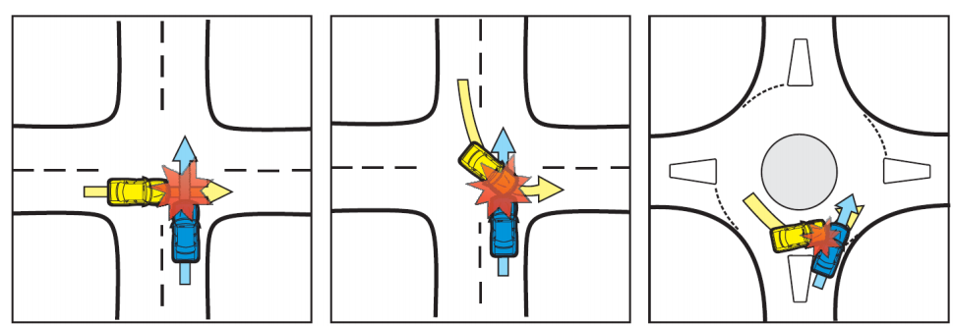
Severity of Conflicts: REDUCED
Severity is related to relative velocities of conflicting streams
Kansas Roundabout Guide, Second Edition

Slide 11
Monetized Safety Benefits
Crash reductions converted to monetary benefit
  Crash costs tied to severity (PDO, Injury, Fatality)
Roundabout vs Existing Stop Control
  $8 million in crash reduction benefits
Roundabout vs Signal
  $4.4 million in additional crash reduction benefit for roundabout compared to signal

Slide 12
Other Considerations
Design vehicles for both options include:
  Tractor-trailer trucks (WB-62FL with 53’ trailer)
  Buses
  Vehicles with boat trailers
  Emergency vehicles
Both options stay within existing right-of-way
Both maintain access to gas station

Slide 13
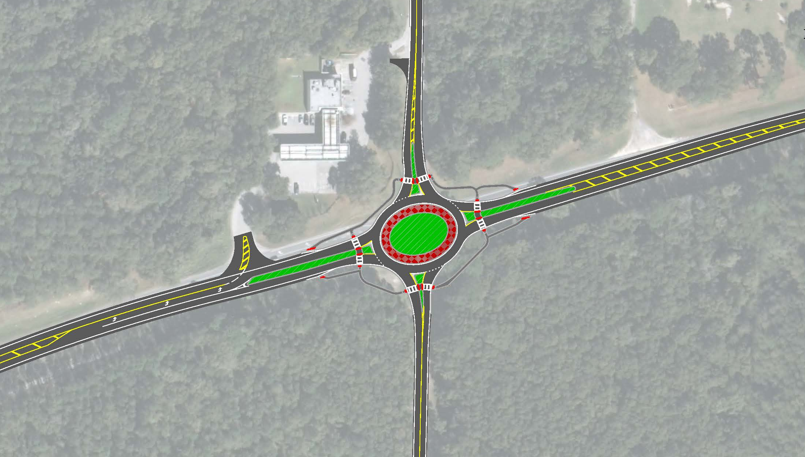
Proposed Roundabout

Slide 14
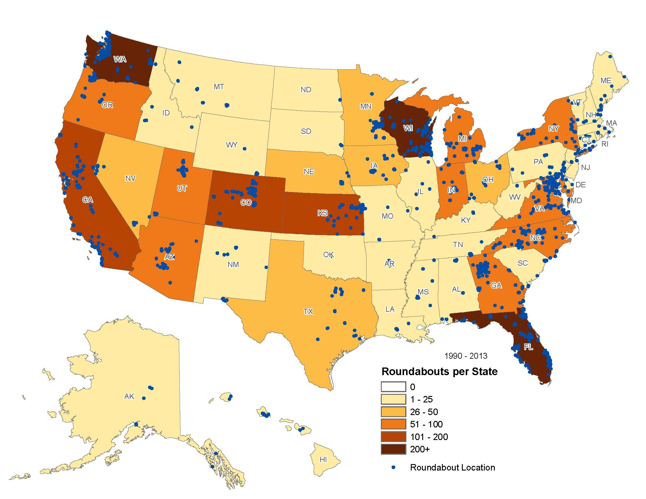
Over 25 Years of US Experience With Roundabouts
Source: Rodegerdts, L. A., “Status of Roundabouts in North America”, TRB 4th International Conference on Roundabouts, Seattle, WA, April 2014.

Slide 15
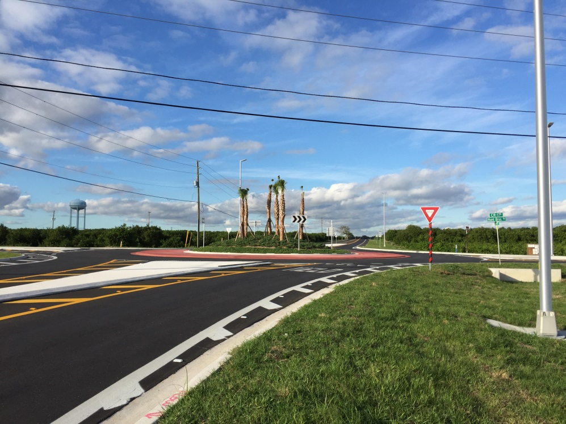
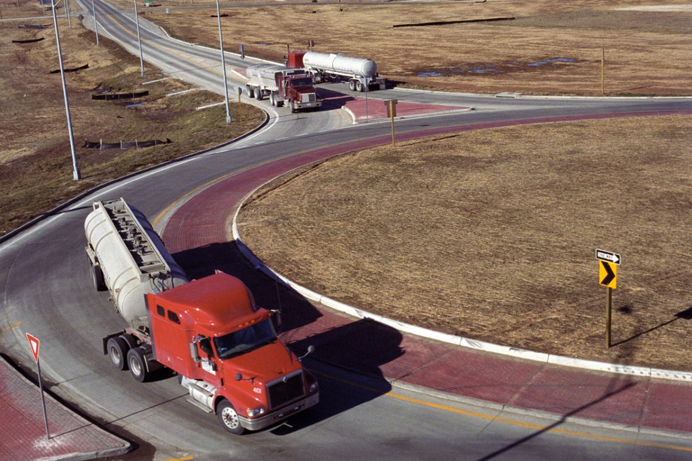
Roundabouts in Rural Environments
Proven safety benefits at rural intersections
Proven truck accommodation
Proven compatibility with high speed roadways
  Additional considerations to transition speeds

Slide 16
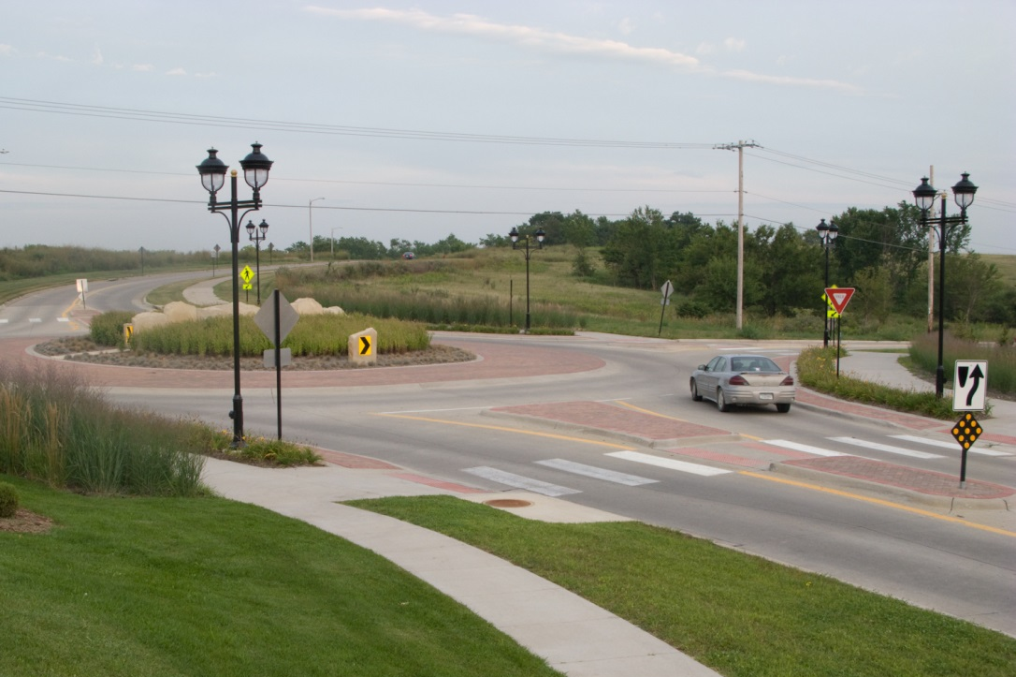
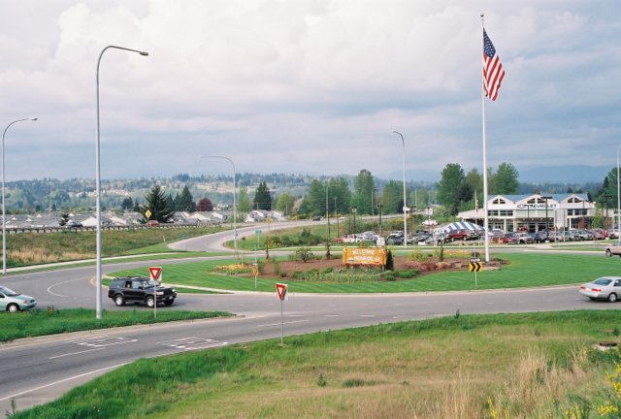
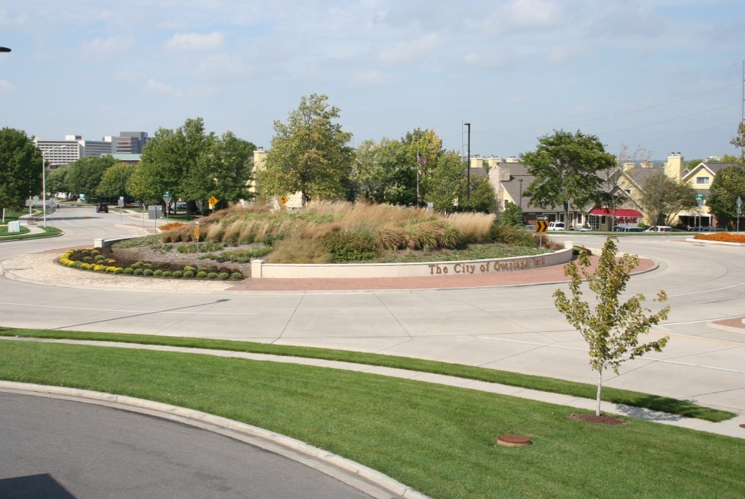
Aesthetic/Gateway Opportunities

Slide 17
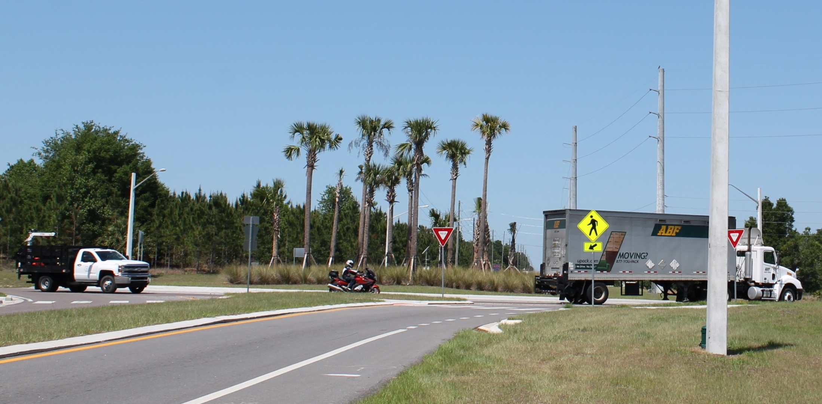
CR 561 at CR 455 (Lake County)

Slide 18
CR 561 at CR 455 (Lake County)
According to Lake County Public Information:
From 2002-2012
  32 Crashes
  2 Fatalities
  3.2 crashes per year
Since Roundabout Opened (June 2015)
  No crashes

Slide 19
Next Steps
Process
  Design-Build currently advertised
Cost
  $1,350,000 budgeted
Schedule
  250 Calendar Days
  June 17, 2016 Estimated Notice-To-Proceed

Slide 20
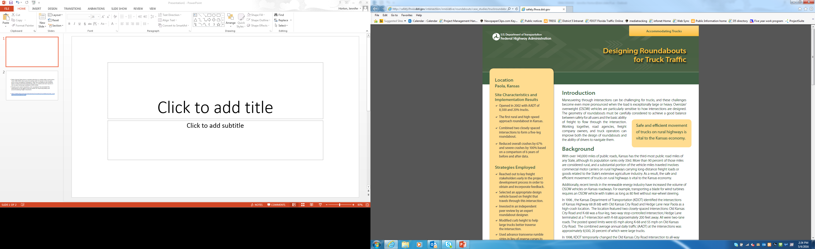
Paola Kansas
1995-2000
  33 crashes
  42 injuries
2002 – Roundabout
opened
  Annual average daily
  traffic 8,500
  20% truck traffic
2003-2008
  11 crashes (67 % reduction)
  ZERO injuries (100% reduction)
“Despite some initial trepidation, the roundabout has exceeded the expectations of the agency and the public for improving safety and accommodating freight movement.”

