Slide 1
Regional Trails Corridor Assessment
River to Sea TPO – TCC/CAC Briefing
September 16, 2014

Slide 2
Presentation Outline
Project Overview
Study Limits
Project Goals
Stakeholder Outreach
Stakeholder Contact List
Stakeholder Workshops
Small Group Meetings
Deliverables and Outcomes
Schedule
What we are working on now
Next Steps

Slide 3
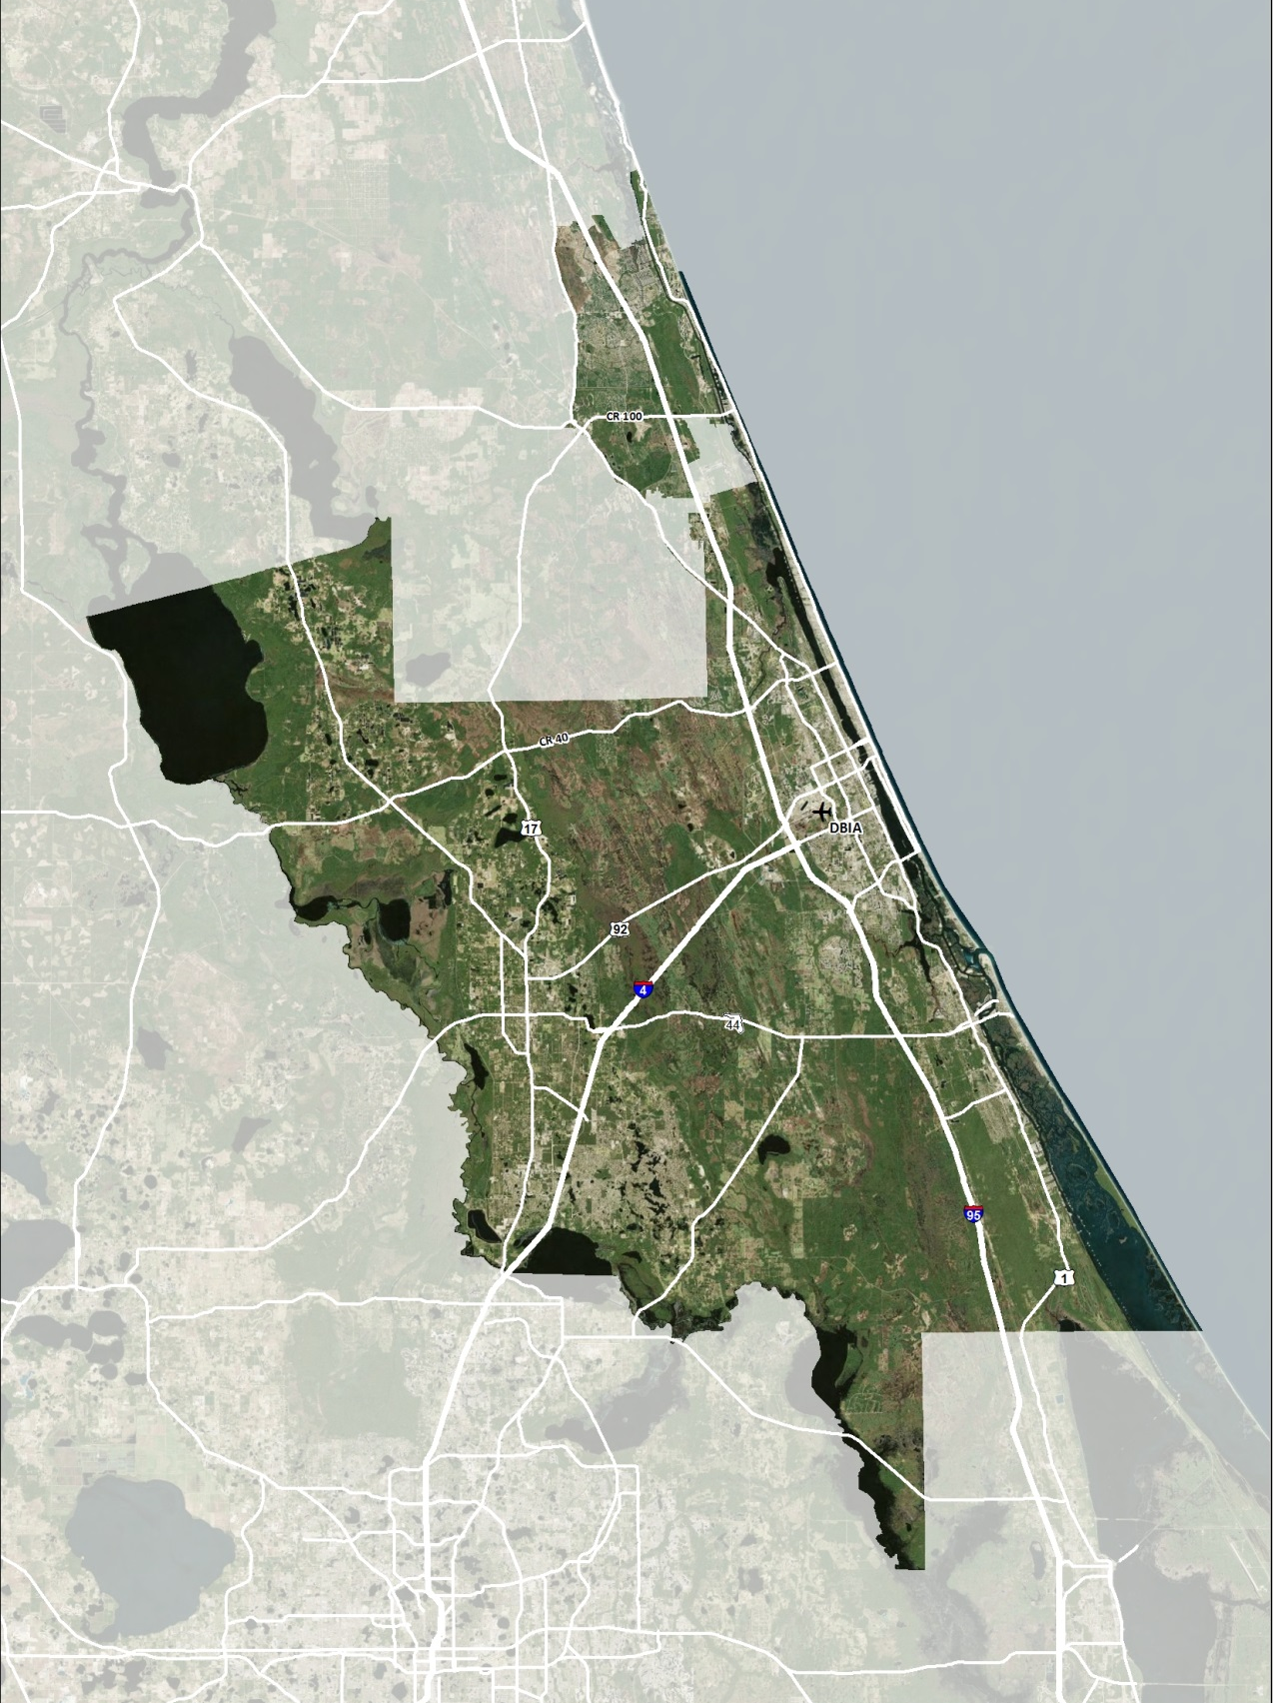
Study Limits – Which Trails are Included?
All paved, regional multi-use trails within the TPO study area.
NO:
Unpaved trails
Sidewalks

Slide 4
Study Limits

Slide 5
Project Goals
Complete the regional trails network in the TPO Planning Area and advance the Florida Greenways and Trails System Plan by developing/finalizing alignments and connections.
Understand/inventory where there are existing trail gaps and determine the feasibility of alignments.
Complete assessments and develop conceptual plans and cost estimates for all gap segments in order to compete for funding.
Trail improvements will NOT be prioritized as a part of this study.

Slide 6
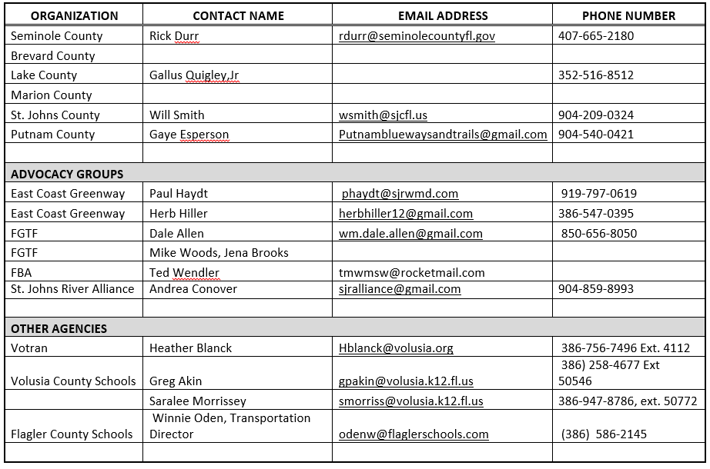
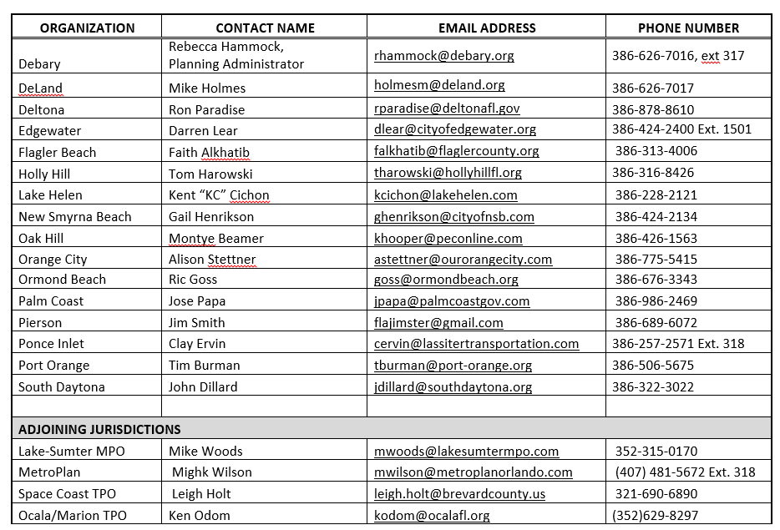
Stakeholder Outreach – Contact List

Slide 7
Stakeholder Outreach – Workshops
Two stakeholder workshops planned
Workshop #1:
Purpose:
Present overview of study and data collection efforts for entire study area to date;
Discuss goals/format for small group meetings
Solicit input from attendees
Date: September 29, 2014 (5-7PM)
Location: Daytona State College – Bergengren Hall (Bldg. 110)
Format: PPT presentation + Boards
Workshop #2 will occur later in the study to present an overview of findings and recommendations

Slide 8
Stakeholder Outreach – Small Group Meetings
Two rounds of small group meetings
Round 1: Shortly after Workshop #1. Will precede detailed field work and concept planning.
Round 2: After draft concept plans are developed
Purpose:
Focus on specific segments in smaller “breakout” sections of the study area.
Confirm stakeholder goals/requirements/conflicts for each segment
Gather sufficient info to focus field work and concept development
10-15 participants per meeting

Slide 9
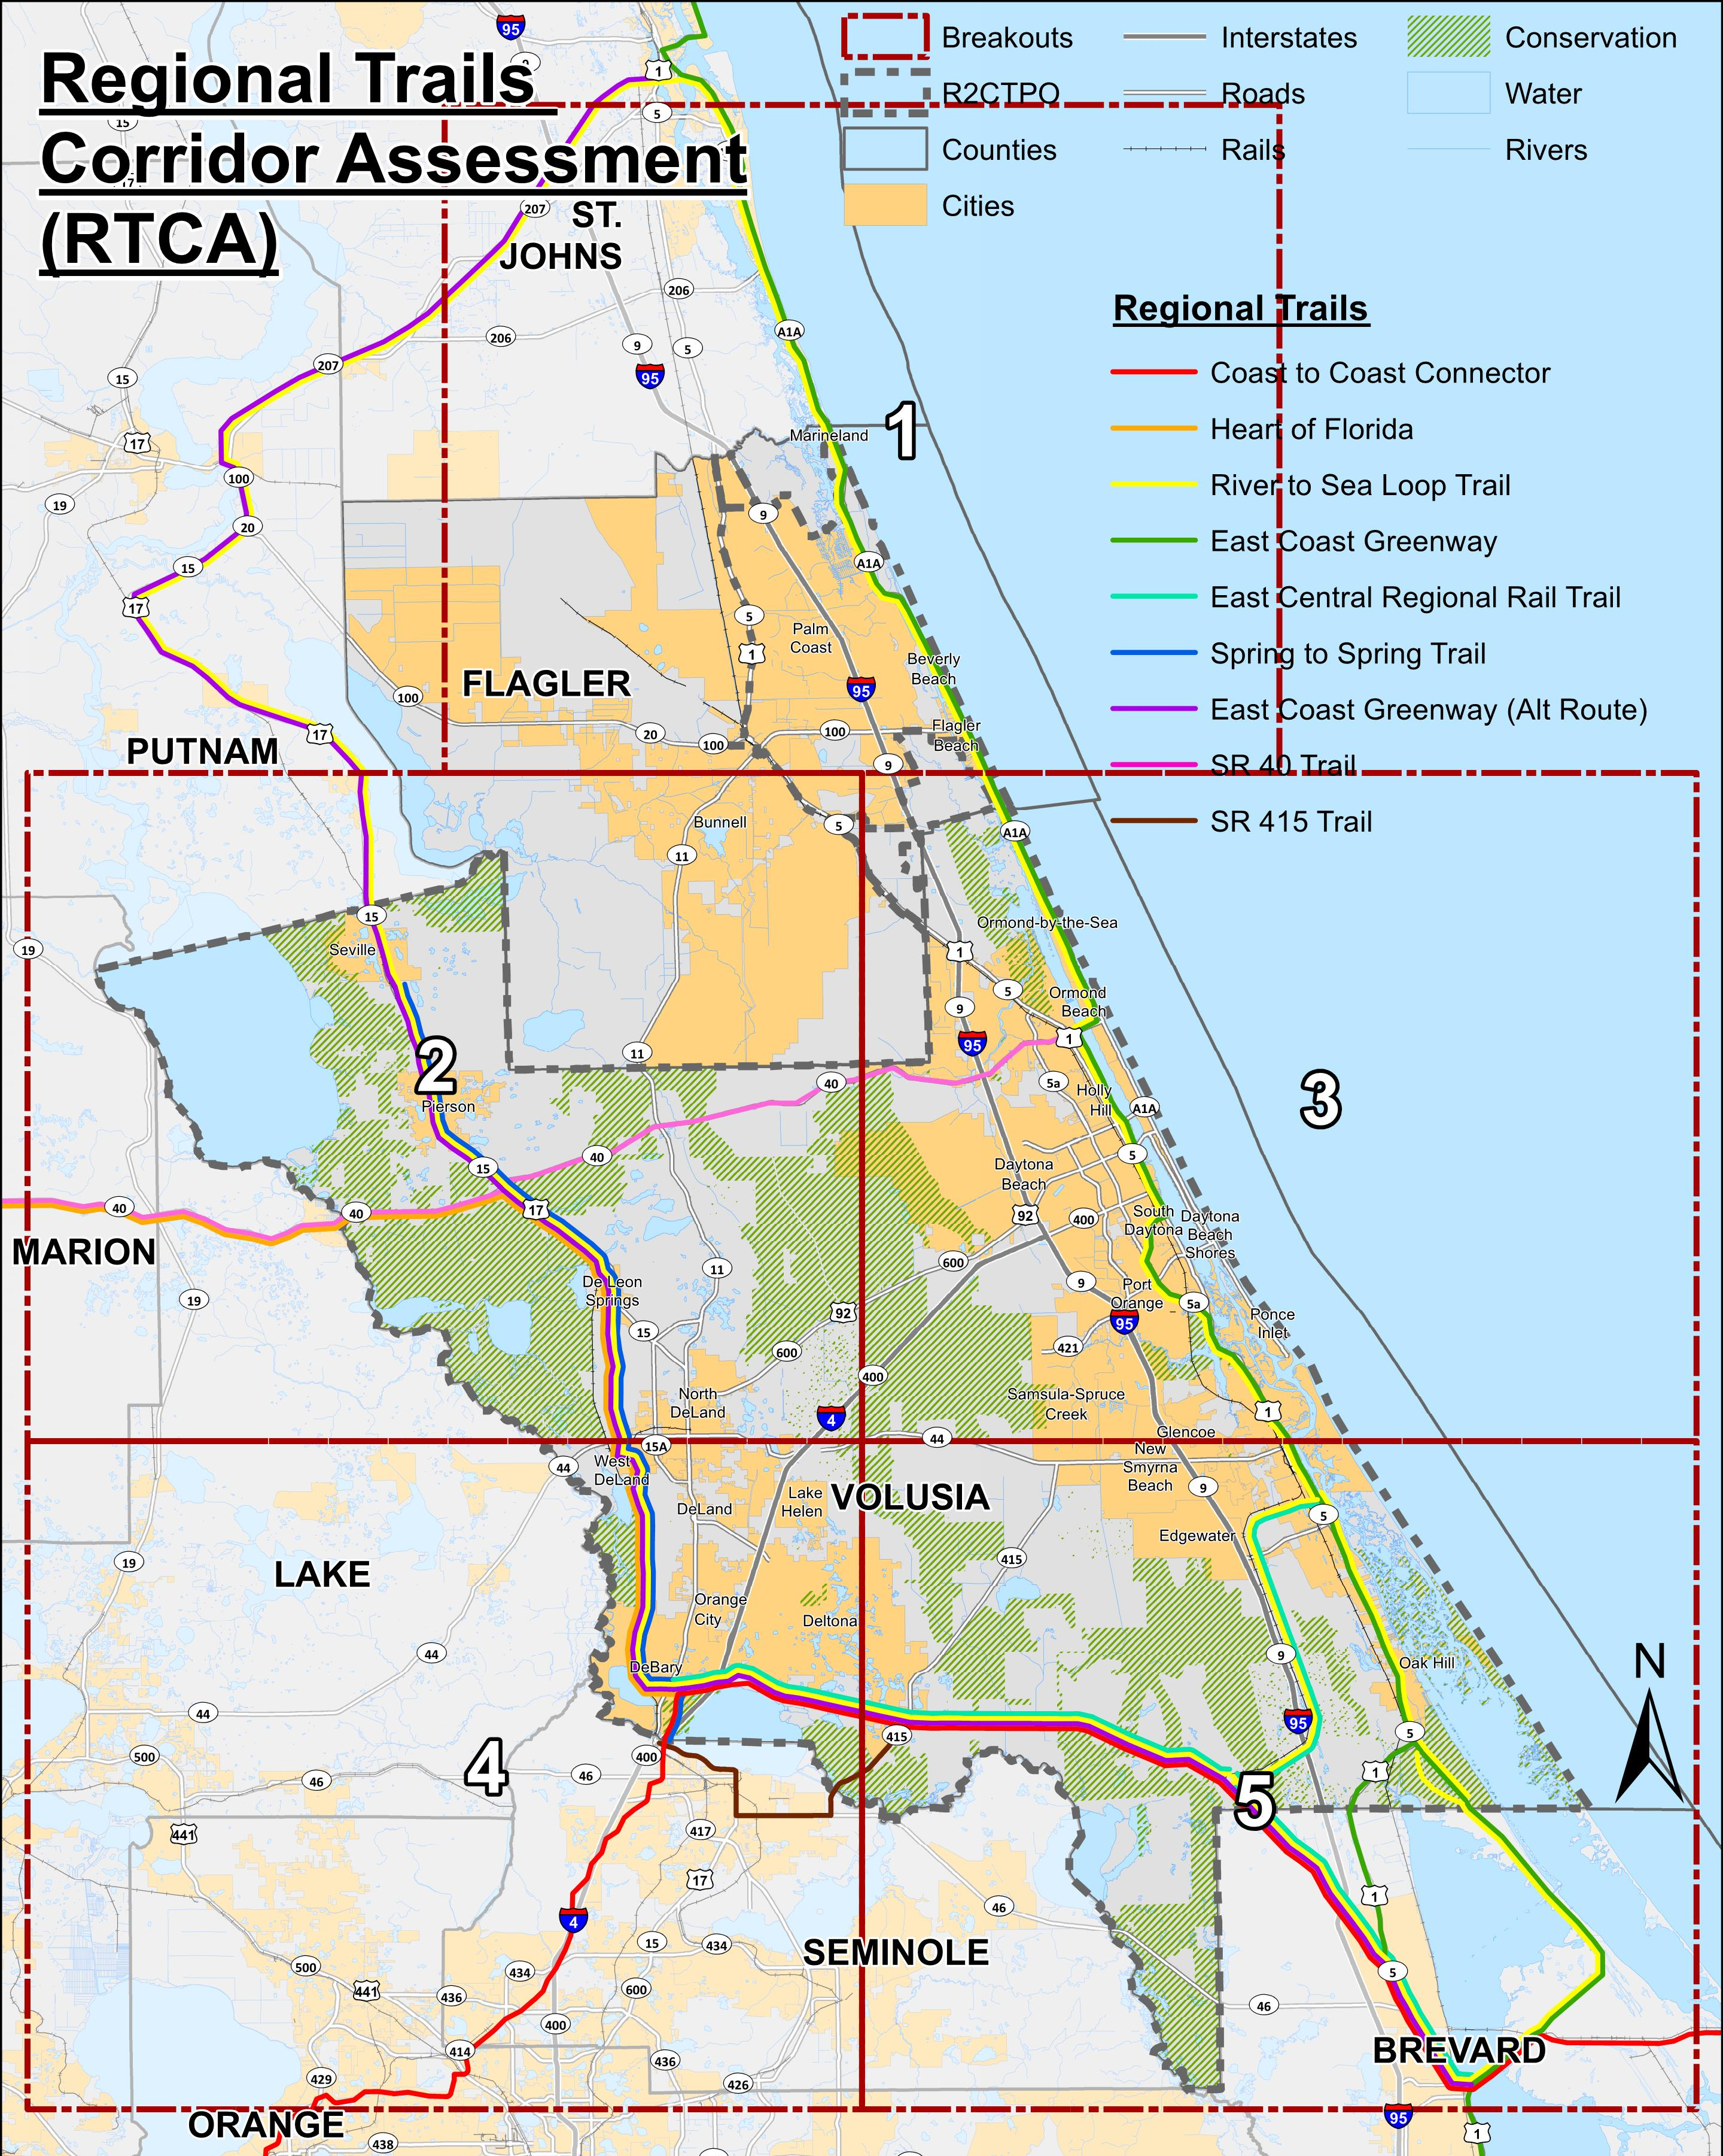
Small Group Meetings

Slide 10
Deliverables
Summary and Final Reports
Alignment Implementation Map
Identify all regional trail facilities in the study area
Denote the status of each trail segment in study
Identify those existing trails that are “substandard”
GIS shapefiles and KMZ file (uploadable to Google Earth)

Slide 11
Schedule – Upcoming Milestones
Stakeholder Workshop #1
Monday, September 29th; 5-7pm
Small Group Meetings – Round 1
Early/Mid-October
Field Work/Draft Concept Plans
Throughout October
Small Group Meetings – Round 2
Early November
Next presentation to BPAC
November 12, 2014

Slide 12
Project Contacts
Consultant Contacts:
Lara Bouck, PE, AICP (Project Manager)
lara.bouck@rsandh.com, 407-893-5847
Ginger Hoke, RLA
ginger@hokedesign.com, 407-923-6027
R2CTPO:
Jean Parlow (Project Manager)
jparlow@r2ctpo.org, 386-226-0422, ext. 20417
Stephan Harris (Bicycle/Pedestrian Coordinator)
sharris@r2ctpo.org, 386-226-0422, ext. 20428

Slide 13
QUESTIONS??

