Slide 1

Regional Trails Corridor Assessment
River to Sea TPO Board Briefing
February 25, 2015

Slide 2
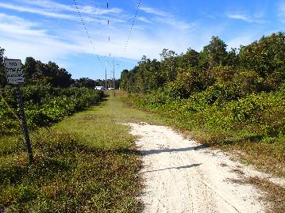
Project Goals
Complete the regional trails network in the TPO Planning Area and advance the Florida Greenways and Trails System Plan by developing/finalizing alignments and connections.
Understand/inventory where there are existing trail gaps and determine the feasibility of alignments.
Complete assessments and develop conceptual plans and cost estimates for all gap segments in order to compete for funding.
Trail improvements will NOT be prioritized as a part of this study.

Slide 3
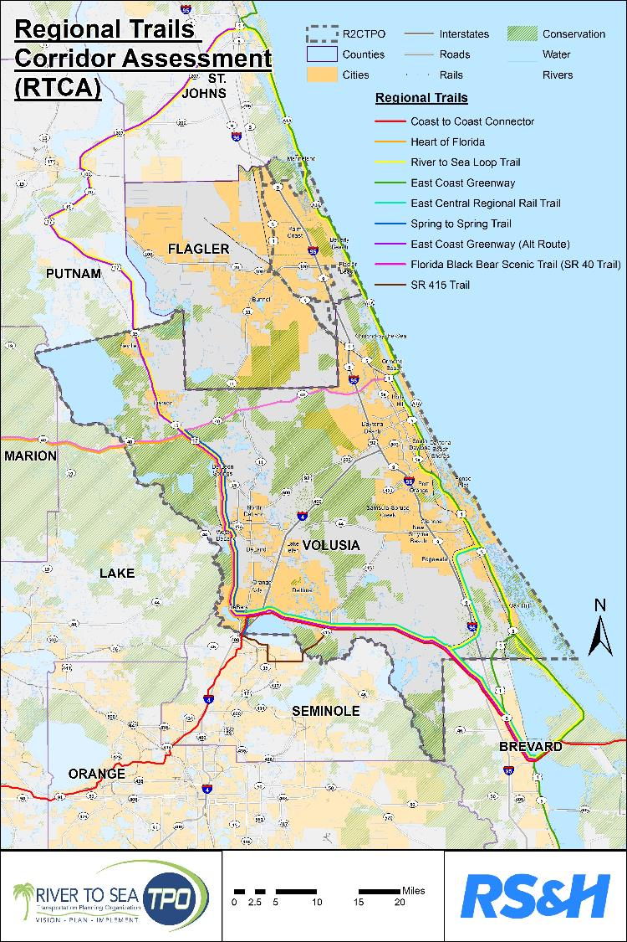
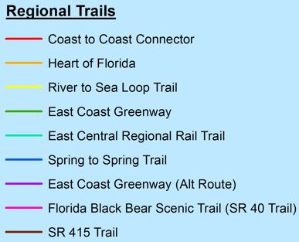
Regional Trails for RTCA

Slide 4
Project Progress Overview
Data Collection
Concept / Cost Development and Documentation
Stakeholder Meeting #1
Stakeholder Meeting #2
Small Group Workshops
Field Reviews
September 29, 2014
23 Attendees
Introduced Study and Obtained Input
November 19-20, 2014
Eight (8) field review meetings
Visited Potential “Gap” Locations
Aug-Nov 2014
October 29-30, 2014
Detailed Review of Trail Segments
Four (4) Interactive Workshops
December 17, 2014
26 Attendees
Presented Draft Study Findings

Slide 5
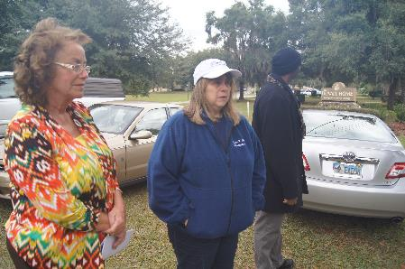
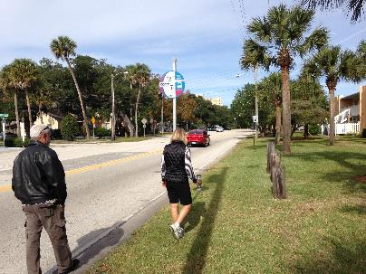
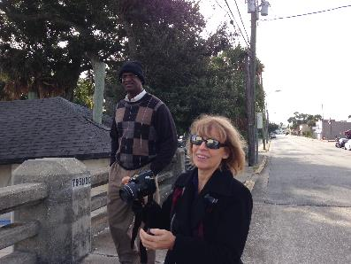
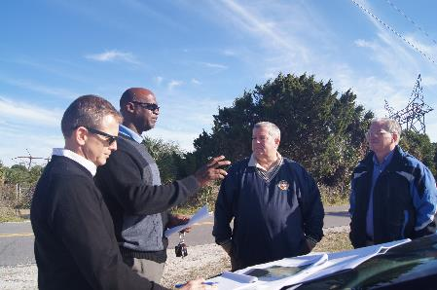
Inventory of Regional Trails
Existing Trails
Planned / Programmed Trails
Gaps and Proposed Alignments

Slide 6
Regional Trail Widths Guidelines
Excerpts from National and State Trail Guidelines and Manuals
FDOT Plans Preparation Manual, 2012 (Design Guidance for Shared Use Paths) 8.6.2 Widths | FDOT Manual on Uniform Traffic Control Devices (MUTCD) (known as the Florida Greenbook) 2011 (Shared Use Path) | FHWA, Manual on Uniform Traffic Control Devices Source: Best Practices Design Guide | American Association of State Highway and Transportation Officials (AASHTO), Guide for the Development of Bicycle Facilities, 2012 4th edition (Shared Use Paths)
Typically, widths range from 10-14 feet The minimum width for a two-directional shared use path is 10 feet. | The minimum recommended width for a paved two-way path is 10 feet. In many cases, it is desirable to increase the minimum width to 12 feet. In limited cases, 8 feet may be acceptable. | The tread of a shared-use path should be at least 10 ft. wide. A minimum of 8 ft may be used on shared-use paths that will have limited use. On shared-use paths with heavy volumes of users, tread width should be increased to a range from 12 to 14 ft. | The minimum paved width for a two-directional shared use path is 10 ft Typically, widths range from 10 to 14 ft. A path width of 8 ft may be used for a short distance Eleven (11) foot pathways are needed to enable a bicyclist to pass another path user going the same direction.

Slide 7
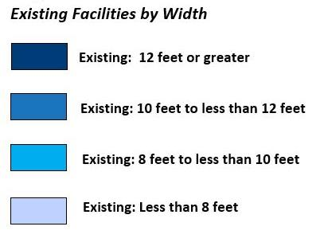
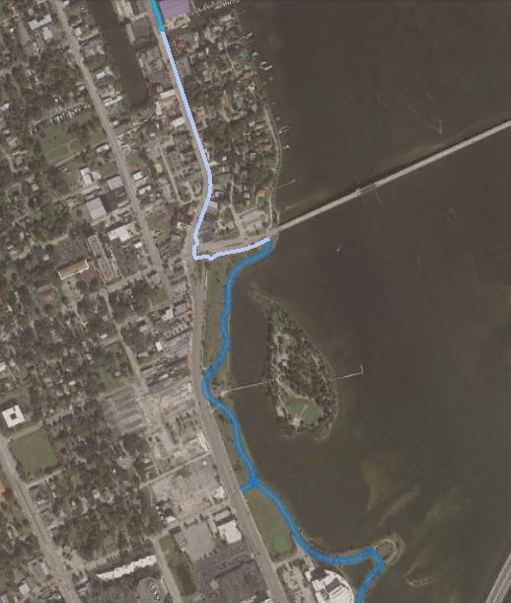
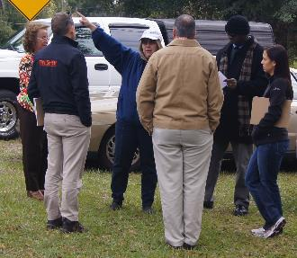
Existing Regional Trails

Slide 8
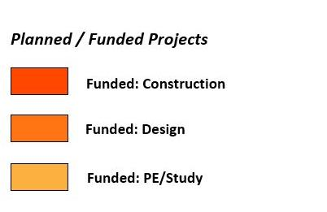
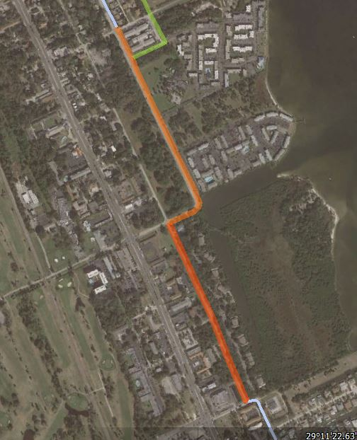
Planned/Programmed Trails
Work Programs
TIP
State and Local Projects
Studies

Slide 9
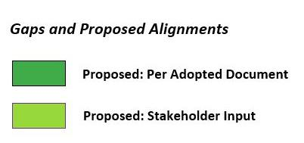
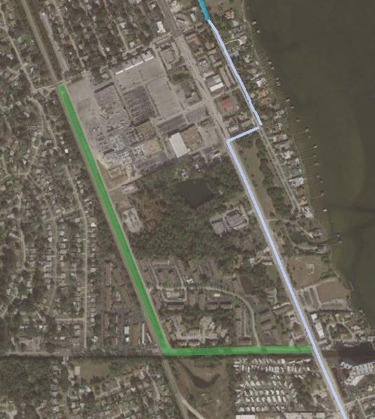
Gaps and Proposed Alignments
Resolutions
Master Plans
Regional Corridor Alignments
Field Review
Stakeholder Input

Slide 10
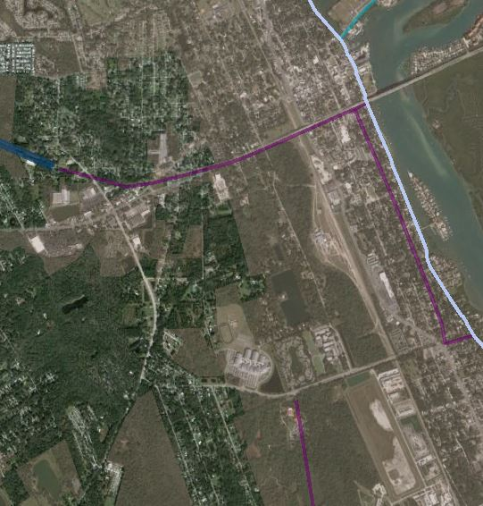
Connectors / Potential Trails of Regional Significance

Slide 11
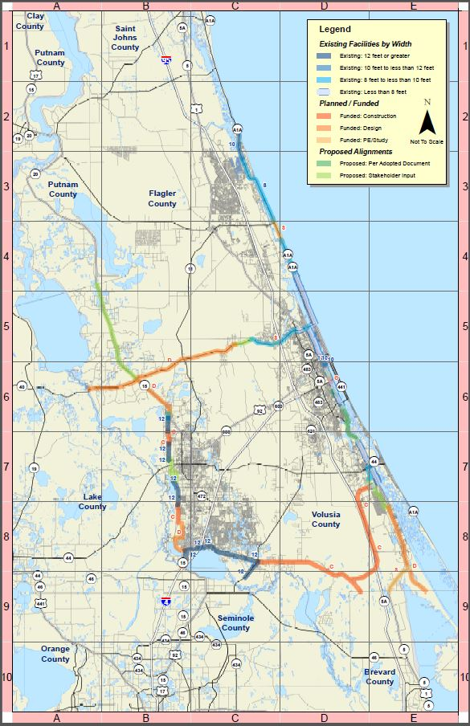
RCTA Inventory Results

Slide 12
Trail Gap Matrix (1 of 2)
Trail Gap Segment ID | Jurisdiction | Road Name(s) | Regional Trail(s)* | Segment Start | Segment End | Length (miles) | Recommended Next Steps
A | City of Flagler Beach | A1A | ECG, R2C | N. 9th Street | S 26th Street | 2.9 | Conduct feasibility study subsequent to completion of City’s parking study
B | City of Ormond Beach | A1A | ECG, R2C | Standish Drive | East Grenada Boulevard | 1.5 | Conduct feasibility study for bike lanes along Halifax Drive and Standish Drive
C | City of Daytona Beach | Beach Street | ECG, R2C | Marina Point Drive | Bellevue Avenue | 0.7 | Complete concept design for gap
D | City of South Daytona | Carmen Drive and Reed Canal Road | ECG, R2C | Ridge Boulevard at Carmen Drive | Reed Canal Road at US 1 | 1.2 | Complete concept design for gap
E | City of Edgewater | W. Park Ave, Mango Tree Dr., 16th St., Hibiscus Dr., Roberts Road | ECG, R2C | East Central Regional Rail Trail (ECRRT) terminus at Dale Street | Roberts Road | 4.5 | Complete feasibility study of southbound ECRRT connection through Edgewater
F | Volusia County (West of DeLand) | W. Minnesota Ave, S. Grand Ave, S. Beresford | S2S, R2C, ECG-A, HoF | W. Beresford Rd to terminus of Alexander Dr. | Beresford Park | 2.9 | Complete concept design for gap
* ECG = East Coast Greenway (and Alternate); R2C = River To Sea; HoF = Heart of Florida; S2S = Spring to Spring; ECRRT = East Central Regional Rail Trail

Slide 13
Trail Gap Matrix (2 of 2)
Trail Gap Segment ID | Jurisdiction | Road Name(s) | Regional Trail(s) | Segment Start | Segment End | Length (miles) | Recommended Next Steps
G | Volusia County (West of DeLand) | Grand Avenue | S2S, R2C, ECG-A, HoF | Lemon Street | King Street | 1.7 | Subsequent to County’s construction of five foot bike lanes and five foot sidewalks in both directions, continue to monitor community support for potential construction of a regional trail with a standard width
H | Volusia County (DeLeon Springs) | US 17 / Baxter Street | S2S, R2C, ECG-A, HoF | McInnis Elementary School | Baxter Street at Grand Avenue | 0.1 | Complete feasibility study for crossings at Baxter Street and US 17 and trail connecting from McInnis Elementary School to Grand Ave
I | Volusia County | SR 17 | R2C, ECG-A | SR 40 | Putnam County Line | 13.7 | Complete concept design for gap
J | Volusia County (West of Ormond Beach) | SR 40 | Florida Black Bear Scenic Trail | Cone Road | Airport Road | 2.2 | Complete concept design for gap

Slide 14
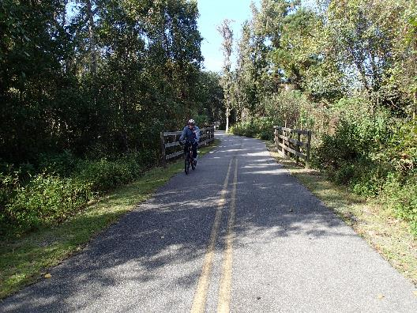
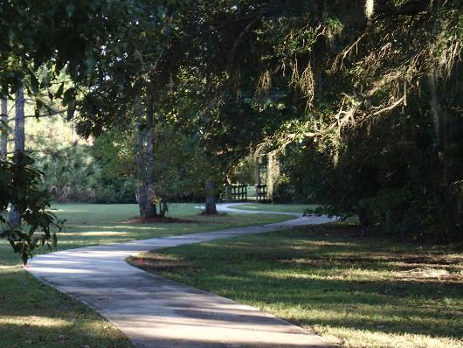
Project Deliverables
GIS / KMZ files
General Concept Plans and Cost Estimates for Gaps
Final Report
  Data Inventory
  Methodology
  Identification of Challenges and Opportunities
February/March 2015

Slide 15
NEXT STEPS
Present to R2CTPO CAC, TCC and Board
  February 17th and 25th
Complete Final Report / GIS Map
  Early March 2015
Study Adoption
  March 2015
Data Collection
Concept / Cost Development and Final Report / GIS
Stakeholder Check In #1
Stakeholder Check In #2
Small Group Workshops
Field Reviews
March 2015

Slide 16
Project Contacts
Consultant Contacts:
Steve Cote, PE, AICP (Project Manager)
steve.cote@rsandh.com, 678-528-7220
Ginger Hoke, RLA
ginger@hokedesign.com, 407-923-6027
R2CTPO:
Jean Parlow (Project Manager)
jparlow@r2ctpo.org, 386-226-0422, ext. 20417
Stephan Harris (Bicycle/Pedestrian Coordinator)
sharris@r2ctpo.org, 386-226-0422, ext. 20428

Slide 17

QUESTIONS ?

