Slide 1
Mobile Safety City
October 2013

Slide 2
Mobile Safety City
An educational facility will feature:
child-sized miniature buildings,
streets,
crosswalks,
traffic lights,
a railroad crossing,
Bicycle paths
Volusia County School’s current curriculum will be used
and is designed to teach our young people to recognize
safety hazards found in everyday life and learn to make
The best choices when faced with potential hazardous
situations.

Slide 3
Mobile Safety City
Mobile Safety City will enhance the existing and proposed bike education elements of the Volusia County Public School’s Physical Education Program.
It will be available for use throughout the school year to elementary aged students K-5. (Reg Ed & ESE)

Slide 4
Mobile Safety City
Programs include:
Bicycle safety,
Bus Safety,
Pedestrian safety,
Stranger awareness,
Traffic Safety,
Traffic Signs
and Traffic Lights.
Occupies a section of parking lot with a
minimum of 70’ X 80’ for 4 stations.

Slide 5
Encouraged to Bike or Ride
Kids are encouraged to bike (or walk) to school for
Three main reasons:
To enhance the health of kids - Increased physical activity can combat a host of health problems facing kids today.
To improve air quality and the environment - Replacing car trips to school with walking or bicycling can help reduce air pollution and traffic.
To create safer routes for walking and bicycling - Sidewalks, education programs and traffic calming measures are some of the ways to improve conditions.

Slide 6
Overseer of Project
Cookie Grafton, Instructional Materials,
Health & Physical Education Specialist for
Volusia County Schools will oversee the
project and provide updated progress
reports for two years.

Slide 7
Material List
(5) Portable Stop Sign – 24” - $41.99 each
(2) Railroad Crossing Sign – 18”x18” - $42.00 each
(3) School Bus Stop Sign – 18”x24” - $32.25 each
(5) School Crossing Signs - $62 each
(20) Sign Base and Pole – 4 ft Predrilled – 37 lb. - $108.95 each
(4) Portable (Functional) Remote Control Traffic Lights (w/ auto cycle) - $495 each (Any 2” pole can be used to mount – brackets included)
(5) Street Name Signs – 6”x24” - $45.95 each
(5) Post Brackets for Street Name Signs - $11.50 each
(5) Post for Street Name Signs - $48.95 each
(3) Traffic Cones – 42” High - $70.10 each
(1) Begin and End Sign - 24” x 12” - $35 each
(7) Artificial Trees - $59.97 each
Green Outside Carpet (Total coverage of 5’x75’ - $1.10/sq. ft.)
(10 Rolls) 2” wide white and yellow tape for outlining:
1.88”x20 yards - $3.37
Streets
Bicycle Lanes
Sidewalks
Crosswalks
Railroad Crossing
(20) Plywood Sheets – (5) 8’X8’ Sheets per bldg.-4 Buildings X 5 Sheets – 20 Sheets x $25 each
(4) 8’x8’ (drawings of bldgs.) for the facing of each building
(By Students)
Miscellaneous Hardware – Hinges, screws, etc.
(10) Storage Bins – $39.99 each
2013 Trailer w/ Ramp (for transporting materials) – 7’ X 16’

Slide 8
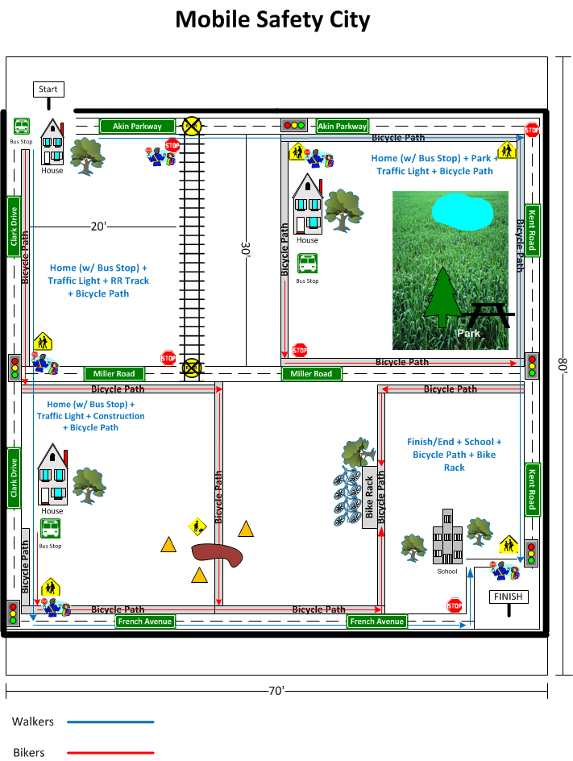

Slide 9
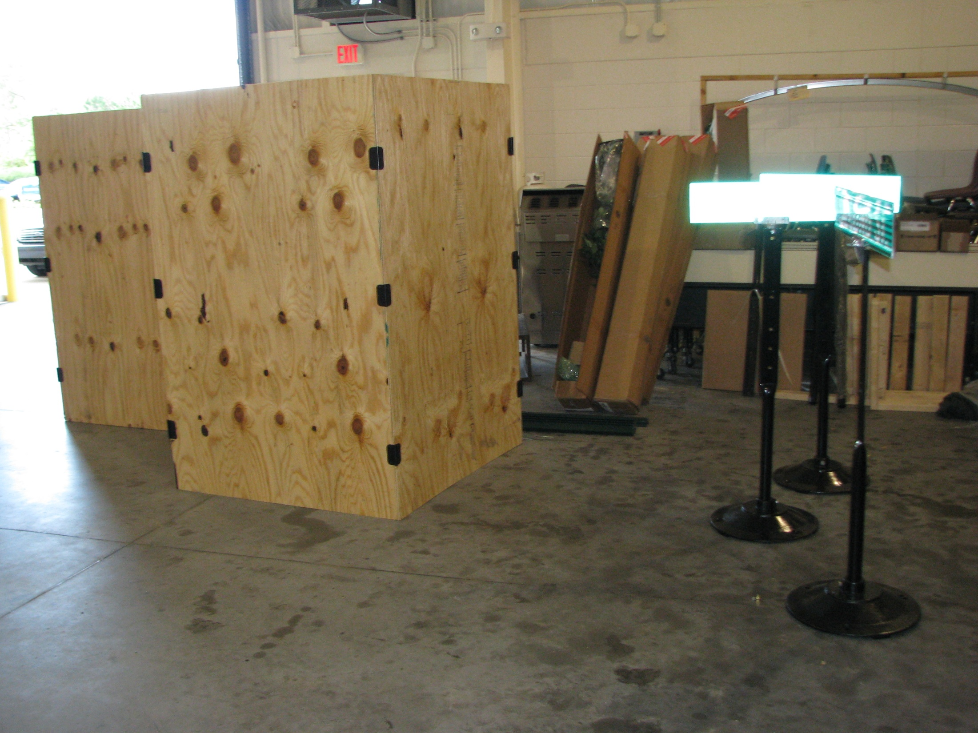

Slide 10
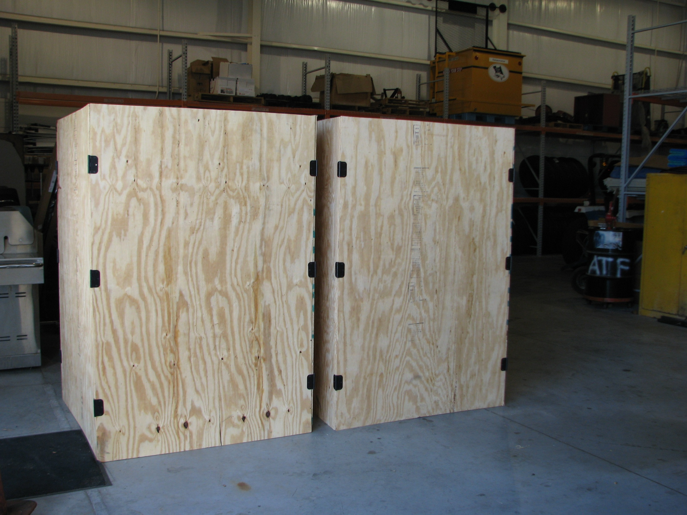

Slide 11
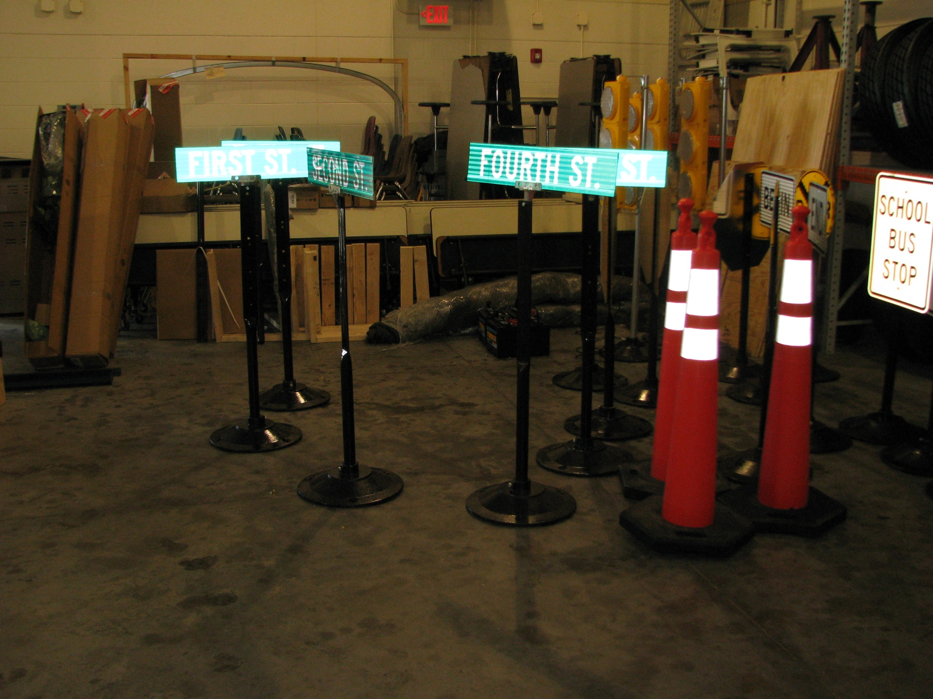

Slide 12
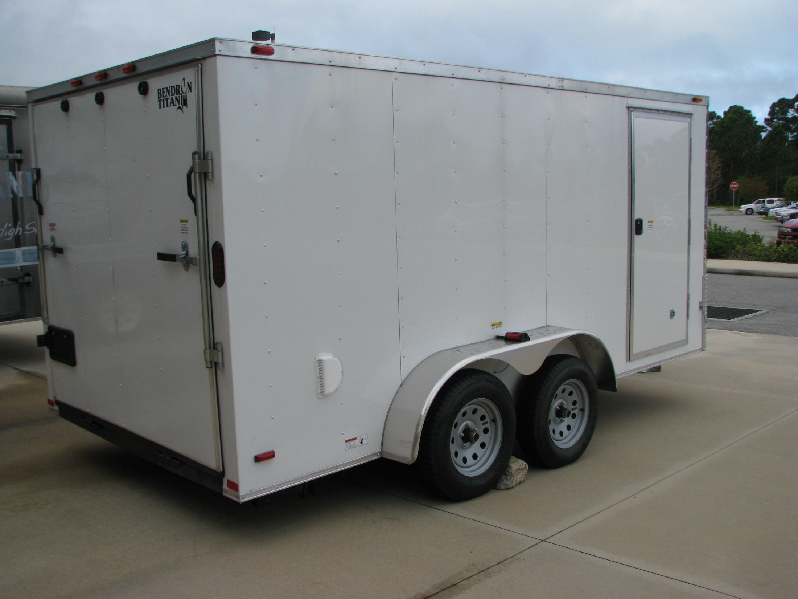

Slide 13
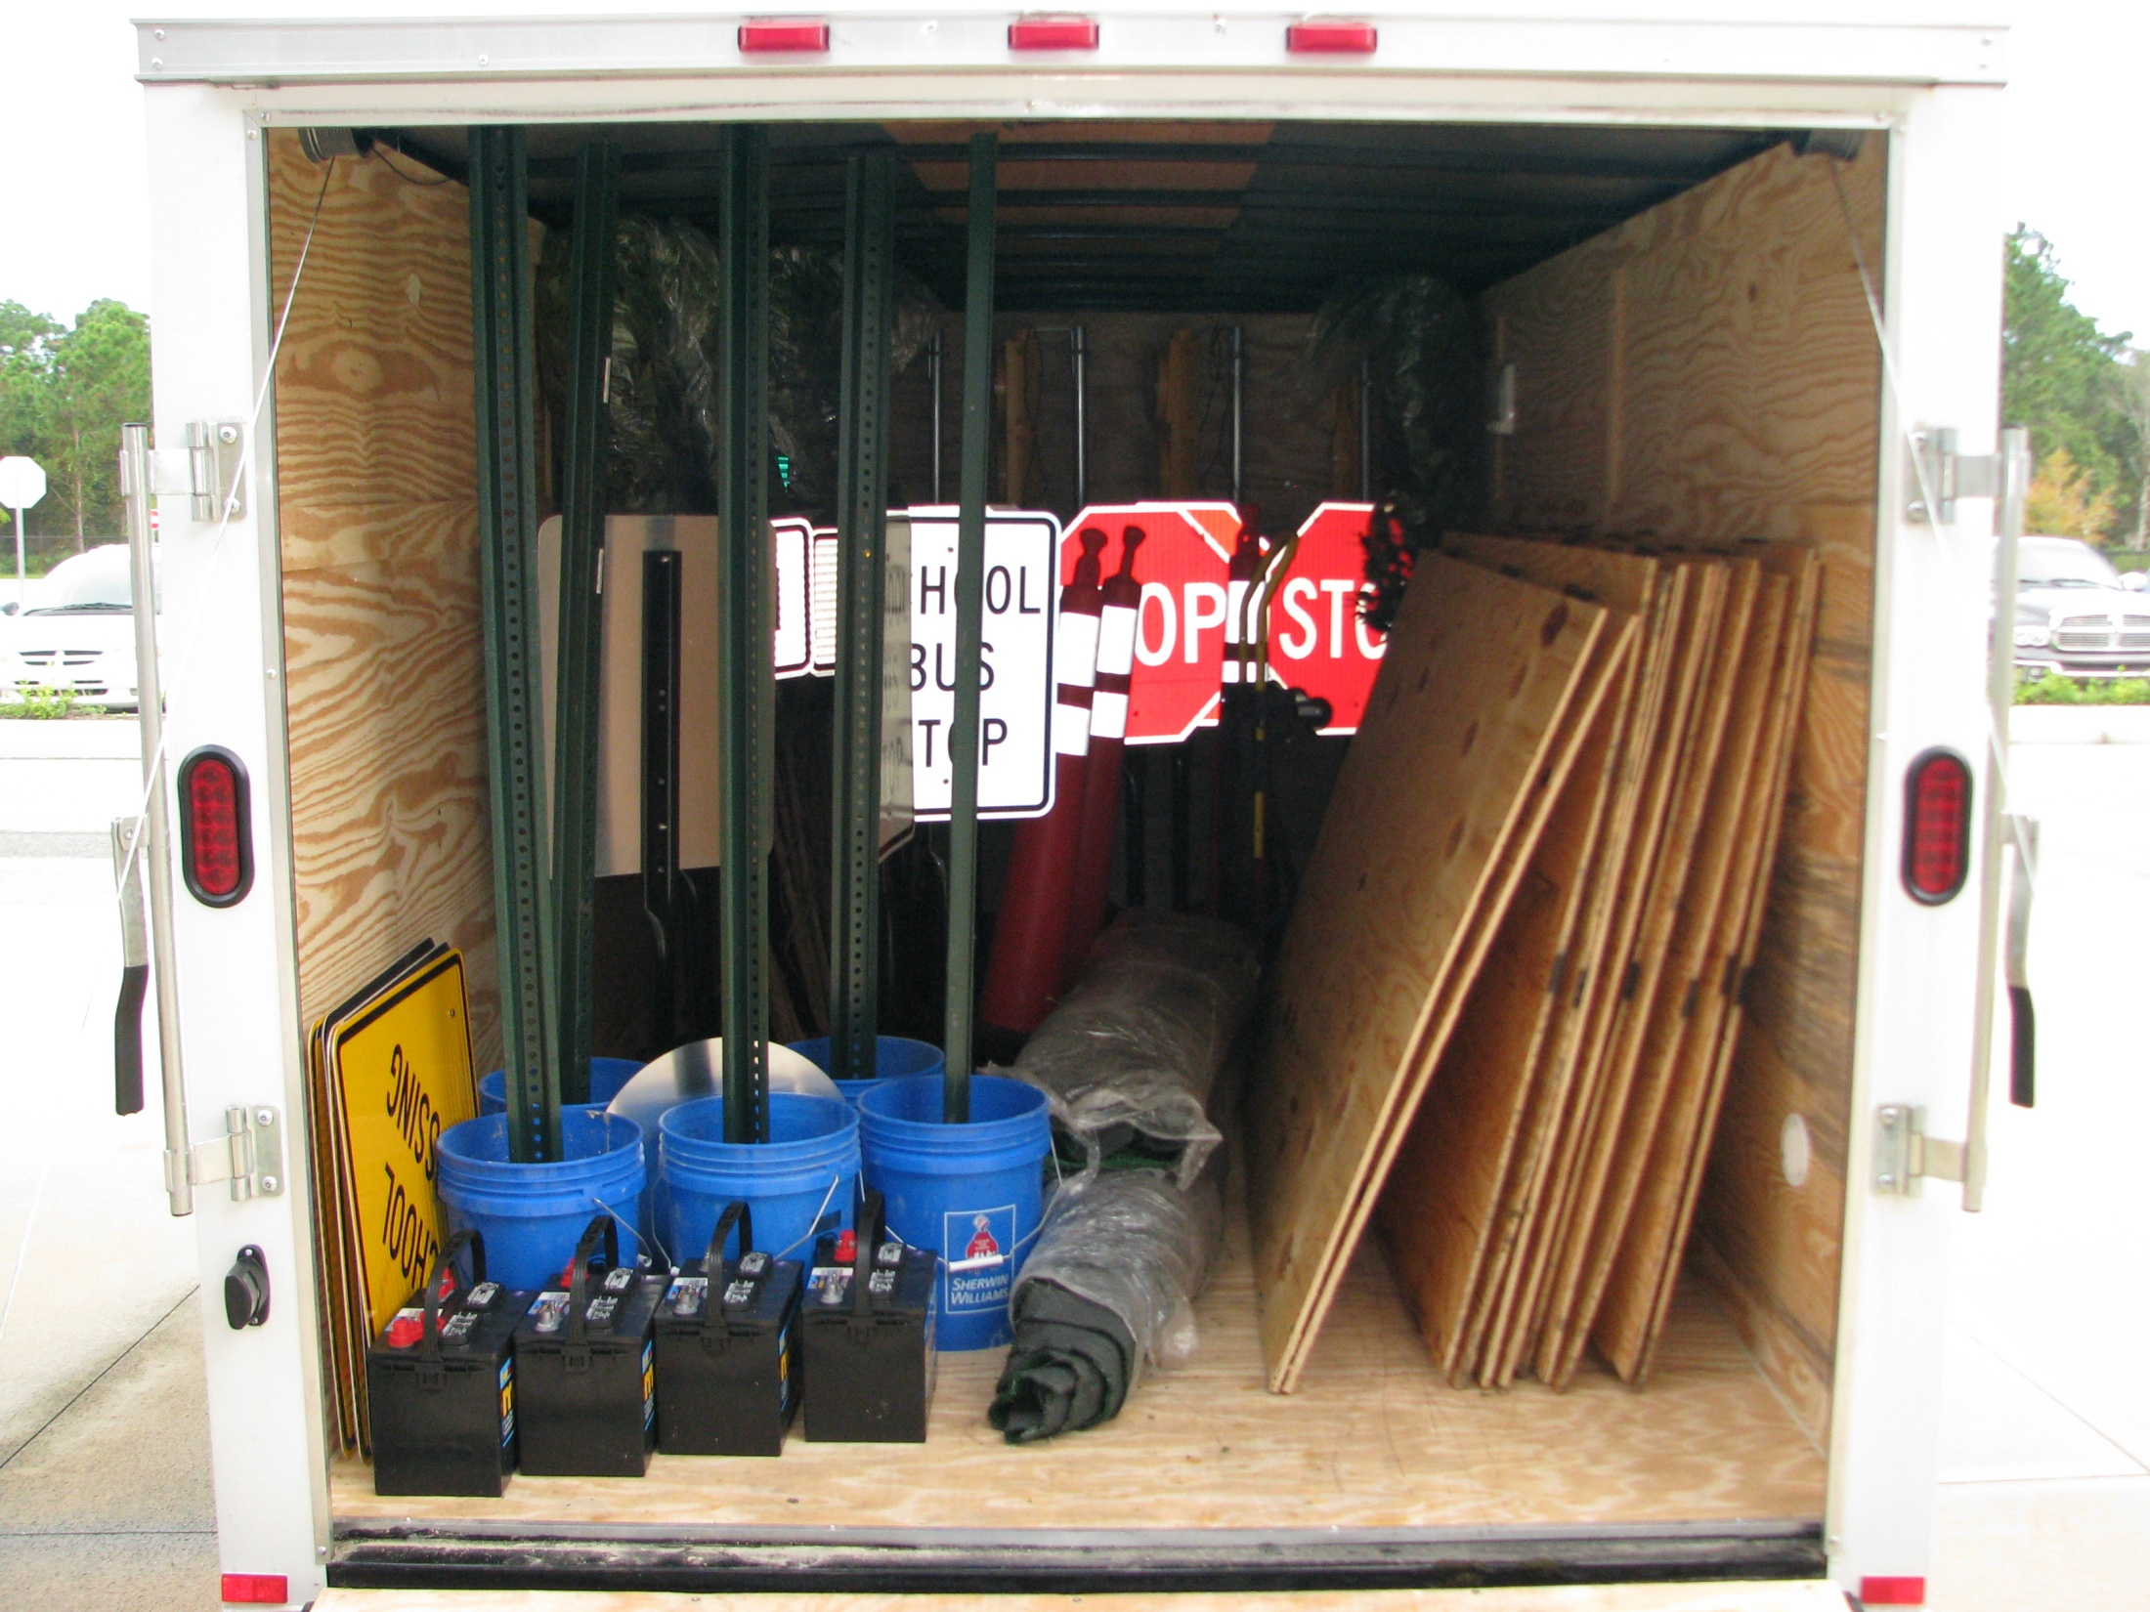

Slide 14
