Slide 1
Freight, Goods and Services Plan & Economic Impact on Central Florida

Slide 2
Freight Advisory Council
Florida Dept. of Transportation
Freight Industry Professionals
Transportation Planners/Engineers
Economic Development Staff
Land Use and Real Estate Experts

Slide 3
How Much Freight?
Imports 37.9 million tons
Within Region 20.6 million tons
Through*
120.6 million tons
Exports 23.1 million tons
Source:
2010 FDOT Trade and Logistics dataset and 2009 full Surface Transportation Board (STB)
Waybill dataset.
ª The base year for the rail data is 2009. Through rail moves were not included due to
the inability to estimate it with the full Surface Transportation Board (STB) Waybill dataset.

Slide 4
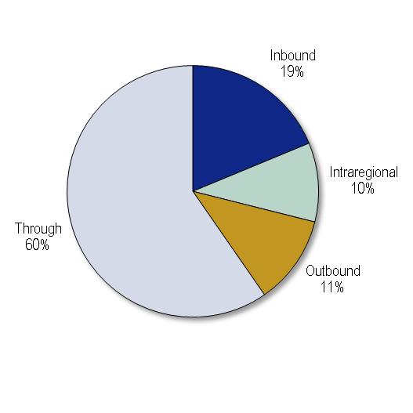
How Much Freight?
Direction 2010ª
Millions
Inbound 37.9
Outbound 23.1
Intraregional 20.6
Through^{b} 120.6
Total 202.3
Source: 2010 FDOT Trade and Logistics dataset and 2009 full Surface Transportation Board (STB) Waybill dataset.
ª The base year for the rail data is 2009.
^{b} Through rail moves not included due to the inability to estimate it with the full Surface Transportation Board (STB) Waybill dataset.

Slide 5
Freight Generators
Outbound freight
by originating county

Slide 6
Freight Attractions
Inbound freight by
destination county

Slide 7
Commodity Flow-Volusia

Slide 8
Commodity Flow-Volusia

Slide 9
Commodity Flow-Volusia

Slide 10
Commodity Flow-Volusia

Slide 11
Commodity Flow-Volusia

Slide 12
What is Moving? Top 10 Commodities
Source: 2010 FDOT Trade and Logistics dataset and 2009 full Surface Transportation Board (STB) Waybill dataset.

Slide 13
How is Freight Moving?
Note: Does not include through rail volumes

Slide 14
Forecast Summary
35% growth

Slide 15
Challenges and Recommendations
Capacity
Community Impact
Institutional/ Regulatory
Challenges
Physical
Infrastructure
Operational
Institutional/ Regulatory
Solutions

Slide 16
Capacity and Mobility
Travel demand model results for overall level of service and truck volume growth
Trucking GPS data to analyze existing bottlenecks and key corridors
Corridor fact sheet for intermodal connectors and key freight corridors
Existing and on-going studies

Slide 17
Community Impacts
Economic competitiveness
Air quality
Safety
Environmental justice
State of repair
Land use conflicts

Slide 18
Institutional and Regulatory
Examine federal, state and local legislation and ordinances for freight specific issues
Examine funding sources relative to needs
Document potential implications and mitigation strategies

Slide 19
Preparing Recommendations
Strategic recommendations on how to avoid and mitigate incompatibilities between freight movement and non-freight land uses
Examples of location where these strategies may be applied.

Slide 20
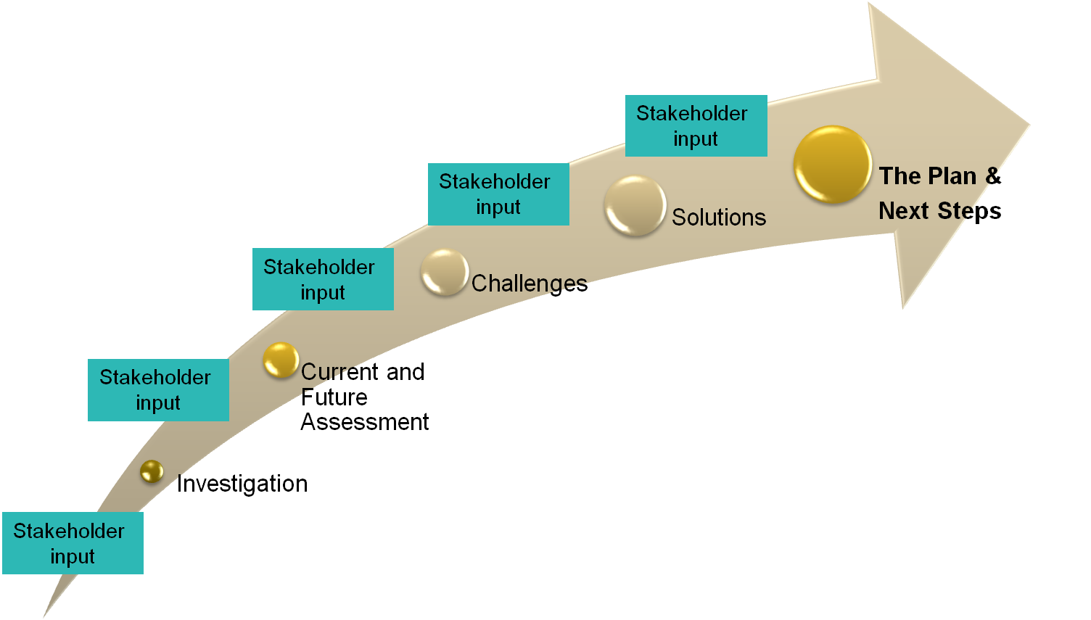
Project Schedule
1-6 months
7-10 months
10-12 months
12-14 months
14-18 months
Air Cargo Market Study – Feb FAC meeting
Logistics and Land Use Profile– March FAC
Needs Assessment & Draft Recommendations – June FAC

