Slide 1
2040 Long Range Transportation Plan for River to Sea Transportation Planning Organization
November 26, 2014
River to Sea TPO Board

Slide 2
2040 Long Range Plan
25-Year Planning Horizon
Update LRTP every 5 years
Identify needed major improvements
Determine those that are “cost feasible” (i.e., highest priority for expected funds)
Preserve and maintain prior investments
Transportation Improvement Program (TIP) must be fully funded
Available Funds
Needed Projects

Slide 3
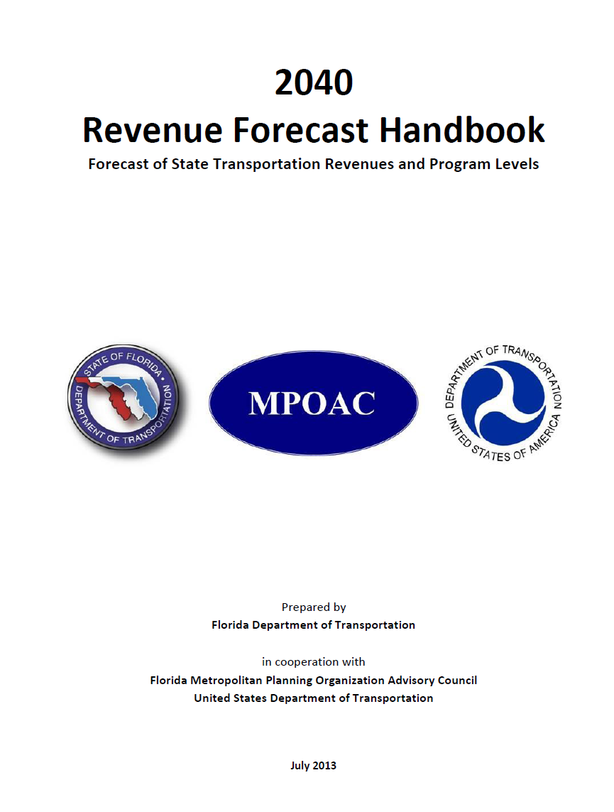
Methodology
Revenue Forecasts were calculated in accordance with the...
Notes:
The Florida Department of Transportation (FDOT) has developed a new long range revenue forecast. The forecast is based upon recent federal and state legislation (e.g., MAP-21, changes to Florida’s Documentary Stamps Tax legislation), changes in factors affecting state revenue sources (e.g., population growth rates, motor fuel consumption and tax rates), and current policies.
forecast does not include estimates for local revenue sources

Slide 4
Revenue Forecasting Process
Adopted Cost Feasible Plan
Capacity Elements
Local
Non-Capacity Elements
State and Federal
Planned Improvements
Revenue Estimates
Notes:
Document revenue estimates and how used
2014 Base Year
Estimates for 2019-2040 (22 years); use TIP/Work Program for earlier years
Estimates for planning purposes, not a commitment

Slide 5
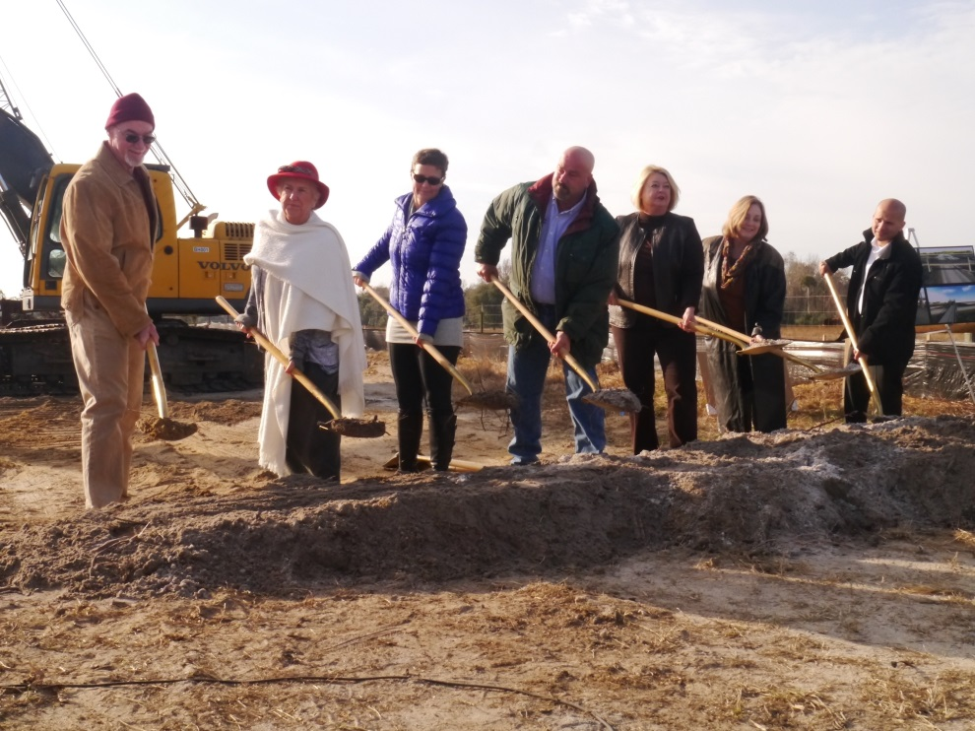
Capacity Programs
“Statewide”
SIS Highways Construction & ROW
Statewide Public Transportation Programs (Aviation, Rail, Intermodal, Seaport Development)
Other
Other Arterials
Construction & ROW
Transit

Slide 6
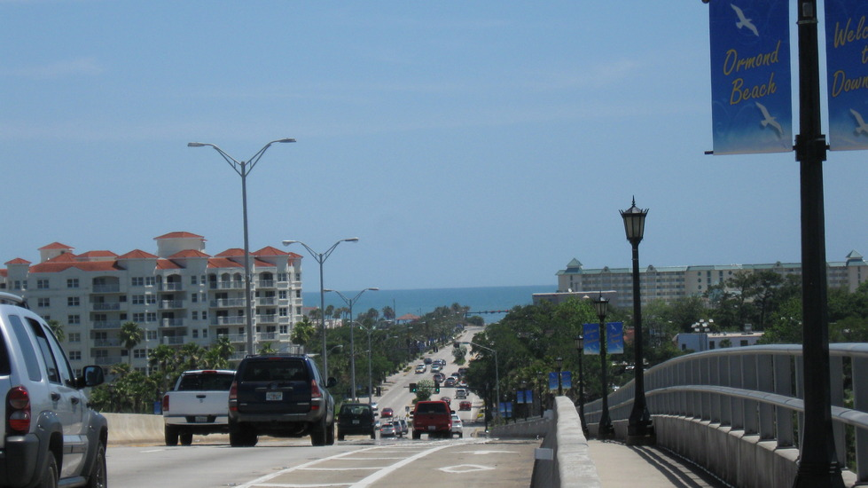
Non-Capacity Programs
Safety
Resurfacing
Bridge (repair and replace)
Product Support (planning and engineering)
Operations and Maintenance
Administration
Notes:
Safety:
1. Highway Safety
2. Rail/Highway Crossings (discontinued)
3. Grants
Resurfacing:
1. Interstate
2. Arterial & Freeway
3. Off-System
4. Turnpike
Bridge:
1. Repair or replace - On System
2. Local Bridge Replacement
3. Turnpike
Product Support::
A. Preliminary Engineering (all)
B. Construction Engineering Inspection (all)
C. Right-of-Way Support (all)
D. Environmental Mitigation
E. Materials & Research (all)
F. Planning & Environment (all)
G. Public Transportation Operations
Operations & Maintenance (all)
B. Traffic Engineering & Operations (all)
C. Toll Operations (all)
D. Motor Carrier Compliance
A. Administration (all)
B. Fixed Capital Outlay (all)
C. Office Information Systems

Slide 7
Sources of Revenue
Federal (DOT)
State (FDOT)
Local

Slide 8
Federal Revenue Sources
Federal Highway Trust Fund (Highways and Transit)
Primary source – motor fuel tax (gasoline, diesel, special fuels, CNG)
Miscellaneous – tires, new tractor/trailer purchases, etc.
Most Highways and Transit funds allocated to states via complex funding formulas in Federal Authorization Acts
Notes:
FL is donor state

Slide 9
State Revenue Sources
Taxes and Fees
Highway fuel-related
Vehicle-related
Tourism-related
Tolls/Turnpike (bond sales, tolls and concession revenues)
Growth Management Funding (Doc Stamps)
Federal Aid

Slide 10
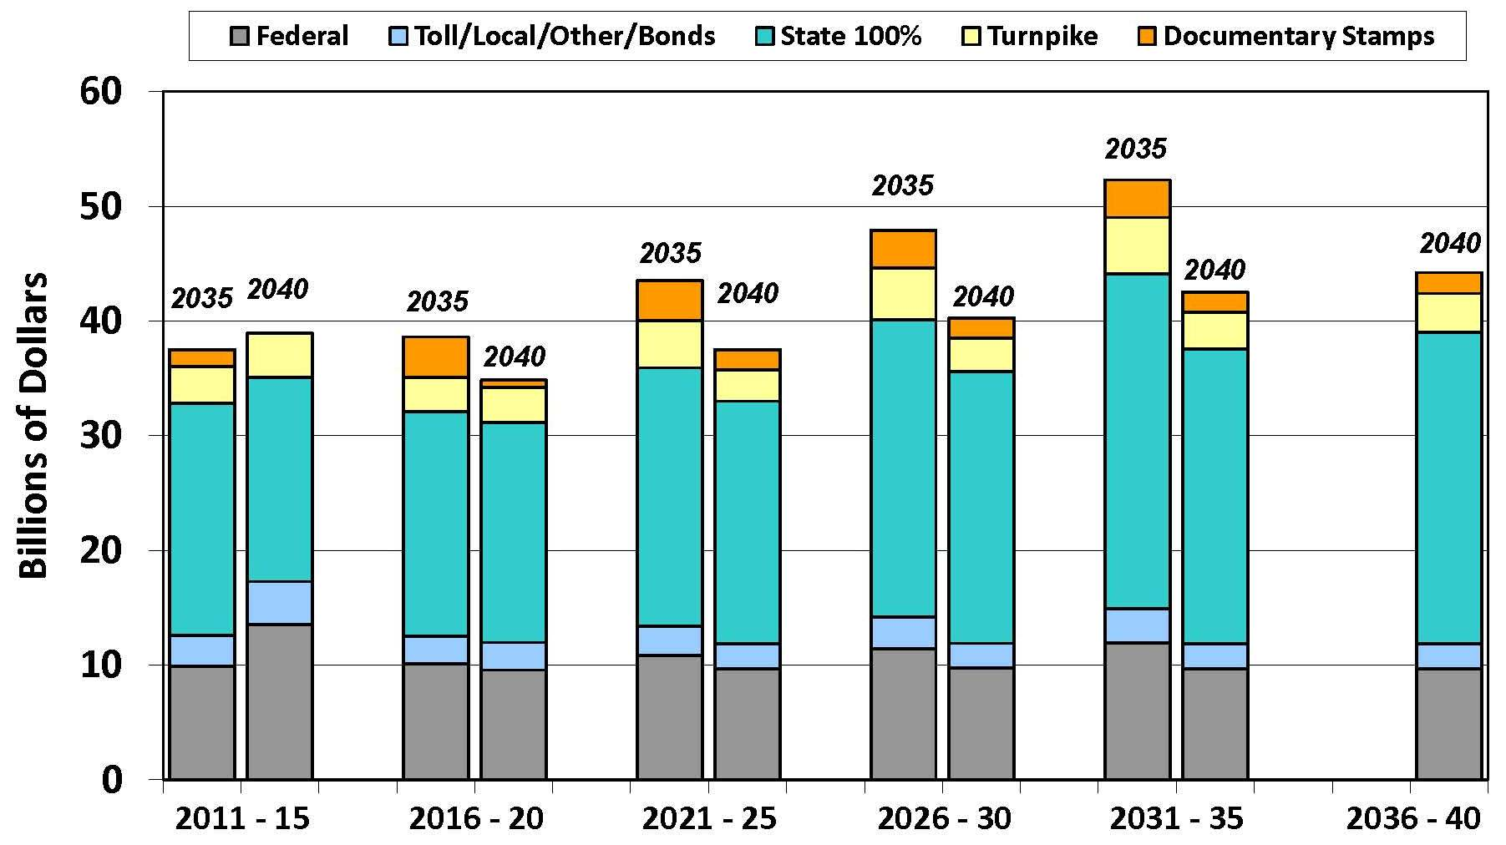
Statewide Revenue Forecast
2040 vs. 2035
5-Year Time Period (Fiscal Years)
Source: 2040 Revenue Forecast and Guidance, FDOT, Statewide Workshop, August 21, 2013

Slide 11
Projected State & Federal Revenues ($ Millions)
Capacity Programs | 2019-2020 | 2021-2025 | 2026-2030 | 2031-2040 | Total (2040)
SIS Highway Construction & ROW | $200.7 | - | $557.4 | $428.7 | $1,186.7
Arterial Construction & ROW | $45.6 | $101.9 | $96.3 | $210.8 | $454.6
Transit | $22.2 | $57.3 | $60.2 | $126.2 | $265.9
Total Capacity Program | $268.5 | $159.2 | $713.9 | $765.7 | $1,907.2
TMA Funds (SU) | $9.4 | $23.6 | $23.6 | $47.2 | $103.7
Source: FDOT 2040 Forecast of State and Federal Revenues for Statewide and Metropolitan Plans;
March 2014
Notes:
TMA funds are same as SU funds in the 5-year work program
Estimates for 2014 through 2018 are contained in the FDOT Adopted Work Program.

Slide 12
Projected Votran Revenues
($ Millions)
Type | 2019-2020 | 2021-2025 | 2026-2030 | 2031-2035 | 2036-2040 | Total
Volusia County Operating Budget for Votran | $20,045,309 | $55,617,955 | $64,476,456 | $74,745,884 | $86,650,966 | $301,536,570
Volusia County Financial Support for SunRail | $8,150,283 | $17,084,456 | $15,122,111 | $17,530,671 | $20,322,853 | $78,210,374
Total | $28,195,592 | $72,702,411 | $79,598,567 | $92,276,555 | $106,973,818 | $379,746,944
Source: Votran
Virtual status quo level
Operating policy of indefinite deferral of service expansion
Notes:
Votran’s capital and operating needs are funded within the context of Volusia County’s annual budget as well as the R2C TPO TIP and LRTP
funding is derived from Volusia County and other local sources, as well as Federal Highway Administration (“FHWA”) and FTA grants and FDOT grants
Funding should be considered as dedicated, without discretion for any other purpose.
There is no planned replacement match from Volusia County for SunRail funding (SunRail feeder routes).

Slide 13
Local Revenue Sources
Local Option Gas Tax
Impact Fees
Volusia County
City of Palm Coast
Flagler County
Local Sources Include…

Slide 14
Projected Local Revenue
($ Millions)
Local Government | Fuel Tax (CIP) | Impact Fees | Total
Volusia County | $219,044,354 | $48,141,480 | $267,185,834
Flagler County | $23,836,054 | $4,968,704 | $28,804,758
City of Palm Coast | $31,032,527 | $26,507,893 | $57,540,420
TOTAL | $273,912,935 | $79,618,077 | $353,531,012
Source: Fishkind & Associates, Inc.

Slide 15
Projected Total (2019-2040)
($ Millions)
System, Agency, Local Government | State/Federal Funds | Local Revenues | Total
River to Sea TPO
Capacity Programs | $1,907,200,000 |  | $1,907,200,000
TMA Funds | $103,700,000 |  | $103,700,000
Votran |  | $379,746,944¹ | $379,746,944
Volusia County |  | $267,185,834 | $267,185,834
Flagler County |  | $28,804,758 | $28,804,758
City of Palm Coast |  | $57,540,420 | $57,540,420
SunRail | $0 | $0 | $0
TOTAL | $2,010,900,000 | $353,531,012 | $2,364,431,012
¹ Flagler County transit revenue forecast under development

Slide 16
2040 Revenue Forecast (Estimated)
85%

Slide 17
Potential Revenues Sources
Local Option Sales Tax (1-cent limit for infrastructure)
Volusia County has none implemented
Flagler County has ½ cent option
Palm Coast shares in Flagler County local option sales tax
Mobility Fee
Charge on new development for impacts on transportation facilities
Sensitive to vehicle or person miles traveled
Fund multimodal transportation improvements
Miles Driven Fee
Keyed to amount of vehicle travel rather than fuel consumption
Rental Car Surtax
A surcharge of $2.00 per day for the lease or rental in Florida of a for hire passenger motor vehicle.
Revenues generated would not be a significant revenue source for transportation infrastructure funding.

Slide 18
Thank You

