Slide 1
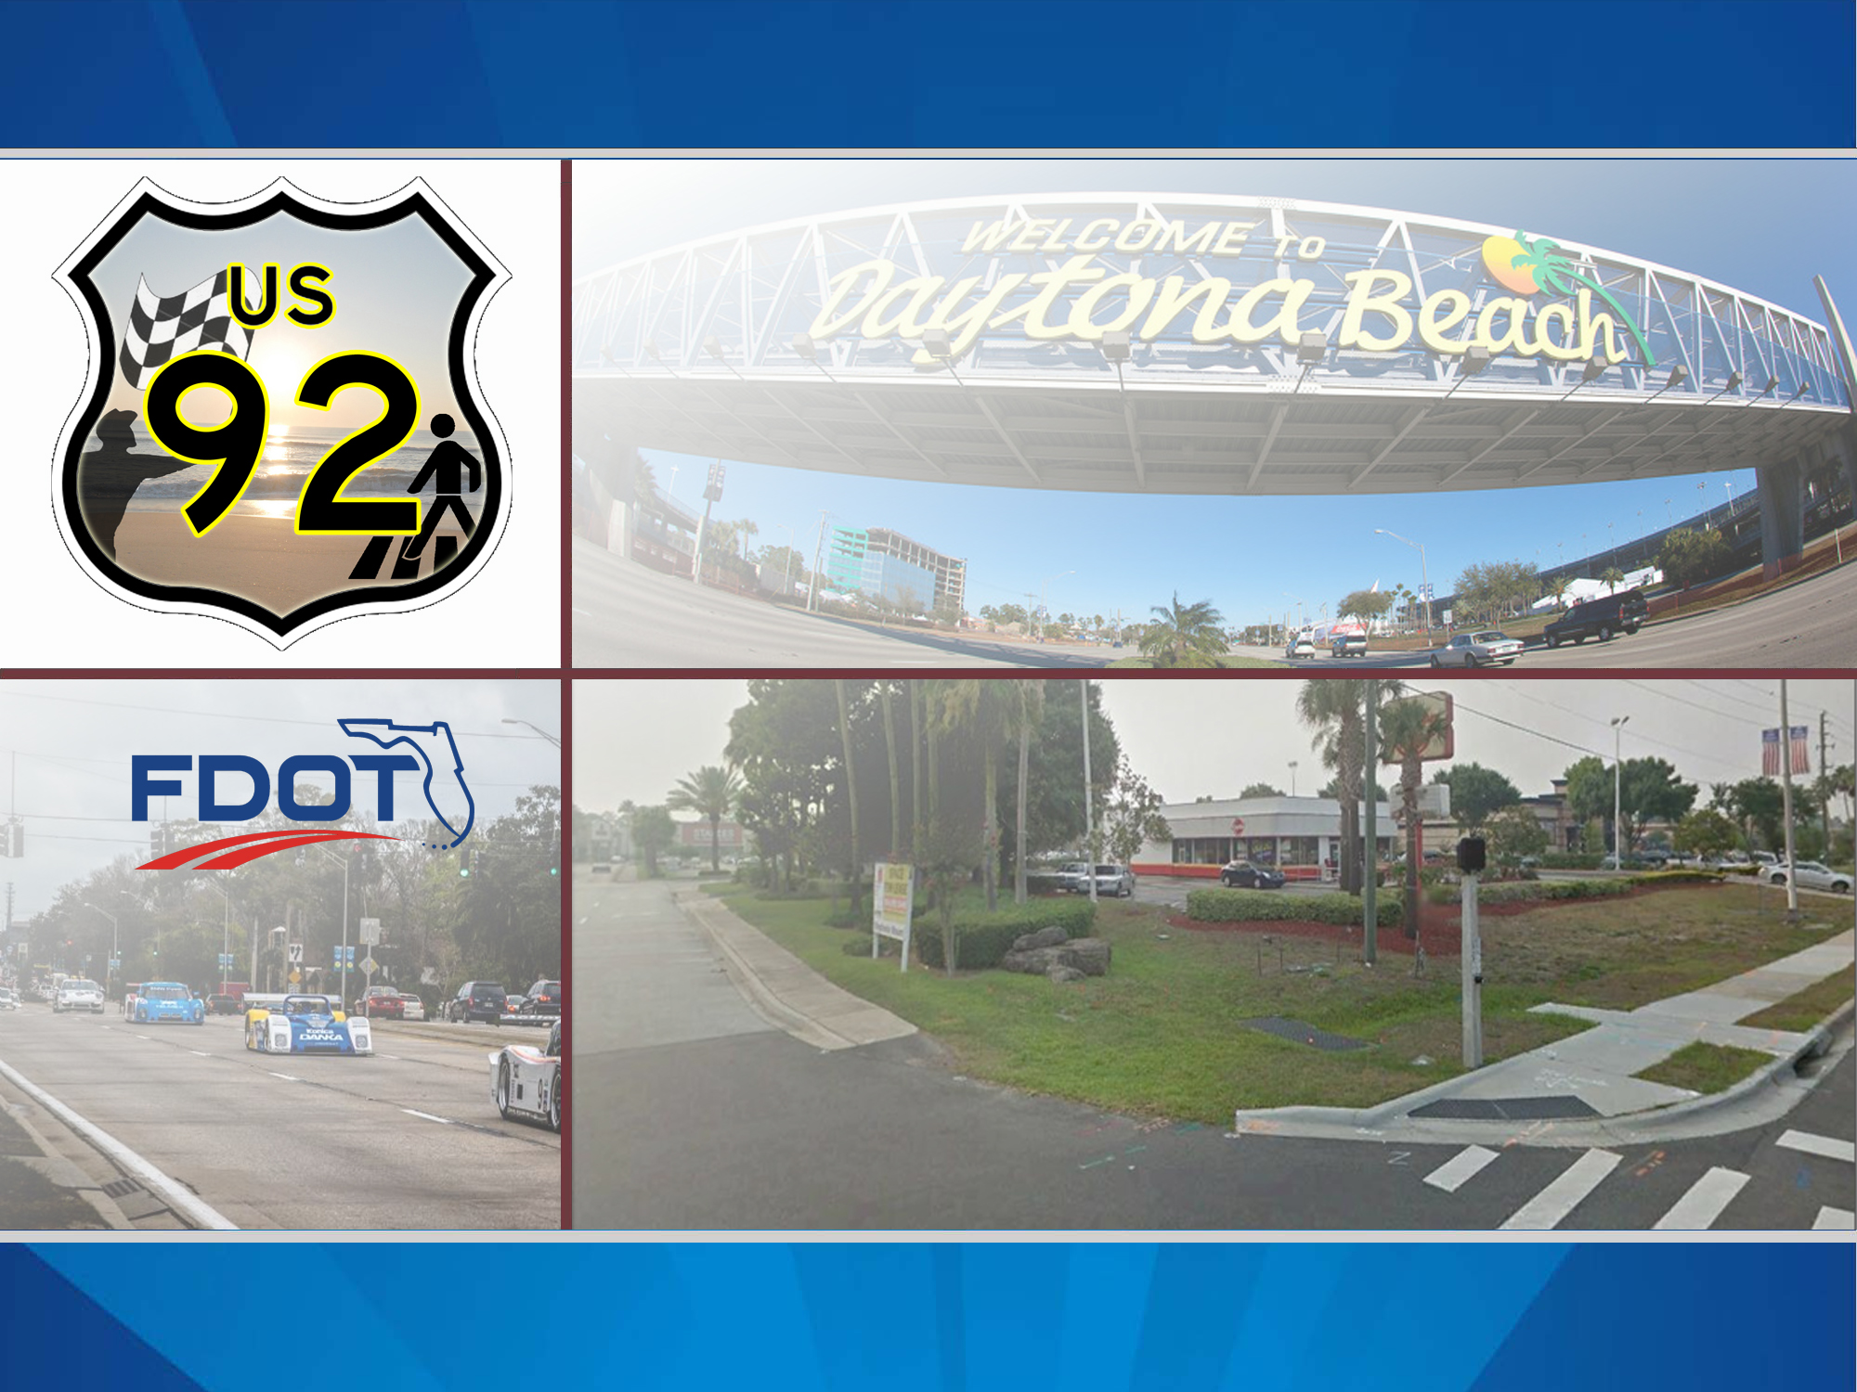
US 92 Pedestrian Connectivity & Safety Assessment Study
Study Overview
February 24, 2016

Slide 2
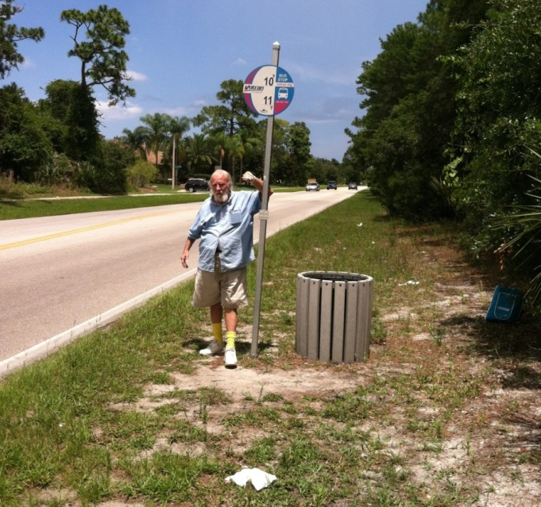
Purpose and Need
To identify existing pedestrian facilities along US 92/ISB and neighboring roadways that connect to specific pedestrian-generating development
Determine improvements needed for enhanced pedestrian connectivity and safety
Identify funding options for implementation strategies
Prioritize improvements needed for enhanced pedestrian connectivity and safety
Cyclist on International Speedway Boulevard
Transit stop on Dunn Avenue
US 92 Pedestrian Connectivity & Safety Assessment

Slide 3
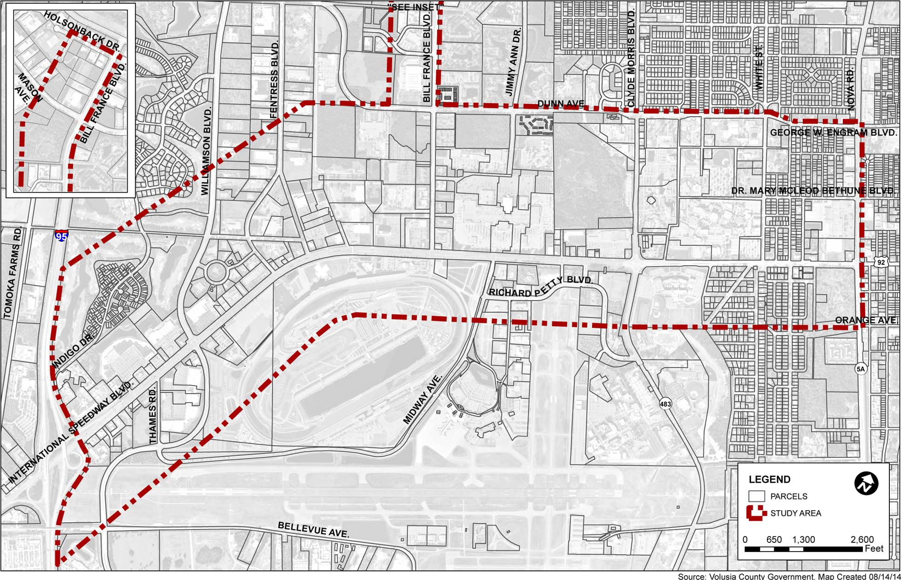
Study Area Map
I-95 (west) to SR 5A/Nova Road (east)
US 92 Pedestrian Connectivity & Safety Assessment

Slide 4
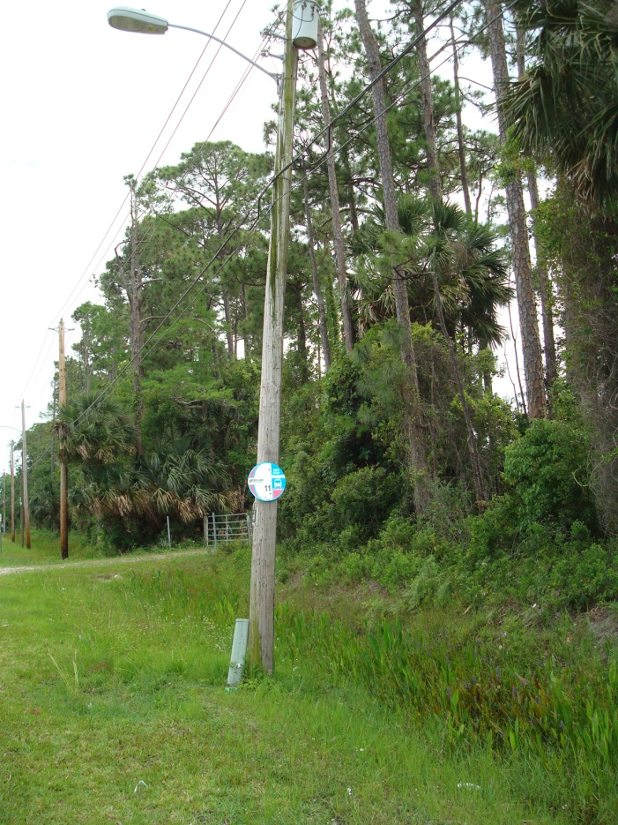
What We Found
Summary of Issues & Constraints
Limited bicycle parking facilities
Bicyclists observed using sidewalks instead of designated bike lanes
Limited or no shade trees along sidewalks
Lack of sidewalk continuity
Majority of crosswalks are unmarked
Lack of pedestrian refuges at traffic signals
Sidewalks are disconnected from adjacent land uses
Many bus stops lack amenities
Transit stop on Thames Road
US 92 Pedestrian Connectivity & Safety Assessment

Slide 5
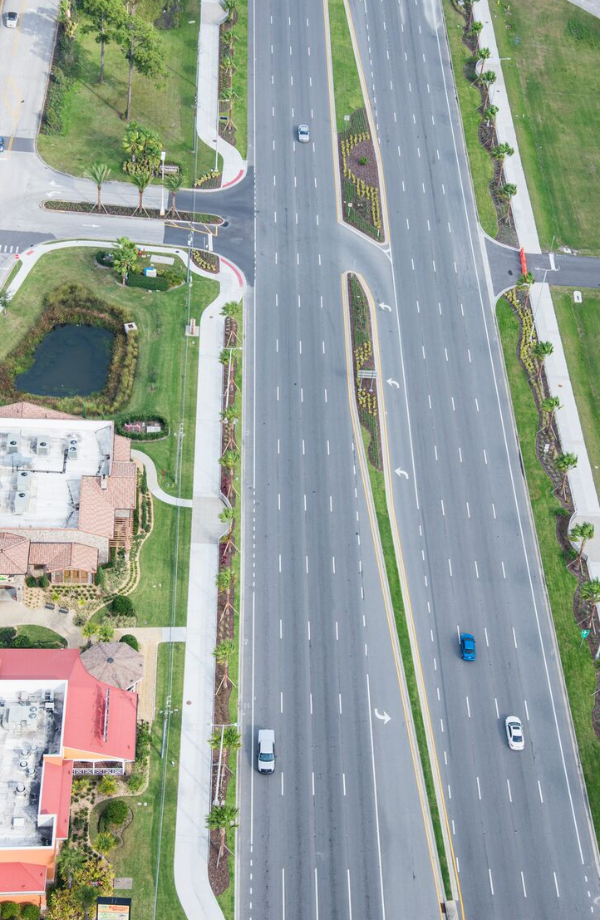
What Was Accomplished
Project Deliverables
Recommended Improvement Prioritization Criteria based on the 2014 Volusia County ADA Transition Plan
Recommended Improvements Prioritization and Cost Estimate Matrix
Conceptual Design Criteria to guide future safety enhancements and bicycle/pedestrian improvements
Cyclist on International Speedway Boulevard
US 92/International Speedway Blvd.
US 92 Pedestrian Connectivity & Safety Assessment

Slide 6
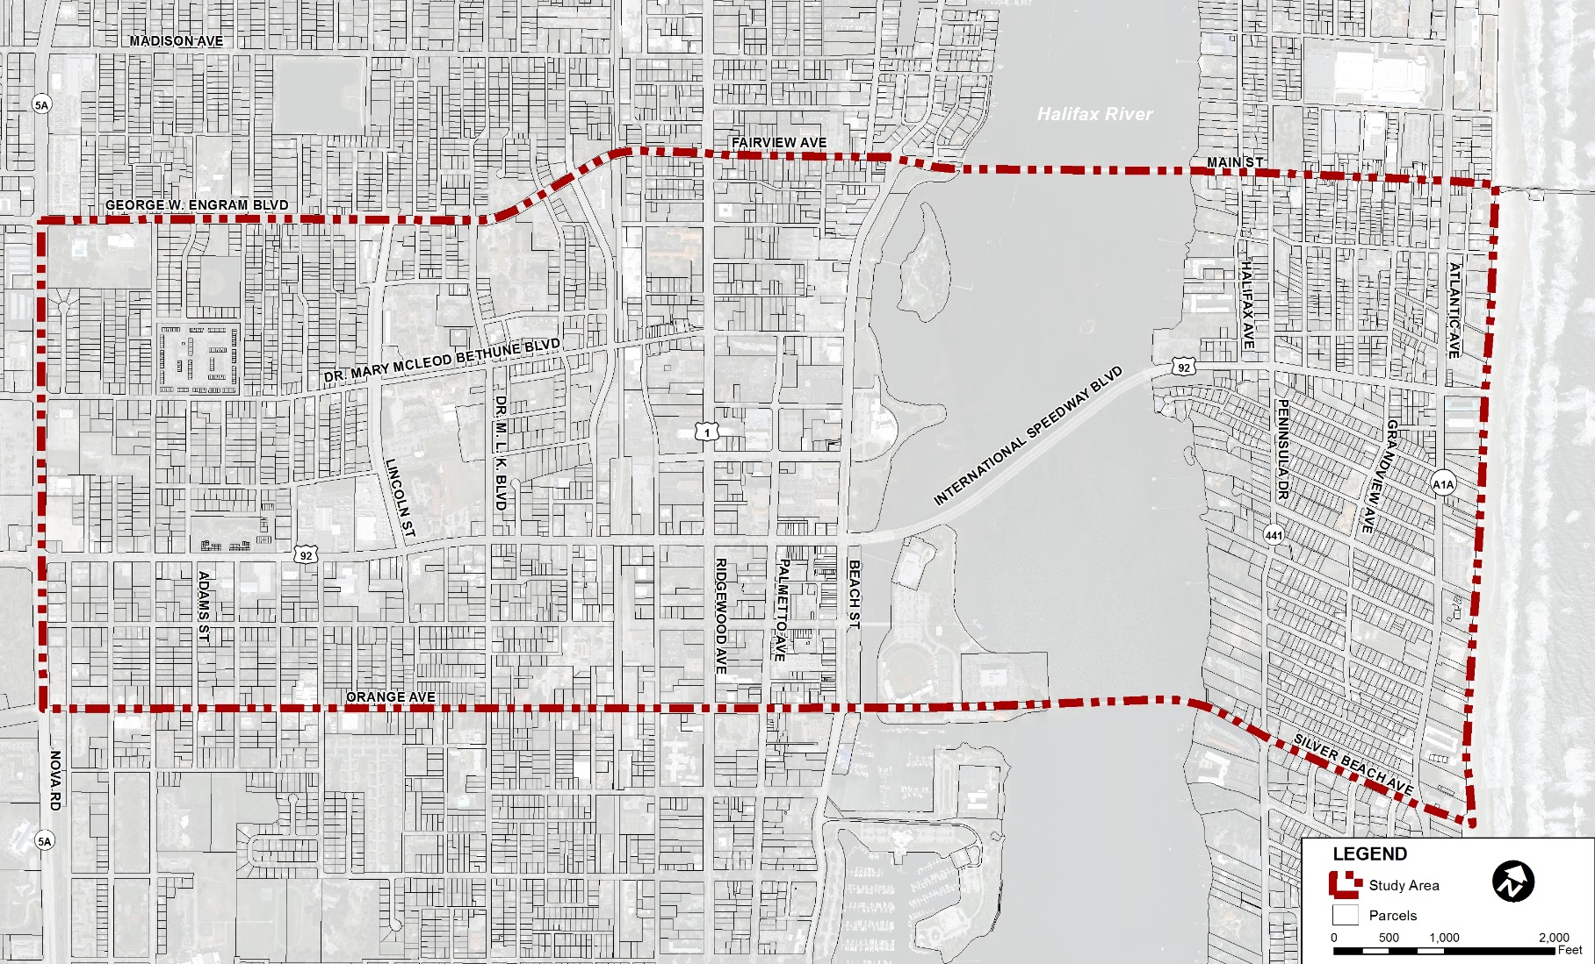
What We’re Doing Now
Phase II Study Area (Nova Road to SR A1A/Atlantic Avenue)
US 92 Pedestrian Connectivity & Safety Assessment

Slide 7
US 92 Pedestrian Connectivity & Safety Assessment Study
Judy Pizzo, MS
Planning Project Manager
FL Dept. of Transportation
386-943-5167
Judy.Pizzo@DOT.State.FL.US
February 24, 2016

