Slide 1

FM No.: 432100-1-22-01
Florida Department of Transportation, District 5
SR 400 (I-4) Project Development and Environment (PD&E) Study
September 17, 2013

Slide 2
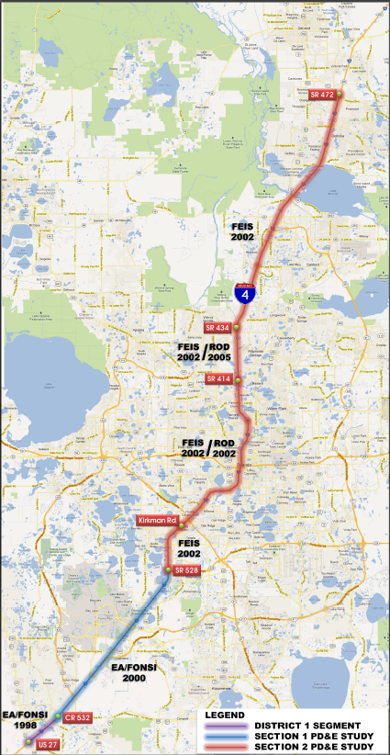
Original approvals by FHWA
EA from Memorial Blvd to CR 532
EA from CR 532 to SR 528
EIS from SR 528 to SR 472
Reevaluation Segment | EA | FONSI | FEIS | ROD | Pending ROD
A = US 27 to CR 532 | X | X
B = CR 532 to SR 528 | X | X
C = SR 528 to SR 435 (Kirkman Rd) |  |  | X |  | X
D = SR 435 (Kirkman Rd) to SR 434 |  |  | X | X
E = SR 434 to SR 417/SR 429 |  |  | X |  | X
F = SR 417/429 to SR 472 |  |  | X |  | X

Slide 3
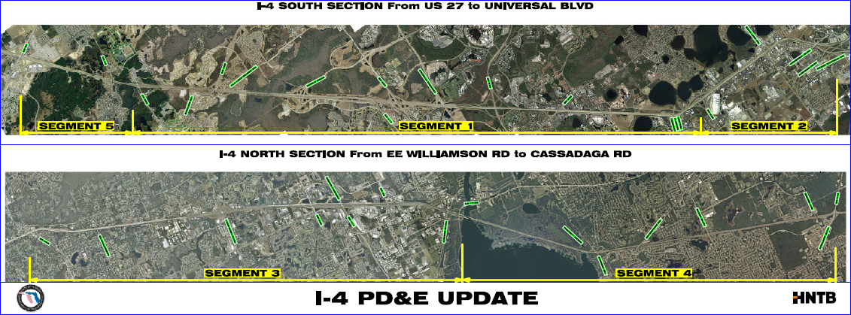
I-4 PD&E Updates

Slide 4
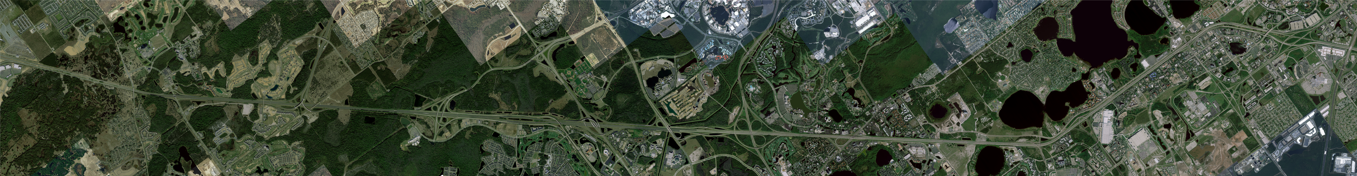











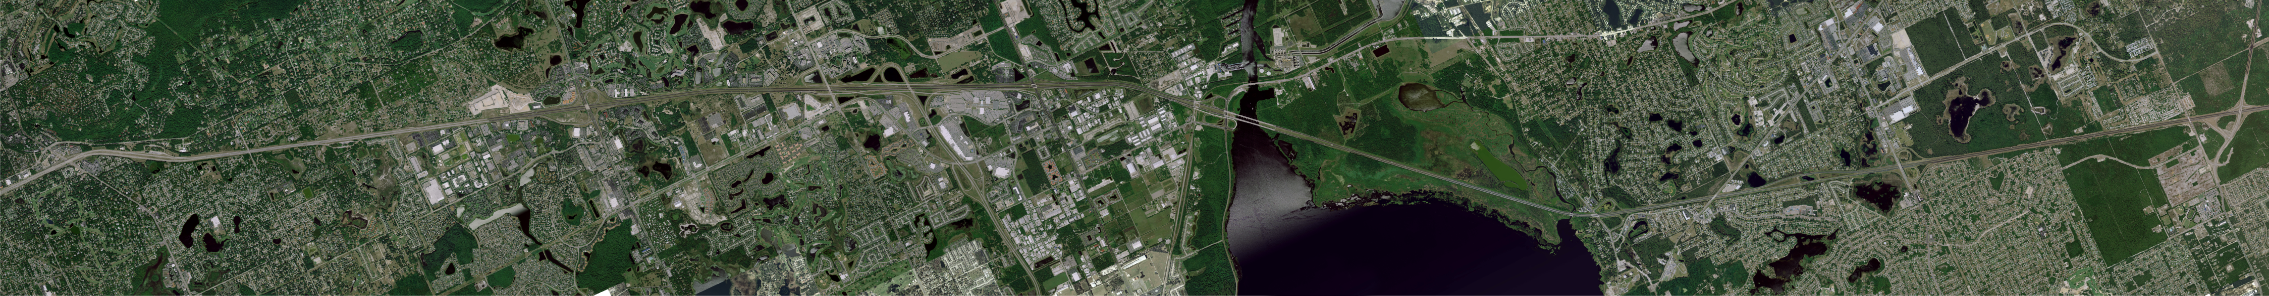












STAKEHOLDER ISSUES
Crossroad Limits
Local Work Plans
New Interchange Requests

Slide 5
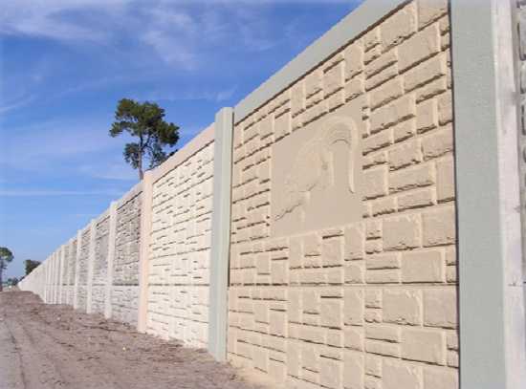
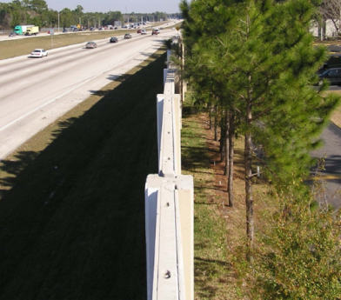
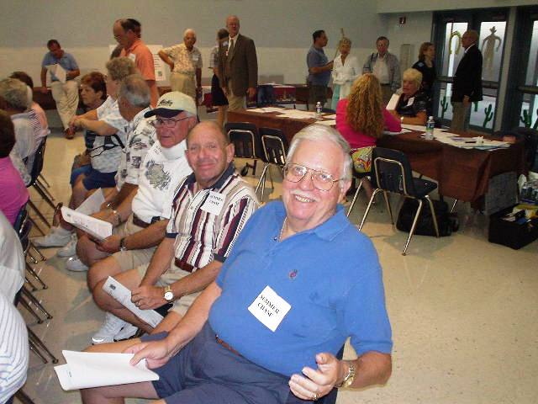
ENVIRONMENTAL
Physical Environment
  Noise
  Contamination
  Cultural Resources/Section 106
Natural Environment
  Wetlands
  Threatened and Endangered Species
Social Issues
Environmental Justice
Public Involvement
Follow NEPA Process

Slide 6
WHAT HAS CHANGED?
Noise Guidelines changed by FHWA 2010
  Adopted by FDOT May 2011
USACE Mitigation Rule – Adopted in 2008
1987 USACE Wetland Delineation Manual Modified With Regional Supplements in 2008
New Mitigation Banks within Corridor
Senate Bill Changes
Impaired Waterbody Lists (303d) Updated
Antiquity Issues

Slide 7



AGENCY COORDINATION
Jurisdictions
  FHWA, FDOT, USACE, USFWS, NPS, NMFS, SJRWMD, SFWMD, FFWCC, FDACS, USCG, State/County parks, local agencies
  Board of Trustees of the Internal Improvement Trust Fund (TIITF)
Pre-App Meetings with Agencies
Review Existing Permits and Documentation

Slide 8
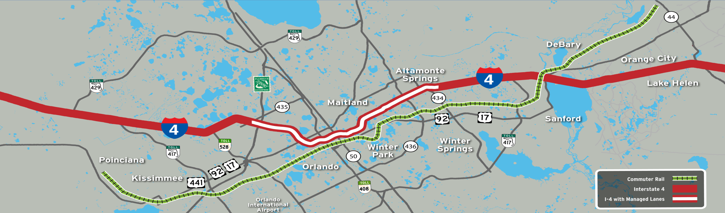
I-4 CORRIDOR RAIL ENVELOPES
Kirkman Rd to John Young Pkwy
Rail Aerial
in the Median (8.5’ )
John Young Parkway to US 441
LRT in the Median (32’)
US 27 to SR 528
HSR
in the Median (44’)
US 441 to Grant St
LRT on the East side of I-4

Slide 9
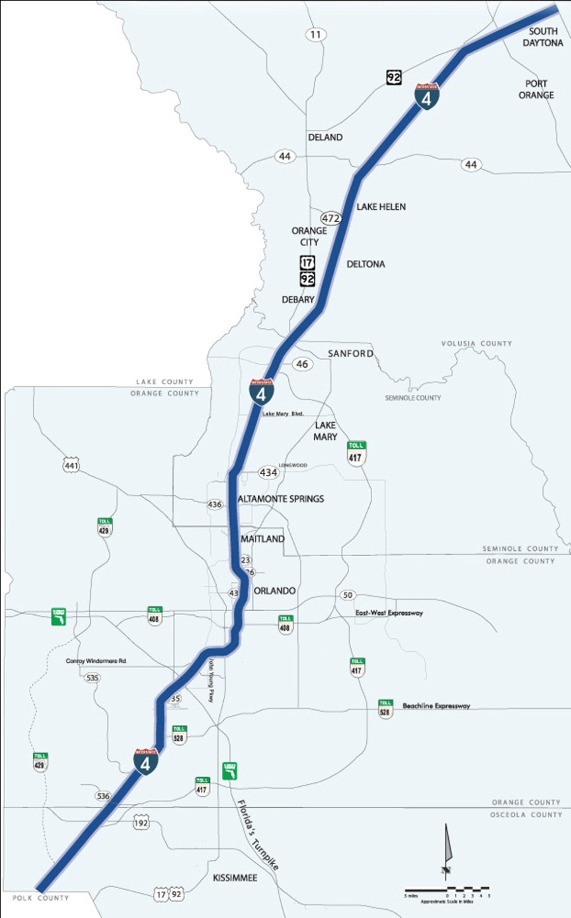
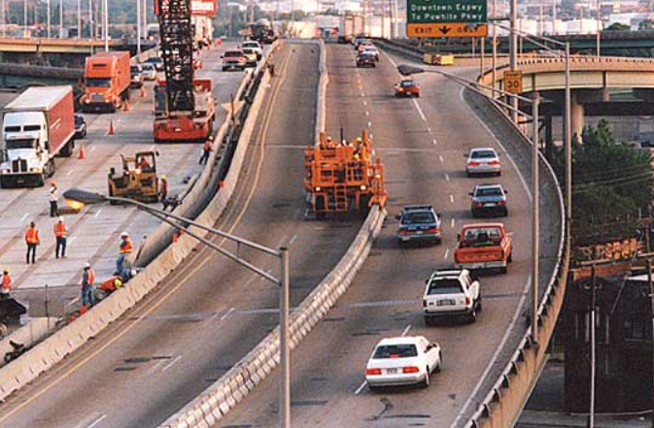
I-4 ZIPPER EXPRESS LANES
High level comparison of the express lanes concepts along I-4 including:
  6+4 PD&E concept Zipper Reversible managed lanes (6+2+1 Reversible)
Limits of Comparison
  East of SR 434 to SR 472 (20 miles)
Use of the Results
  Determine if it is warranted to pursue a zipper reversible express lane concept with the I-4 extension PD&E Update Project
End Project
Begin Project

Slide 10
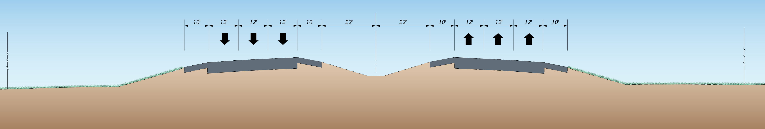
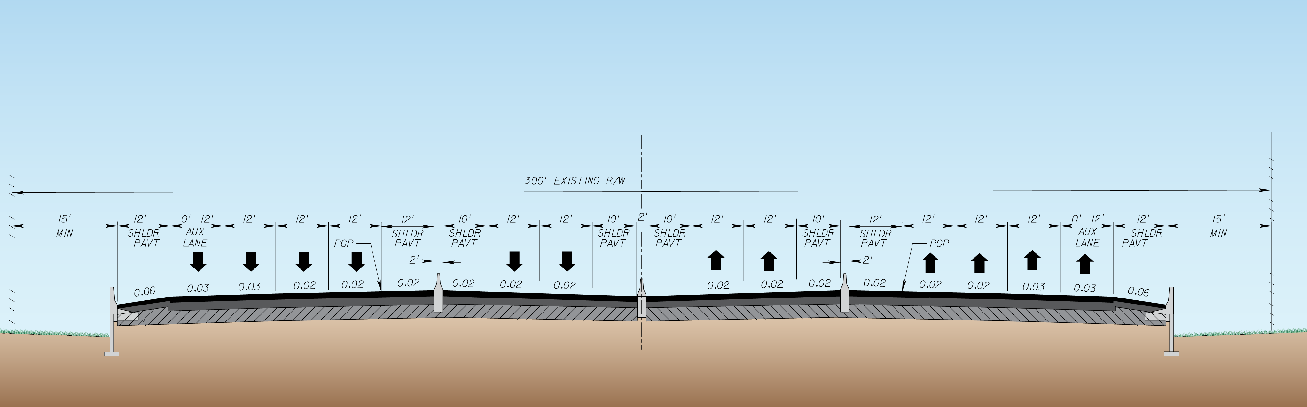
EXISTING TYPICAL SECTION
TYPICAL SECTION
Full Shoulder Widths
Variation Required
for Border Width

Slide 11
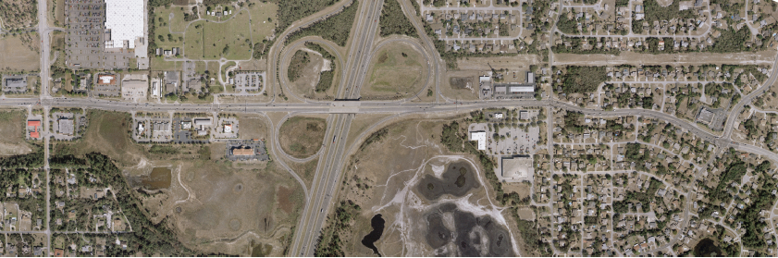
CROSSROAD LIMITS
Crossroads Area of Influence
  Based on traffic congestion
  Access management
  Adjacent intersections
  Land uses
  Incident Management Routes
0.6 miles

Slide 12




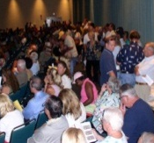


PUBLIC ENGAGEMENT AND COMMUNITY OUTREACH
Innovative Technologies
Collateral Materials Development
Media
Relations
Meetings/
Hearings
Interactive Web
FDOT Social Media
Webcast Capability
Moving-4-ward.com
Synergistic-Coordinated Approach Consistent Messaging
Stress Benefits, Use Plain Language to Explain Technical Features
One-on-One Key Influencer Meetings
Speak at HOA/Neighborhoods
Alternatives Meetings
Public Hearings
Press Releases
Support Department Public Information Office

Slide 13
DEVELOPMENT OF PREFERRED ALTERNATIVES
Traffic Operations
Minimize Right of Way Impacts
Consistent with Core Section
Business Rule Variables for Express Lanes
  Interchanges direct access
  Slip ramps
Addresses Environmental Impacts

Slide 14
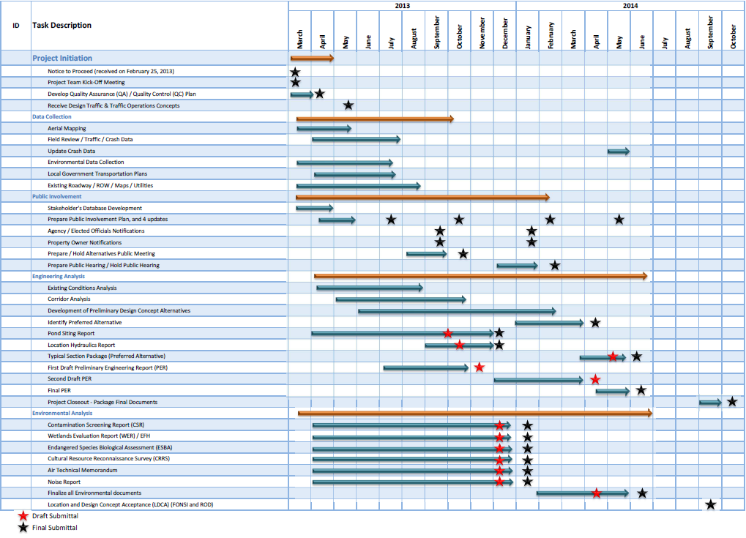
SCHEDULE

Slide 15
CONTACT INFORMATION
  Ms. Beata Stys-Palasz
    Florida Department of Transportation
    719 South Woodland Blvd.
    DeLand, Florida 32720
    Phone: 386-943-5418
    Email: Beata.Stys-Palasz@dot.state.fl.us
  Mr. Luis Diaz
    610 Crescent Executive Court, Suite 400
    Lake Mary, Florida 32746
    Phone: 800-889-8237
    Email: ldiaz@hntb.com

