Slide 1
Heart of Florida Loop East Section
BPAC Meeting
June 10, 2015

Slide 2
Heart of Florida Loop-East Section
In the River to Sea TPO planning area, the Heart of Florida Loop consists of the Florida Black Bear/SR 40 Trail, US 17 Trail and the Spring to Spring Trail (a total of 39 miles).

Slide 3
Heart of Florida Loop-East Section
SR 40 Trail
US 17 Trail
Spring to Spring Trail

Slide 4
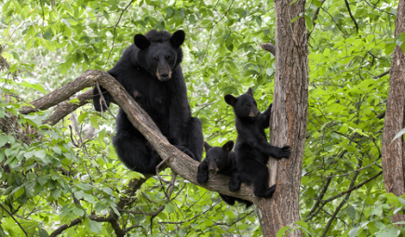
Florida Black Bear/SR 40 Trail
Connecting Marion, Lake and Volusia Counties
Volusia County Limits: St. Johns River to US 17
Width: 12 feet
Length: 6.5 miles
Current Status: PD&E/feasibility study programmed in FY 2020
Estimated Cost: $1.1 million

Slide 5
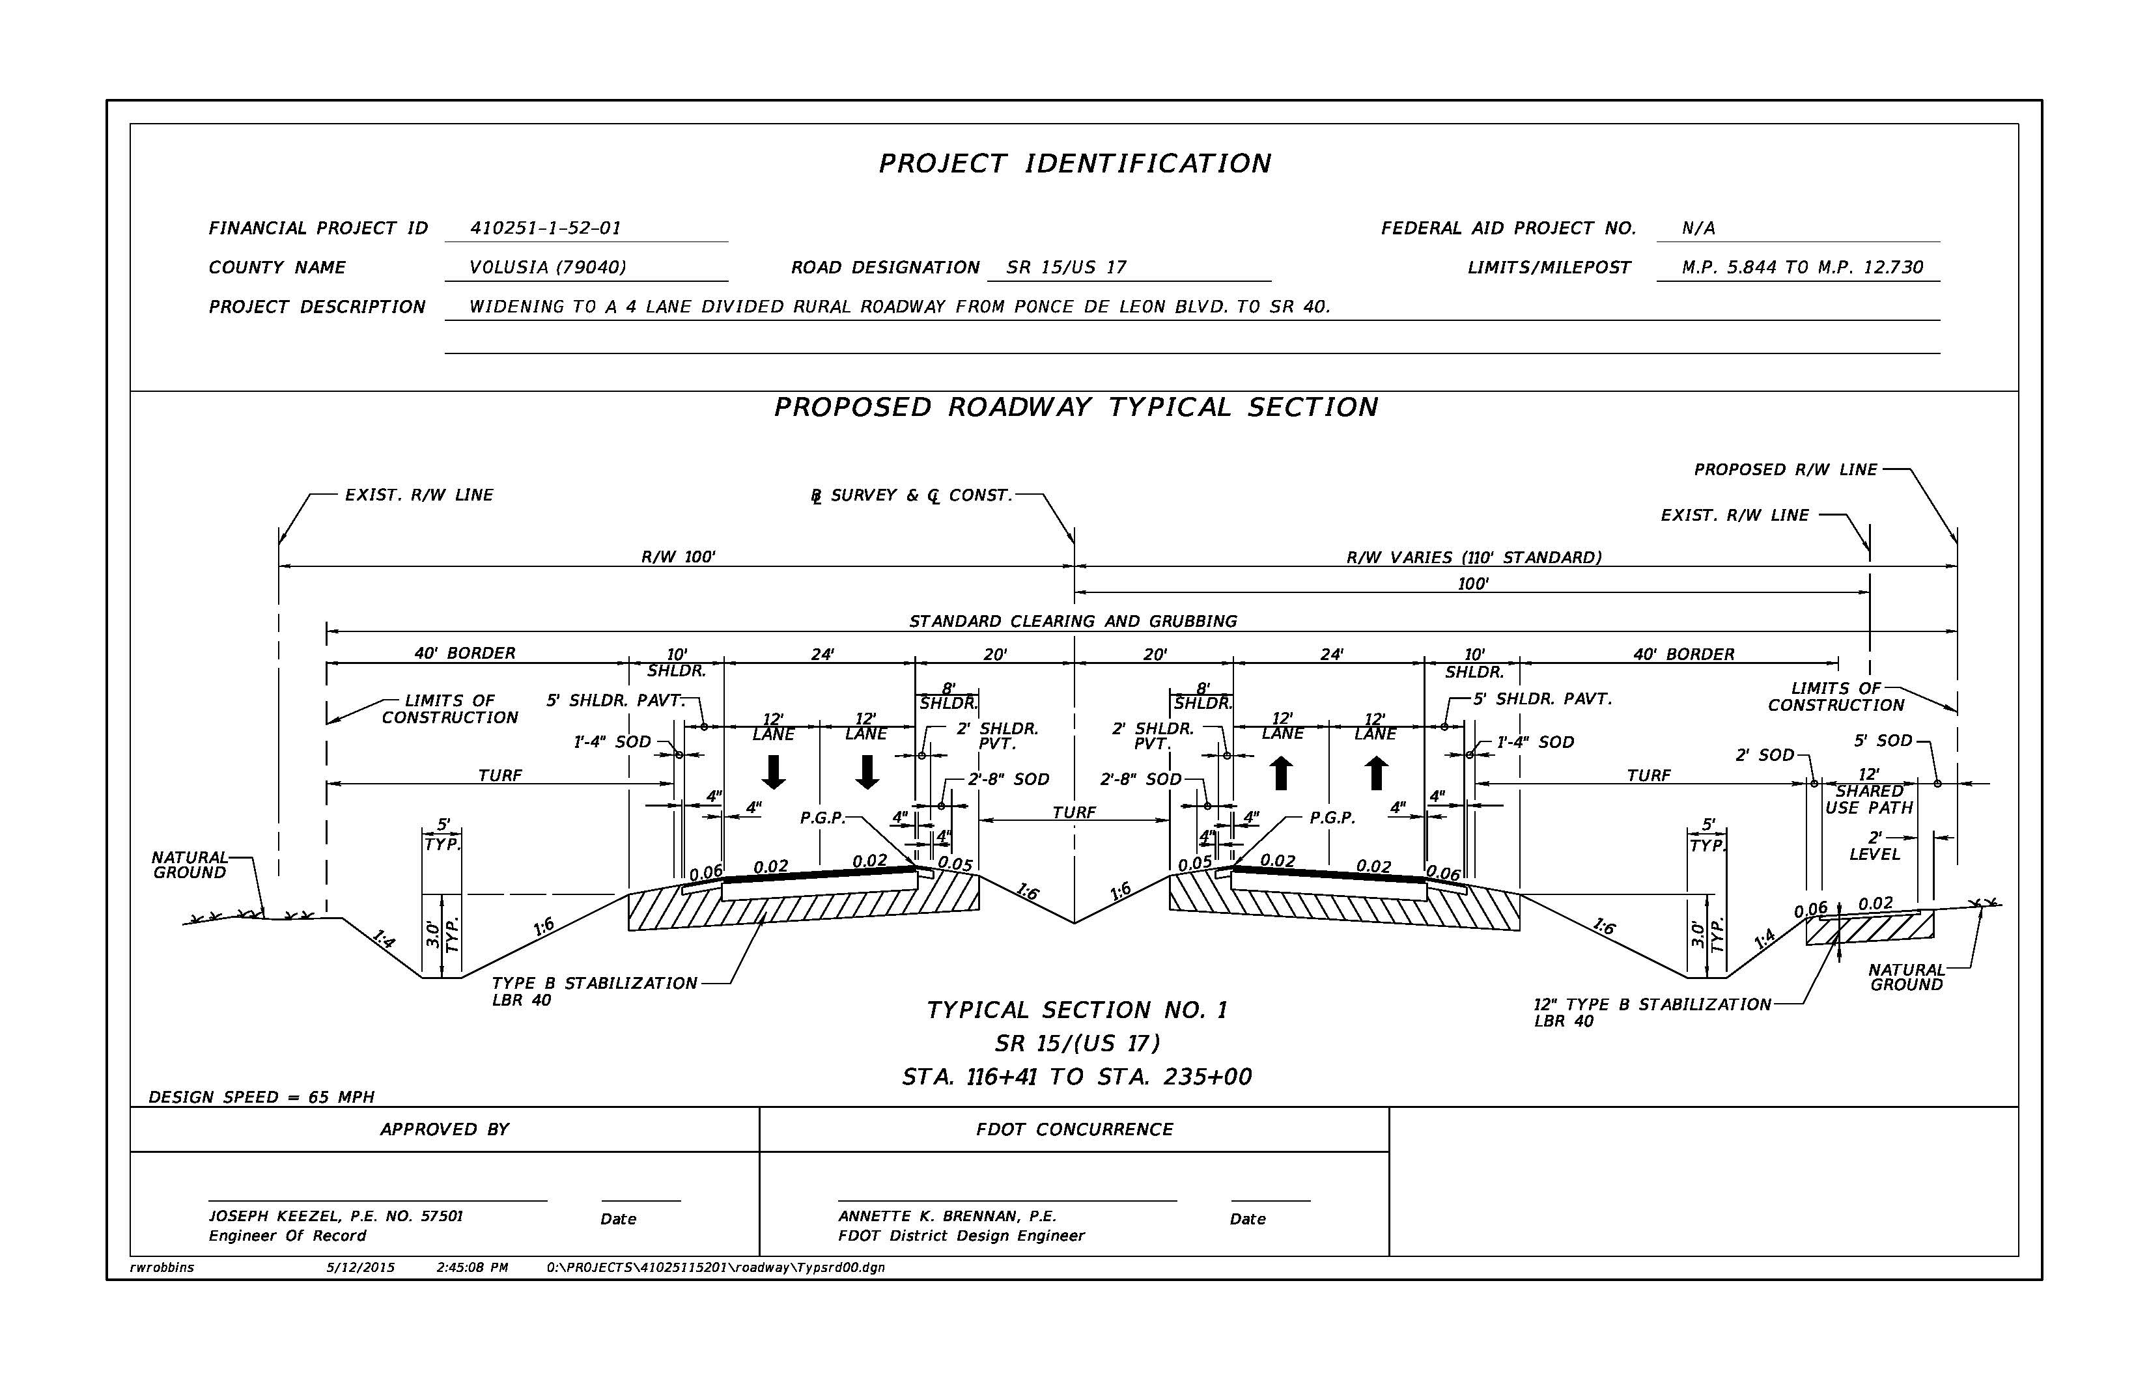
US 17 Trail
Developed in conjunction with the widening of US 17/SR 15
Limits: Ponce de Leon Boulevard to SR 40 (east side)
Width: 12 feet
Length: 6.84 miles
Current Status: Design & Right of Way (40% design plans)
Estimated Cost: $1.2 million
(construction not funded)
Proposed Roadway
Typical Section →

Slide 6
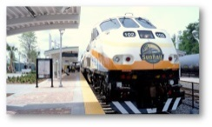
Spring to Spring Trail
Gap H
Gap G
Gap F
Seminole/Volusia Gap

Slide 7
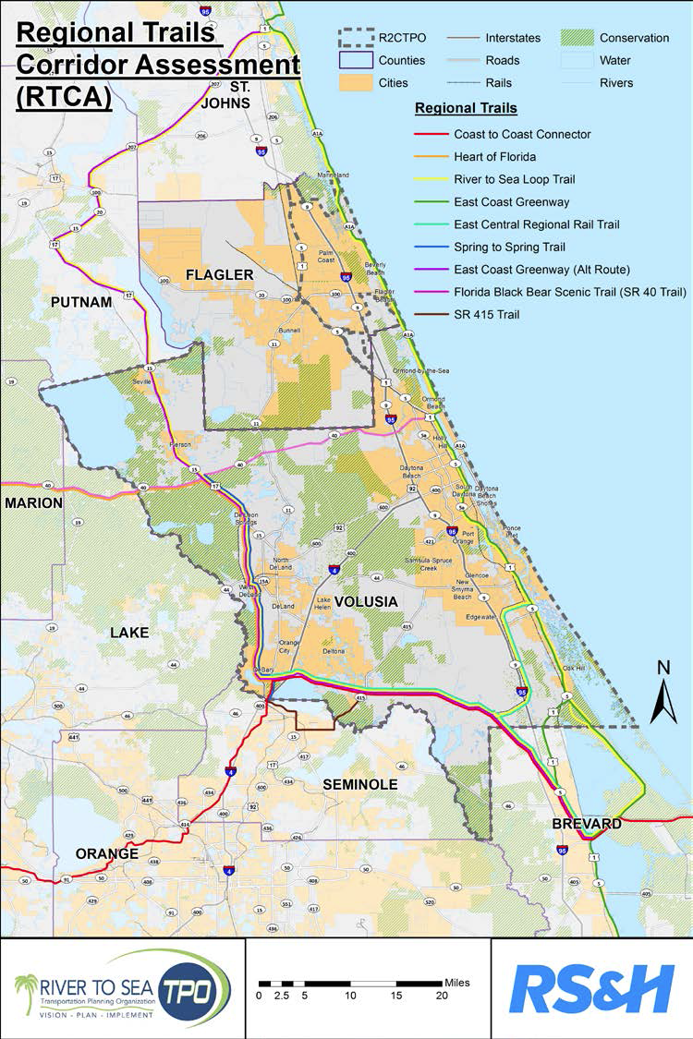
Goals of the RTCA
Complete the regional trails network in the River to Sea TPO planning area
Advance the FGTS Plan by identifying trails for the 2015 Opportunity Map Update
Develop/finalize trail alignments and connections
Inventory existing trail gaps and develop conceptual plans and cost estimates

Slide 8
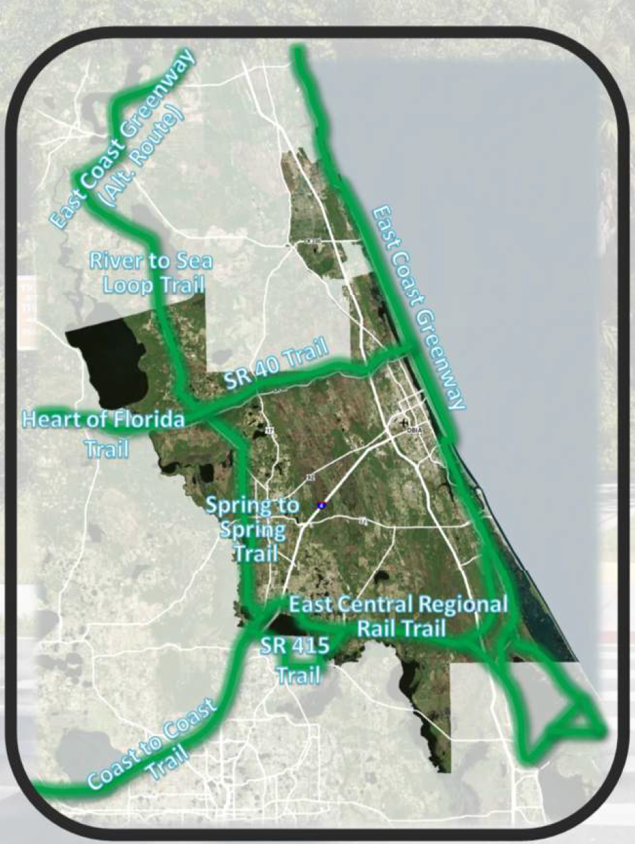
Regional Trail Connections to the Heart of Florida Loop
St. Johns River to Sea Loop/East Coast Greenway (alternate route)
SR 40 Trail
East Central Regional Rail Trail

Slide 9
Thank You

