Slide 1
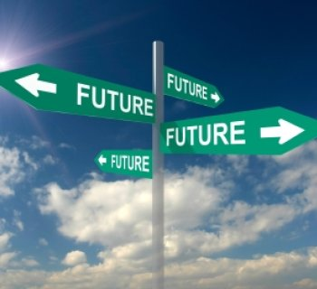
Transit
Development
Plan
“If you don't know where you are going, you will probably end up somewhere else”
-Lawrence J. Peter

Slide 2
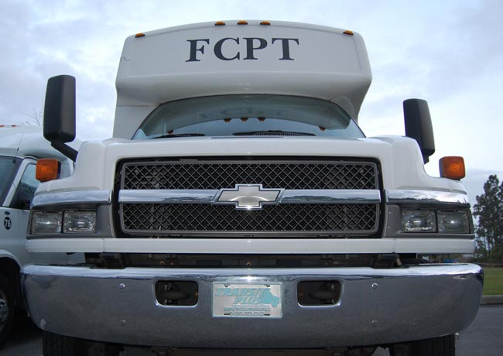



Flagler County Transit Development Plan
2015-2025
Flagler County
Public Transportation
R2C TPO: CAC/TCC August 19, 2015

Slide 3

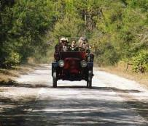
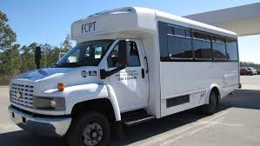
Study Purpose & Key Objectives
Improve Public Transportation
Local, Regional, State, Federal Coordination and Funding
TDP: Meet Requirements for urbanized areas (341.052 F.S., Rule14-73 F.A.C)
Public Involvement
Complete TDP Adoption and Approval

Slide 4
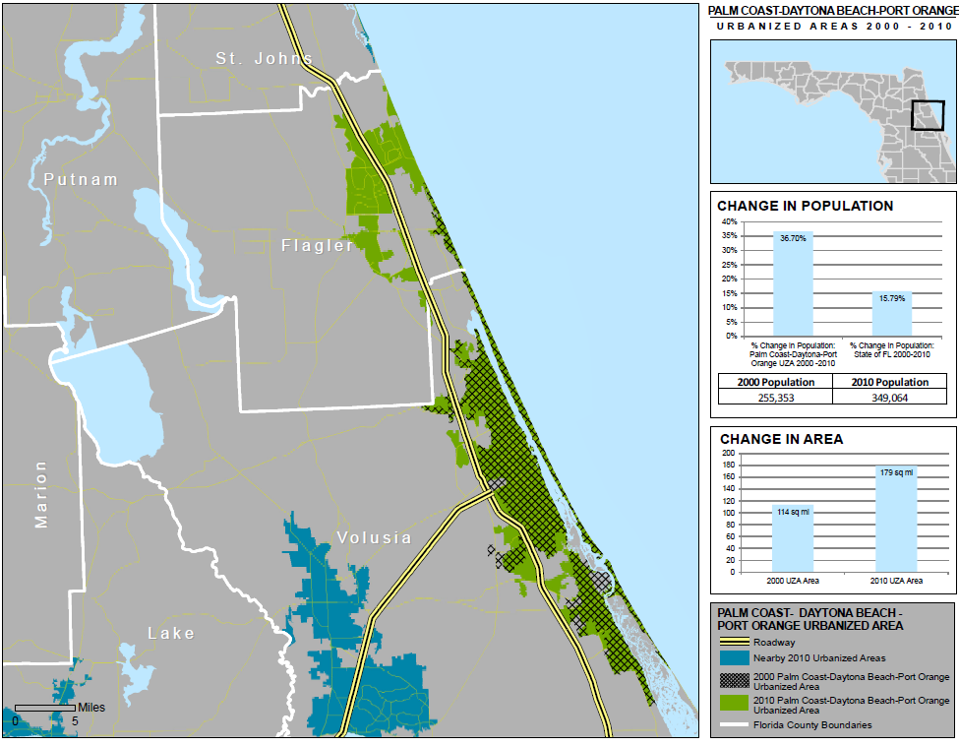
2010 Census Impact:
Rural to Urban
Eligible for S5307 FTA
Eligible for FDOT Block Grant
Multi-Year Planning of TDP
2010 New Urbanized Area Includes Flagler County

Slide 5
Phase 1
Demographics
Phase 2
Needs Assessment
Goals & Objectives
Phase 3
Demographics Update
Performance
Demand Analysis
Benchmarking
Service Alternatives
Capital & Operating
Situational Assessment
System Design and Funding
Funding Analysis
Intergovernmental Coordination
Intergovernmental
Fixed Route Concepts
System Performance
Studies Conducted FY09 - FY 14
1+2+3+ Public Involvement + Adoption Process = TDP

Slide 6
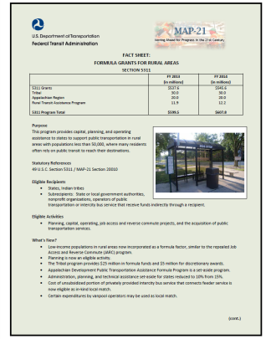
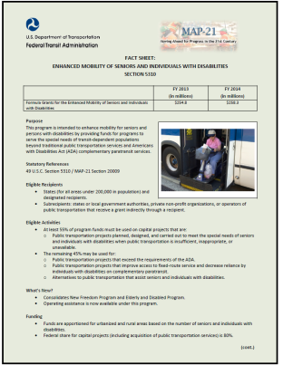
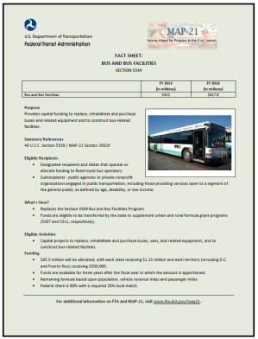
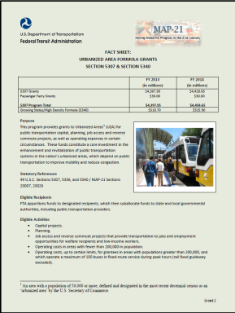
TDP:
Establishes Eligibility
Prioritizes Projects
Input to FDOT TPO TIP / STIP
Maintains Program of Projects
Compete for Discretionary Funding

Slide 7
Public Transportation Funding
Federal Transit Administration (FTA)
State of Florida & Local
Section 5307 (Urbanized Area Formula)
Section 5310 (Enhanced Mobility for Senior and Individuals with Disabilities)
Section 5311 (Rural Area Formula Program)
Section 5339 (Bus and Bus Facilities Formula)–
Commission for Transportation Disadvantaged
Local Funding
FDOT Service Development Program
FDOT Block Grant Funds

Slide 8
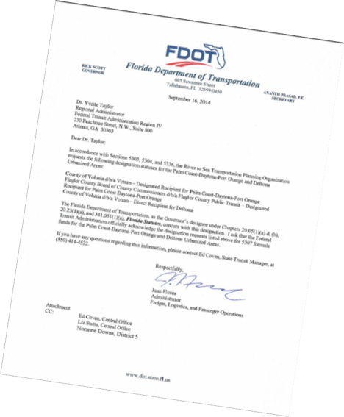
Flagler: Designated Recipient (DR)
“Receive and apportion” the amounts made available to Flager Portion of UZA
Prepares the final program of projects
Partner with TPO and VOTRAN (other DR)

Slide 9
Major Elements of a TDP
Community Profile – Vision
Existing System Analysis
Situation Appraisal
Needs, Issues, and Opportunities
Public Involvement
Goals, Objectives & Policies
Service Alternatives - Priorities
Ten Year Planning Estimates
Capital / Operating
Transit Action Program
“TAP”

Slide 10
Health
* Access
* Benefits
Mobility
* Service
* Partners
Economy
* Job Access
* Workforce Development
* Tourism
* Business Access
Education
* Access
* Skills
* Knowledge
Environment & Livability
* Physical
* Cultural
Relevance

Slide 11
Transit Development Planning
Demographics Analysis
Existing System Peer / Trend
FTA / FDOT
Funding Opportunities
Performance Evaluation
Conceptual Service Network
Flagler County
Situation Appraisal
Goals Objectives, Strategies
Intergovernmental Coordination
Public
Involvement
Service Improvements
2015-2025
Comply with FDOT TDP Requirements

Slide 12
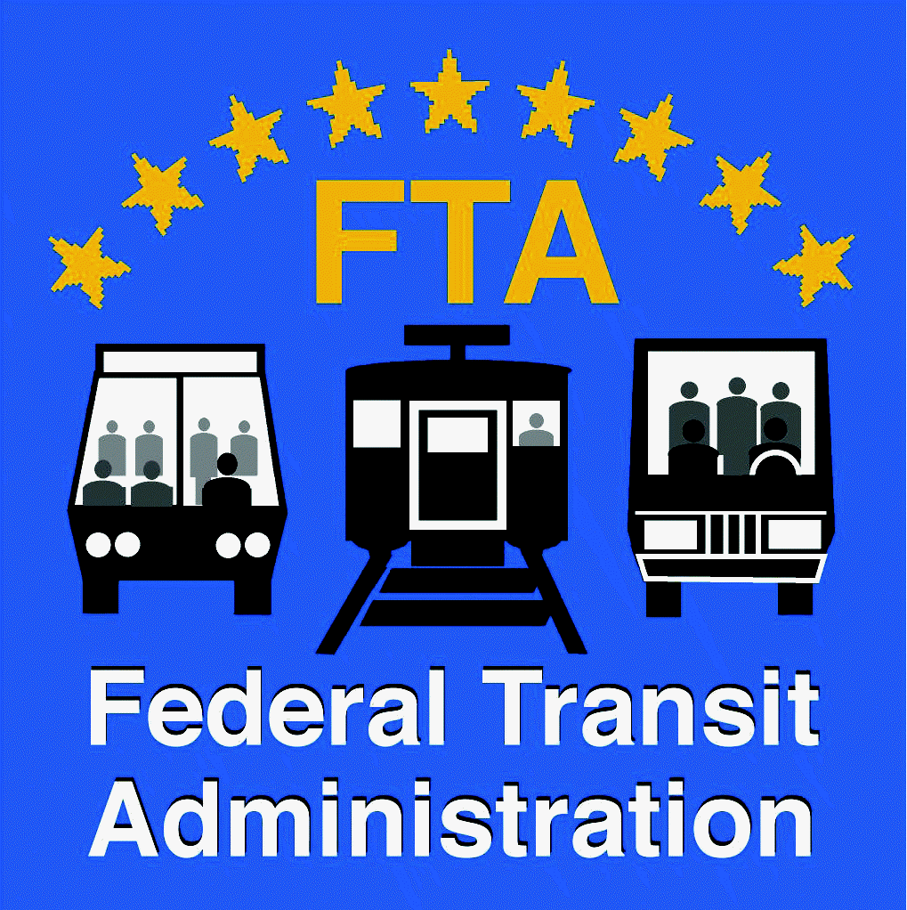

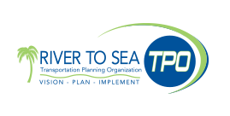



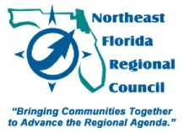


Partner Coordination

Slide 13

Public Involvement
Outreach
Advisory Review Committee (ARC)
Outreach Community Associations
Community Leader Interviews
Customer Surveys
Intergovernmental Coordination Committee
On-Line Access / Outreach
Public Workshops
TPO / NEFRC
TPO Process Coordination
Public Hearing and Adoption

Slide 14
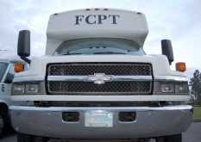
What Makes A Great Public Transit System?
Service Design
Community Relevance
Teamwork
Market Needs & Opportunities
Partnerships
Investments
Customer Service
Excellent Service Delivery
Facilities
Connectivity
Job
Access
Go
Green
Accessibility
Tourism
Image
Reliable
Convenient
Mobility
Management
Efficient
Frequent
Regional
Connections
Education
Senior Services

Slide 15
TDP Public Workshops
Tuesday, August 11th, 2015
4:00 pm – 6:00 pm
Flagler County Emergency Operations Center Training Room A
Flagler County Emergency Services
1769 E Moody Blvd # 3, Bunnell, FL 32110
Wednesday, August 12th, 2015
4:00 pm – 6:00 pm
Palm Coast Community Center
305 Palm Coast Pkwy NE, Palm Coast, FL 32137

Slide 16
Goals, Objectives and Strategies
    Public Transit Vision
    Public Transit Mission
Flagler County exceeds expectations in delivering a well-balanced multi-modal transportation system that promotes economic development, community accessibility, sustainability, and environmental sensitivity.
Flagler County will operate and coordinate a multi-modal public transportation system that effectively and efficiently meets the existing and future mobility needs as identified through on-going outreach to Flagler County’s residents, visitors and businesses.

Slide 17
Goal 1: Smart Growth Development
Support future development that is smart-growth oriented, low impact and environmentally friendly that reduces urban sprawl and incorporates transit oriented development and bicycle/pedestrian access.
Objective: Evaluate and participate in the development of and updates to regional plans, advocating policies that support transit use.

Slide 18
Goal 1: Smart Growth Development
Strategy1.1: Conduct an ongoing Comprehensive Plan evaluation to define appropriate modifications to support smart growth.
Strategy1.2: Support revisions to land development codes to reflect those Comprehensive Plan changes that support smart growth.
Strategy1.3: Create local public transportation design standards and include them in a resource to provide to local governments, development agencies and the business development community.
Strategy1.4: Perform education and outreach activities to developers to facilitate the incorporation of public transit amenities and transit supportive design elements in new developments.
Strategy 1.5: Develop a demonstration public transportation project that highlights the local eco-tourism industry through seasonal services and/or public-private partnerships.
Strategy1.6 : Flagler County shall monitor its transportation system and the Concurrency Management Program to ensure adequate transportation system capacity prior to issuance of development orders to include potential transit, pedestrian and bikeway enhancements.

Slide 19
Goal 2: Goal: Multi-jurisdictional planning
Develop an efficient, effective, and convenient process to address multi-jurisdictional planning within Flagler County and throughout the region.
Objective: Advocate Flagler County’s transportation interests through participation in regional transportation decision making.

Slide 20
Goal 2: Multi-jurisdictional Planning
Strategy: Coordinate with all municipalities within Flagler County, FDOT, Volusia TPO, St. Johns and Duval County through active participation in planning events, committees, and boards.
Strategy: Use the regional transportation planning process as a means to incorporate local transit projects into funding programs.
Strategy: Maximize TPO involvement; receive transportation/transit funds and program projects into a Transportation Improvement Program for the County.

Slide 21
Goal 3: Integrated Transportation System
Implement an integrated transportation system that addresses the needs of a variety of traveler markets and trip purposes
Objective: Expand the transportation system to promote a greater range of transportation options.

Slide 22
Goal 3: Integrated Transportation System
Strategy: Improvements to the County’s transportation system should be planned to protect the environment, providing alternatives to single occupancy vehicles such as shared ride services, fixed route and demand response transit and providing park-and-ride facilities for express services to regional urban centers.
Strategy: Implement transit alternatives (fixed route/deviated route bus services, paratransit services, ride share and vanpooling) as demand requires, that are consistent with needs and alternatives identified in this plan to reduce the rate of growth in traffic congestion.
Strategy: Promote public transportation alternatives that lower the overall cost per trip burden generally experienced through demand response transit service.
Strategy: Continue development of a robust system of sidewalks, trails, bike lanes and pathways that interconnect activity centers and neighborhoods to provide access to alternative transportation options.

Slide 23
Goal 3: Integrated Transportation System
(continued)
Strategy: Work cooperatively with neighboring communities to implement services that improve the connectivity between public transportation modes and services throughout the region.
Strategy: Assess changing demographic and socio-economic characteristics every 12 to 24 months (e.g. number of 55+ residents, increasing number of zero vehicle households, net in-migration etc.) and tailor transit services to adapt to those trends.
Strategy: Create opportunities for public involvement through actively soliciting input from citizens, community and interest groups in the planning and implementation of public transportation services.

Slide 24
Goal 4: Public Stewardship of Financial Resources
Ensure prudent public stewardship of financial resources and secure funding for a program of system maintenance and improvements.
Objective 4.1: Maintain an equitable fare strategy and establish farebox recovery standards.
Objective 4.2: Seek to obtain additional local funding and maximize leveraging of state and federal funding partnerships.

Slide 25
Goal 4: Public Stewardship of Financial Resources
Strategy 4.1.1: Conduct a fare analysis and establish target revenue income.
Strategy 4.1.2: Provide preventive maintenance and efficient operations of vehicles.
Strategy 4.2.1: Develop and explicit service and capital improvement program defining use of local funding sources and financing techniques.
Strategy 4.2.2: Establish a legislative funding priority program to seek state and federal funding partnerships.
Strategy 4.2.3: Establish and monitor annual financial performance measures.

Slide 26
Goal 5: Implement Appropriate Levels of Transit
Implement appropriate levels of transit throughout the County.
Objective: Consider a cost-effective expansion of public transportation services through the most effective mix of options as travel demand forecasts warrant.

Slide 27
Goal 5: Implement Appropriate Levels of Transit
Strategy 5.1.1: Select the optimum administrative and operating structure for new/expanded service delivery options in the future.
Strategy 5.1.2: Make use of resources such as the Florida statewide transit vehicle procurement contract to select the options and detailed specifications to purchase service vehicles at a pre-negotiated cost.
Strategy 5.1.3: Identify, secure and maximize federal (such as 5307 & 5311) and state (Block Grant & Service Development) funding, and seek public/private partnership opportunities to provide service where it may be otherwise be difficult to do so.
Strategym5.1.4: Develop new mobility services with an emphasis on serving the top education, training, and job access destinations of residents.
Strategy 5.1.5: In the future, Flagler County will participate in the Florida Department of Transportation District 5 Commuter Assistance Program to improve highway congestion and air quality.

Slide 28
Goal 6: Provide for Capital Infrastructure
Provide associated capital vehicles, inventory, infrastructure, amenities and equipment for mobility services.
Objective: Develop and maintain a comprehensive capital improvement program.

Slide 29
Goal 6: Provide for Capital Infrastructure
Strategy 6.1.1: Establish a program to itemize and prioritize capital improvement needs that address system maintenance, vehicle replacement and expansion to include costs and financial strategies.
Strategy 6.1.2: Establish a master bus stop and infrastructure program which meets minimum design standards, criteria for prioritizing stop improvements, meets ADA requirements and promotes convenience.

Slide 30
Goal 7: Create a safe and accessible transit environment
Objective:
Provide transit amenities/infrastructure to enhance the appeal of transit for both existing and potential customers.
Strategy: Pursue agreements with property owners for placement of bus stops and transfer opportunities at high demand locations.
Strategy: Create safety criteria for placement of fixed bus stops to include adequate lighting and pedestrian access.
Strategy: Measure boardings and alightings at individual stops and develop a hierarchy of amenity requirements.
Strategy: Consider contracts with private companies that provide transit benches and shelters at no cost to the County in exchange for advertising rights.

Slide 31
Goal 8: Education and Awareness
Educate the community on the benefits of public transportation and solicit support for mass transit initiatives through outreach.
Objective 8.1: Communicate the role of transit in Flagler County.
Objective 8.2: Provide customer focused outreach activities to educate and facilitate utilization of services.

Slide 32
Goal 8: Education and Awareness
Strategy 8.1.1: Create a communications program that includes a stock powerpoint presentation and educational materials to inform existing and potential customers on the benefits of transit.
Strategy 8.1.2: Engage the business community’s support in communicating with employees and offering travel planning assistance and fare discounts.
Strategy 8.1.3: Utilize proven strategies to reach out to transit’s most high use markets; senior citizens, youth, and low income residents.
Strategy 8.1.4: Convey the environmental and economic benefits of transit related to energy conservation and sustainability.

Slide 33
Goal 8: Education and Awareness
Strategy 8.2.1: Develop and maintain a travel training program with an emphasis on moving paratransit customers to fixed route services.
Strategy 8.2.2: Develop travel training programs specific to target markets including senior citizens, disabled customers and youths.
Strategy 8.2.3: With the launch of any new service types, conduct an outreach program that includes public opportunity to brand and theme services.

Slide 34
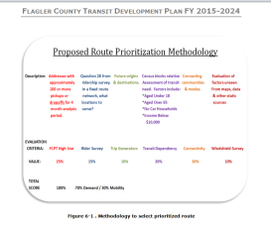
Fixed Route Development Criteria
FCPT High Use = 25%
Rider Survey Trip Generators = 25%
Transit Dependency = 15%
Connecting Communities = 10%
T-BEST Model Ridership and Productivity Forecasting = 25%
FCPTS Users
Rider Survey
Trip Generators
Transit Preference
Connectivity
Field Observations
Alternatives

Slide 35
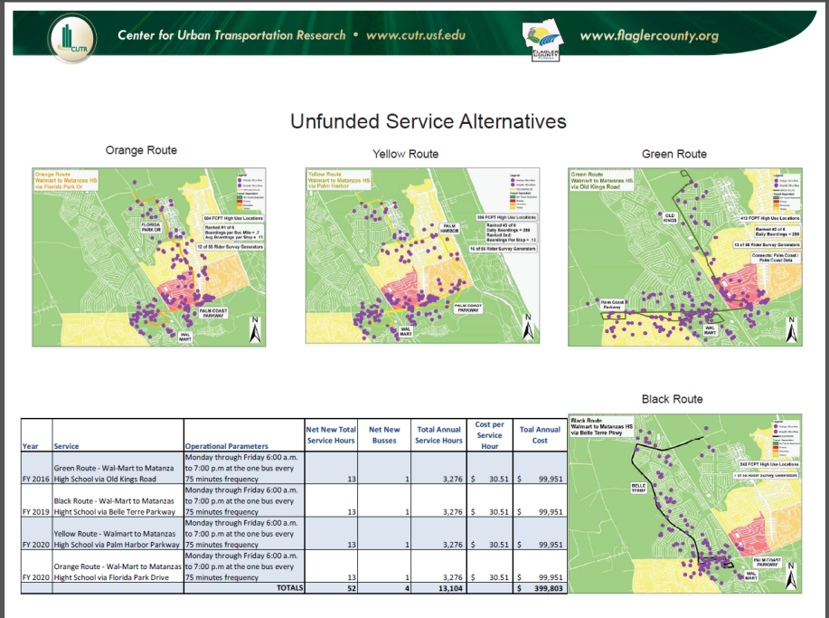

Slide 36
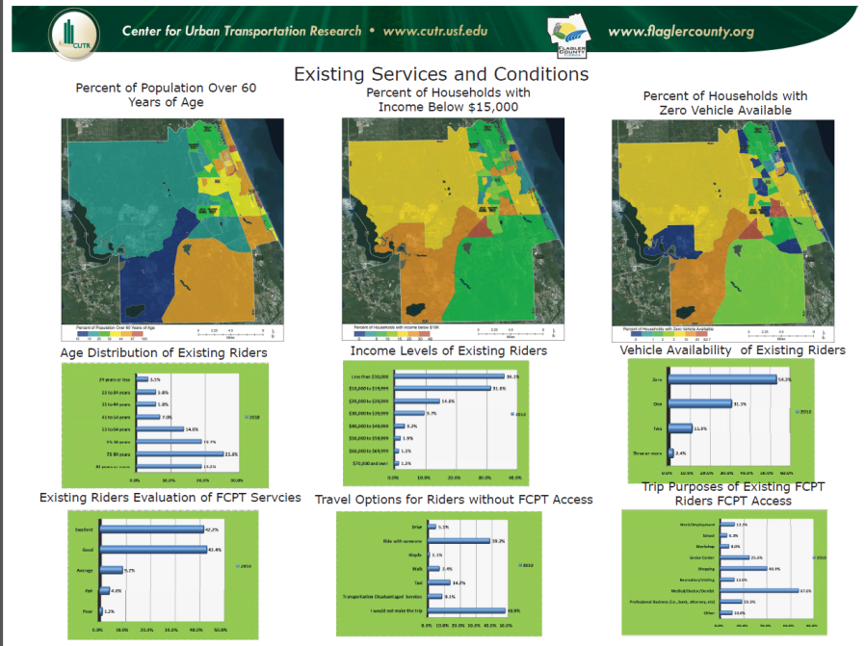

Slide 37
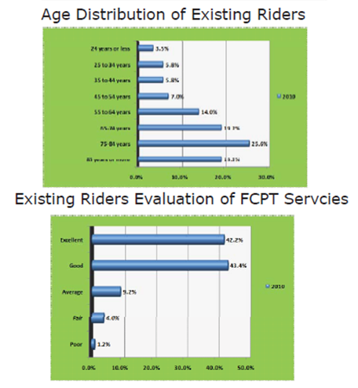


Slide 38
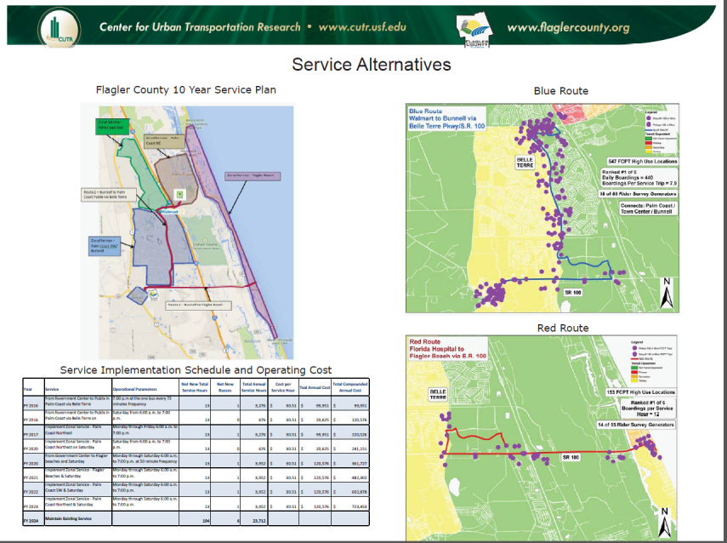

Slide 39



Slide 40
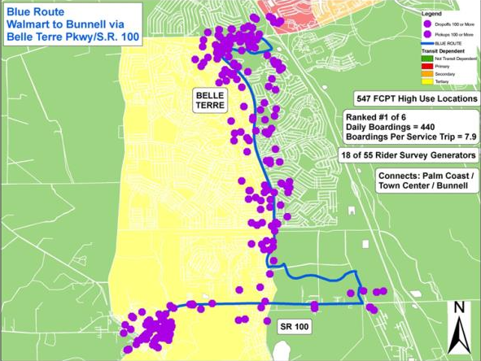
Palm Coast Pkwy / Cypress Point Pkwy
Belle Terre Pkwy
Town Center / Fla Hospital
SR 100 / Bunnell
Highest projected daily ridership of all candidate routes
Highest projected boardings per service trip of all candidate routes
Serves the highest number of trip generators gathered from the FCPT rider survey
Serves 547 of the FCPT service high use addresses within ½ mile
Connects Palm Coast and Bunnell via Town Center

Slide 41
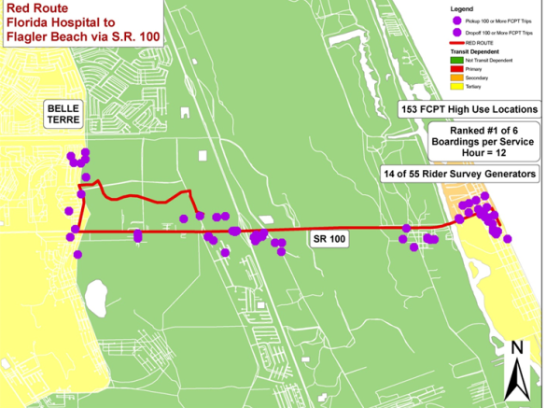
Connect Blue Route
Florida Hospital
Flagler Beach
Highest projected number of boardings per service hour in operation of all candidate bus routes
Can be operated with a 30 minute frequency of service with a single bus
Relatively high number of generators served based on route length
Connects the City of Palm Coast with Flagler Beach

Slide 42
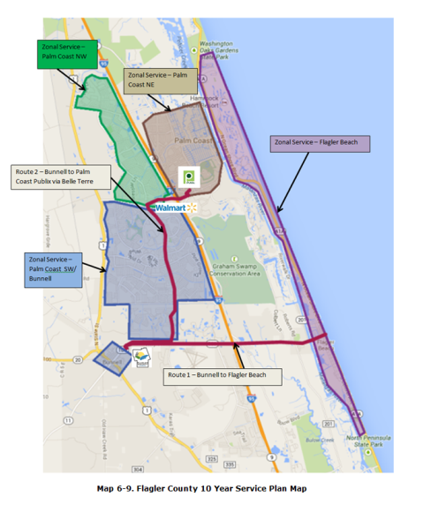
Zonal Flex
Service
Fixed routes will operate on a constant schedule along the most frequently traveled corridors in the County. Some users of the system will utilize the network of walking trails, bicycle paths and other pedestrian features to access the fixed routes. For others, the fixed routes can only be made accessible by the use of FCPT vehicles operating in zones throughout the County.

Slide 43
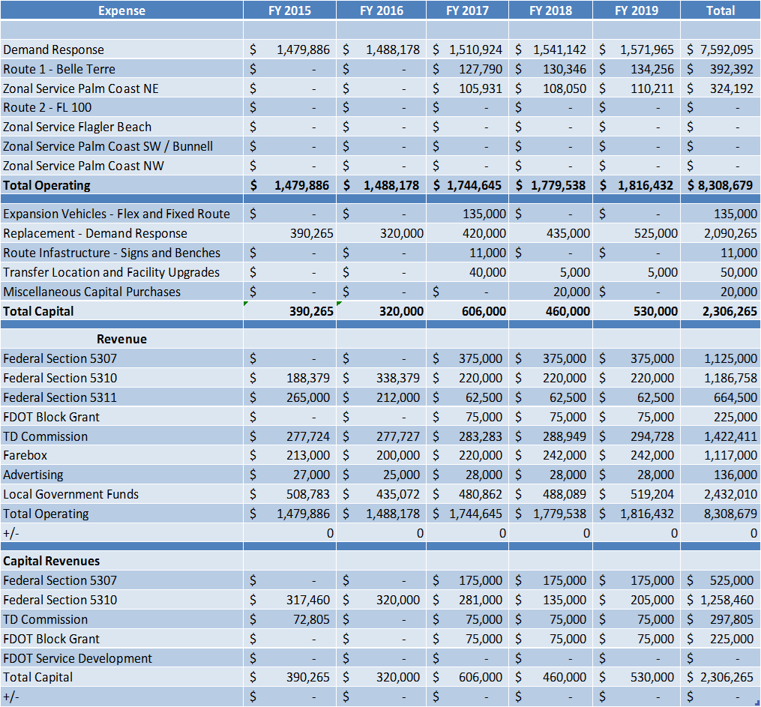

Strategic Funding Scenario
Reduction Rural Funding (5311)
Enhanced Senior / Disabled (5310) Discretionary Funding
Access Urban Formula Funding
Access FDOT Block Grant Funding
Compete for Service Development Funding
Illustration

Slide 44
TDP Project Schedule
ID | Feb | Mar | Apr | May | Jun | Jul | Aug | Sep | Oct | Nov | Dec
1
2
3
4
5
6
7
8
9
10
11
12
Flagler Formal TDP
Intergovernmental Coordination
Advisory Review Committee (ARC)
Assemble and Document Plan
Public Involvement Plan
Final Plan
MPO Endorsement
BoCC Adoption
FDOT Review
FDOT Approval

Slide 45
Endorsement & Adoption Meetings
Endorsement: River to Sea TPO
August 26, 2015 @ 9:00 AM
River to Sea TPO Conference Room
2570 W. International Speedway Blvd., Suite 100
Daytona Beach, FL 32114
Adoption: Flagler Board of County Commissioners
September 9, 2015 @ 9:00 AM
Government Services Building
Board Chambers
1769 E. Moody Blvd.
Bunnell, FL 32110

Slide 46

Thank
You
Gregg@CUTR.USF.EDU
Rob Gregg, Director
Ann Joslin, Senior Researcher
Martin Catala, Senior Researcher
Transit Management and Innovation Program
Center for Urban Transportation research
University of South Florida

