Slide 1
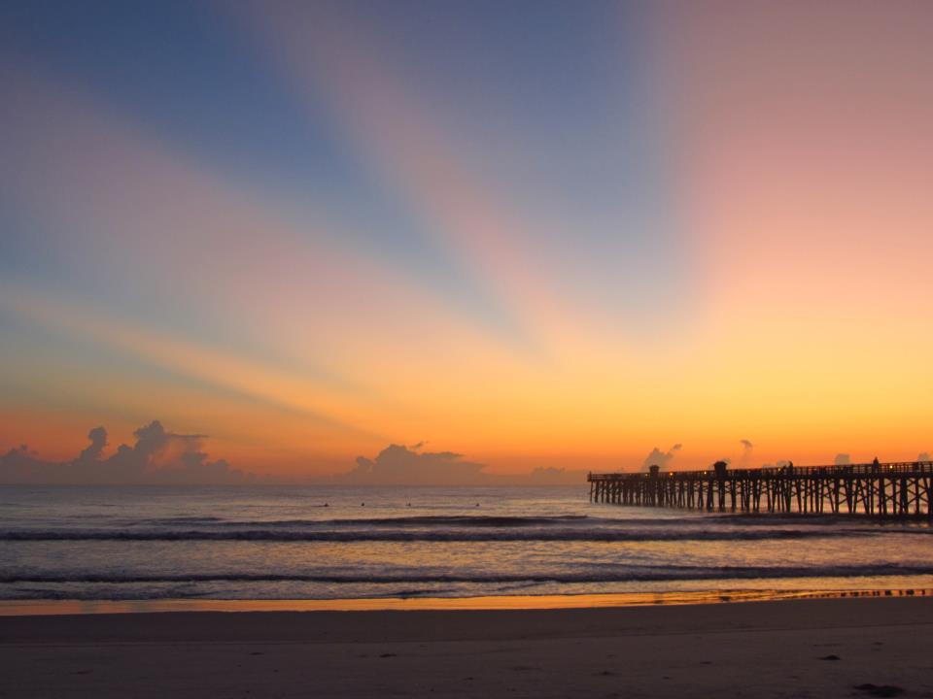
Volusia Transportation Planning Organization (TPO) October 23, 2012
Craig Coffey,
County Administrator

Slide 2
Key Discussion Items
Proposed TPO Map
County Membership
City of Bunnell Membership

Slide 3
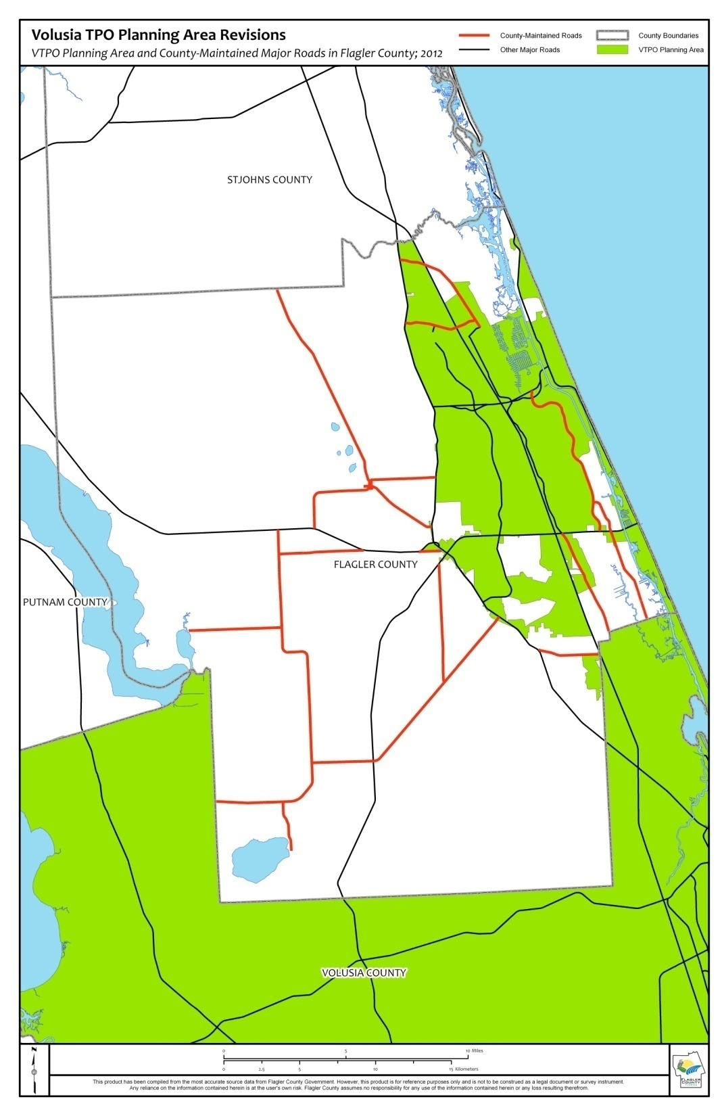
Proposed TPO MAP and COUNTY ROADS
Flagler County has many County-owned and maintained roads affected by the Proposed TPO boundaries.

Slide 4
PROPOSED TPO MAP SPLITS COUNTY ROADS
Several roads the Proposed TPO included could have been omitted that are currently rural and will remain rural for more than a decade.
Many partial roads were taken in to accommodate the City of Palm Coast boundaries but caused fragmented splits on County roads.
Splitting of Roads will create issues with:
a. Funding ⬄ Urban and Rural
b. Competition ⬄ More Roads More Funding
c. Coordination ⬄ Agreement and Priority
d. Timing ⬄ Added Difficulties for County

Slide 5
PROPOSED TPO MAP SPLITS COUNTY ROADS
Such Splits are not a problem in Volusia County because all the County is within the TPO and Volusia does not qualify for the same rural funding sources that Flagler County does.
Split Road will likely create hardships with Flagler County projects
We Recommend A Win-Win Approach:
⇨Mostly Keep Palm Coast City Limits
⇨Clearly delineate County Roads out of TPO

Slide 6
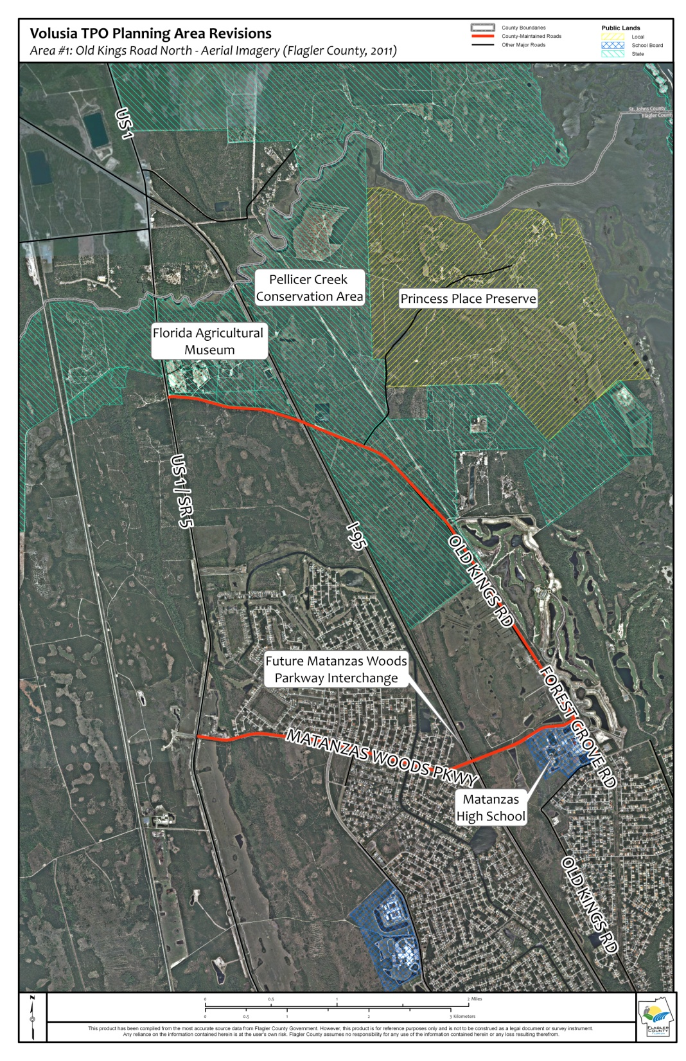
Old Kings Road North & Matanzas Woods Parkway
County owned and maintained roads.
Rural development (5 acre lot) or conservation/preserves .
High school and low density Conservatory.

Slide 7
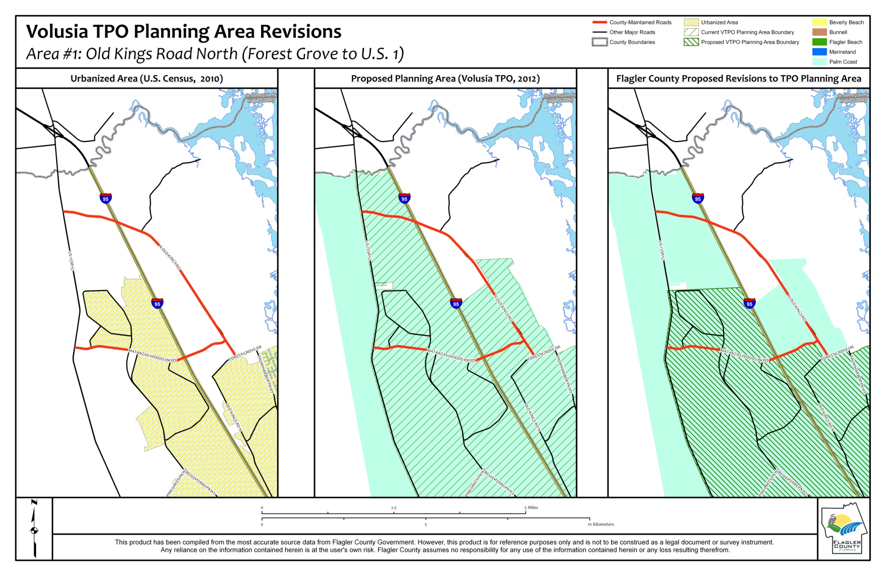
Old Kings Road North & Matanzas Woods Parkway
Notes:
This is a County owned and maintained road along very rural development (5 acre lot) or conservation/preserves except right around the high school and low density Conservatory. The TPO could include the City lands and exclude the road. At the very least from Matanzas northward could be excluded. None of this roadway was required to be included and if included it will be detrimental to the use of funding available to the County.

Slide 8
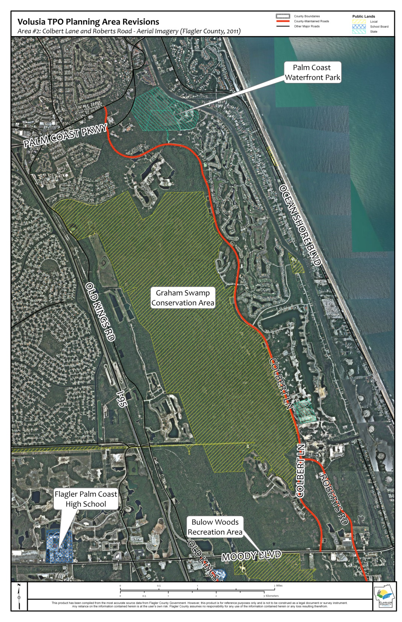
Colbert Lane & Roberts Road
County owned and maintained roads.
Very northern tip near Palm Coast Parkway and the east side as Grand Haven is considered urbanized .
Sparsely populated today with Graham Swamp on the west side of the roadway and low density development.
County is constructing enhancements and has projects programmed requesting State/County funding in coming years for shoulders, bike lanes, and trails.

Slide 9
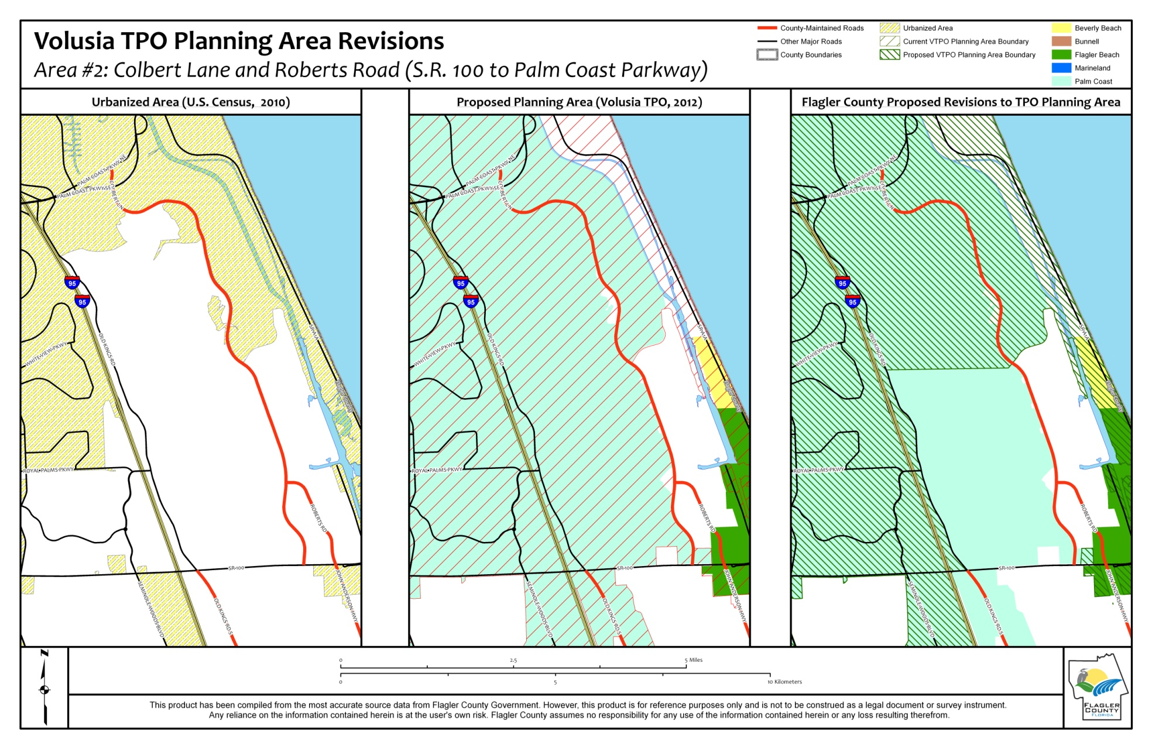
Colbert Lane & Roberts Road

Slide 10
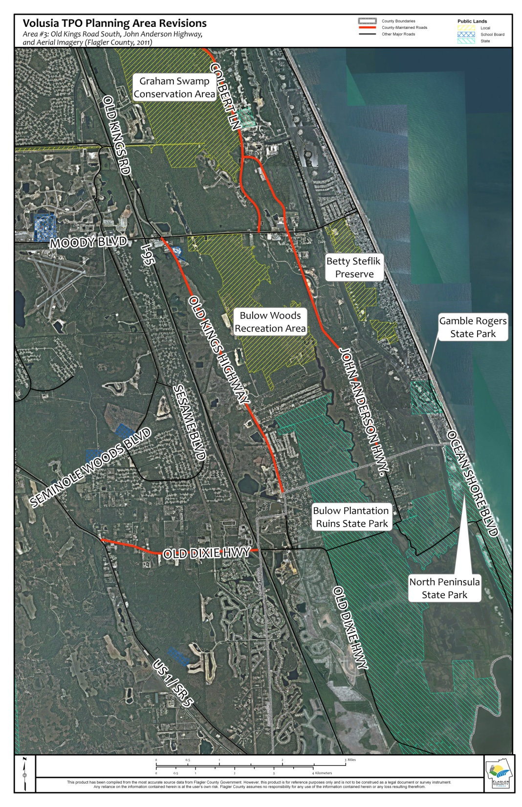
Old Kings Road South, John Anderson Hwy & Old Dixie Hwy (US 1 to I-95)
County owned and maintained roads with future growth planned.
Sparsely population today except in the small portion of Flagler Beach.
County project for State/County funding programmed in coming years for shoulders, bike lanes, and trails.
Very northern portion of John Anderson is urbanized due to nearby population to the east that would not really utilize John Anderson.

Slide 11
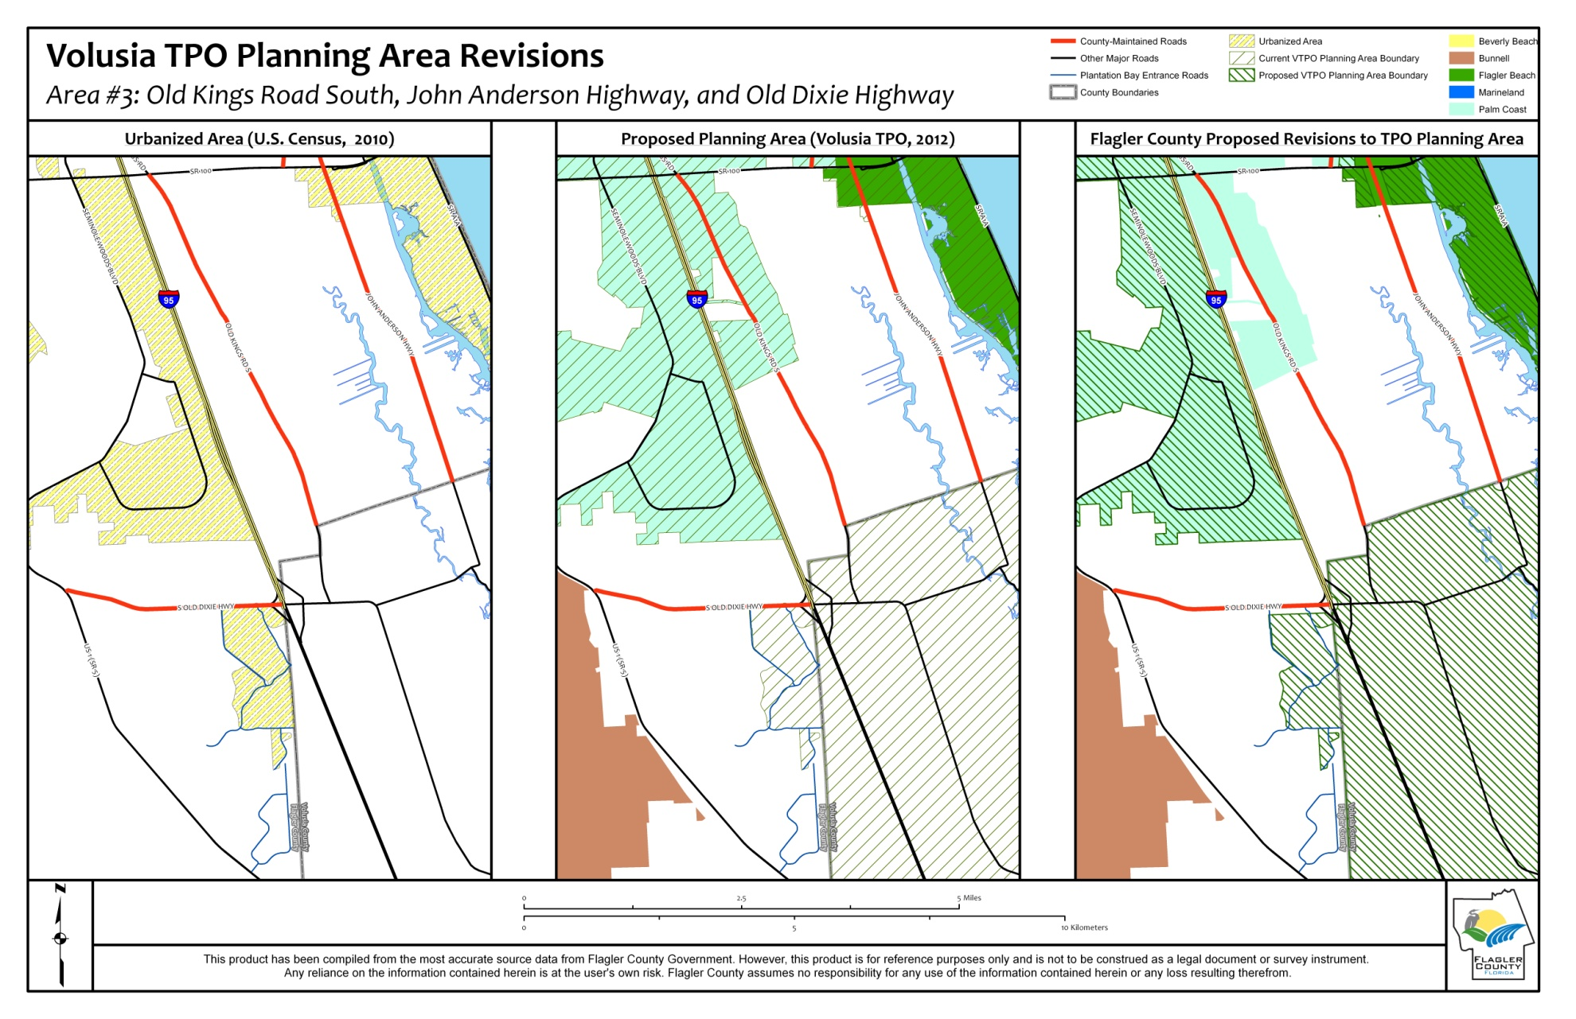
Old Kings Road South, John Anderson Hwy & Old Dixie Hwy (US 1 to I-95)

Slide 12
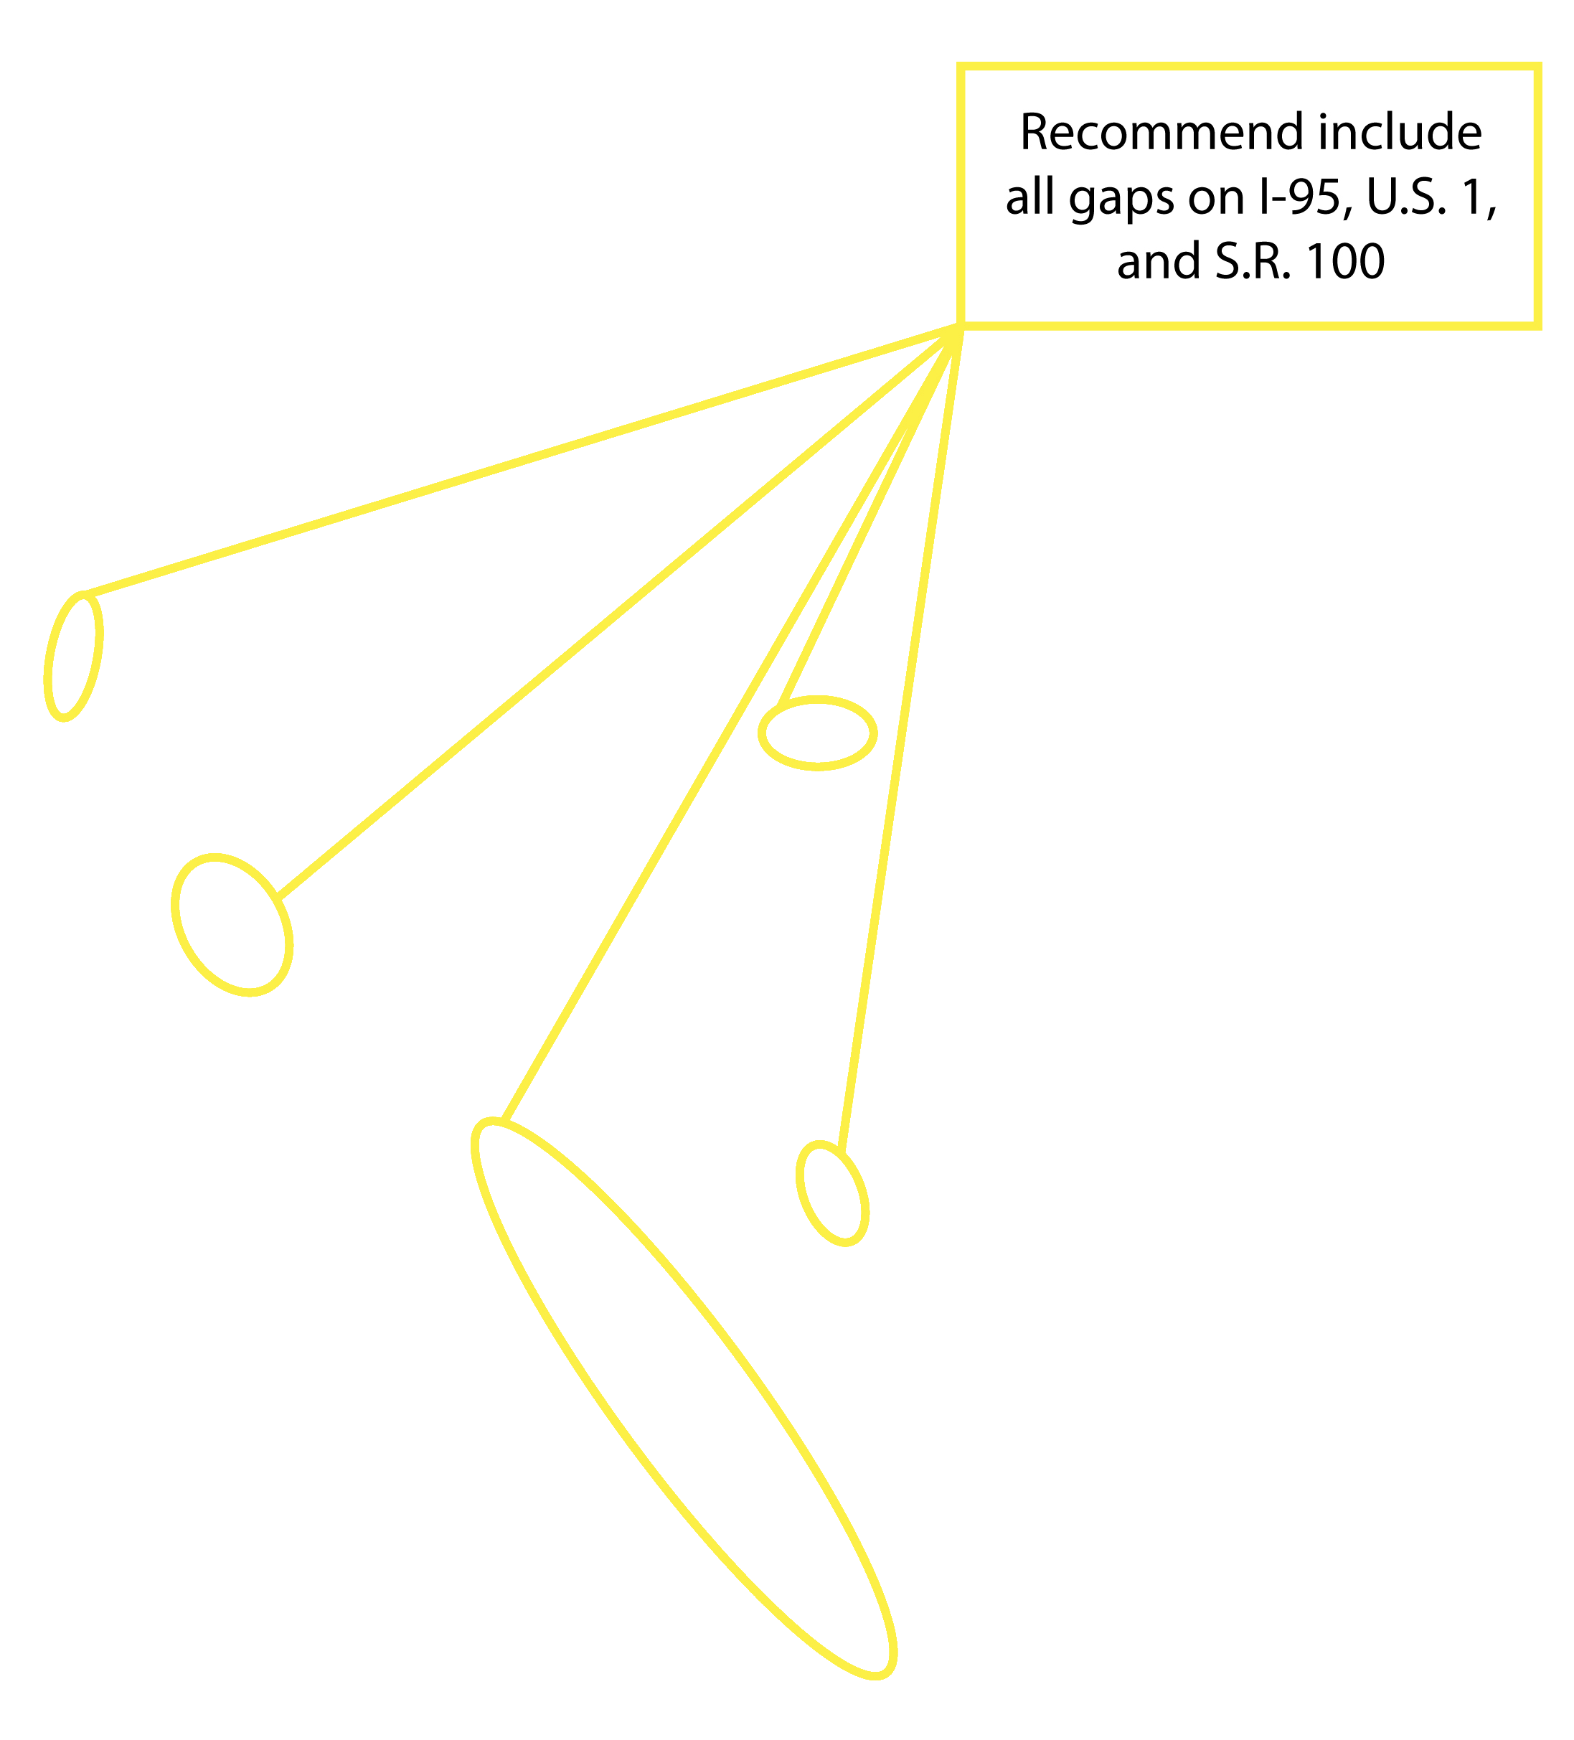
GAPs to Major Roadways (US 1/I-95/SR100)

Slide 13
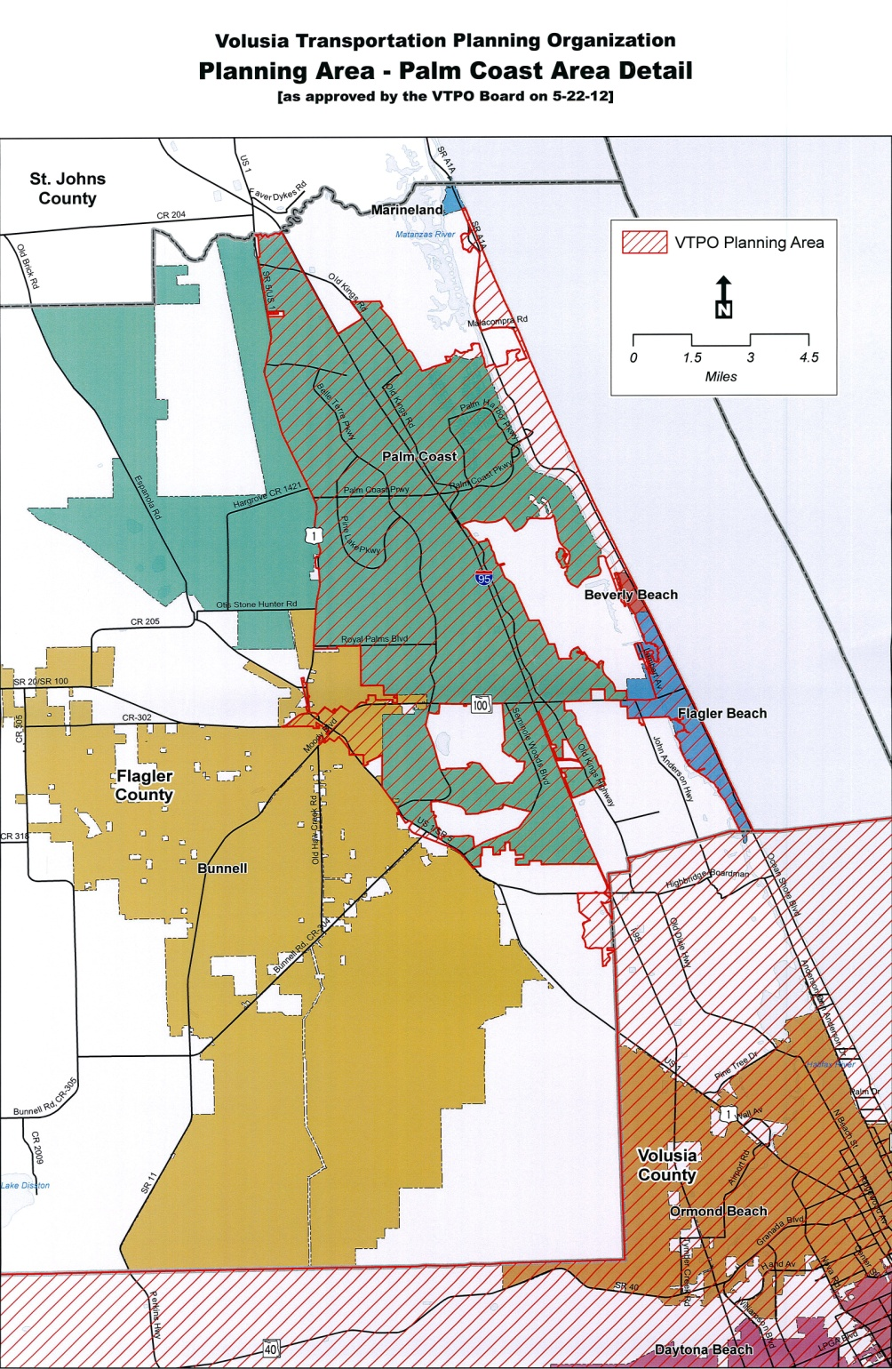
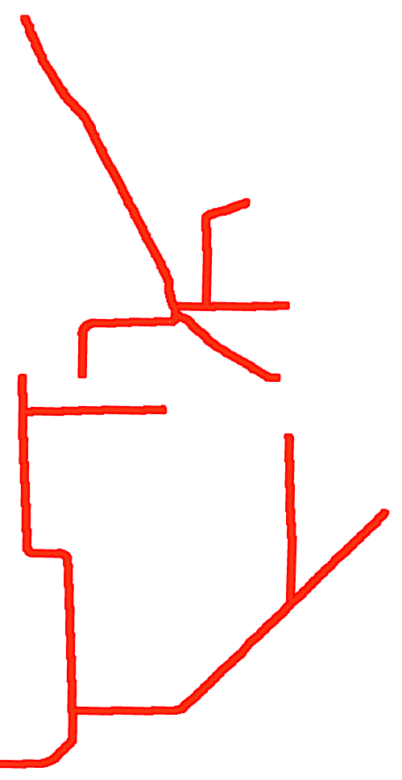
Other County Arterial
& Collector Roads in
Western Flagler County
County Roads NOT in the Planning Area

Slide 14
Flagler County proposes to be TPO Member?
The County has many roads within the Proposed TPO area serving population requiring coordination.
Coordination will be required with County for area outside Proposed TPO boundaries for roads, trails, solutions.
Flagler County serves as the Community Transportation Coordinator (CTC) for mass transit and operates General Aviation Airport, etc.
Flagler County makes up 1/6 of population of both Counties and may be able to partner legislatively to support assistance of projects.

Slide 15
How Would Flagler County Proposed TPO Membership Work?
Under VTPO Bylaws, Volusia County must make up 1/3 of the TPO Membership regardless of population.
Volusia County’s 6 seats on the TPO Board each currently have 5.55% of the total Board vote based on rule not population.
Flagler County desires a seat with very little voting weight, simply to have a formal seat in Board discussions
Volusia County’s 5 seats would increase to 6.6% voting weight per seat based on rule, not based on population.
Flagler County’s seat would have the remaining 0.33% County-allocated voting weight based on rule, not population
This proposal would not affect any other City membership or weighting for the rest of TPO Board.

Slide 16
Counties Membership
Flagler County – 1 Seat out of 19 total voting members

Slide 17
Bunnell TPO - Rotating Membership
Currently Beverly Beach and Flagler Beach share a rotating TPO seat.
The most populated sections of Bunnell are being taken in as urbanized areas. More than Beverly Beach.
Logically Bunnell should be part of this rotation as it has a greater population than Beverly Beach.
Second Largest City in the State by area.
This should have minimal effect on the other members.

Slide 18
Thank You

