Slide 1
The FAST Act
Fixing America’s Surface Transportation
River to Sea
TPO Board Meeting
September 28, 2016

Slide 2
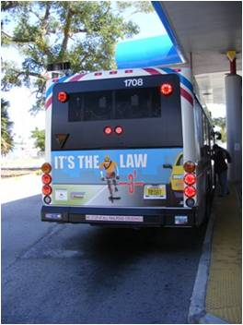
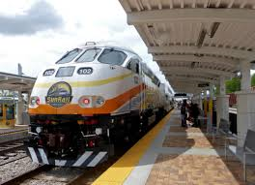
Overview
The FAST Act replaced MAP-21
First long-term transportation law since 2005
Signed into law by the President on December 4, 2015
FAST is a 5-year bill - $300 billion

Slide 3
Funding
Federal highway investment increases by 15%
Federal transit investment increases by 18%
Highways
$10.03 billion increase for Florida over the 5-year period ($226.3b total)
Florida gets 95% rate of return on formula funds
Transit
$3.7 billion increase for Florida over the 5-year period ($61.1b total)
Additional funding through discretionary programs

Slide 4
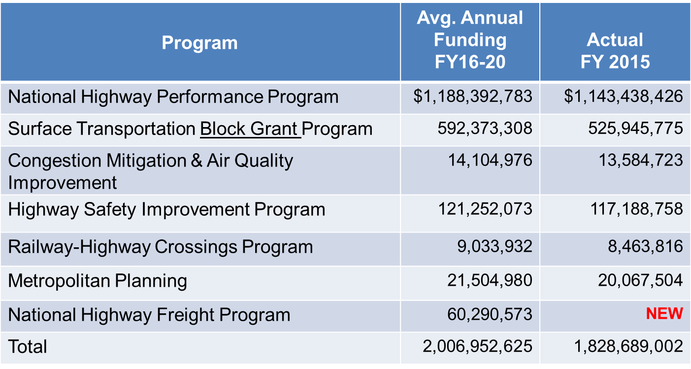
Florida Funding by Program
Source: FHWA Presentation to MPOAC, Jan. 28, 2016

Slide 5
Other Provisions
Establishes new freight program; dedicated funding
Creates an Innovative Finance Bureau (TIFIA, Tolling)
$95 million for research/testing of gas tax alternatives
Competitive/discretionary programs
Additions to program eligibility (CMAQ, HSIP, NHPP, STBGP)
Continues Programs of MAP-21
Performance Measures and targets
Emphasis on Freight program
Acceleration of project delivery

Slide 6
Changes for MPO’s
Modest funding increases for MPOs ($314 to $359 million)
Must have transit representation on MPO boards
Plans must include intercity buses and bus facilities
Engage ports and employer-based commuting programs
Tourism and natural disaster/storm risk reduction
System resiliency and reliability
Plans must include performance measures & targets
Possible consolidation of MPOs

Slide 7
Rule-Making
Changes to the definition of a Metropolitan Planning Area (MPA)
MPA must include the entire urbanized area, plus the contiguous area forecast to become urbanized within the 20 year planning horizon
Would jointly develop planning products including a single metropolitan long range transportation plan (LRTP), Transportation Improvement Program (TIP), and performance targets
This does not currently effect the R2CTPO

Slide 8
Rule-Making
Performance Area | NPRM | Comments Due | Final Rule
Safety Performance Measures | March 11, 2014 | Closed June 30, 2014 | Published March 15, 2016
Highway Safety Improvement Program | March 28, 2014 | Closed June 30, 2014 | Published March 15, 2016
Statewide and Metro Planning; Non-Metro Planning | June 2, 2014 | Closed October 2, 2014 | Published May 27, 2016
Pavement and Bridge Performance Measures | January 5, 2015 | Closed May 8, 2015 | Anticipated November 2016
Highway Asset Management Plan | February 20, 2015 | Closed May 29, 2015 | Anticipated November 2016
Performance of the NHS, Freight, and CMAQ Measures | April 22, 2016 | Closed August 20, 2016 | TBD

Slide 9
Upcoming Presentations
Review of more specific actions required for the R2CTPO to implement the FAST Act
Discussions of performance measures, target setting and reporting
Changes to the criteria used to select projects for the LRTP and TIP

