Slide 1
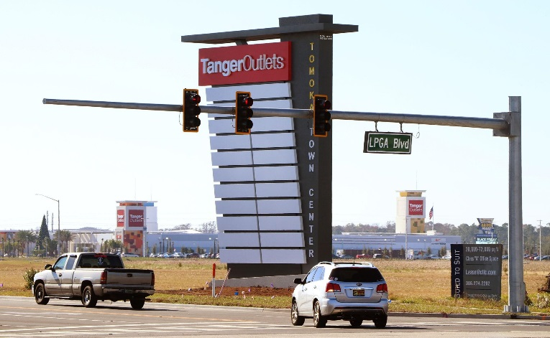
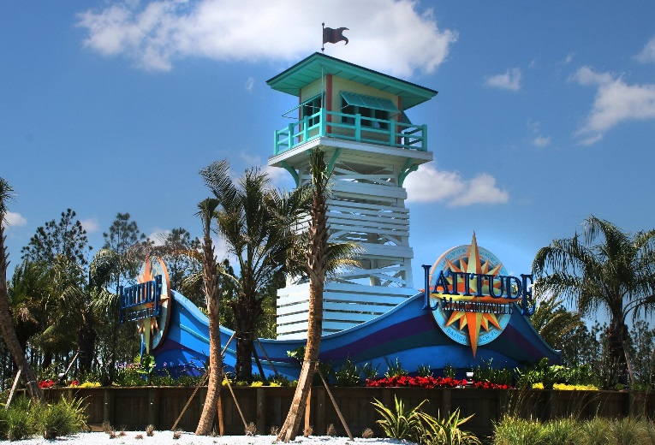
LPGA Sub-Area Study
Presented by Kok Wan Mah, PE
April 16, 2019
Prepared by
Notes:
Purpose: To provide an evaluation on the effect the approved and planned regional development will have on the transportation network in the area.

Slide 2
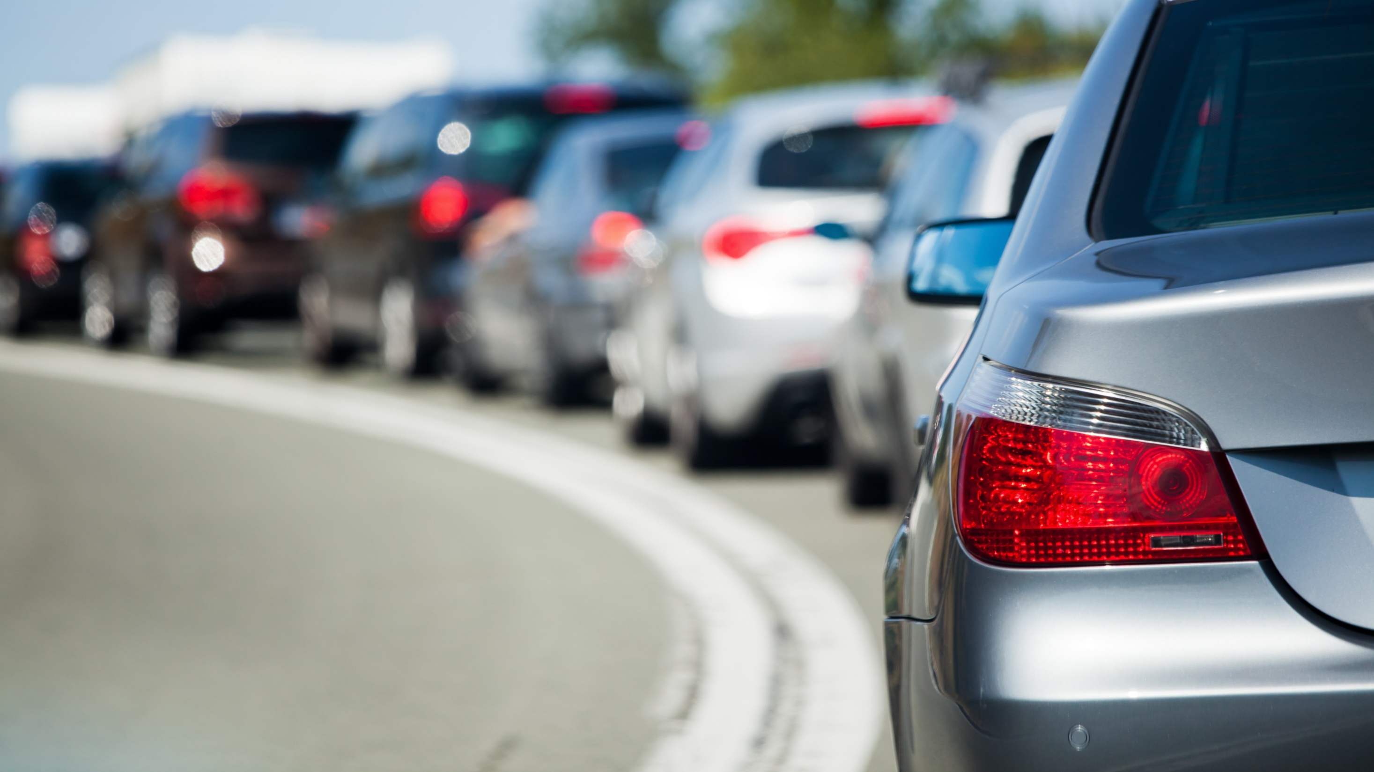
Presentation Outline
Purpose
Existing Conditions
Future Scenarios
Results
Next Steps
Notes:
Purpose: To provide an evaluation on the effect the approved and planned regional development will have on the transportation network in the area.

Slide 3
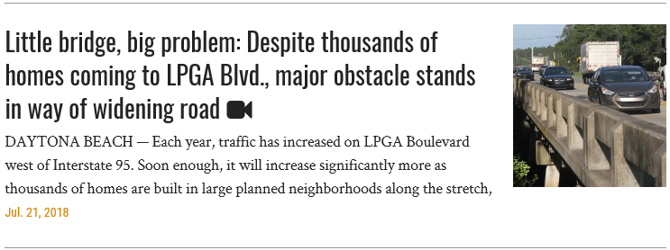
Why are we here?
Source: All headlines and news stories are from the Daytona Beach News-Journal
Notes:
Degradation of operations, congestion, capacity, development. It’s a matter of having the infrastructure keep pace with the development.
By the end of the presentation: How land use and development can minimize impact on the infrastructure.
Council member Post’s public meeting, Feb 25.

Slide 4
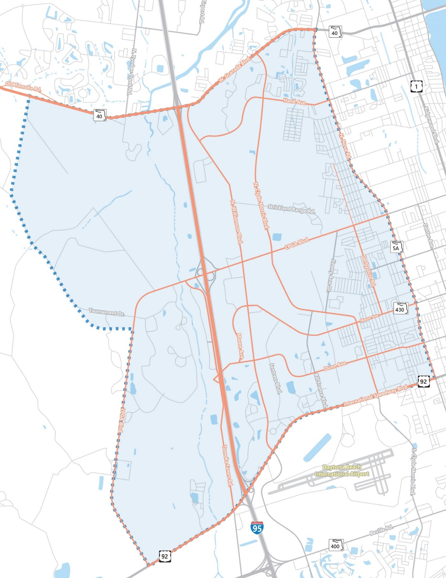
Study Area
Study Area
Study Area Roadway Network (Existing)
Study Boundary (Approximately 35 square miles)
SR 40 to the north
US 92 to the south
Nova Road to the east
Potential future Tournament Drive Extension to the west
Study Roads (244 lanes-miles of roads)
I-95
US 92
Nova Road (SR 5A)
Granada Boulevard (SR 40)
LPGA Boulevard
Clyde Morris Boulevard
Derbyshire Road
Dunn Avenue
Hand Avenue
Mason Avenue
Tomoka Farms Road
Tymber Creek Road
Williamson Boulevard

Slide 5
Presentation Outline
Purpose
Existing Conditions
Future Scenarios
Results
Next Steps

Slide 6
Vested Development Trips
Daytona Beach
Holly Hill
Fountainhead
Ormond Beach
Granada Pointe
Marshside Village
Pineland PRD
Ormond Central
Ormond Crossings
Sam’s Club
NADG Phase 1
Tomoka Pointe Apartments
Minto Parcel B
Cypress Trail
Clyde Morris Industrial
Mosaic
Concierge DD
The Preserve
Buc-ee’s
Integrated LPGA
Honda of Daytona
Subaru of Daytona
Shade Tree Apartments
Mason Industrial
Costa HQ
Great American Auto
Vested trips–Traffic from approved developments that are not accounted on a roadway facility.
Information provided by partners: Daytona Beach, Holly Hill, Ormond Beach
Notes:
Define vested trips
Use of the adopted CFRPM and verified the socioeconomic data for these developments.
Most familiar with the developments being planned in CoDB… consultant to the City for the past 3.5 years.

Slide 7
This is a callout
This is a callout
11TH St.
N Clyde Morris Blvd
This is a callout
This is a callout
Daytona Auto Mall development begins
Construction begins at Cornerstone Office Park
Mason Ave.
N Williamson Blvd
Roadwork begins at Bayberry/Mosaic
N Tomoka Farms Rd.
Development Around the Interchange
November 2005
Notes:
Just concentrating on the area around the interchange. Study area extends further to the north and south.

Slide 8
11TH St.
N Clyde Morris Blvd
Interior Roads built at Lionspaw
N Williamson Blvd
Mason Ave.
Home Construction begins at Mosaic
N Tomoka Farms Rd.
Development Around the Interchange
August 2006

Slide 9
Florida Hospital construction begins
11TH St.
N Clyde Morris Blvd
N Williamson Blvd
Mason Ave.
N Tomoka Farms Rd.
Development Around the Interchange
November 2007

Slide 10
N Clyde Morris Blvd
LPGA Blvd.
Retail Development begins at LPGA Blvd. and Williamson Blvd.
Champion Elementary School
N Williamson Blvd
Mason Ave.
Father Lopez High School
N Tomoka Farms Rd.
Development Around the Interchange
October 2008

Slide 11
LPGA Blvd.
N Clyde Morris Blvd
More Retail at Technology Blvd
N Williamson Blvd
Mason Ave.
Daytona Auto Mall development continues
Trader Joes Distribution Center
N Tomoka Farms Rd.
Development Around the Interchange
March 2015

Slide 12
11TH St.
N Clyde Morris Blvd
Tanger Outlet Mall Construction Begins
N Williamson Blvd
Mason Ave.
N Tomoka Farms Rd.
Development Around the Interchange
April 2016

Slide 13
11TH St.
N Clyde Morris Blvd
Minto Communities
N Williamson Blvd
Mason Ave.
N Tomoka Farms Rd.
Development Around the Interchange
March 2018
March 2018
Extra line of text if needed.
Notes:
Latitudes, Margaritaville
Beginning to see Tymber Creek Road Extension

Slide 14
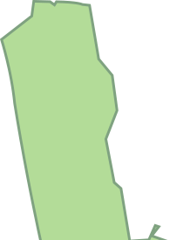
Birchwood
Integra Apartments
11TH St.
Williamson Blvd Industrial
N Clyde Morris Blvd
Orthopedic Surgery Center
Superwash
Clyde Morris Industrial Warehouse
Buc-ee’s
Eastwood Apartments
Tomoka Point Apartments
Minto Senior Living
Sam’s Club
Vantrust
Tanger Outlets
N Williamson Blvd
Mason Ave.
Trader Joe’s Distribution Center
Mosaic
N Tomoka Farms Rd.
Hendrick Honda Dealership
Great American Auto Dealership
Development Around the Interchange
March 2018 – Including Vested Developments
March 2018
Extra line of text if needed.

Slide 15
Presentation Outline
Purpose
Existing Conditions
Future Scenarios
Results
Next Steps
Notes:
CFRPM model based off of the one done for the LPGA Interchange Modification Report (IMR)
Year 2040 horizon year

Slide 16
Roadway Capacity
Over Capacity
100%
Near Capacity
80%
ROADWAY CAPACITY
Under Capacity
0%
Notes:
Let’s talk about volume-to-capacity (v/c).
Reflection of mobility and quality of travel of a section of a roadway. It compares roadway demand (vehicle volumes) with roadway supply (carrying capacity).
How do we get something over capacity? Adopted capacity.
MW notes: Don’t focus too much on adopted capacity definition. Keep it simple (capacity)….The presentation to VC CC seemed to spend too much on this but then it rushed through the scenarios. Spend less time on VMT and VMT/Capacity.

Slide 17
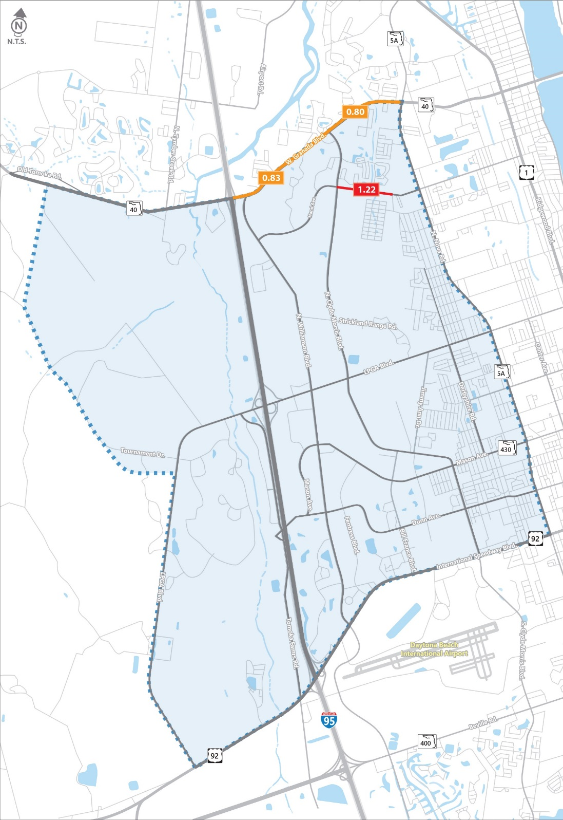
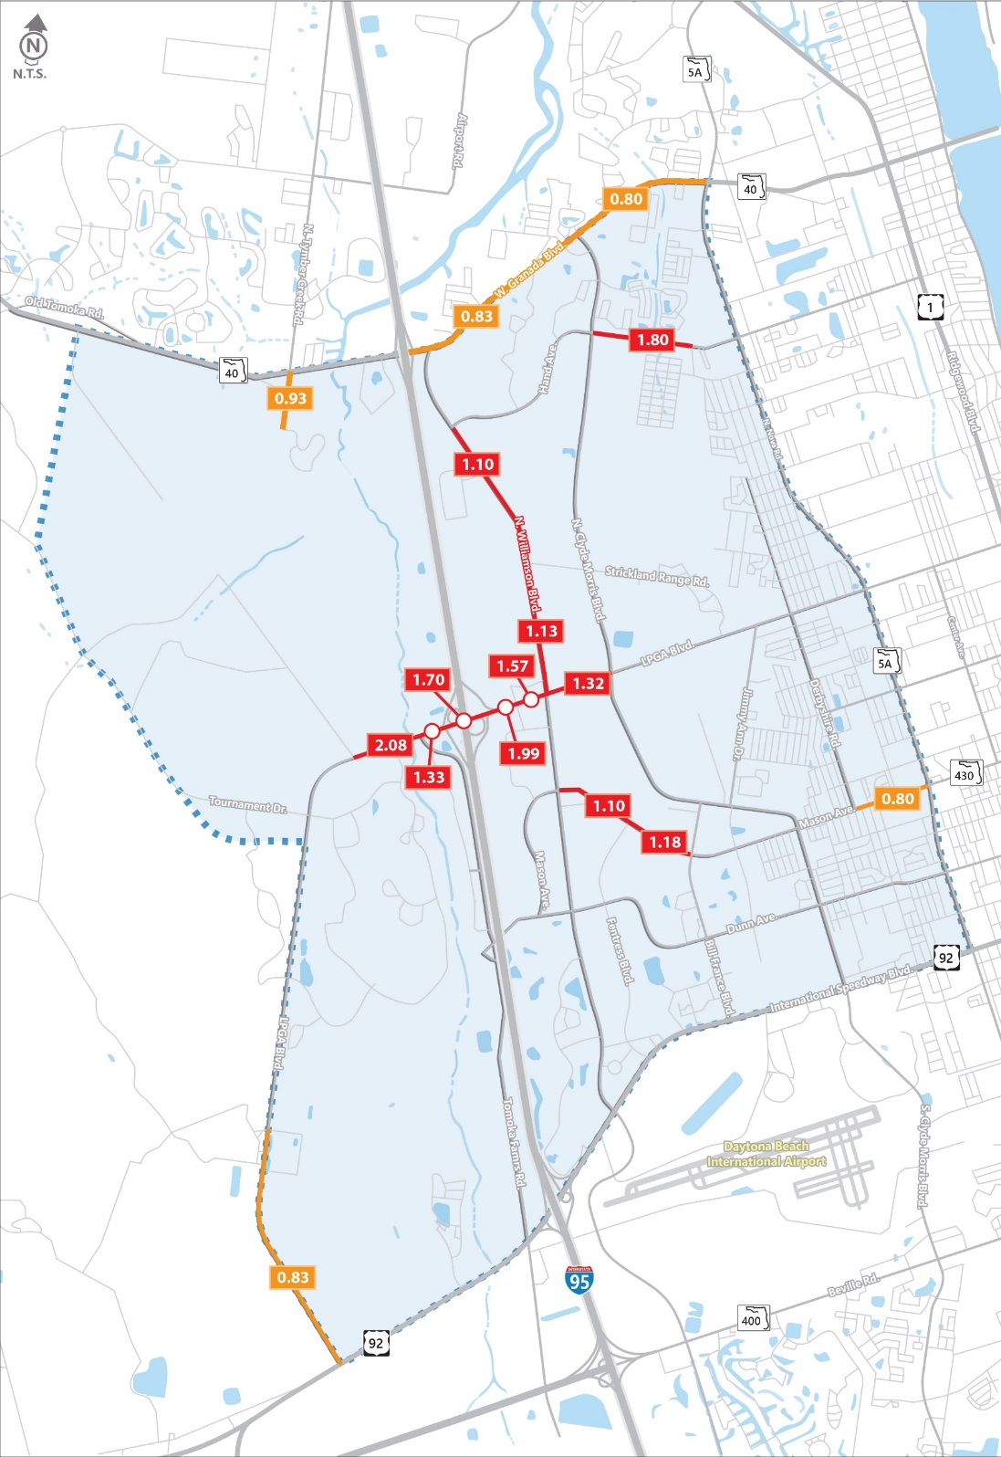
Capacity Concerns–Existing Traffic
Capacity Concerns–Existing Traffic Plus “Vested” Development Trips
Existing Traffic
0.00
0.80<Volume-to-Capacity (V/C)<0.999
0.00
Volume-to-Capacity (V/C)>1.00
Notes:
Existing: Near capacity – 2; Over capacity – 1
Existing Plus Vested: Near capacity – 5; Over capacity – 11

Slide 18
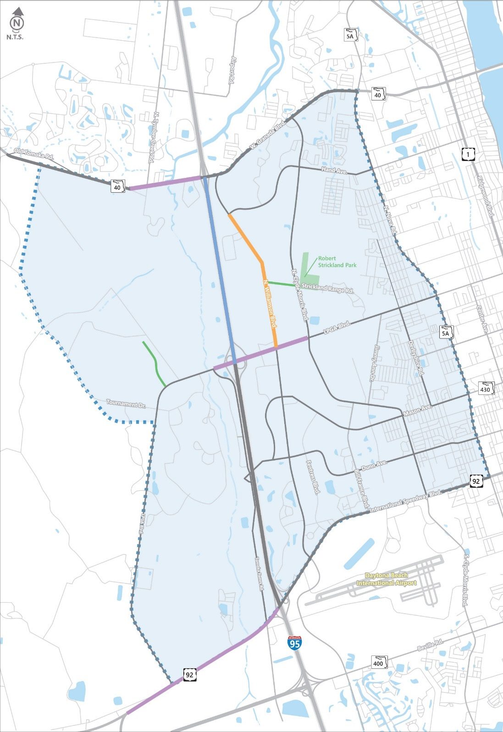
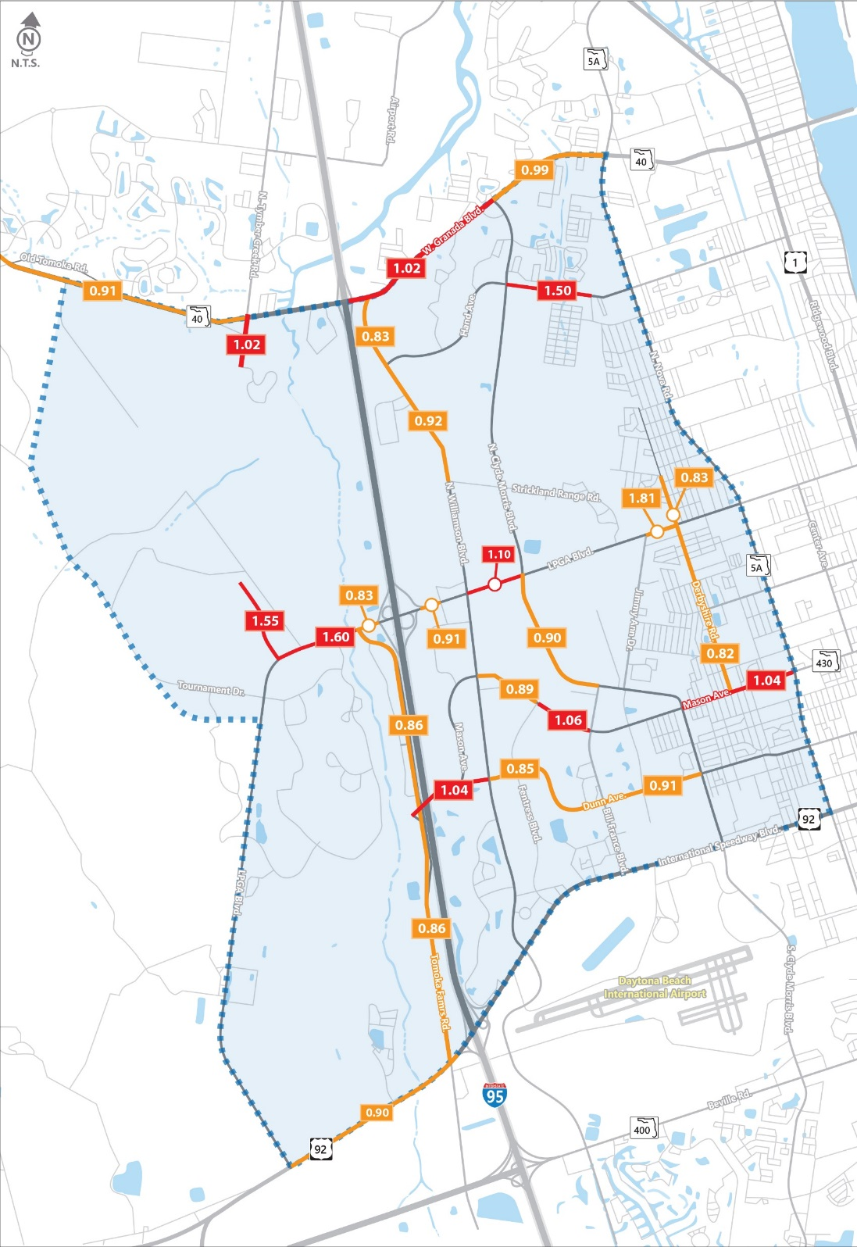
Capacity Concerns–Existing (2017) Plus Vested Development Trips
CAPACITY CONCERNS–Year 2040
Base Year 2040 Number of Lanes
Base Year (2040) Comparison
2 Lane Roadway
4 Lane Roadway
6 Lane Roadway
8 Lane Roadway
Study Area
0.00
Compare
0.80<Volume-to-Capacity (V/C)<0.999
0.00
Volume-to-Capacity (V/C)>1.00
Notes:
I-95 – 8 lanes – Current capacity
US 92 – 6 lanes – FDOT project
SR 40 6 lanes – FDOT PD&E and likelihood of widening by 2040
LPGA Blvd – 6 lanes – Developer’s Agreement and likely capacity improvements
Show number of lanes and results. Then compare with the vested trips run.
Existing Plus Vested: Near capacity – 5; Over capacity – 11
Base Year 2040: Near capacity – 16; Over capacity – 9

Slide 19
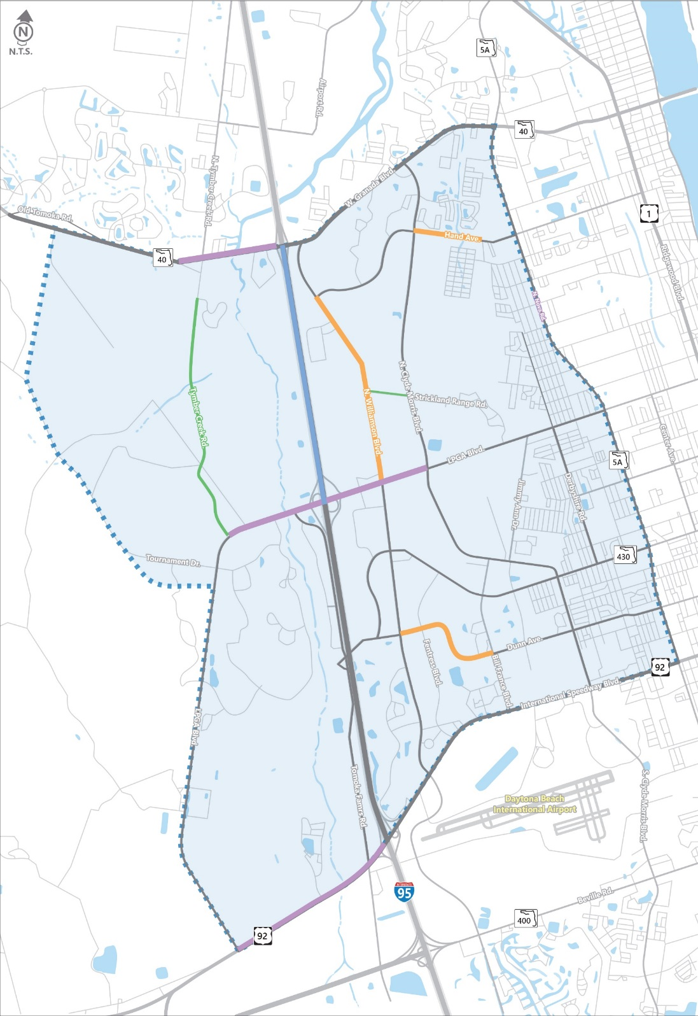
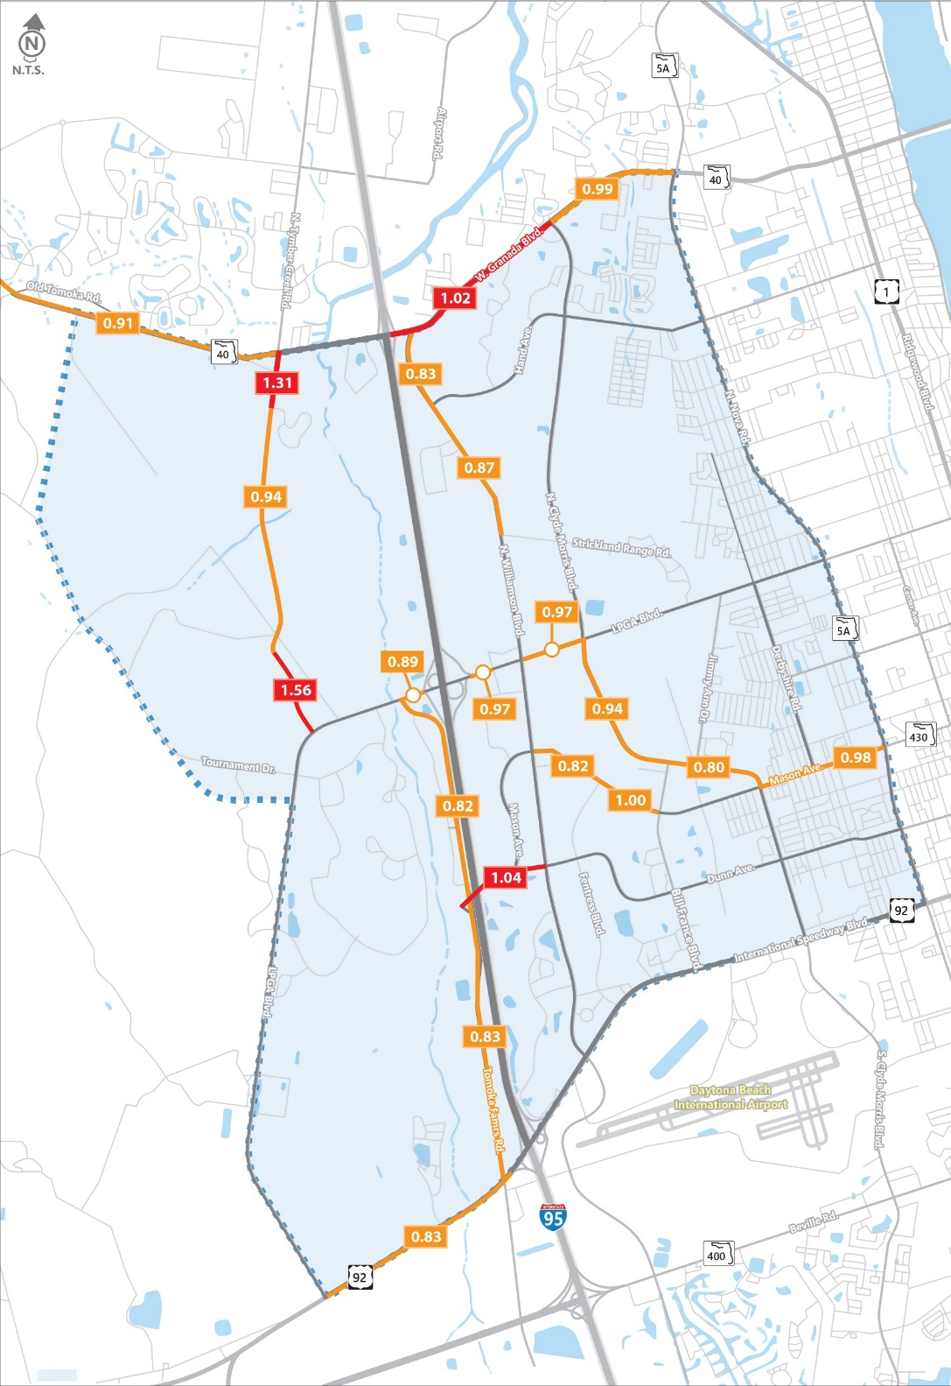
Scenario 1
Number of Lanes
Capacity Concerns
“Low-Hanging Fruit”
Includes Roadway Projects:
Tymber Creek Road
Hand Ave widening
LPGA Blvd widening
Dunn Avenue widening
2 Lane Roadway
4 Lane Roadway
6 Lane Roadway
8 Lane Roadway
Study Area
0.00
0.80<Volume-to-Capacity (V/C)<0.999
0.00
Cost Estimate: $83,069,358
Volume-to-Capacity (V/C)>1.00
Notes:
32 lane-miles of improvements
Scenario 1: Near capacity – 16; Over capacity – 5
MW: Per Judy’s direction, clarified, enlarged titles. Moved key to the right. (JEC: concur)

Slide 20
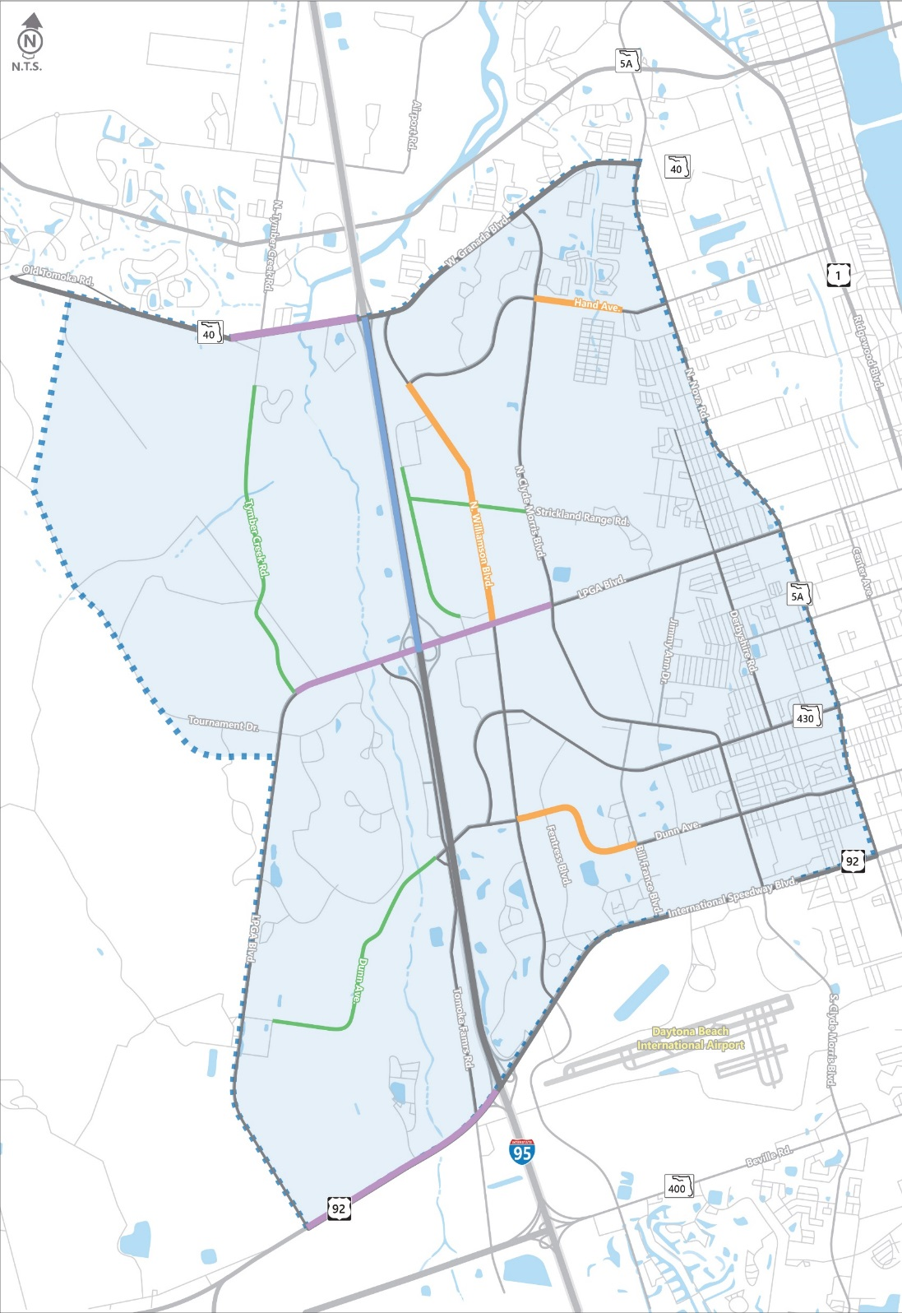
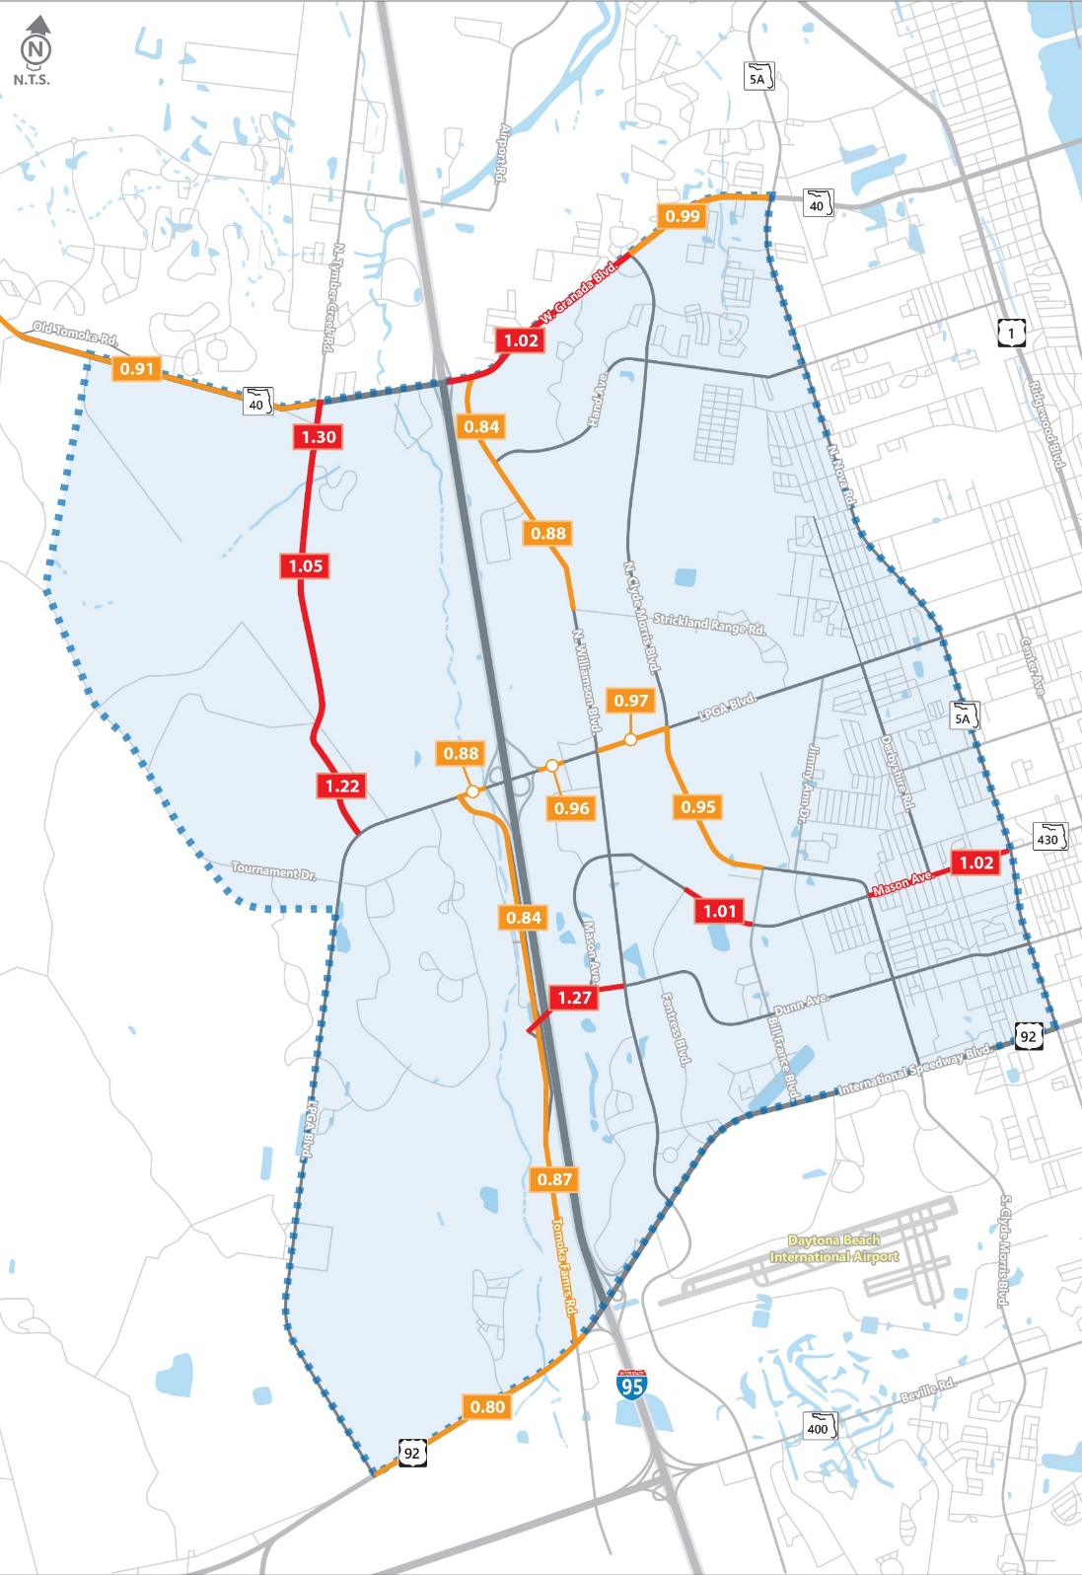
Scenario 2
Number of Lanes
Capacity Concerns
“Southern Relief”
Includes: Scenario #1 Projects + Dunn Avenue Extension
Scenario 2:
2 Lane Roadway
4 Lane Roadway
6 Lane Roadway
8 Lane Roadway
Study Area
0.00
0.80<Volume-to-Capacity (V/C)<0.999
0.00
Cost Estimate: $105,069,358
Volume-to-Capacity (V/C)>1.00
Notes:
Scenario 1, plus:
Dunn Ave Extension – 2 lanes
Scenario 2: Near capacity – 11; Over capacity – 7

Slide 21
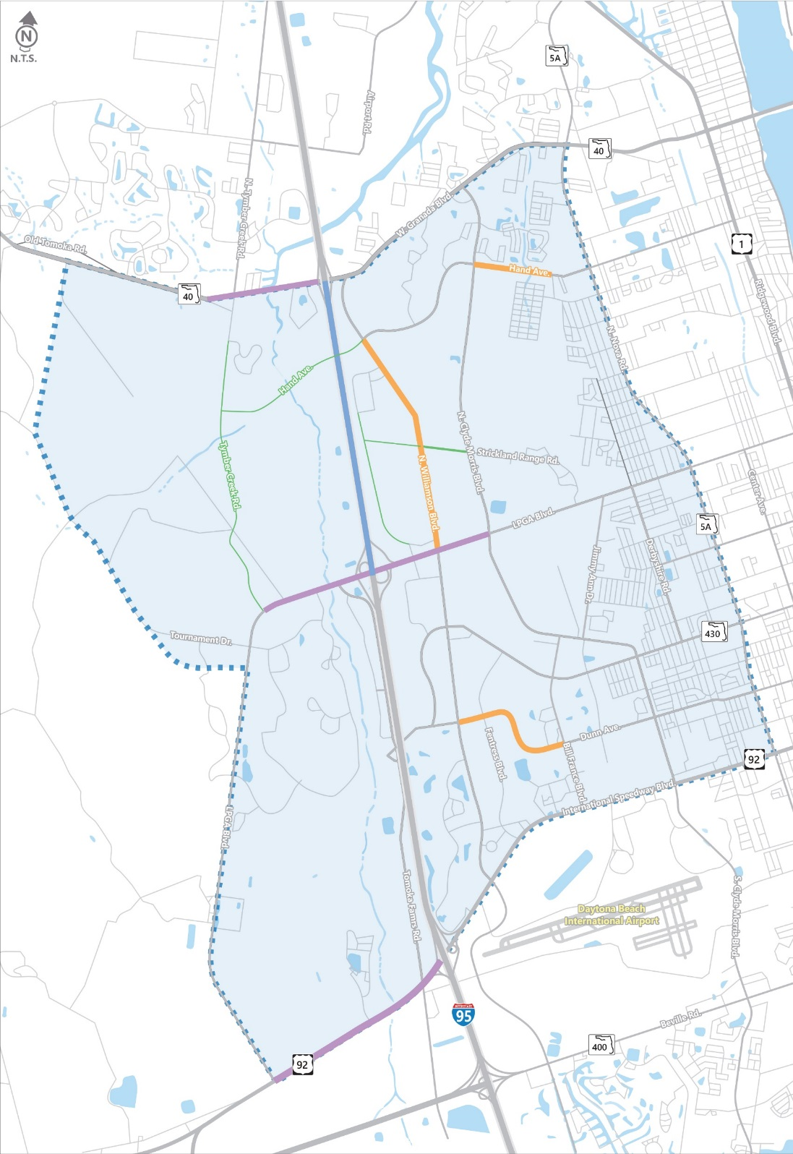
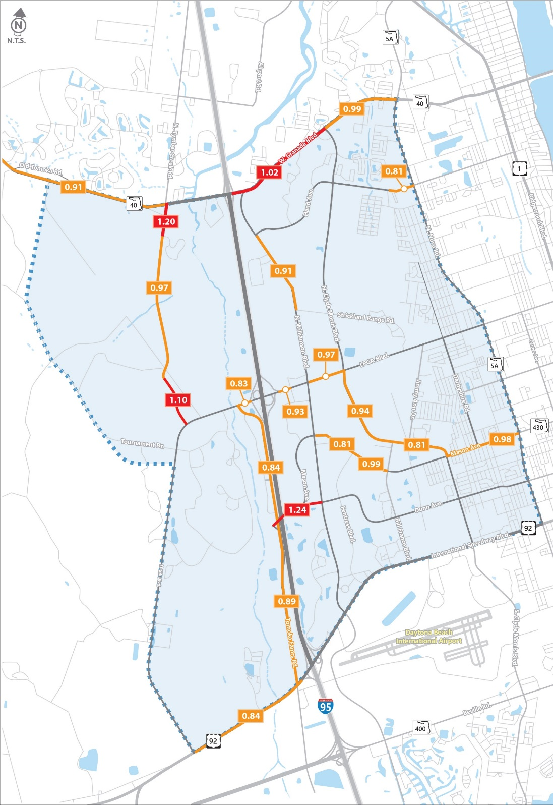
Scenario 3
Number of Lanes
Capacity Concerns
Capacity Concerns
“Northern Relief”
Scenario 3:
Includes: Scenario #1 Projects + Hand Avenue Extension
2 Lane Roadway
4 Lane Roadway
6 Lane Roadway
8 Lane Roadway
Study Area
0.00
0.80<Volume-to-Capacity (V/C)<0.999
0.00
Cost Estimate: $113,369,358
Volume-to-Capacity (V/C)>1.00
Notes:
Scenario 1, plus:
Hand Ave Extension – 2 lanes
Scenario 3: Near capacity – 16; Over capacity – 4

Slide 22
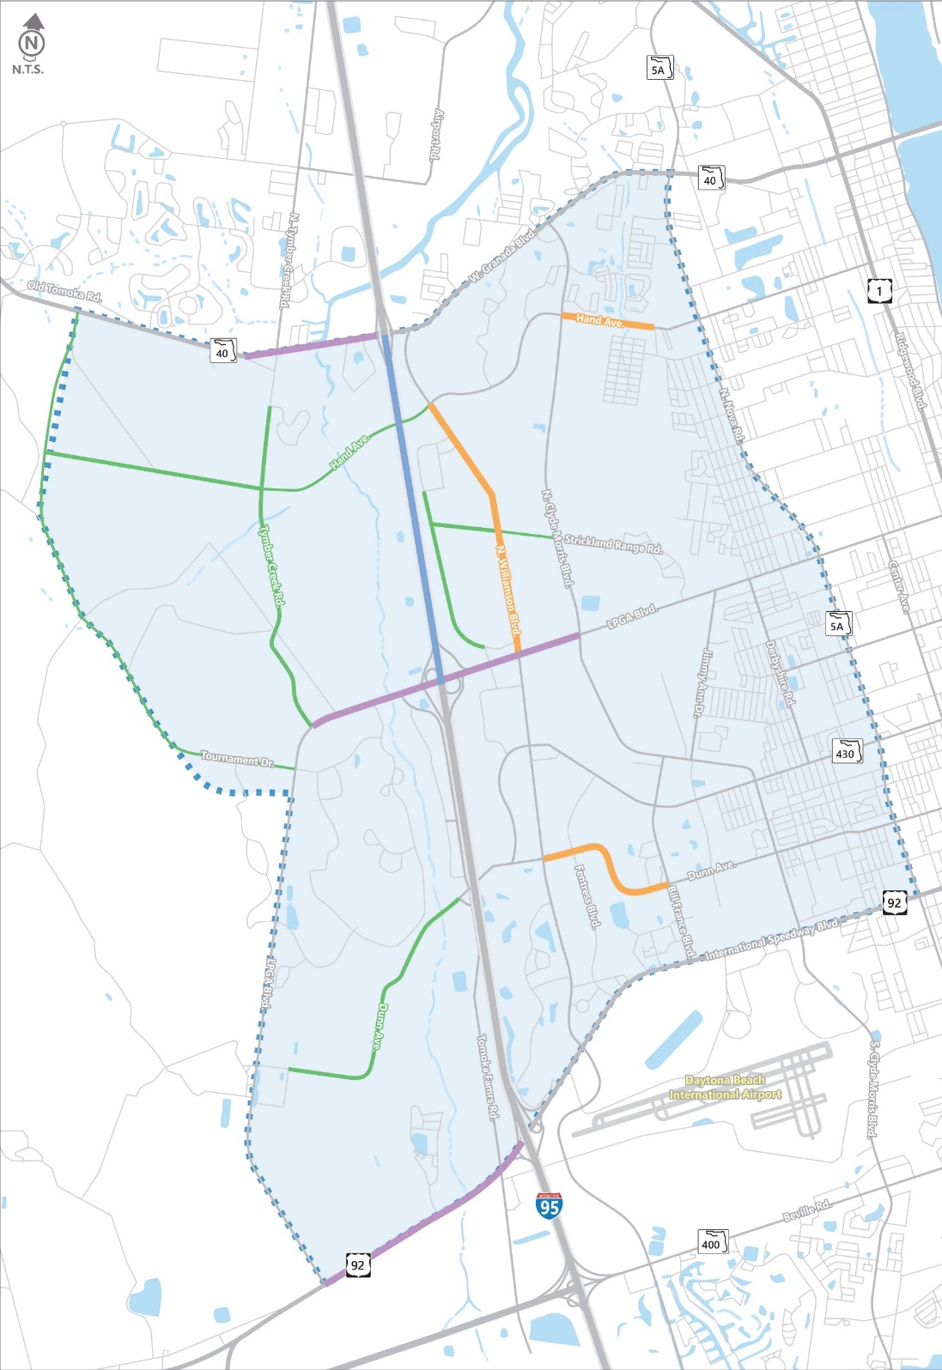
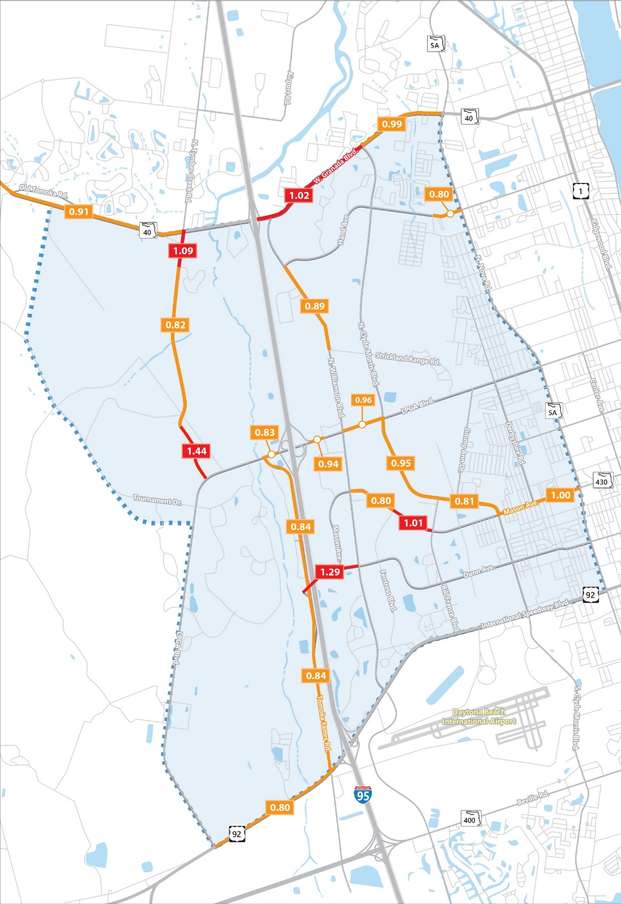
Scenario 4
Number of Lanes
Capacity Concerns
“Pie-in-the-Sky”
Scenario 4:
Includes:
PLUS:
Hand Ave Extension +
Tournament Dr Extension
Scenario 1
Scenario 2
Scenario 3
2 Lane Roadway
4 Lane Roadway
6 Lane Roadway
8 Lane Roadway
Study Area
Champion Elementary School
0.00
0.80<Volume-to-Capacity (V/C)<0.999
0.00
Cost Estimate: $153,769,358
Volume-to-Capacity (V/C)>1.00
Notes:
Scenario 1, 2 & 3, plus:
Hand Ave Extension – 2 lanes
Scenario 4: Near capacity – 16; Over capacity – 4

Slide 23
Presentation Outline
Purpose
Existing Conditions
Future Scenarios
Results
Next Steps

Slide 24
Scenario Comparison – Overall Congestion Levels Capacity vs Lane-Miles (Lower is better)
Notes:
Bar between Vested and Base alternatives

Slide 25
Scenario Comparison – Congestion Forecast Percentage of Trips Experiencing Congestion (Lower is better)
EXISTING CONDITIONS
2017 Existing Conditions
2017 Existing Plus Vested
Base 2040
Scenario 1 “Low-Hanging Fruit”
Scenario 2 “Southern Relief”
Scenario 3 “Northern Relief”
Scenario 4 “Pie-in-the-Sky”
Notes:
Add Example

Slide 26
Improvement Costs
Projects included on the half cent sales surtax
Improvement | Construction Cost * | Number of Lanes | Limits
Tymber Creek Rd | $17,050,000 | 2 | Minto to SR 40
LPGA Blvd Widening | $ 42,564,257 | 6 | Tymber Creek Road to Clyde Morris Blvd
Hand Ave Widening | $6,955,101 | 4 | Nova Rd to Clyde Morris Blvd
Dunn Ave Widening | $16,500,000 | 4 | Williamson Blvd to Clyde Morris Blvd
Dunn Ave Extension | $22,000,000 | 2 | Tomoka Farms Rd to LPGA Blvd
Hand Ave Extension | $39,500,000 | 2 | Williamson Blvd to Tournament Drive
Tournament Drive Extension | $9,200,000 | 2 | LPGA Blvd to SR 40
TOTAL $153,769,358
* Costs provided by Volusia County Engineering
Notes:
Break it out by scenario
Green – Projects included on the half cent sales surtax’

Slide 27
Scenario Comparison – Cost Estimates
Scenario 1
Scenario 2
Scenario 3
Scenario 4
“Low Hanging Fruit”
$83,069,358
“Southern Relief”
$105,069,358
“Northern Relief”
$113,369,358
“Pie-in-the-Sky”
$153,769,358
Notes:
MW: Modified Title some.

Slide 28
Funding Mechanisms
Current Funding | Estimated Revenue |  | Remarks
 | 2019 | 2020
5 cent local option gas tax | $6,374,847 | $6,438,595 | Countywide
Impact fees | $3,256,921 | $3,989,627 | All Zone 1
Proportionate fair share | ?? | ?? | All earmarked for Williamson Blvd construction widening of LPGA Blvd widening study/design
Potential Funding
Sales surtax

Slide 29
Presentation Outline
Presentation Outline
Purpose
Existing Conditions
Future Scenarios
Results
Next Steps

Slide 30
Next Steps
Stakeholder Meetings
Council/Commission Presentations
Public Workshop
Transportation Planning Organization (CAC and TCC)
Study Document
Currently Final “Draft” Status
Finalize After Meetings & Public Workshop
Discussion Points
Study Scenarios and Results
“Smart Growth”

Slide 31
Smart Growth–Land Use/Transportation Life Cycle
LAND USE
TRAVEL
ROAD CAPACITY
generates
demands

Slide 32
Smart Growth–Land Use/Transportation Life Cycle
WE ARE HERE
LAND USE
TRAVEL
ROAD CAPACITY
generates
demands
Anticipate
Forecast
Accommodate

Slide 33
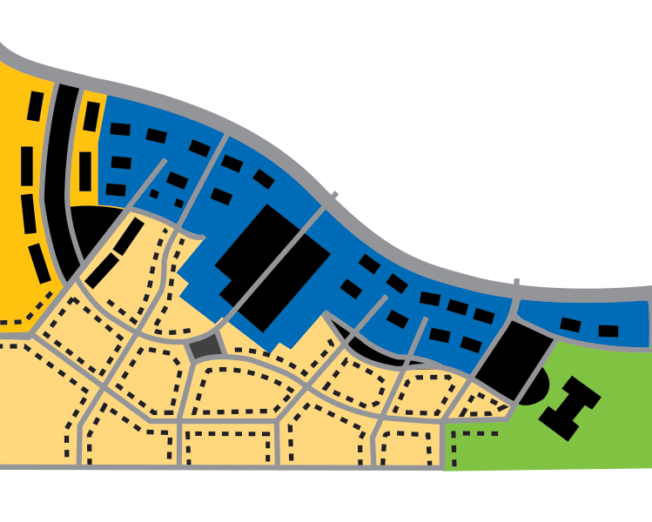
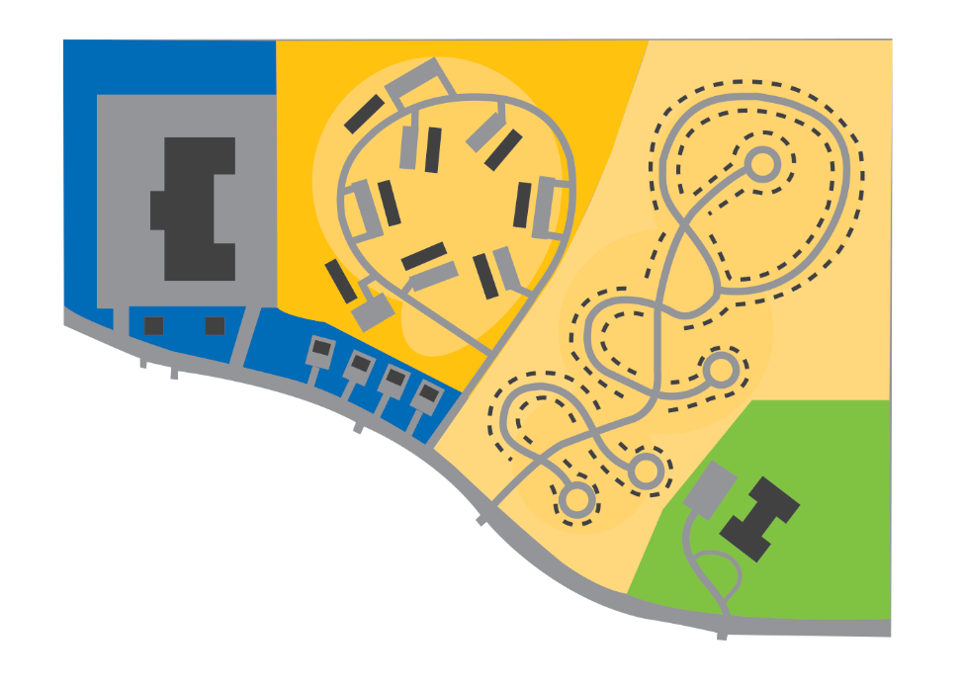
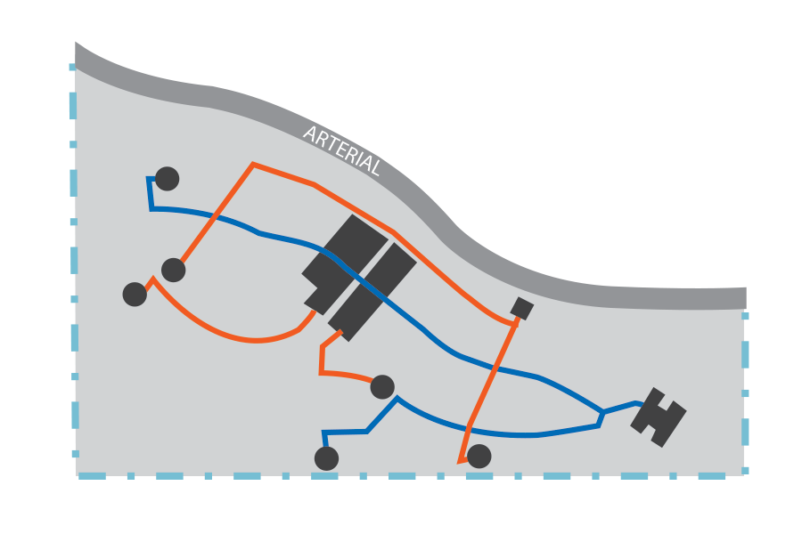
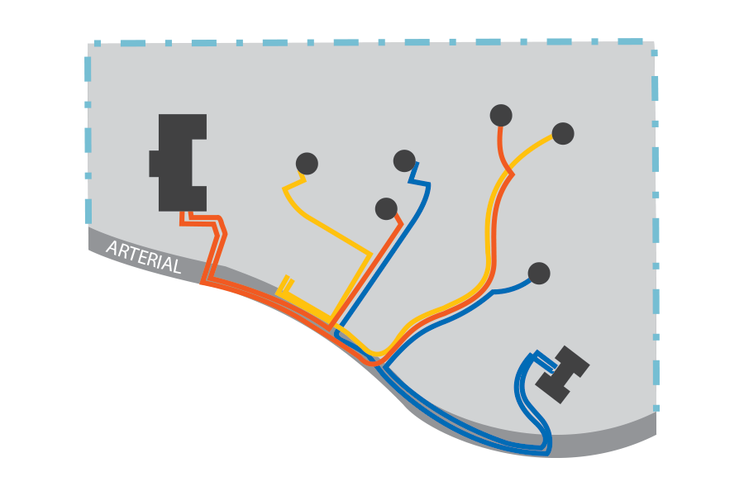
Smart Growth – Development Design’s Impacts on Transportation
Apartments
MALL
HOUSES
APTS.
MALL
SCHOOL
SCHOOL
HOUSES
Conventional
Traditional
Notes:
A tale of two cities

Slide 34
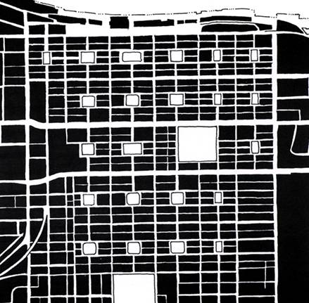
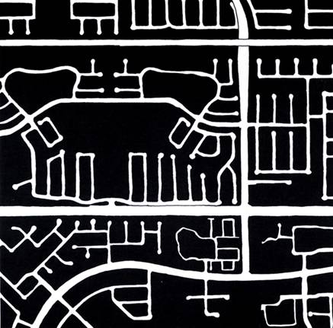
Street Networks Establish the Framework of a Community
Notes:
Savannah vs Jacksonville

Slide 35
“
“
Trying to cure traffic congestion with more capacity is like trying to cure obesity by loosening your belt.
― Glen Hiemstra, Futurist

Slide 36
Thank you!
Questions?
Kok Wan Mah, PE | kmah@vhb.com

