Slide 1

River to Sea Transportation Planning Organization (TPO)
2040 Long Range Transportation Plan
Environmental Justice

Slide 2
River to Sea TPO 2040 Long Range Transportation Plan – Environmental Justice
An Environmental Justice Approach to Transportation Planning
2040 River
to Sea Long Range Transportation Plan
Ensures the involvement of the entire community in public outreach and participation efforts.
The DOT is the lead agency charged with ensuring nondiscrimination stemming from environmental justice issues related to transportation planning. The statutory language of DOT Order 5610.2(a) focuses on minority and low-income populations.
This 2040 Long Range Transportation Plan (2040 LRTP) recognizes the need to consider all affected populations when making responsible planning decisions, including those who are elderly and those without access to a personal vehicle.
Transportation planning decisions both directly and indirectly influence the health of people and the environment. Decision-making and policy implementation affect air and water quality, noise, and inter and intra-neighborhood connections.

Slide 3
Environmental Justice Legislation
Civil Rights Act of 1964: Title VI
Executive Order 12898 Federal Actions to Address Environmental Justice
The National Environmental Policy Act of 1969 (NEPA)
Section 109 (H) of Title 23
The Uniform Relocation Assistance and Real Property Acquisition Act of 1970
Transportation Equity Act for the 21st Century (TEA-21)
Other United States Department of Transportation (US DOT) statutes and regulations

Slide 4
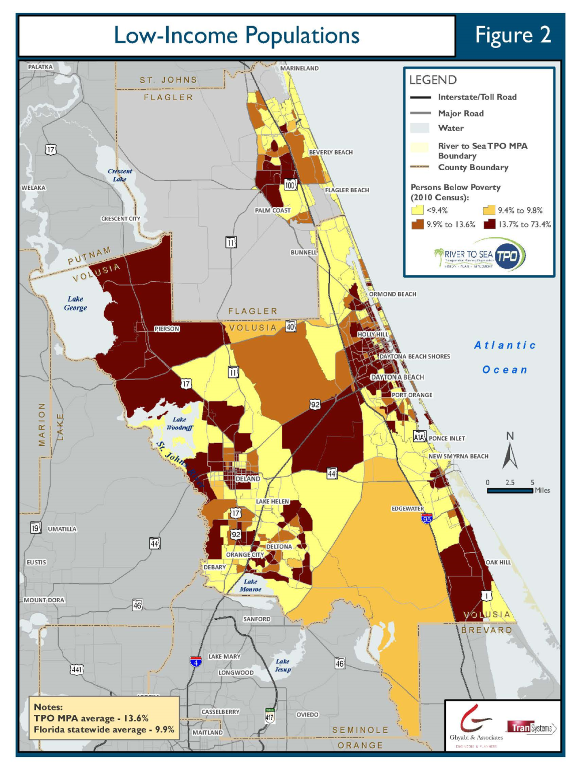
River to Sea TPO MPA
Low-Income Populations

Slide 5
River to Sea TPO MPA
Low-Income Populations
Low-income populations are those living below the poverty level
In the River to Sea TPO MPA, 13.6% of residents meet this designation. This figure is higher than the Florida average of 9.9%.

Slide 6
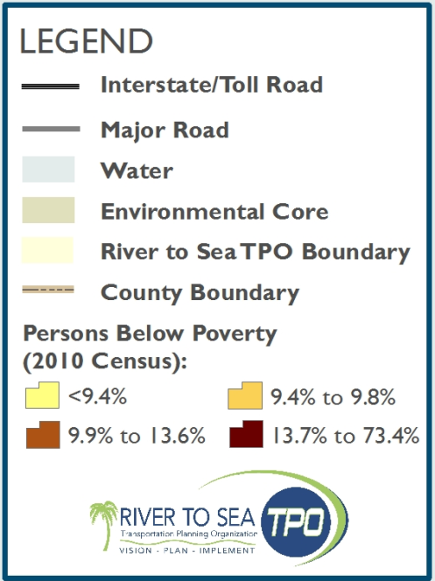
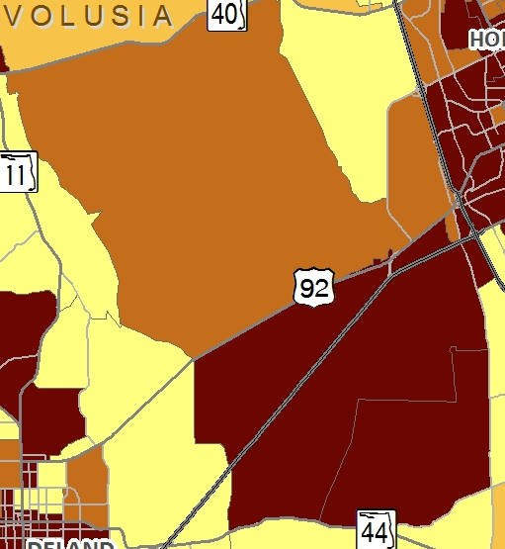

Central Volusia
County
US 92 serves as the northern edge of a land area bordered by SR 44 in the south
This area extends from approximately five miles east of DeLand to I-95 in the west

Slide 7
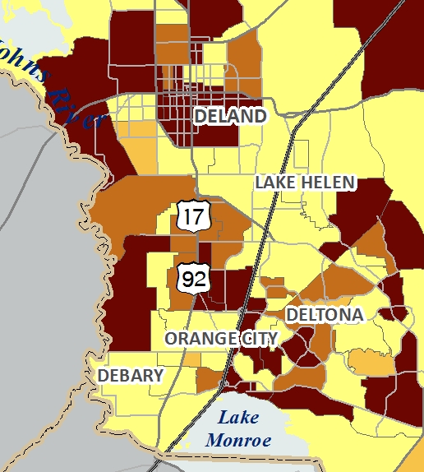

West – Southwest
Volusia County
US 17 into DeLand and west to the St. Johns River
South along US 17-92 low-income populations are located around the south-western edge of the River to Sea TPO MPA
From DeBary in the west to Osteen in the east, low-income populations are located on both sides of I-4, north of Lake Monroe, and west of SR 415

Slide 8
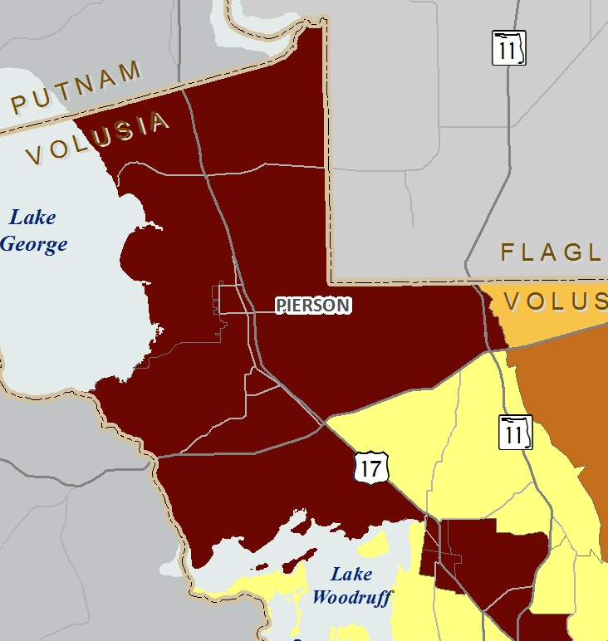
Northwest Volusia County
Areas east of Lake George, on the Putnam – Volusia County lines extending east to SR 11 and south to Lake Woodruff and US 17, have a high percentage of low-income residents

Slide 9

Southeast Volusia County
Areas of Southeast Volusia County with high percentages of low-income populations are in close proximity to the intersection of SR 44 and US 1
Low-income populations are also found south of SR 442, east of I-95, and reaching south to the Volusia – Brevard County lines. US 1 traverses through this area, its major population center being Oak Hill

Slide 10
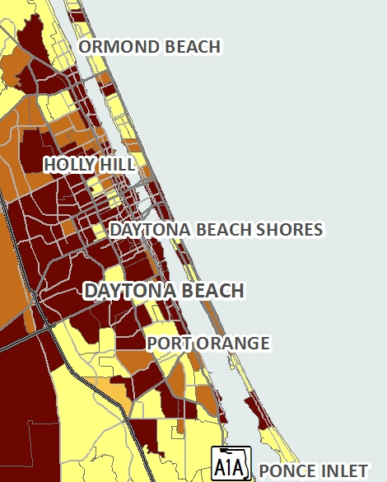

East Volusia County – East of I-95
Holly Hill
Daytona Beach
South Daytona
High percentages of low-income populations are located east of I-95 south of Ormond Beach to Ponce Inlet
Percentages are particularly high in Holly Hill, Daytona Beach and South Daytona

Slide 11
Southwest Flagler County
Areas west of I-95 and east of US 1 are highlighted by this 2040 LRTP as having a high percentage of residents qualifying as low-income
The primary roadway serving this area is SR 100. Low-income populations are both north and south of SR 100.

Slide 12
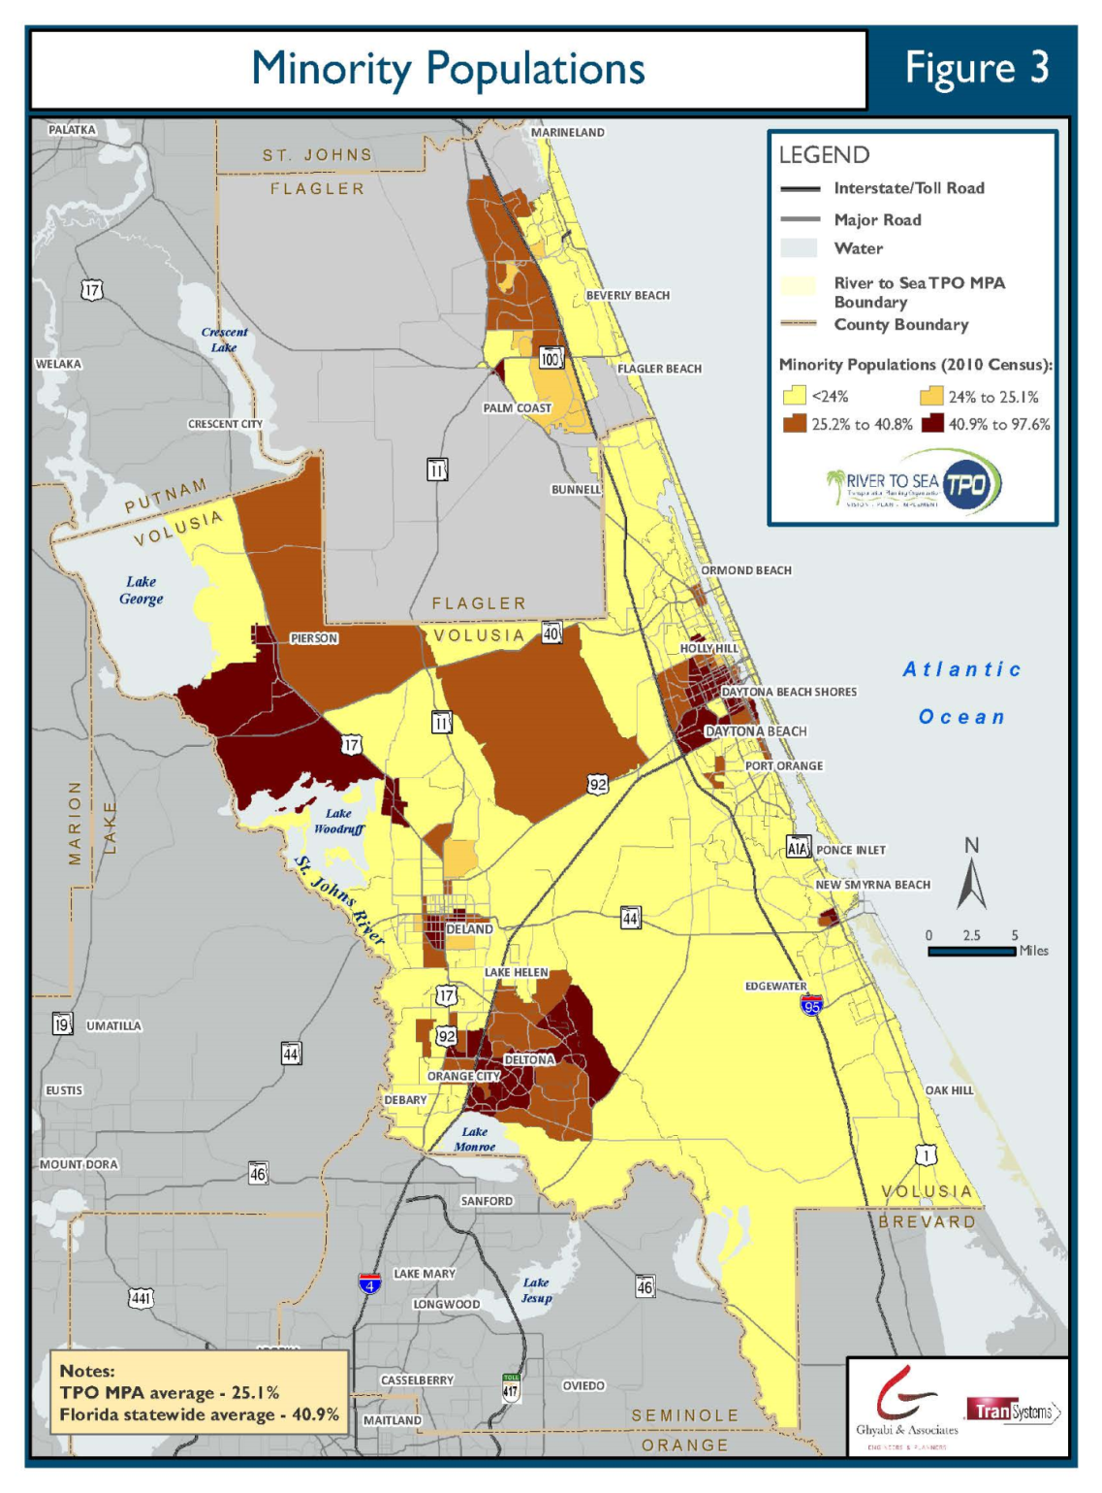
River to Sea TPO
Minority Populations

Slide 13

River to Sea TPO MPA
Minority Populations
Minority populations examined by this LRTP include: Black; Hispanic or Latino; Asian; American Indian or Alaska Native; and Native Hawaiian and Other/Pacific Islander
The River to Sea TPO MPA average percentage of minority populations is 25.1%
This figure is below the statewide average of 40.9%

Slide 14
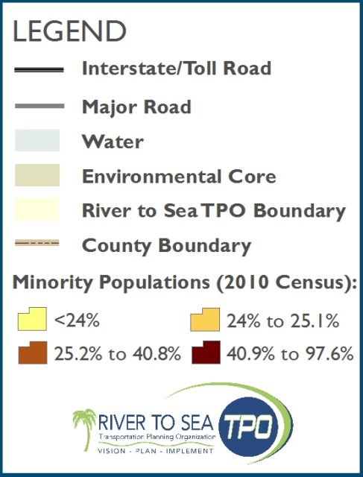
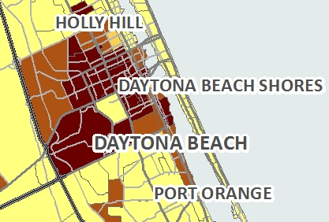

Northeast Volusia
County
The highest percentages of minority populations within the TPO MPA are located in the vicinity of Daytona Beach
Boundaries of the identified area include: SR 430 (north); local road Shady Place (south); SR 5A (west); and US 1(east)
Minority population percentages in this area reach as high as 97.6%. The average minority density for this portion of Volusia County is approximated at 90.6%

Slide 15
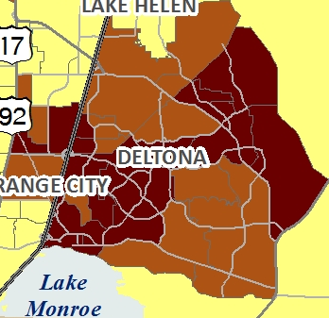

Deltona
Located directly adjacent to I-4, both to the east and west
Local roads that serve these communities are Saxon Boulevard, Newmark Drive, Providence Boulevard, N. Normandy Boulevard, and E. Normandy Boulevard
The selected planning analysis area averages a 45.3% minority population, with the highest percentage (51.5%) located between Providence and Saxon Boulevards

Slide 16
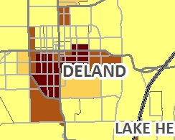

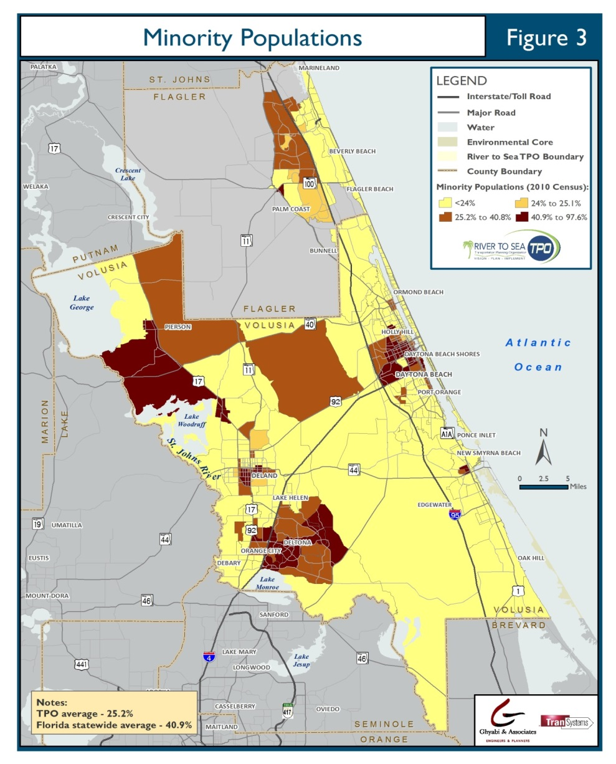
DeLand
Southern DeLand, from SR 44 in the north - to SR 15 in the south, is a third Environmental Justice planning analysis area
US 92 bisects the highlighted portion of DeLand. In particular, the neighborhoods east of S. Adelle Avenue, south of W. Beresford Avenue and northeast of Bon Air, in which minorities comprise 93.8% of the total population

Slide 17
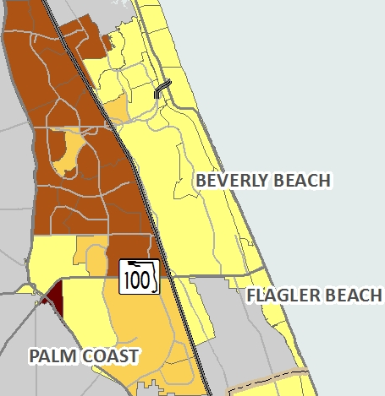

Flagler County
Environmental Justice should also be a key consideration when undertaking planning efforts in the west and northwest portions of Flagler County; particularly west of I-5 and north of SR 100

Slide 18
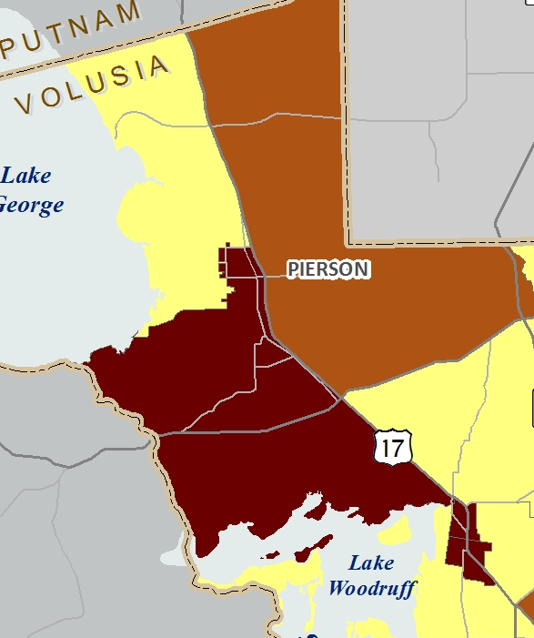

Northwest Volusia
County
Areas surrounding the intersection of SR 40 and SR 15, north of Glenwood, south of Seville, and east of Astor and Pierson are all included in this planning analysis area.

Slide 19
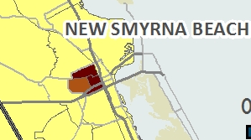
New Smyrna Beach
Enterprise Avenue and Wayne Avenue serve as the south and north borders of the identified planning area, while Halleck Street and SR 1 are the east and west borders
The neighborhoods within these boundaries are comprised of 65% minorities

Slide 20
Summary of Findings
Portions of the River to Sea TPO MPA with an overlap of the two Environmental Justice populations (Low-Income and Minority):
Daytona Beach:
South of US 92, north of Beville Road, and west of Clyde Morris Boulevard, residents have a median income of $29,583 and are comprised of 42% minorities.
Bisected by US 92, areas east of SR 5A, west of US 1, and north of Shady Place, and south of 3rd Street have a median household income of approximately $12,000 and average nearly 90% minority populations.
North of US 92, west of SR 5A, east of Bill France Boulevard, and south of LPGA Boulevard between Jimmy Ann Drive and Derbyshire Road. This selected portion of the TPO MPA is comprised of 73.5% minority populations; with 26% of residents living below the poverty level.
DeLand
US 17-92 bisects an area bordered by South Hill Avenue in the east and SR 15 in the west. Northern edges of this area are West Howry Avenue and East Wisconsin Avenue. Median income figures in this area are approximately $24,000 and minority populations range from 45% to above 90%.

Slide 21
Summary of Findings
Portions of the River to Sea TPO MPA with an overlap of the two Environmental Justice populations (Low-Income and Minority):
Northwest of Deltona and southwest of Orange City:
This area, with US 17-92 as the western edge and I-4 on the east, averages greater than 40% minority populations and less than $25,000 in median household income. Saxon Boulevard is the southern edge of this defined area and East Graves Avenue is the northern border.
Bunnell
The intersection of SR 100 and US 1, bordered by Hyman Circle in the southeast and South Knight Street in the west. This portion of Flagler County has a median household income of $28,594 and is composed of 65.8% minorities.
New Smyrna Beach:
US 1 (east), Wayne Avenue (north), Milford Place (west), and SR 44 (south) - Median income is approximately $20,000 and minority populations average over 55%.

Slide 22


Thank You!
Andy Nicol
awnicol@transystems.com
(407) 790-0135

