Slide 1
Transportation Disadvantaged Local Coordinating Board
Volusia County
March 2015

Slide 2
Educational series - reporting
Introduction
Votran Demand Response Programs
Americans with Disabilities Act (ADA)
Transportation Disadvantaged (TD)
Reasons for Reporting
Oversight
Information Sharing
Education
Improvement
Notes:
The third presentation in the educational series is on reporting.
Votran currently runs two paratransit programs – FTA required for providers of fixed-route service, state program on behalf of BoCC as CTC
Completes reporting for several different reasons stemming from requirements for oversight, to share information with general public, other agencies, and funding partners, to see trends and learn from data to improve system, i.e. ways to determine funding needs, determine policy direction – no shows, performance of staff etc.

Slide 3
Reporting requirements & measures
Federal
National Transit Database
Monthly Safety and Security
Quarterly Grant Reporting
Triennial Review
ADA Compliance Review
State
Monthly Reports
Annual Operating Report
Rate Model
Quality Assurance Performance Evaluation
Local
Performance
Audit
Coordination
Notes:
NTD - Focused on annual fixed-route and ADA reporting of service levels – trips, miles, hours, days of service, accidents/costs/revenue streams/capital assets/
S&S – same as NTD, but done on monthly basis
QGR – Updates on progress of projects funded through each grant
Triennial – Every three year on-site review of all operations after submittal of requested information – covers service, rights, procurement, funding, safety & security
ADA – randomly selected agency review that covers all aspects of ADA compliance – service provision, facilities, funding, policies and processes
State
AOR – agency information, fixed route (passes, trips), paratransit (stretcher, w/c, ambulatory), deviated fixed-route, school board, by funding source, by type, by purpose, no shows, any unmet trips, complaints and commendations, vehicles, road calls, accidents, employees by function, revenues, expenses by function
Evaluation – similar to AOR, but includes surveys, performance measures, performance standards, budget, contractors, vehicle inspections, coordination contract measures/oversight, MOA, audits, matching

Slide 4
TYPES of Information BEING Reported
Financial Management & Compliance Reports Include:
Funding Levels
Costs of Service
Capital Assets
Service Performance Management & Compliance Reports Include:
Ridership – Number, Type, Purpose
Compliments/Complaints
Levels of Service – Hours, Miles
Impacts to Service – Accidents, Cancellations
Notes:
Management Reports & Compliance Report

Slide 5
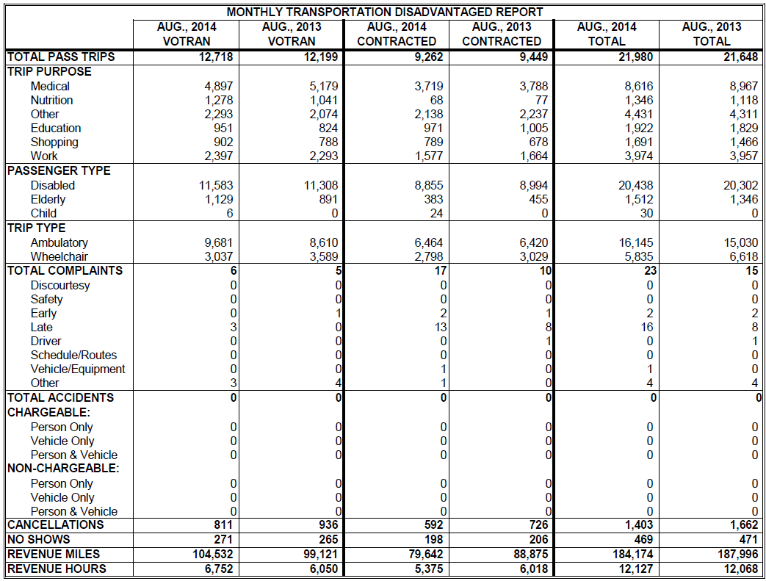
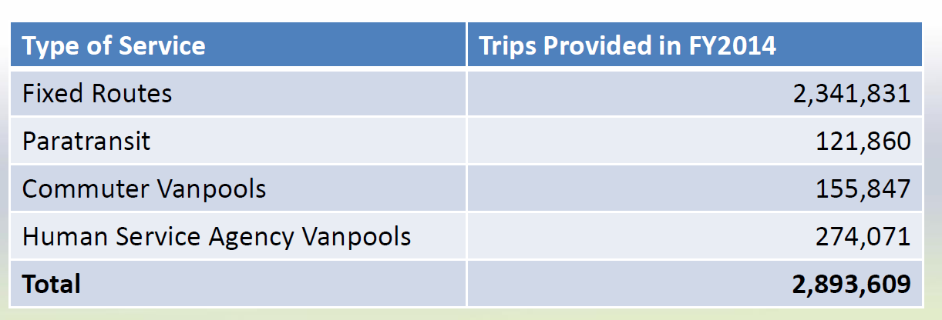
TDLCB Reporting
Votran Monthly Report
Peer Agency Report
Next Steps
Notes:
On par with other agencies with regard to reporting. Several agencies are only having TDLCB meetings quarterly. Votran provides information on entire agency not just paratransit, grant opportunities, new ideas/technology, and tries to keep TDLCB engaged and informed.
Is there something you want to know about that you don’t get?
Last part of educational series at this point, but we want to continue discussions regarding getting you the information you need and want and using these meetings as a forum to discuss system maintenance and improvement. Serve customers to the best of our abilities within regulation and funding levels.
What we covered thus far in the series and any questions?

