Slide 1
Pedestrian & Bicyclist Crash Analysis 2012-2013

Slide 2
Pedestrian & Bicyclist
Injury Trends
Percent Change from
2007-2008 to
2012-2013

Slide 3
Environmental Factors

Slide 4
Environmental Factors

Slide 5
Time & Day: Bicyclists
Time of Day
Day of Week

Slide 6
Time & Day: Pedestrians
Time of Day
Day of Week

Slide 7
Age
The number of crashes for cyclists age 16 to 21 increased 100% from 2003/04 to 2012/13, while all ages increased 42%.
The number of crashes for pedestrians age 16 to 21 increased 40% from 2003/04 to 2012/13, while all ages increased 8%.

Slide 8
Location Characteristics

Slide 9
Location Characteristics

Slide 10
Bicyclist Crash Behaviors

Slide 11
Bicyclist Crash Behaviors
Behaviors for Fatal Bicyclist Crashes
Crash Type | Bicyclist at Fault | Motorist at Fault | Fault Unknown | Total
Bicyclist Failed to Yield | 12 |  |  | 12
Bicyclist Right Turn / Merge | 2 |  |  | 2
Motorist Overtaking Bicyclist | 1 | 3 |  | 4
Motorist Loss of Control / Turning Error |  | 3 |  | 3
Motorist Left Turn / Merge |  | 1 |  | 1
Motorist Right Turn / Merge |  |  | 1 | 1
Grand Total | 15 | 7 | 1 | 23

Slide 12
Pedestrian Crash Behaviors:
Fatalities
Crash Type | Motorist at Fault | Pedestrian at Fault | Both at Fault | Neither at Fault | Cannot Determine Fault | Total
Pedestrian Failed to Yield |  | 44 |  |  |  | 44
Non-intersection - Other/Unknown |  | 6 | 1 |  | 2 | 9
Walking Along Roadway With Traffic – Hit From Behind |  | 3 | 2 |  |  | 5
Dash |  | 5 |  |  |  | 5
Disabled Vehicle-Related | 2 | 3 |  |  |  | 5
Motor Vehicle Loss of Control | 5 |  |  |  |  | 5
Motorist Failed to Yield | 3 |  |  |  |  | 3
All Other | 2 | 9 | 2 | 2 | 6 | 21
Total | 12 | 70 | 5 | 2 | 8 | 97

Slide 13
Top 10 Zip Codes for Pedestrian or Bicyclist Residence
One-third of total area-wide pedestrian and bicyclist crashes
No significant differences in environmental or behavioral characteristics compared to the rest of the metro area
Important for targeting most effective education and enforcement efforts

Slide 14
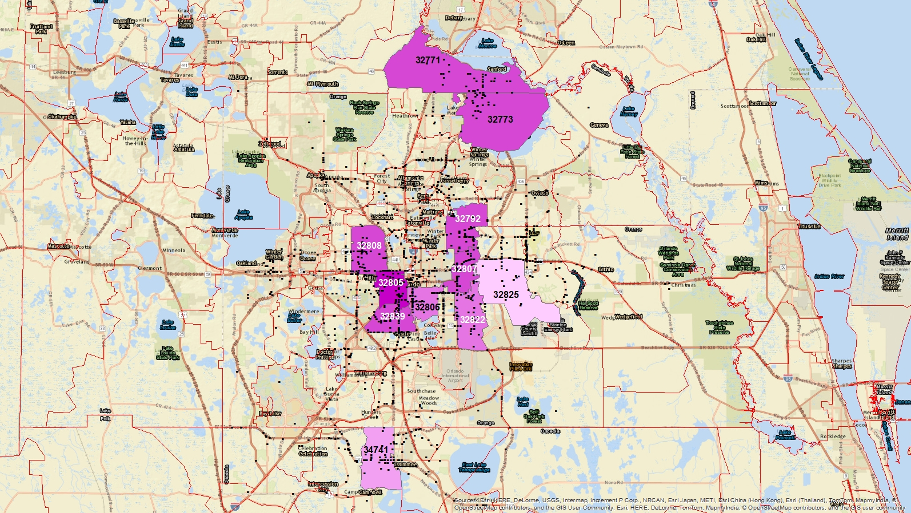
Bicyclist Top 10 Zip Codes Number of Crashes by Zip Code Residence
32805 ………. 68
32839 ………. 59
32808 ………. 57
32792 ………. 57
32771/3 …….57
32807 ………. 56
32806 ………. 46
32822 ………. 44
34741 ………. 41
32825 ………. 36

Slide 15
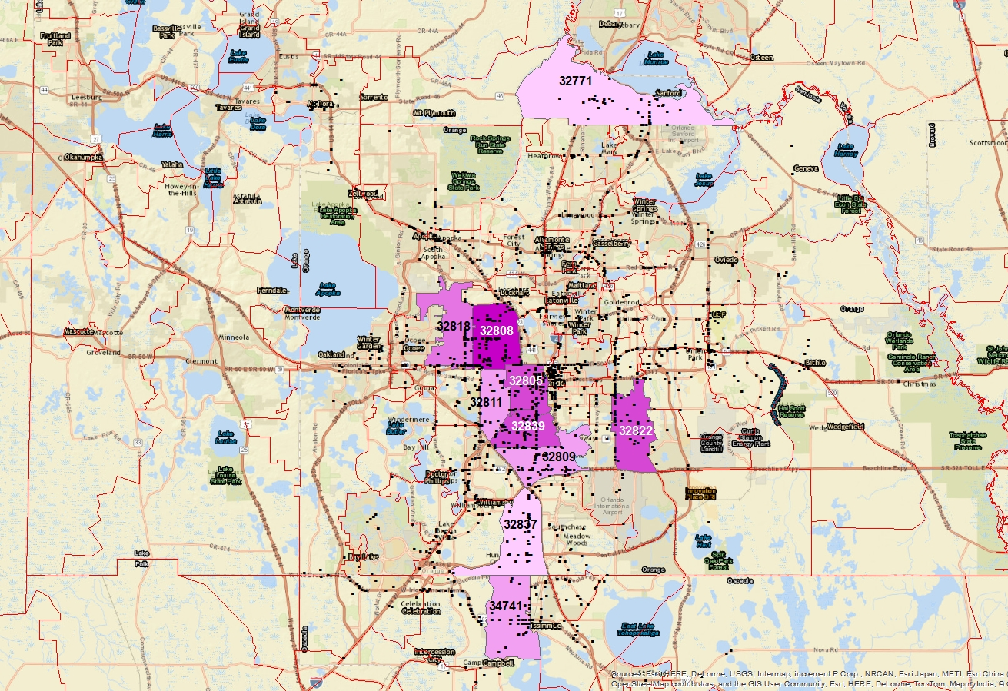
Pedestrian Top 10 Zip Codes Number of Crashes by Zip Code Residence
32808 ……..…. 80
32839 ………... 56
32822 ………... 55
32805 ……..…. 54
32818 ………... 44
32809 ………... 41
32811 ………... 39
34741 ……..…. 38
32771 ……..…. 34
32837 ………... 34

Slide 16
Conclusions
Bicyclists
Increasing faster than pedestrians
Concentrated in low income neighborhoods and along multi-lane arterials
Most crashes involve sidewalk cycling and cycling against traffic
Most fatalities involve bicyclist failure to yield
Pedestrians
Concentrated in low income neighborhoods and along multi-lane arterials
42% of crashes are mid-block; 30% at intersections
Most fatalities involve pedestrian failure to yield

Slide 17
Crashes and Infrastructure

Slide 18
Lanes, Medians & Pedestrians
Mid-Block Crossing Crashes by Number of Lanes
Number of Through Lanes | Change in Crashes per Mile | Change in Fatals per Mile | Number of Crashes |  | Number of Fatals
 |  |  | 2003/04 | 2012/13 | 2003/04 | 2012/13
2-Lane* | 1% | 44% | 100 | 101 | 9 | 13
4-Lane | 6% | 55% | 218 | 230 | 22 | 34
6-Lane | -4% | 19% | 139 | 133 | 26 | 31
8-Lane | -67% | -100% | 6 | 2 | 2 | 0
* On study network only
Greatest increase in fatalities occurred on 4- and 6-lane roads.

Slide 19
Lanes, Medians & Pedestrians
Mid-Block Crossing Crashes With and Without Medians
Number of Through Lanes | Change in Crashes per Mile | Change in Fatals per Mile | Number of Crashes |  | Number of Fatals
 |  |  | 2003/04 | 2012/13 | 2003/04 | 2012/13
2-Lane | 1% | 44% | 100 | 101 | 9 | 13
Divided (4+ Lanes) | -12% | 9% | 251 | 222 | 43 | 47
Undivided (4+ lanes) | 28% | 157% | 112 | 143 | 7 | 18
Greatest increase in fatalities occurred on multi-lane roads without medians.

Slide 20
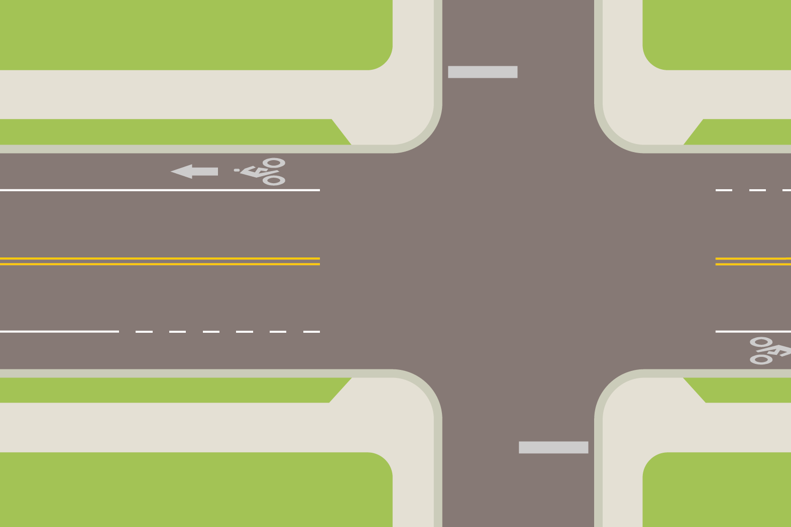
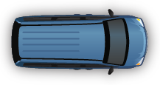
Crashes Mitigated by Bike Lanes
Overtaking Motorist
Percent of Crashes with Bicyclist in Each Position
29%
19%
0.5%

Slide 21
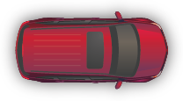
Crashes Aggravated by Bike Lanes
Right Hook
Percent of Crashes with Bicyclist in Each Position
2%
15%
23%

Slide 22
Crashes Aggravated by Bike Lanes
Left Cross
Percent of Crashes with Bicyclist in Each Position
5%
7%
13%

Slide 23
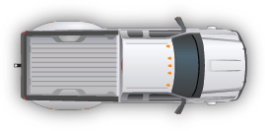
Crashes Aggravated by Bike Lanes
Drive-out
Percent of Crashes with Bicyclist in Each Position
12%
10%
27%

Slide 24
Crashes Aggravated by Bike Lanes
17%
21%
72%*
Wrong-Way Cyclist*
Percent of Crashes with Bicyclist in Each Position
* Bicycling against traffic on a sidewalk or path is not illegal

Slide 25
Crashes Aggravated by Bike Lanes
Left Swoop
Percent of Crashes with Bicyclist in Each Position
2%
13%
3%*
* Some crashes involving bicyclist failure to yield mid-block may have involved a bicyclist who was initially traveling with the flow on the sidewalk

Slide 26
Crashes Not Relevant to Bike Lanes
32%
15%
57%
Crash types not relevant to bike lanes should be a higher proportion if bike lanes are effective at reducing relevant types of crashes.

Slide 27
Injury Severity
 |  | Number and Percent of Injuries and Fatalities
 |  | Travel Lane |  | Bike Lane/ Shoulder
Overtaking Crashes | Fatal & Incapacitating | 5 | 13% | 8 | 33%
 | Fatal & All Injuries | 20 | 50% | 19 | 79%
Crashes Aggravated by Bike Lanes | Fatal & Incapacitating | 8 | 15% | 10 | 12%
 | Fatal & All Injuries | 30 | 57% | 47 | 56%

Slide 28
Similar Results
Copenhagen
(Jensen, 2007)
“The construction of cycle tracks has resulted in an 18-20% increase in cycle/moped traffic…”
“The construction of cycle lanes resulted in a 5-7% increase of cycle/moped traffic…”
Crash Change After Installation
 | Bike Lane | Cycle Track
Right Hook | +73% | +171%
Left Cross | NI | +34%
Drive-out | NI | NI
Overtaking | No change | -67%
Bicycle v. Pedestrian | NI | +128%
Bicyclist Left | No change | -51%
All Bicyclist Injuries | +49% | +30%

Slide 29
Conclusions
Continue focus on improving pedestrian safety along multi-lane roads with better street lighting, medians and enhanced crossings
Education is necessary for bicyclists, pedestrians and motorists, regardless of what types of accommodations we provide
Installation of bikeways cannot be a one-size-fits-all approach

