Slide 1
A Presentation to:
River to Sea TPO Board
May 27, 2015

Slide 2
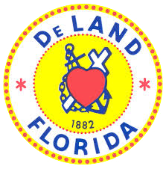
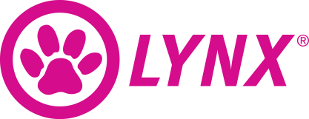
Project Partners
Project Advisory Group
Technical Working Group
Community Liaison Group

Slide 3
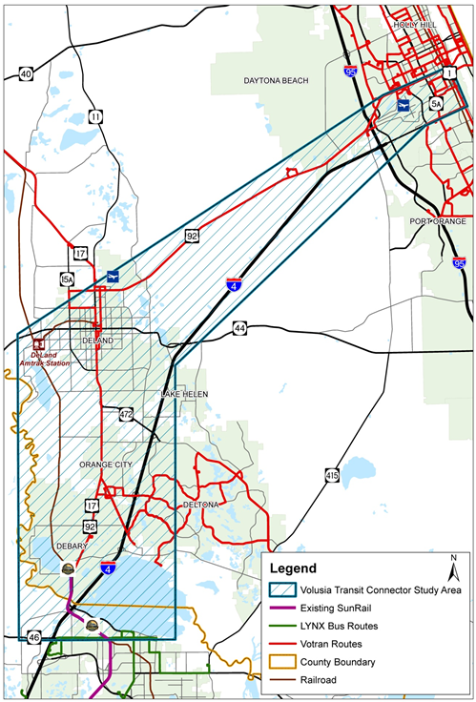
Project Overview:
Study Area
State Road (SR) 46 in Sanford to US 1 in Daytona Beach
Limits defined by FDOT with input from Volusia County and R2C TPO
SunRail Phase 2 North is a committed project
Scope of Services
Systems Planning Study
Identify need for enhanced transit service
Develop/evaluate alternatives
Maintain eligibility for future federal funding
Comprehensive public involvement and local agency coordination

Slide 4
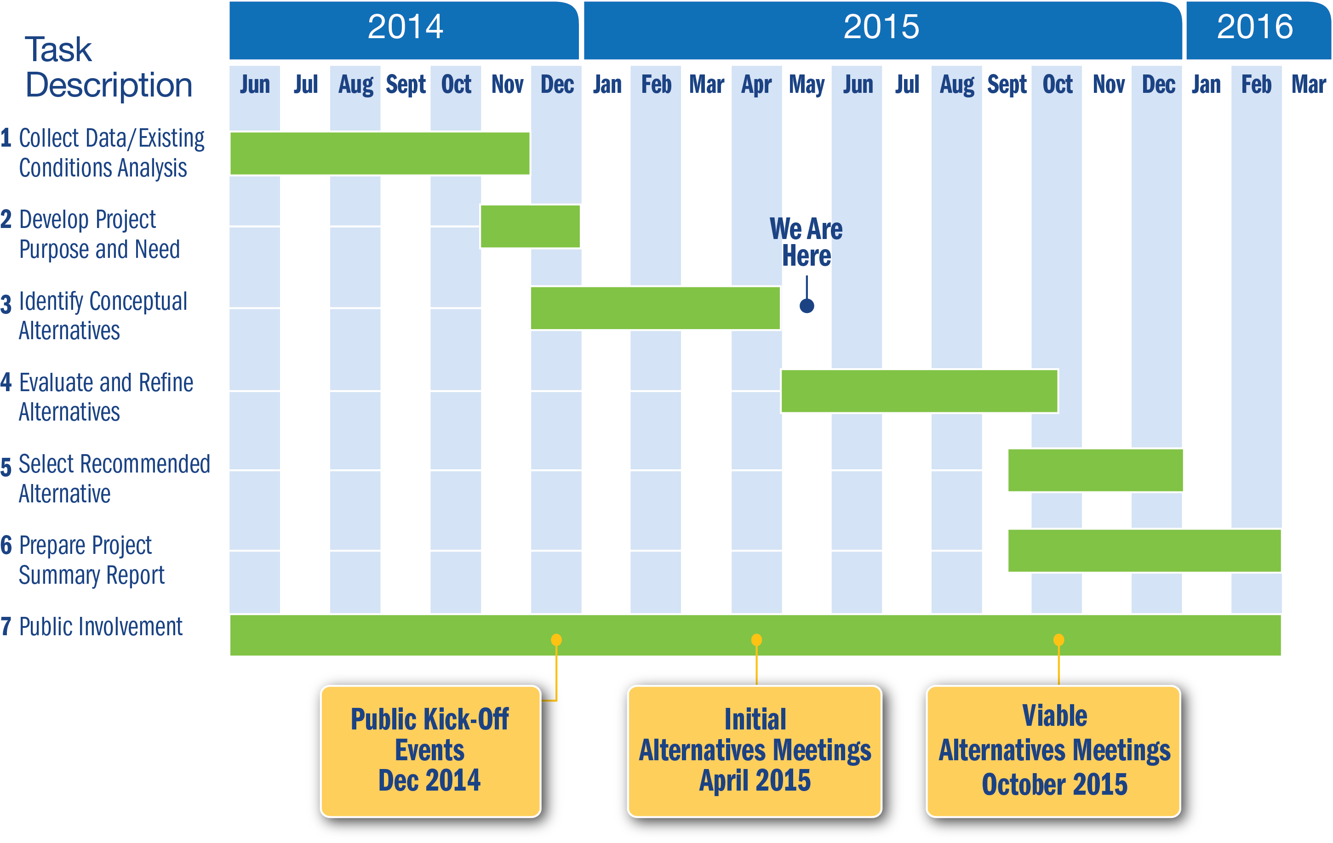
Study Schedule

Slide 5
Initial Mode Screening Results Summary
Mode | Rating | Advance Mode for Corridor Segment Evaluation
Commuter Rail |  | Yes
Light Rail Transit |  | No
Streetcar |  | Yes
Automated Guideway Transit (AGT) |  | No
Monorail |  | No
Bus Rapid Transit |  | Yes
Express Bus |  | Yes
Local Bus |  | Yes
 | High
 | Medium
 | Low

Slide 6
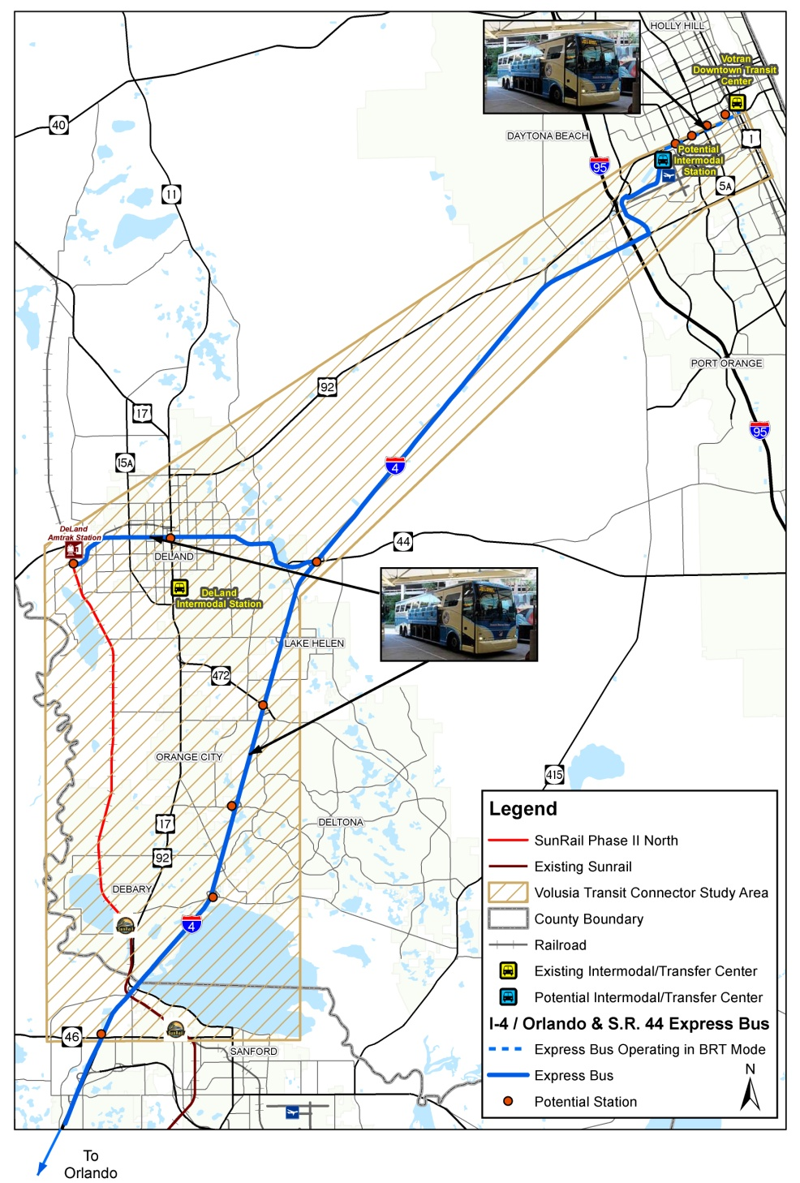
Alternative 1 I-4/Orlando & S.R. 44 Express Bus
Two express bus routes from Daytona Beach
To Orlando
To DeLand
Express bus operates in BRT mode east of potential Intermodal Station to Votran Downtown Transit Center

Slide 7
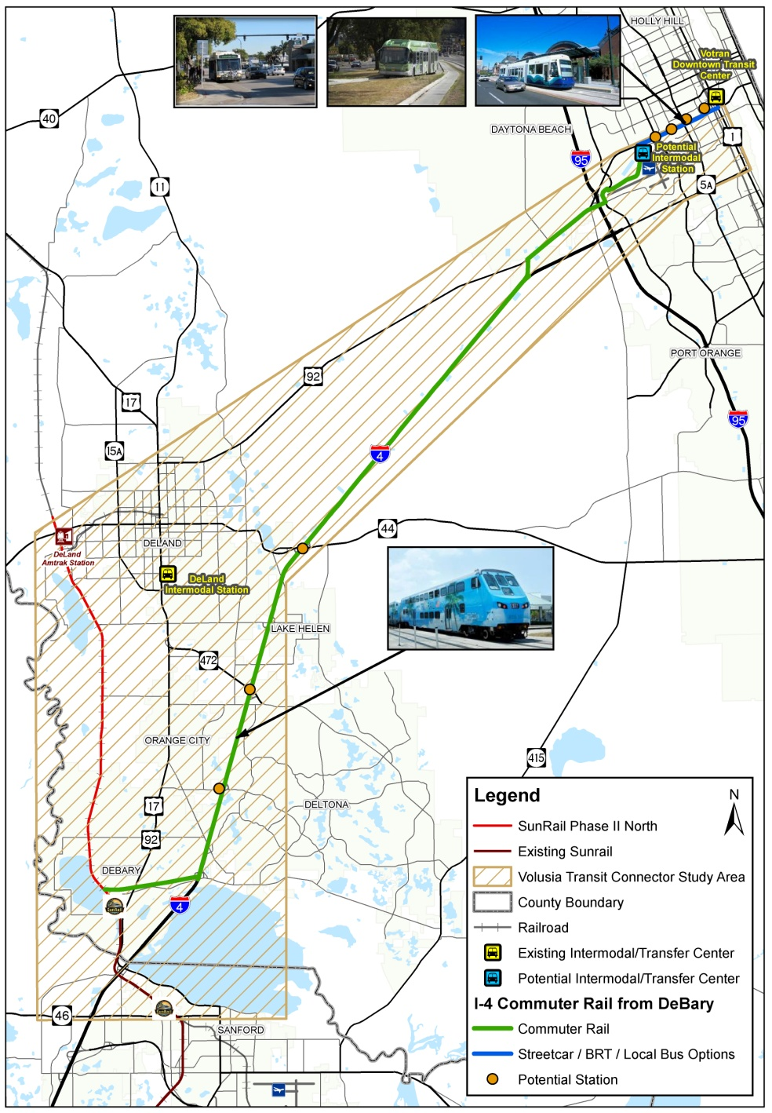
Alternative 2 I-4 Commuter Rail from DeBary
Extension of commuter rail to Daytona Beach via Dirksen Rd or utility corridor and I-4/U.S 92
BRT, local bus, streetcar all options east of potential Intermodal Station to Votran Downtown Transit Center

Slide 8
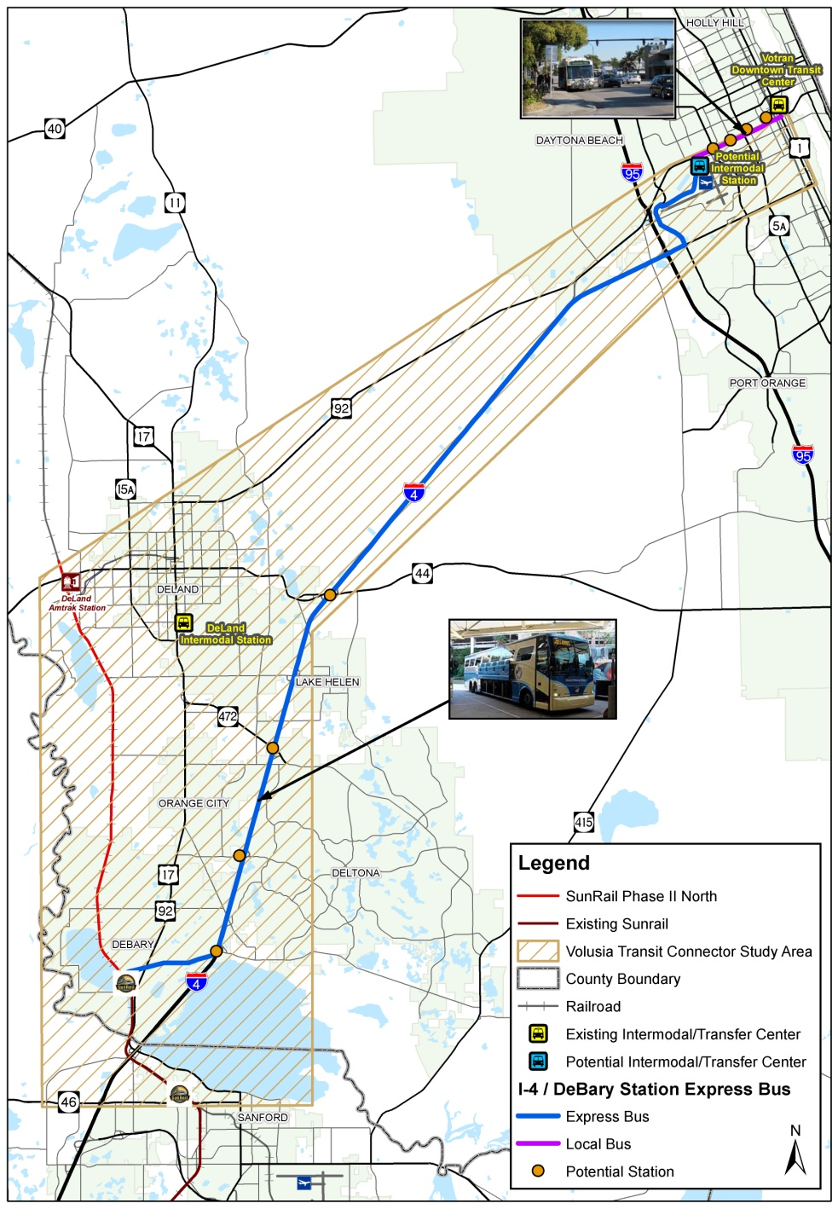
Alternative 3 I-4/DeBary Station Express Bus
Express bus via Dirksen Rd and I-4
Connection to potential Intermodal Station via Midway Ave.
Local bus east to Votran Downtown Transit Center

Slide 9
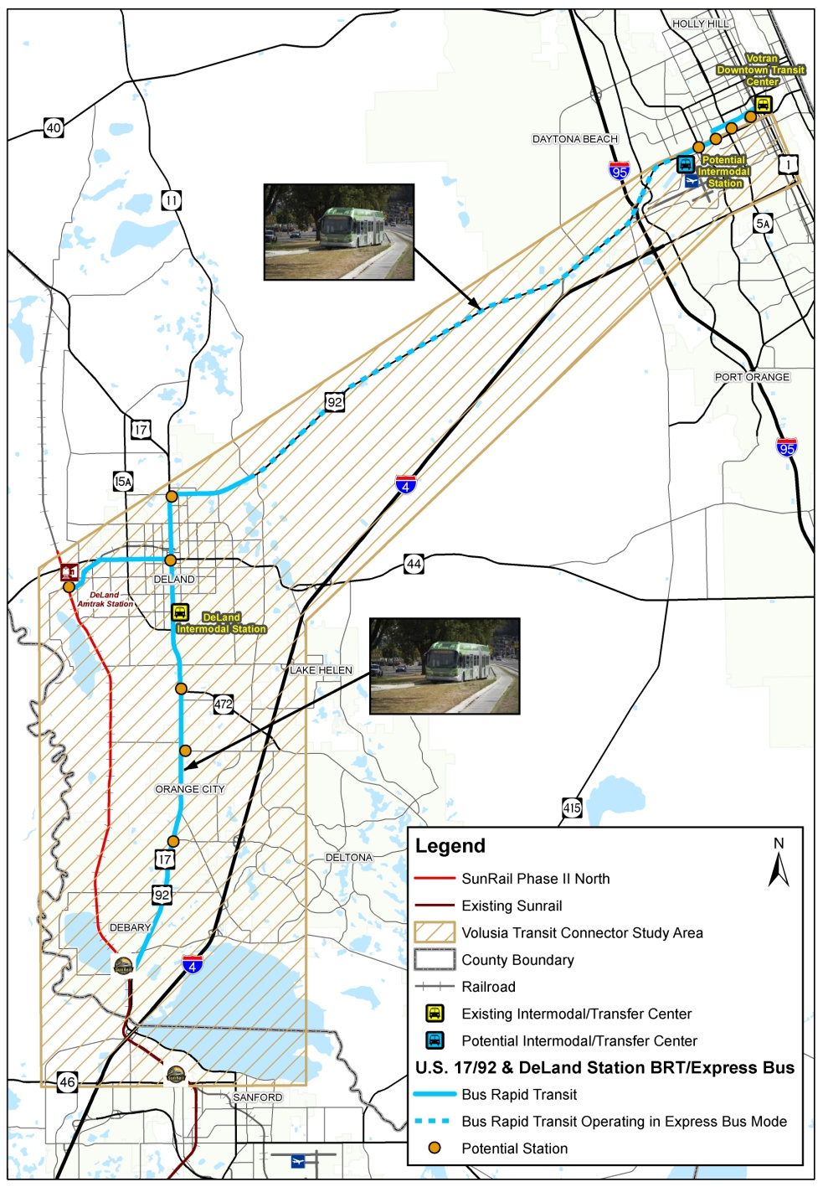
Alternative 4 U.S. 17/92 & DeLand Station BRT/Express Bus
Two BRT routes from Daytona Beach
To DeLand SunRail Station
To DeBary SunRail Station via U.S. 92
Same BRT operation east to Votran Downtown Transit Center

Slide 10
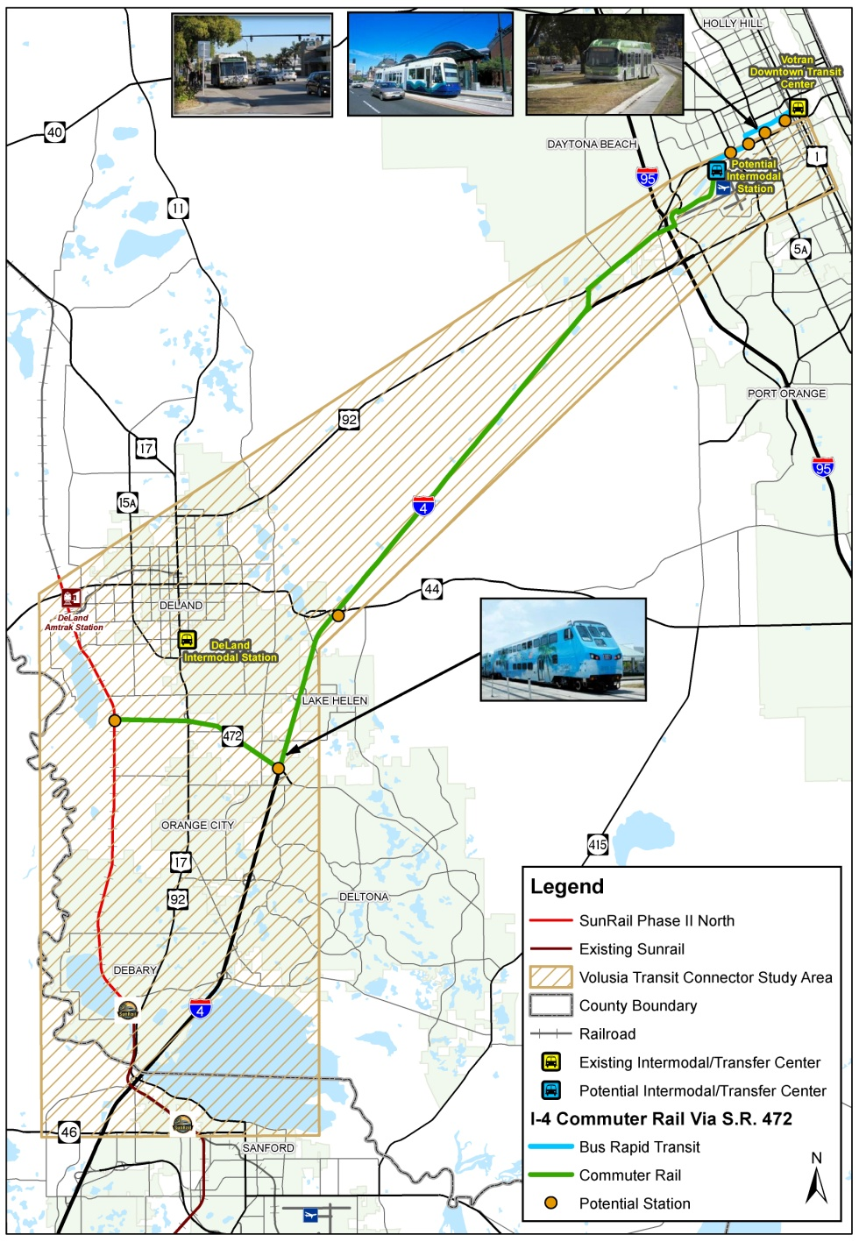
Alternative 5 I-4 Commuter Rail Via S.R. 472
Commuter rail via extended S.R. 472 and I-4 / U.S 92
I-95 crossing at existing grade separation south of U.S. 92
BRT, local bus or streetcar east of potential Intermodal Station

Slide 11
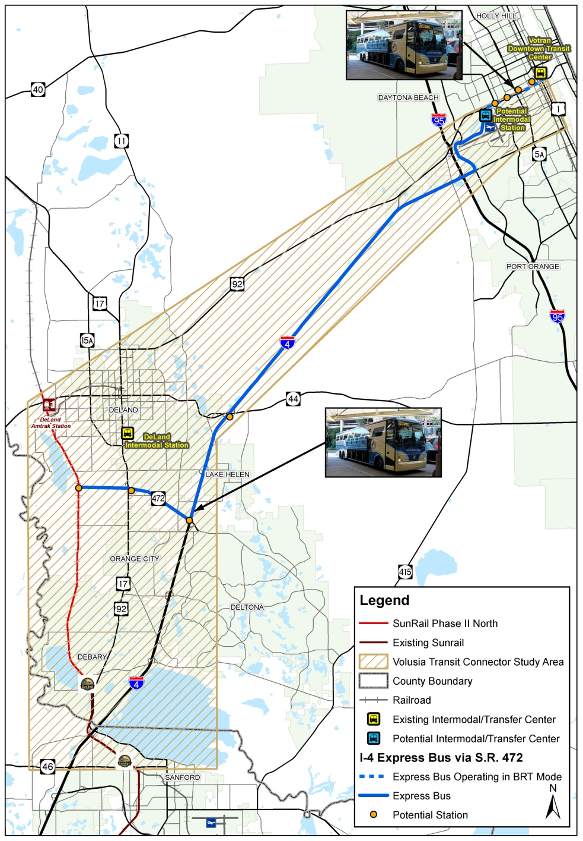
Alternative 6 I-4 Express Bus Via S.R. 472
Express bus via extended S.R. 472 and I-4
Same express bus mode operates east to Votran Downtown Transit Center

Slide 12
Initial Alternatives Public Meetings
April 14th: Daytona Beach
April 15th: DeLand
April 16th: Orange City
Over 120 attendees
Includes Elected Official and members of the Project Advisory Group and Community Liaison Group
Over 65 written comments/survey cards to date
Over 15 general comment cards to date

Slide 13
What Did We Hear?
There is a need to improve transit alternatives for transportation disadvantaged users.
What is the status of SunRail Phase 2 North to DeLand?
Can the railroad spur track east of the Amtrak/SunRail Station in DeLand be used for commuter rail?
Can commuter rail be extended north of the Amtrak/SunRail Station in DeLand and connected to US 92?
Will there be additional feeder bus routes to serve either of the alternatives?
Have you considered extending enhanced transit alternatives into Deltona?

Slide 14
Next Steps
Continue review of public input and refine initial alternatives as necessary
Identify viable alternatives for detailed evaluation
Identify draft recommended alternative
Additional public meetings and elected official briefings
Refine recommended alternative and complete final report
www.volusiaconnectorstudy.com

