Slide 1
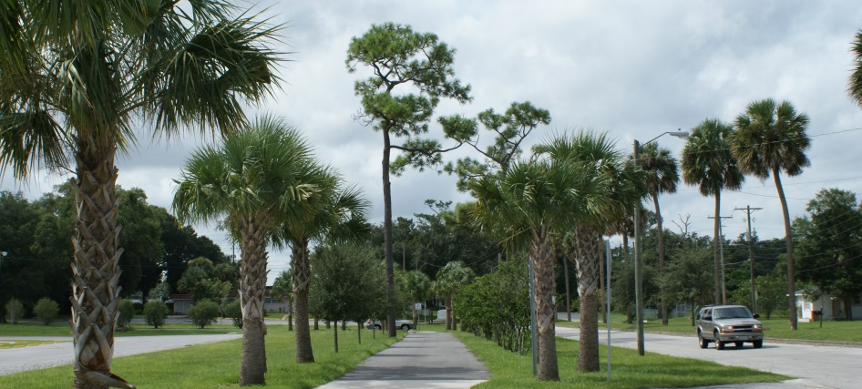
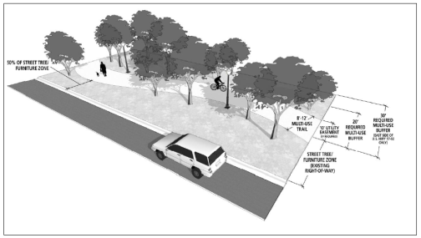
US Hwy 17-92 TOD Bicycle/Pedestrian Trail Feasibility Study
HUD Sustainability Communities Regional Planning Grant
Recipient - East Central Florida Regional Council
Sub-Recipient -City of DeBary
Prepared By: CPH, Inc.
www.cphcorp.com

Slide 2
