Slide 1

Volusia TPO
October 2012
Corridor Improvement Program (CIP) Phase I:
Assessment of US 17-92
Rural Preservation
TOD
Redevelopment
County to
Freight Movement
Multi-Modal
County Travel

Slide 2

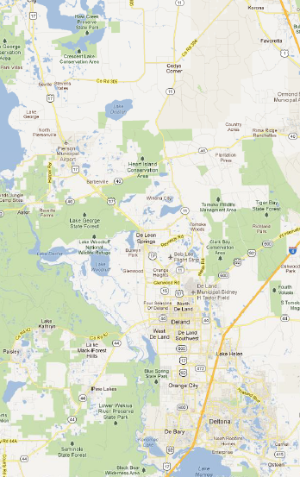

Introduction and Overview
Study Area: US 17-92 from Seminole County line to the Putnam County Line
South Section: Seminole County line to Spring Garden Avenue
North Section: Spring Garden Avenue to Putnam County line
Four cities and Volusia County
Pierson
Orange City
DeLand
DeBary

Slide 3
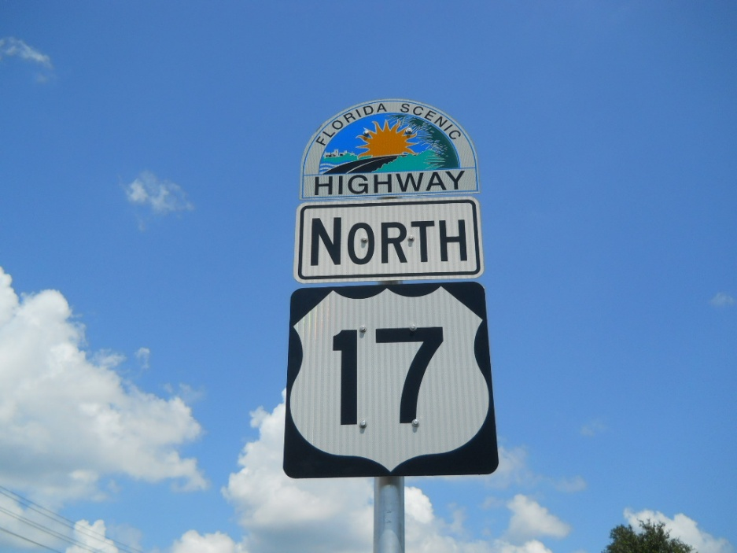
Project Scope
Collect Studies, Plans and Data, Analysis of Existing Conditions and Develop GIS Interface
Identify and Meet with Stakeholders
Review Functional Classification and Strategic Intermodal System (SIS) Requirements and Procedures
Evaluate Potential Impacts of Relocating SIS

Slide 4
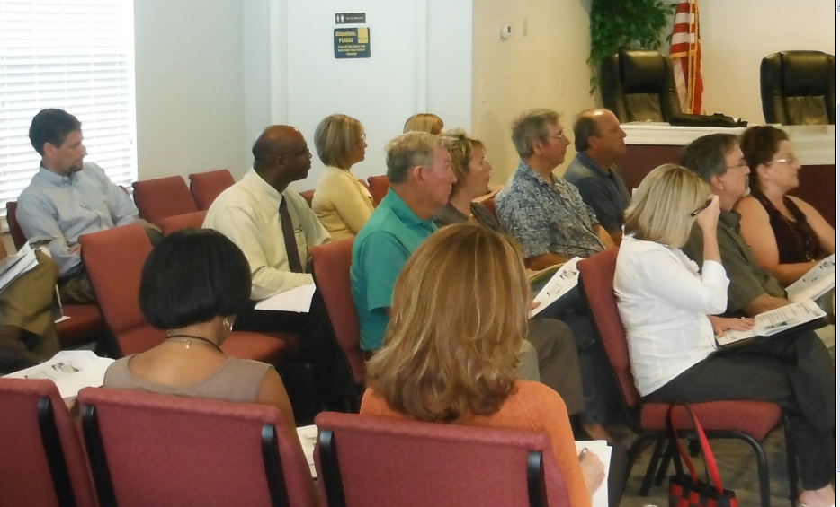
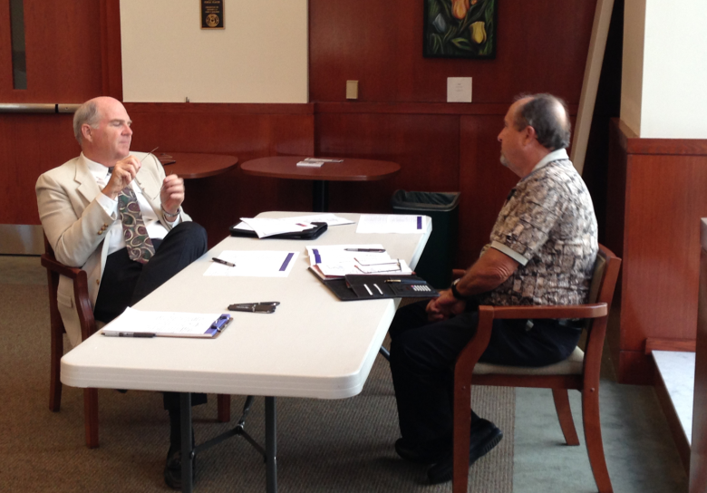
Stakeholders/Working Group
City of DeBary
City of DeLand
City of Orange City
Town of Pierson
Volusia County (Growth Management, Traffic Engineering and Economic Development)
Florida Department of Transportation District 5
Volusia TPO
Votran/SunRail

Slide 5
Data Collection
Volusia TPO Transportation Plans
Comprehensive Plans
Freight Movement Studies
Origin Destination Studies
CRA Plans/Vision Plans/Area Plans
Corridor Studies
Pedestrian/Bicycle Studies and Plans
Streetscape Plans and Projects
Transit Development Plans (Votran)
Commuter Rail Plans (SunRail)
Intersection Improvements
Development Master Plans (DRIs)
SIS Plans and Design Standards

Slide 6
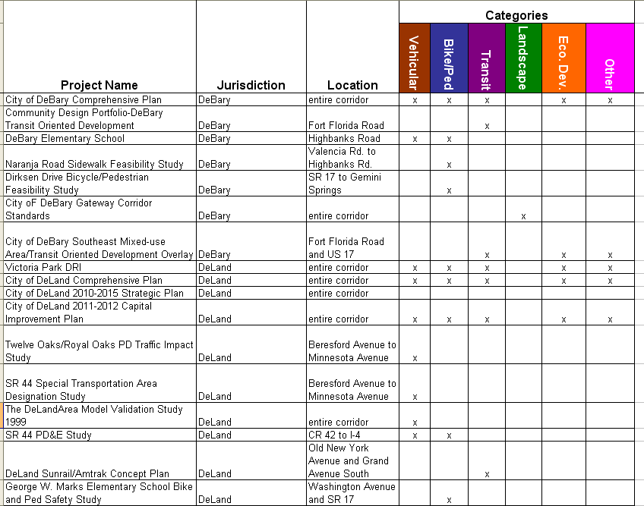
List of Studies
Over 75 studies and plans collected
Conducted Stakeholder meetings over 2 months.
Identified 115 Different Projects

Slide 7
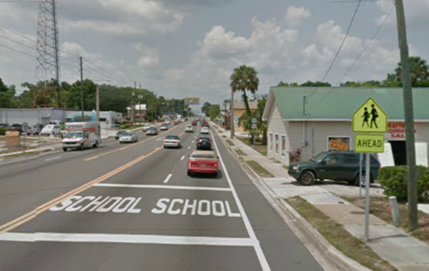

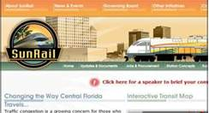
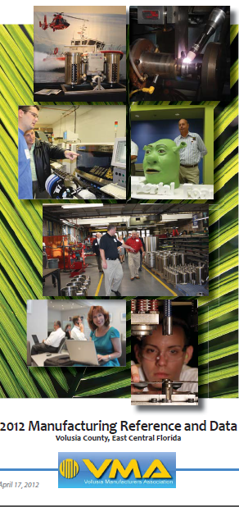
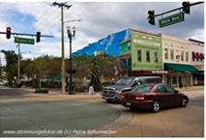
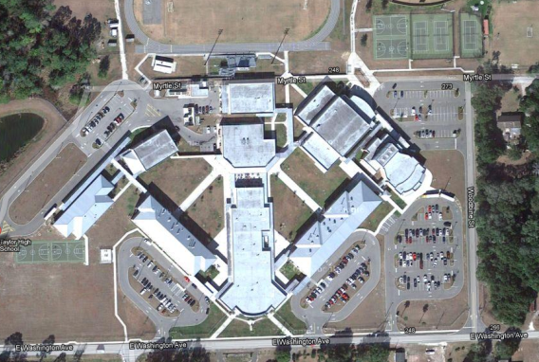
Categories Used in the CIP
Vehicular
Bicycle and Pedestrian
Transit
Landscape-Streetscape
Land Use/Development
Other

Slide 8
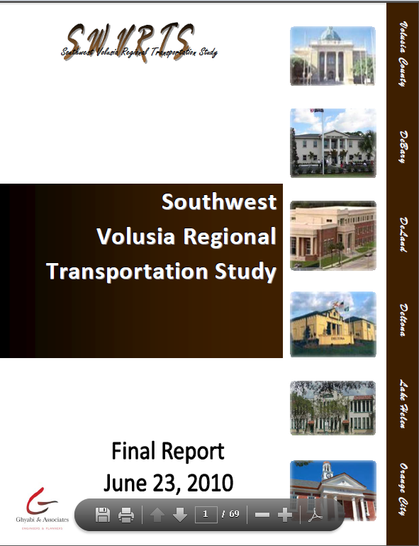
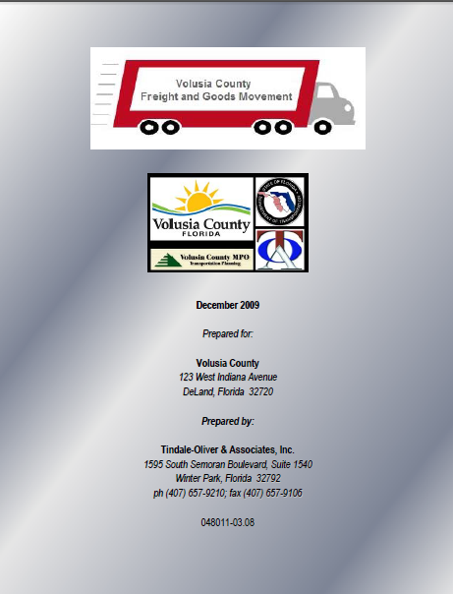
Summary Themes
Vehicular Category:
Match Roadway to Local Preference
Manage Truck Traffic
Analyze SIS Alignment Alternative
Improve Safety and Speed Control
Improve Operational Efficiency
Bike/Ped Category:
Improve Mobility Along and Across the Corridor
Enhance Connectivity with Transit
Maximize Connection to Regional Facilities
Improve Safety

Slide 9
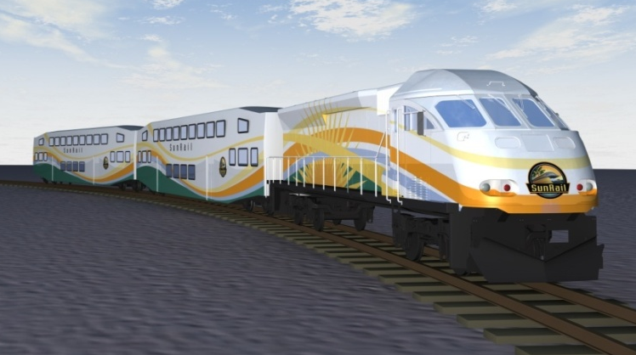
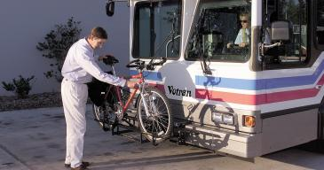
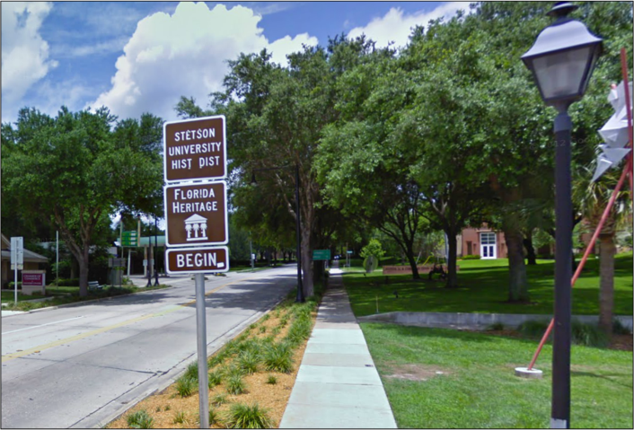
Summary Themes
Transit Category:
Enhance Services to Support Mobility Needs
Interconnect SunRail to Transit
Coordinate Development (TOD) Plans with Transit Plans
Use Transit to Support Economic Development Plans
Landscape/Streetscape Category:
Enhance Community Identity
Develop Context-Sensitive Roadway Designs
Improve Aesthetics

Slide 10
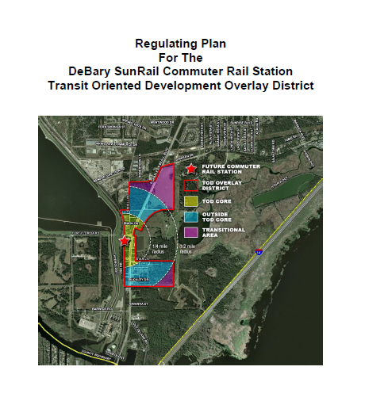
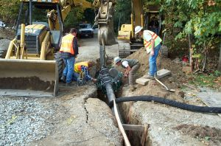
Summary Themes
Land Use/Economic Dev. Category:
Facilitate Economic Development, Redevelopment and Infill
Facilitate Future Growth with Multi-Modal Opportunities
Rural Community Enhancement
“Other” Category:
Coordinate with Capital Improvements (CRA, Utilities, Stormwater, Trails, Parks, etc.)

Slide 11
Typical Projects
Vehicular
Traffic Operations
Access Management
Alternative Routing
Widening (North Section)
Transit
Connectivity with SunRail
Improvement of Bus Shelters and Amenities
Integration into Local Mobility Plans
Other
Sidewalks and Utilities Extension
Bicycling/Pedestrian
Implementation of County Trail Plan
Safety Improvements for Schools
Eliminating Gaps
Landscaping/Streetscape
Incremental site improvements
Pending Redevelopment Plans
Land Use/ Economic Development
Mixed-use and TOD
CRA in DeLand and Orange City

Slide 12
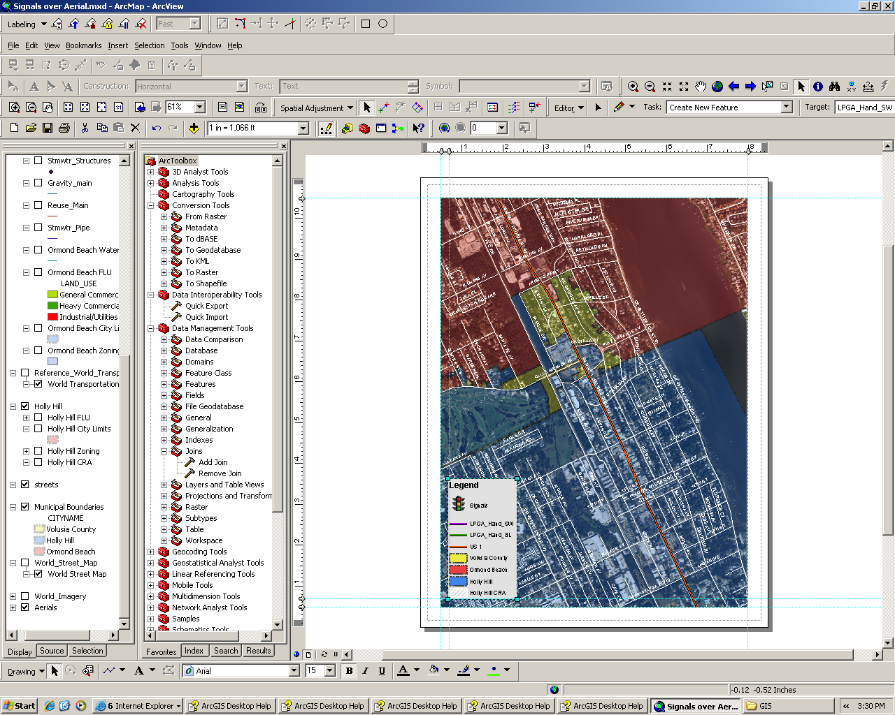
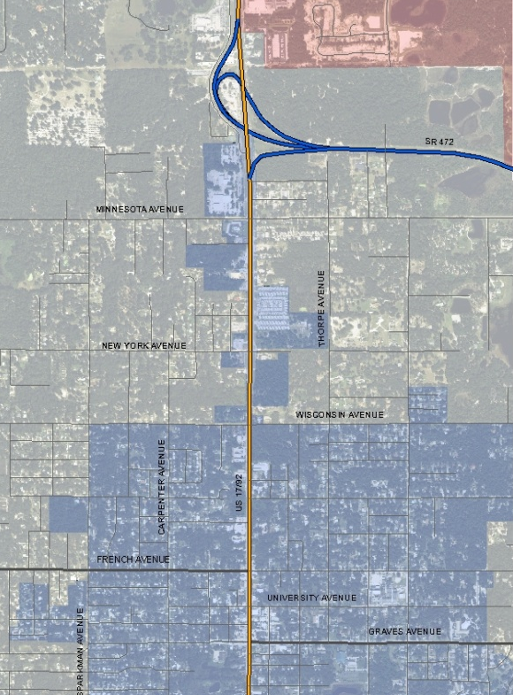
GIS Interface
Same Format as the US 1 CIP GIS tool
Identifies the Projects within the Corridor
Provides Status of the Project
Identifies Complementary and Conflicting Projects
Project: V-11
Category: Vehicular
Location: US 17-92 and Graves Ave
Description: Traffic Control
Jurisdiction: Orange City
Source Document: 2009-2014 Strategic Plan
Study Date: 2009
Status: Completed
Common Projects: None
Conflicting Projects: None
V-11

Slide 13
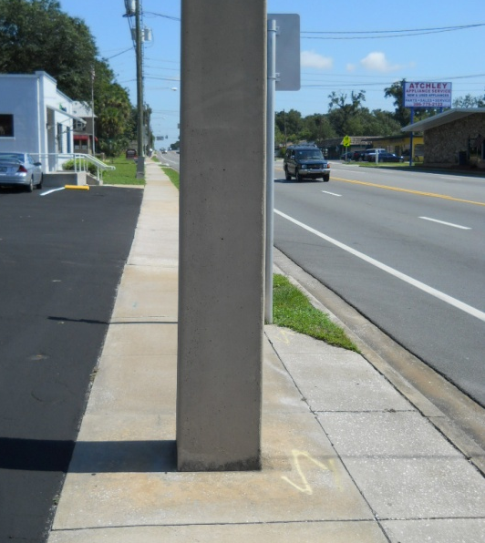
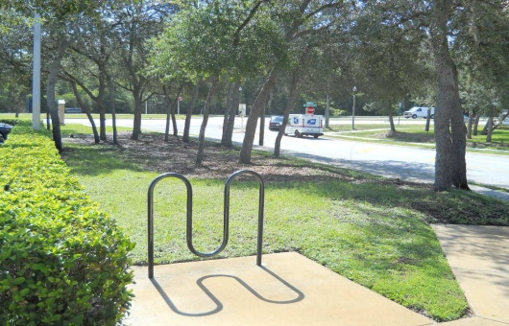
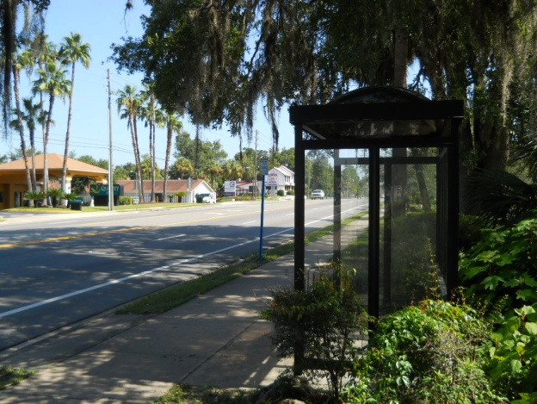
Summary of Existing Conditions
Corridor is 41.1 Miles
19 Different Sections
Function and Local Vision
Traffic Data
Roadway Conditions (pavement, ADA compliance, bike/ped facilities, crash data, etc.)
Transit Stop Conditions

Slide 14
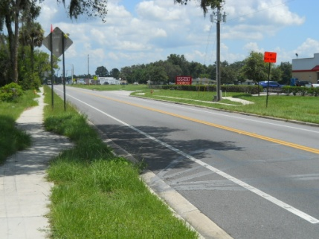
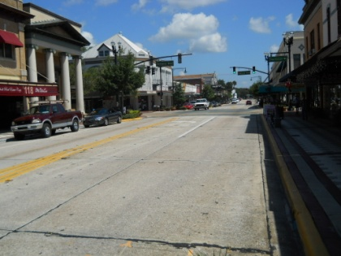
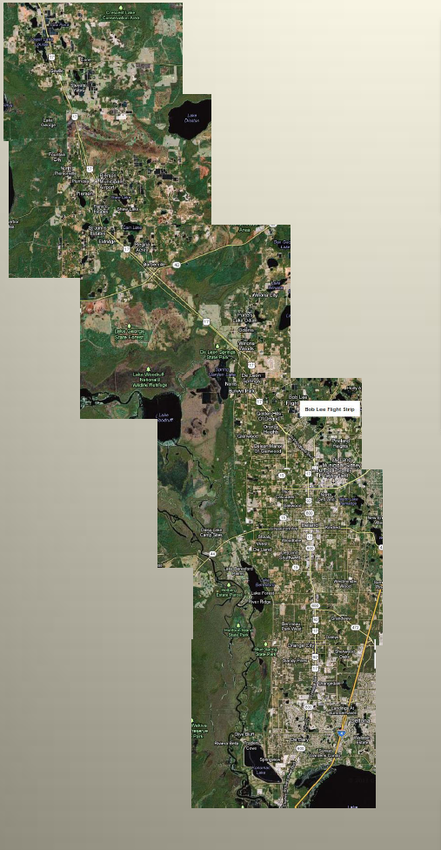
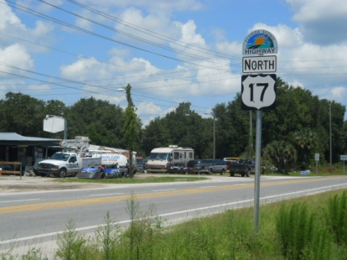

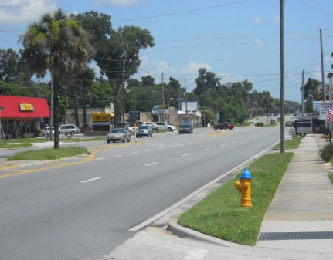
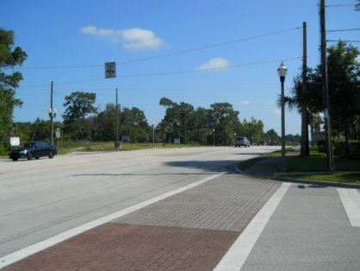
Rural 2-lane undivided
Examples of Roadway Sections
2-lane CBD
Rural 2-lane undivided
Urban 4-lane w/ bi-directional turn lanes
4-Lane urban divided with raised medians
Urban 4-lane divided with raised medians

Slide 15
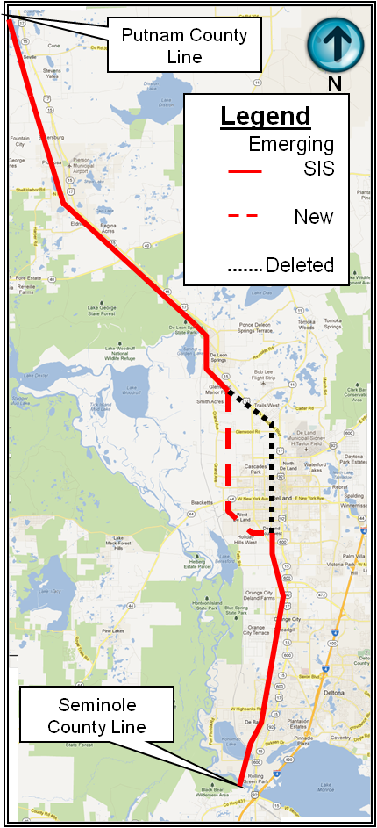
Analysis of Functional Classification and SIS Impacts
Looked at Functional Classification and SIS Issues
2. Florida Intrastate Highway System Eliminated and Blended into SIS
3. Reviewed Design Standards/ Alternatives/Level-of-Service Issues
4. Summary of SIS Designation (SR 472 as alternative SIS facility)

Slide 16
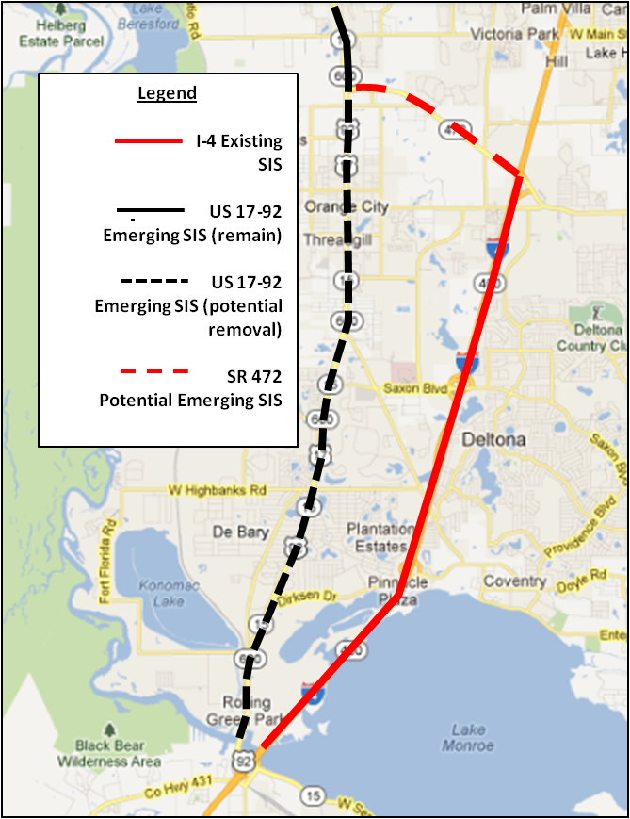
Impacts of SIS Designation
Potential SIS Relocation to Accommodate Local Vision
Provide Routing that Separates Truck Traffic from Redevelopment Areas
Identify Process and Data Requirements for Re-designation
Investigate Funding Resources for SIS

Slide 17
Next Steps
Review and Update Findings with Stakeholders
Complete GIS-based Mapping Projects
Draft Final Report
Hold Final Workshop with Stakeholders
Present Final Report to CAC, TCC and TPO Board

Slide 18



THANK YOU FOR YOUR TIME AND ASSISTANCE.

