Slide 1
OVERVIEW
2040 Long Range Transportation Plan for Volusia Transportation Planning Organization
May 14, 2014

Slide 2
Long Range Transportation Plan (LRTP)
TPO is required by federal law to develop an LRTP and update every five years
Guiding document that identifies transportation projects over the next 25 years
Both federal and state funding sources
Balanced, multi-modal approach to transportation solutions to address needs of the local communities
Must be “Cost Feasible”
Must be adopted by September 30, 2015

Slide 3
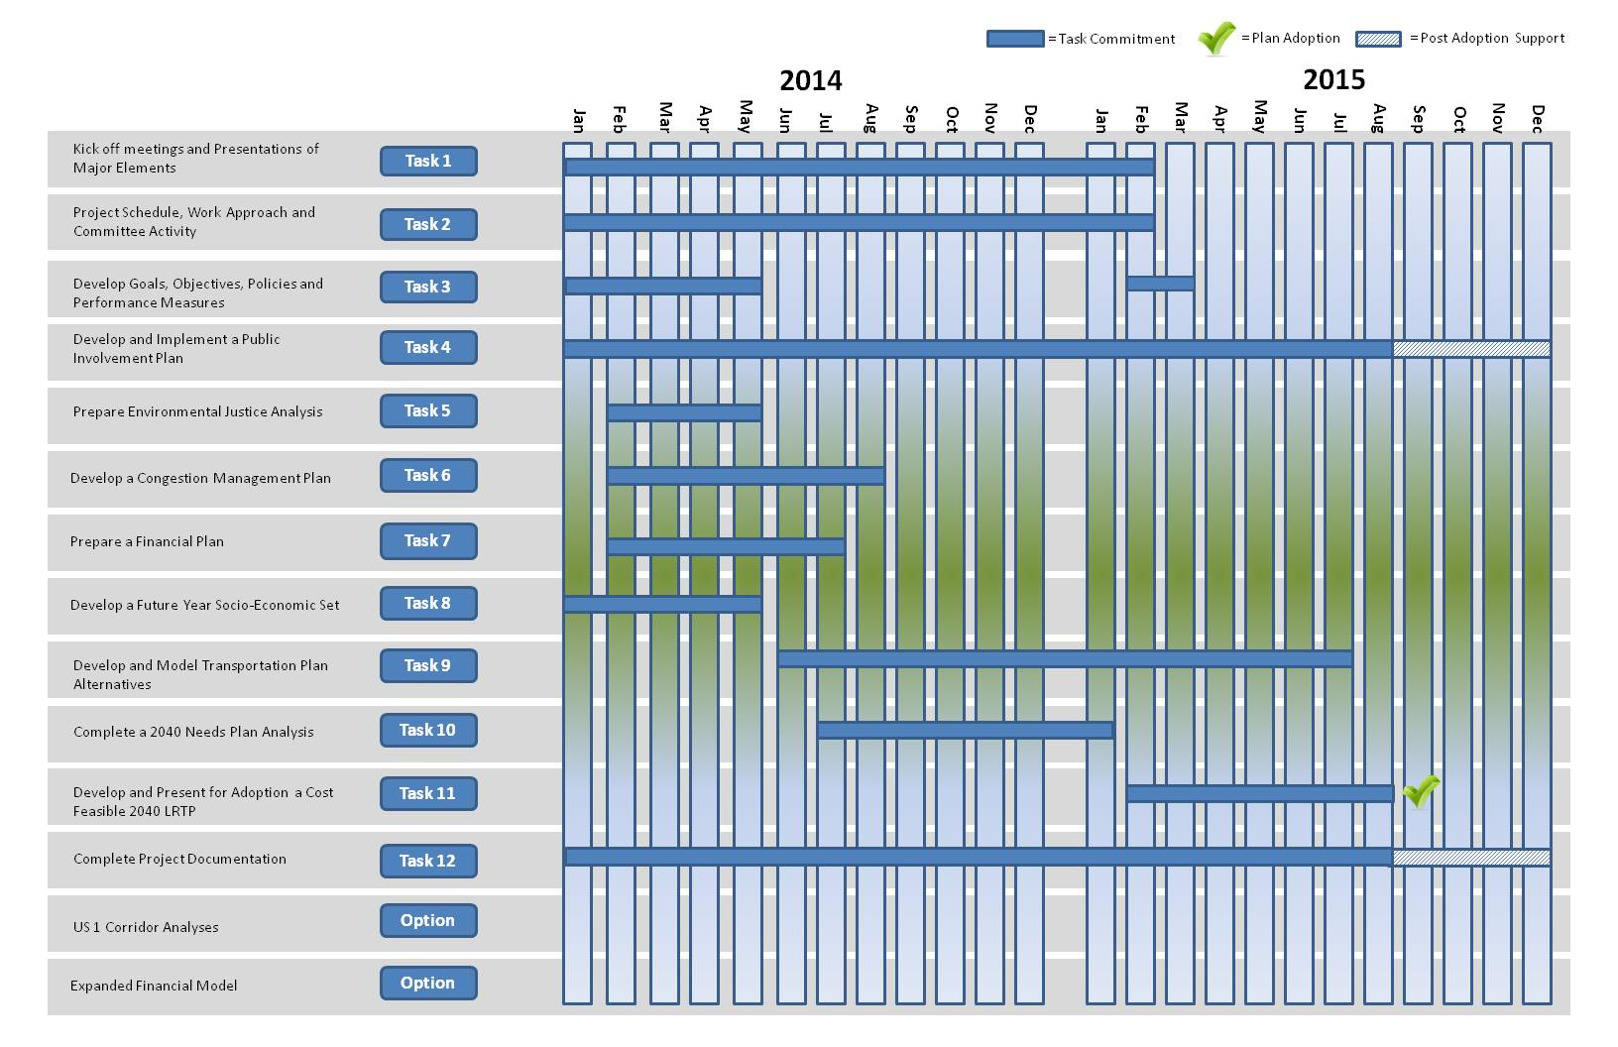
Project Schedule

Slide 4
All tasks and deliverables coordinated with:
TPO Project Manager
Oversight Committee
2040 LRTP Subcommittee
Land Use Subcommittee

Slide 5
Oversight Committee
Ensures completion of key milestones
Membership:
Two TPO Board Members
Chairman of Technical Coordinating Committee (TCC)
Chairman of Citizens Advisory Committee (CAC)
Chairman of Bicycle and Pedestrian Advisory Committee (BPAC)
D5, FDOT Representative
TPO Project Manager
TPO Executive Director

Slide 6
2040 LRTP Subcommittee
Responsible for the overall work plan and review of technical data
13 members, volunteers from:
TCC
CAC
BPAC
Transportation Disadvantaged Local Coordinating Board (TDLCB)

Slide 7
2040 LRTP Subcommittee
Task 2 – Project Schedule and Work Approach
Task 3 – Goals, Objectives, Policies and Performance Measures
Evaluation criteria to rank potential projects
Task 4 – Public Involvement Plan (PIP)
Task 6 – Congestion Management Plan
Criteria for the ranking of congested corridors and intersections
Multimodal project listing of potential improvements
Task 7 – Financial Plan

Slide 8
2040 LRTP Subcommittee
Task 8 – Future Year Socio-Economic Data Set
Coordinated with the Land Use Subcommittee and FDOT D5 model subconsultant
Task 9 – Model Transportation Plan Alternatives
Task 10 – 2040 Needs Plan Analysis
Task 11 – Cost Feasible 2040 Long Range Transportation Plan
Required to be approved by TPO Board by Sept 30, 2015
Serves as basis for 2040 Long Range Transportation Plan

Slide 9
Land Use Subcommittee
Involved in development of future year socio-economic data
Alternative Transportation and Land Use Scenario
Membership from:
Land use planners and developers
Both public and private sector

Slide 10
Critical Path Milestones
Goals, Objectives, Policies and Performance Measures (May 2014)
Public Involvement Plan (July 2014)
Socio Economic Data (May 2014)
Financial Plan (July 2014)
2040 Needs Plan (Dec 2014)
Cost Feasible Plan Alternatives (July 2015)
Adopt Final Cost Feasible 2040 LRTP (Sept 30, 2015)

Slide 11
THANK YOU

