Slide 1

Bicycle/Pedestrian Traffic Data Collection
FDOT – District 5

Slide 2
Manual Counts

Slide 3
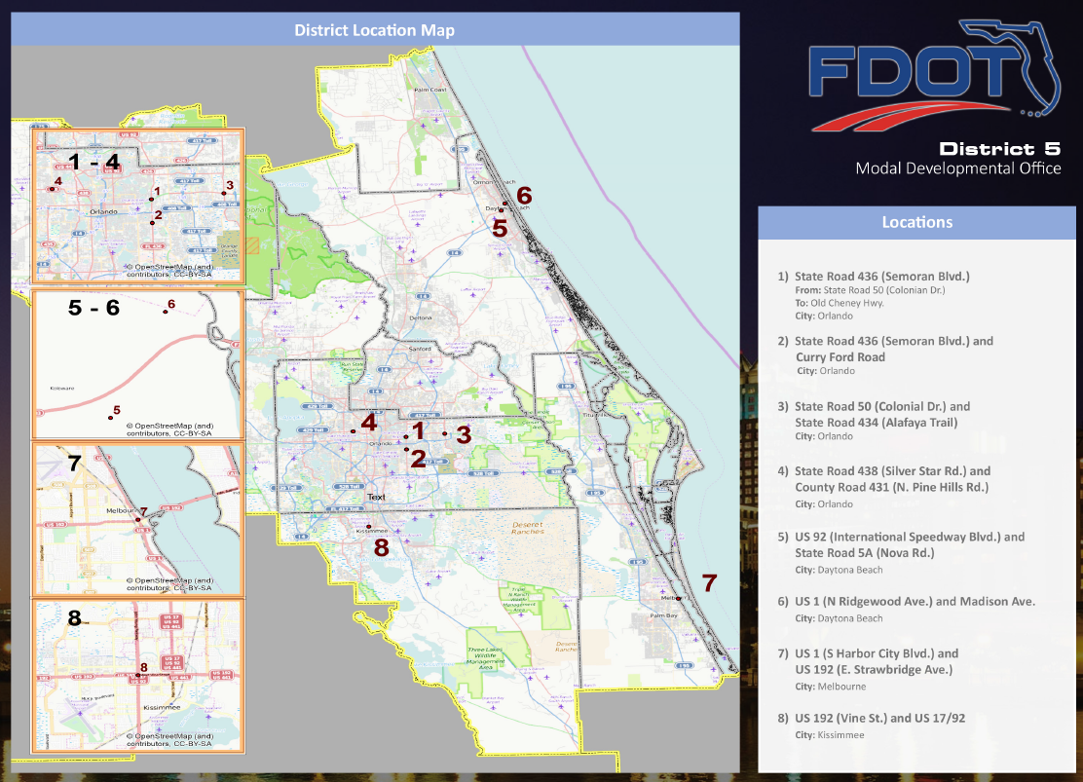

Slide 4
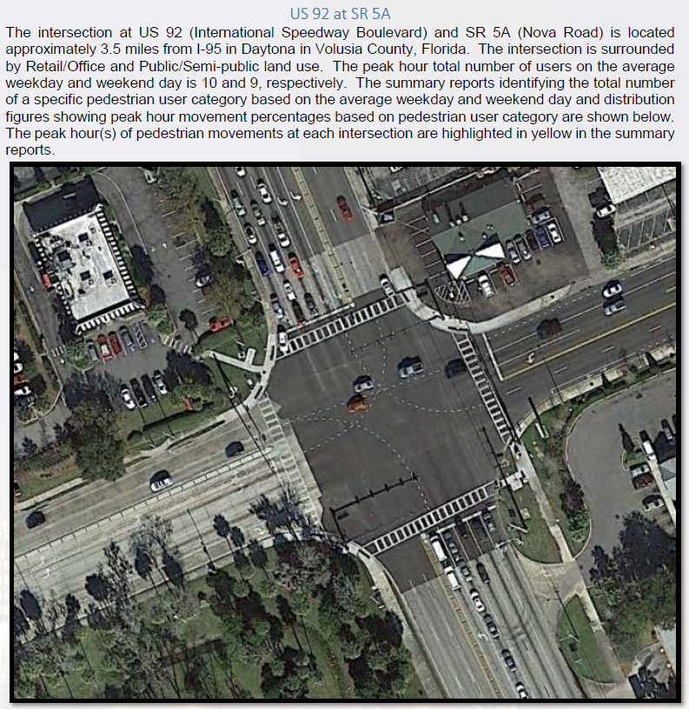

Slide 5
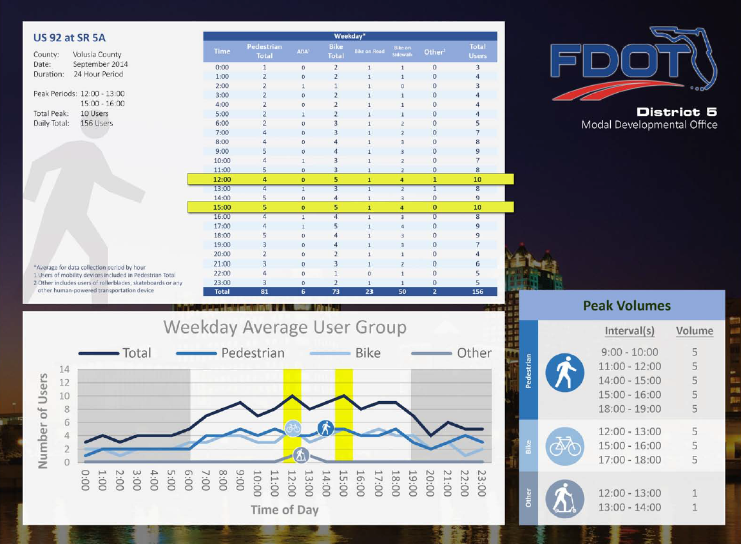

Slide 6
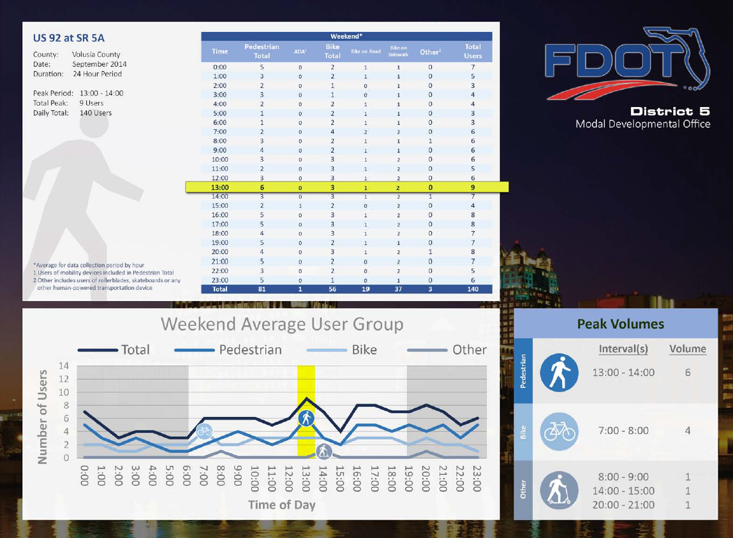

Slide 7
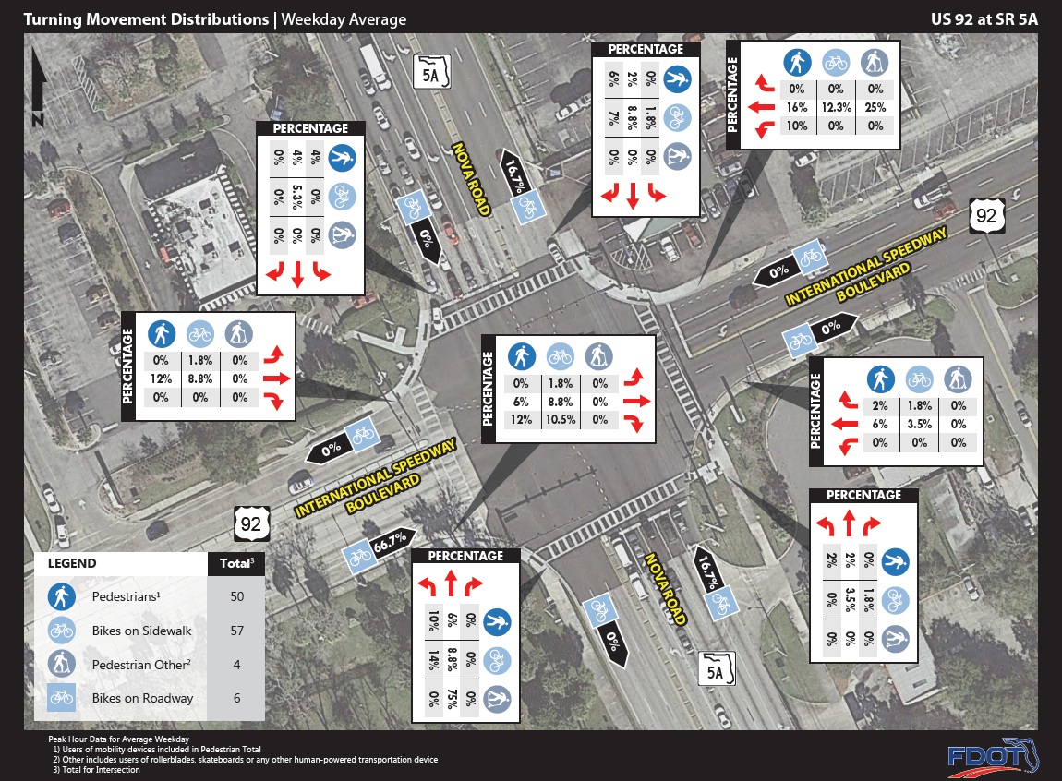

Slide 8
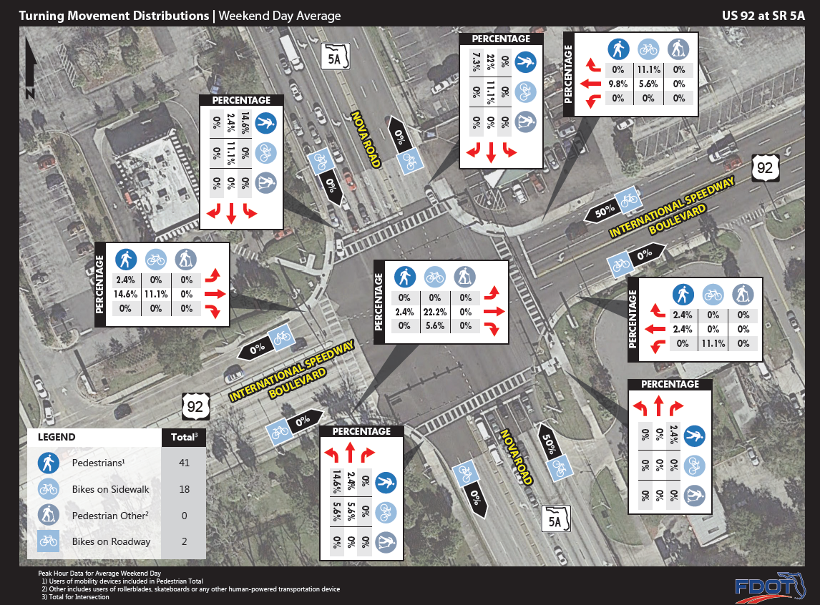

Slide 9
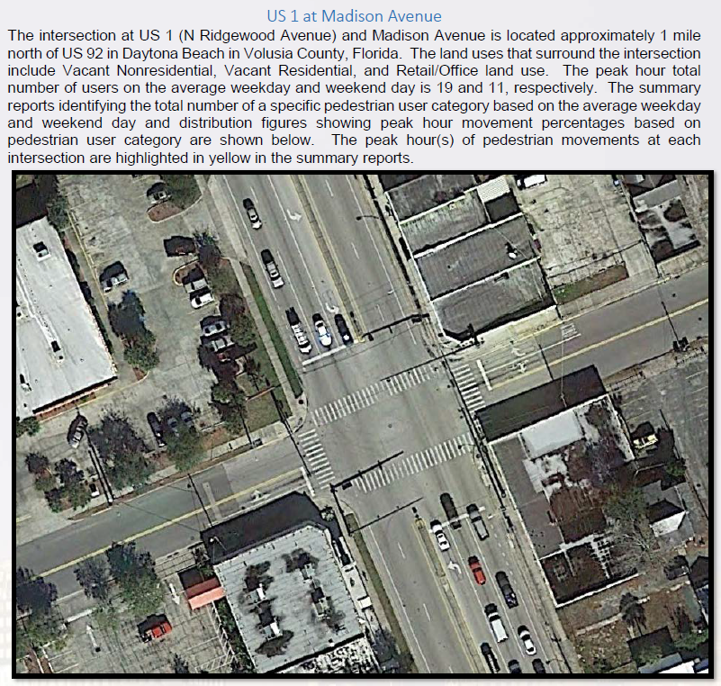

Slide 10
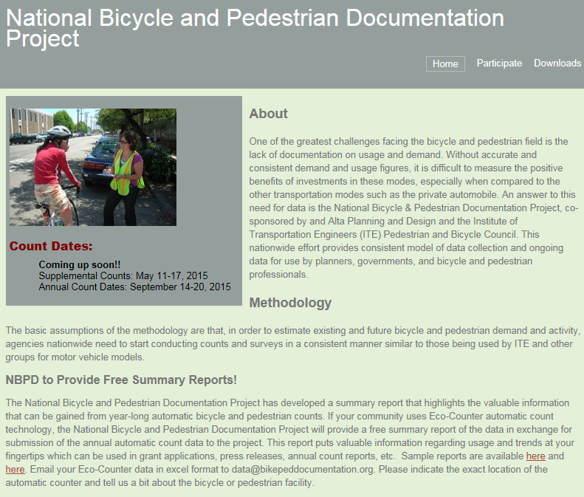

Slide 11

NBPD Logistics
Occurring: January, May, July and September
Times: Weekday: 5-7pm; Saturday: 12-2pm
Must pick a weekday and a Saturday (following or
preceding) as the official count days
Analyze what kind of count is required per location
(screen line or intersection)

Slide 12
GIS Data

Slide 13
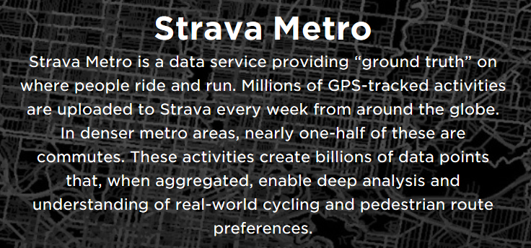

Slide 14
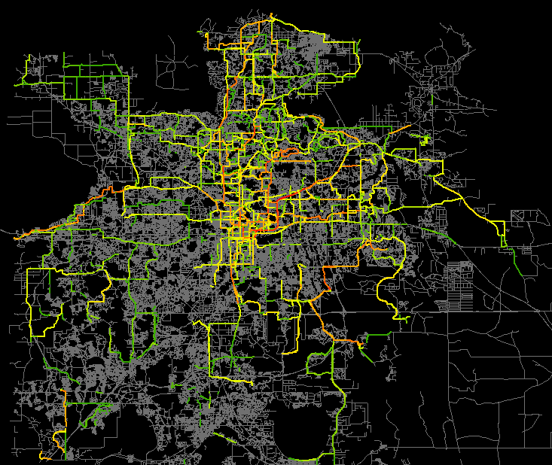

2013
Notes:
These locations were selected from our Safety Action Plan
Unfortunately, the data collected from these counts

Slide 15

Outreach Efforts:
Bicycle Shops
Facebook & Twitter
MetroPlan events
Future: SunRail stations signs

Slide 16
Application of Data

Slide 17
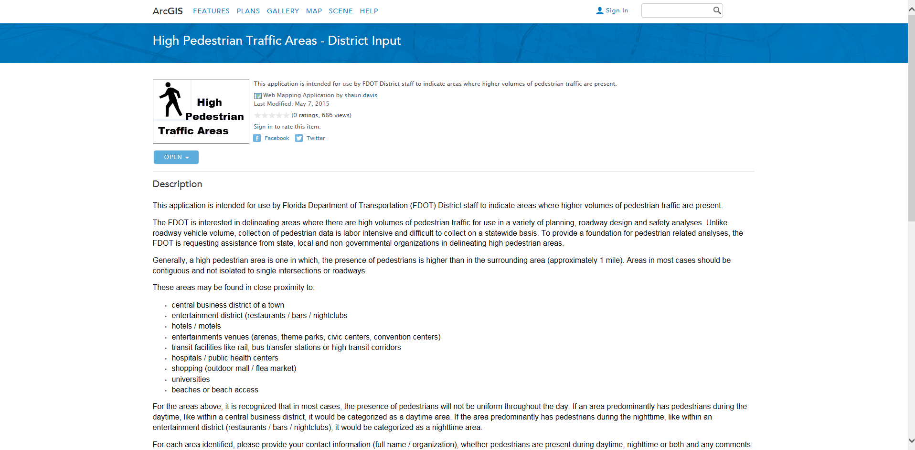
http://www.arcgis.com/home/item.html?id=9690adbefc914fad804d8fa27cae1707

Slide 18
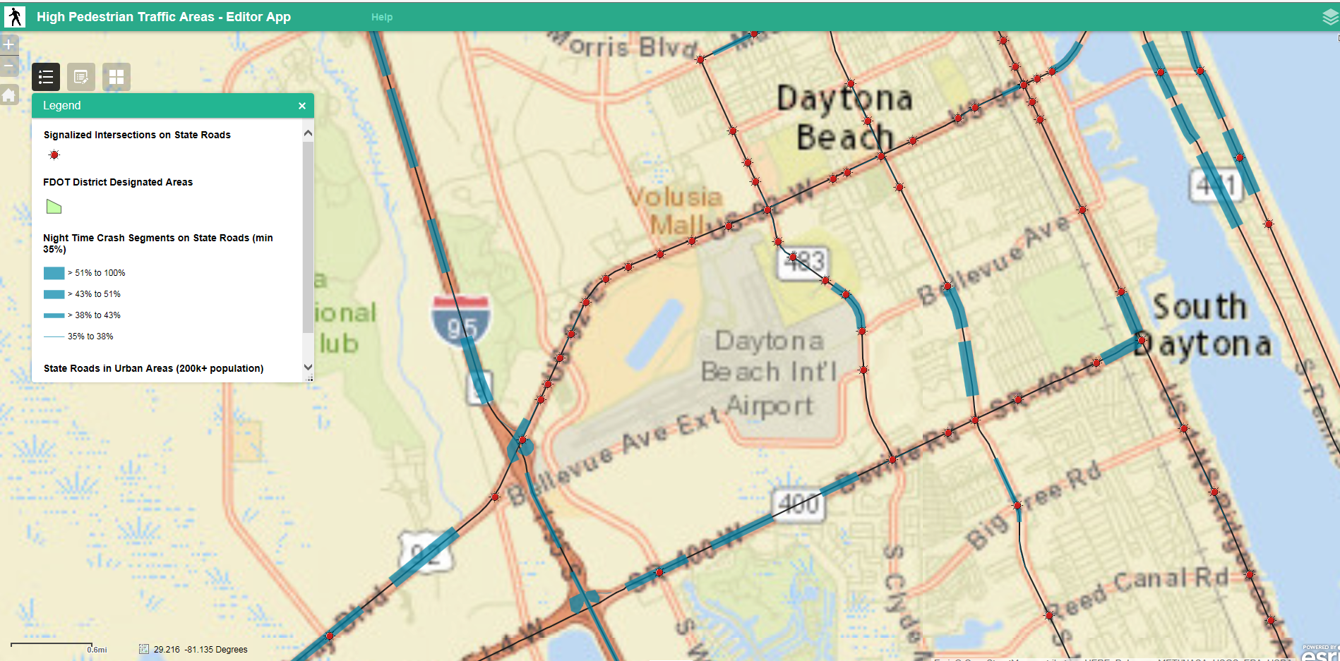
GIS hot spot mapping

Slide 19
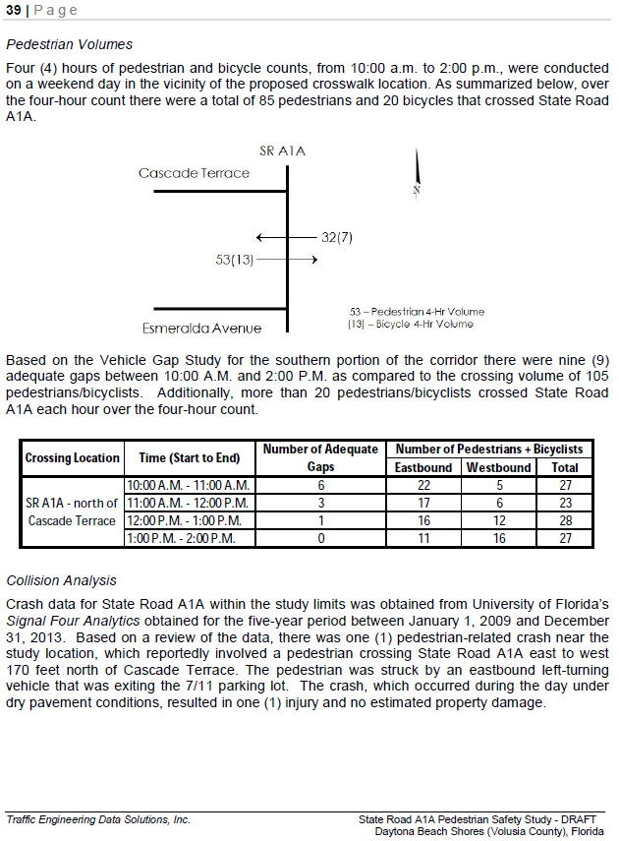
Data Sources

Slide 20
Application of Data
Prioritize improvements in high demand areas
Design of facilities to accommodate capacity
Provide exposure data to quantify bicycle/pedestrian crash rates

Slide 21
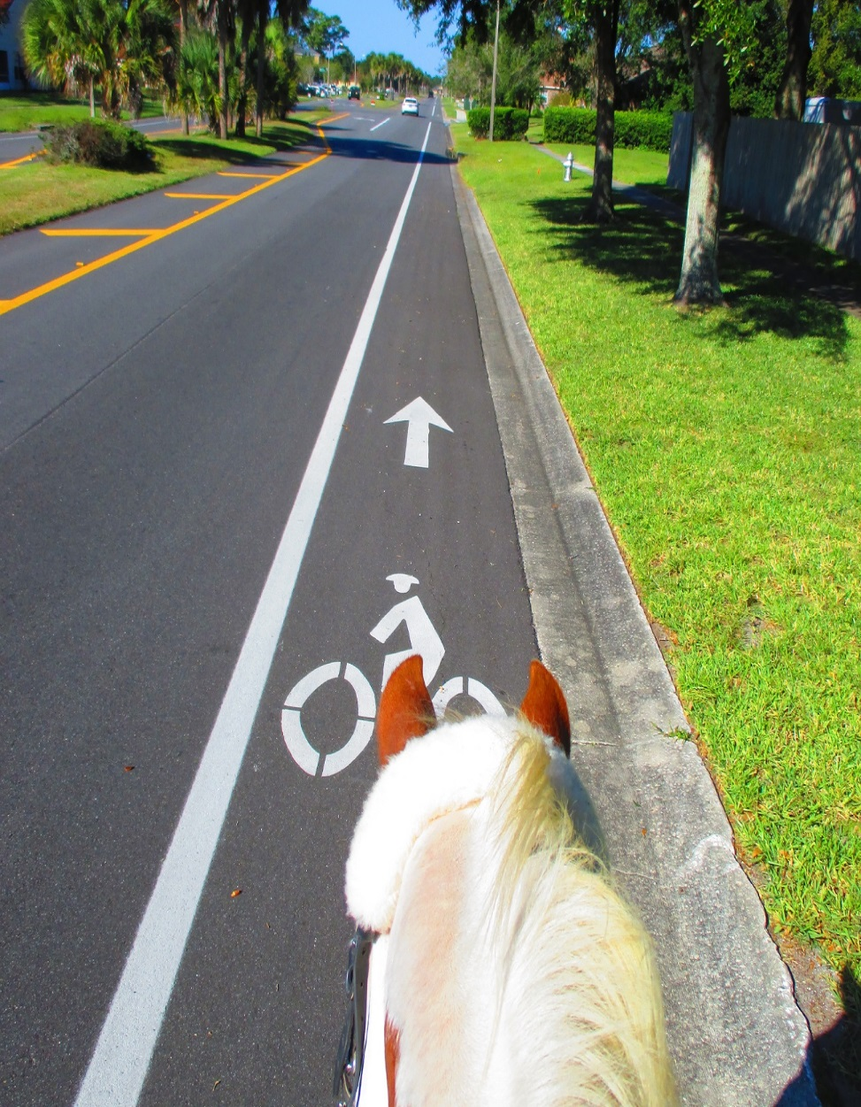
Deborah Tyrone
FDOT District 5
Bicycle/Pedestrian Coordinator
Deborah.Tyrone@dot.state.fl.us

