Slide 1
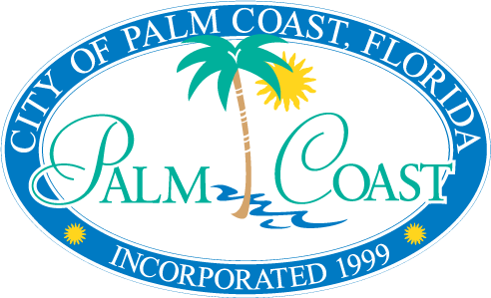
Transportation Planning Organization (TPO)
Proposed planning area
Background
TPO Planning Area
Highlights of Selected Corridors

Slide 2
BACKGROUND –
City of Palm Coast
Population (From 2010 US Census)
  75,180 (+/-80%) of Flagler County Population (95,696)
Continued growth – 2012 BEBR population (76,450)
2035 population projection +/-168,000
Improving employment market
  Job creation (+2,700 since Oct. ‘09)
  Largest unemployment drop in the State between Sept. 2011 and Oct. 2012 (-3.3%)

Slide 3
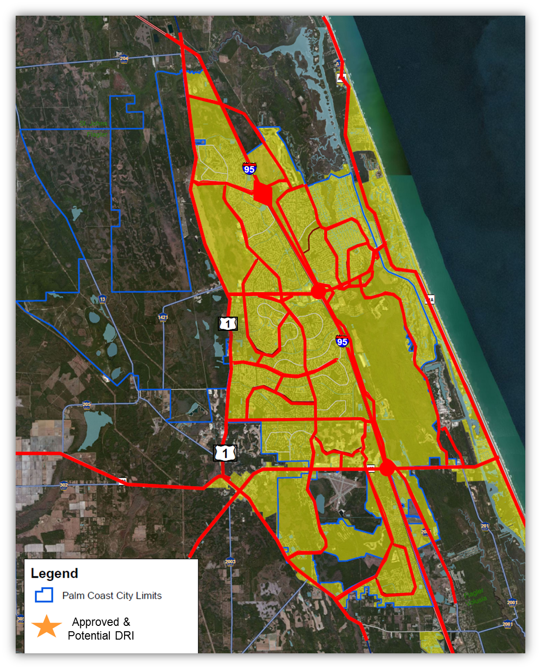
MAJOR ROADWAY NETWORK
1,182 lane miles (68.5% of Flagler County total)
Developing Alternative Transportation System (Multi-Use Paths)

Slide 4
BACKGROUND –
City of Palm Coast
City of Trails and Paths
Over 125 miles of Multi-use Paths

Slide 5
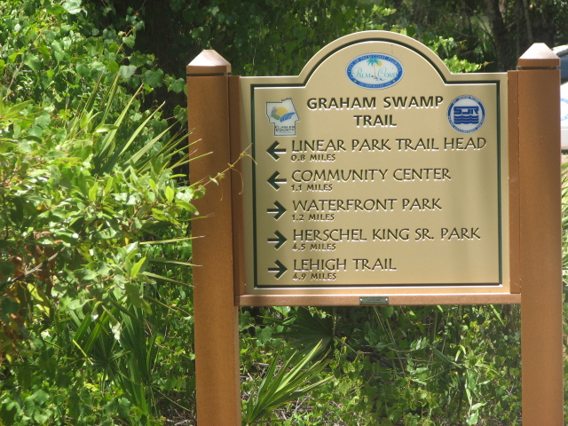
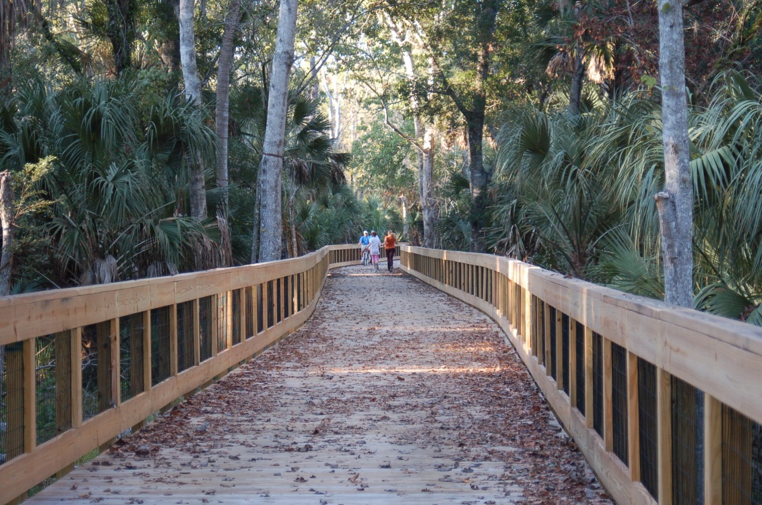
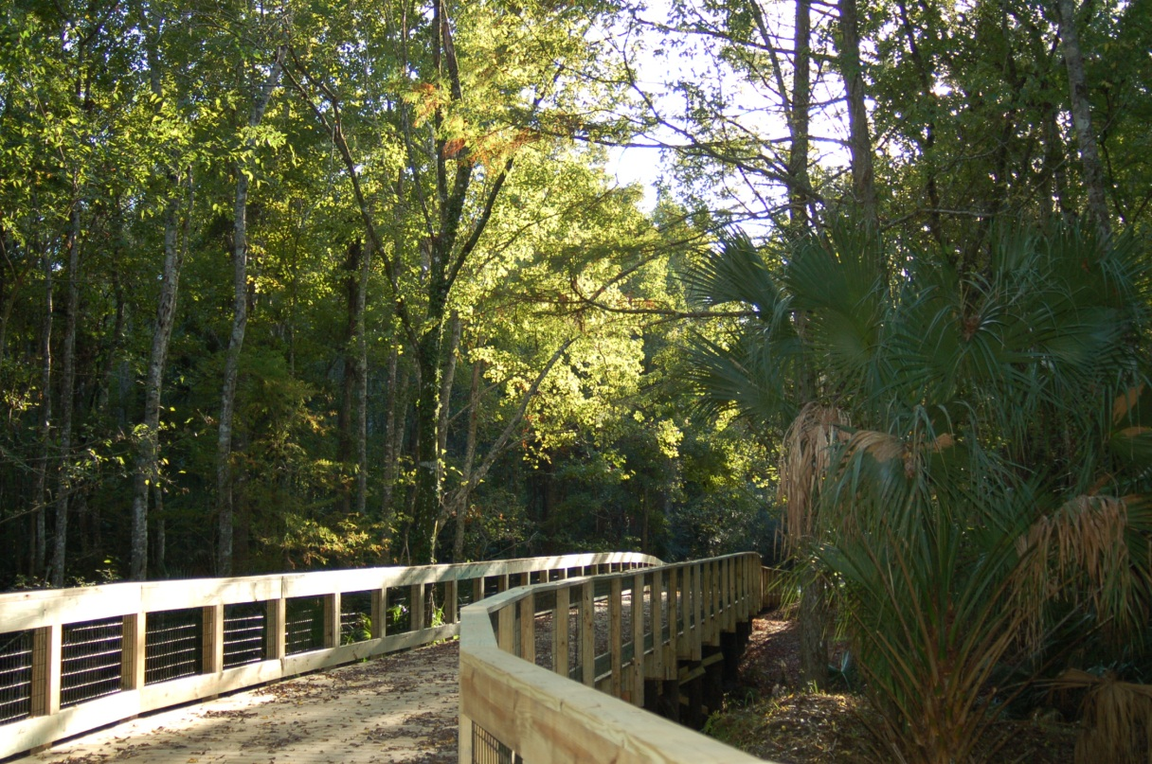
BACKGROUND –
City of Palm Coast
Graham Swamp Trail

Slide 6
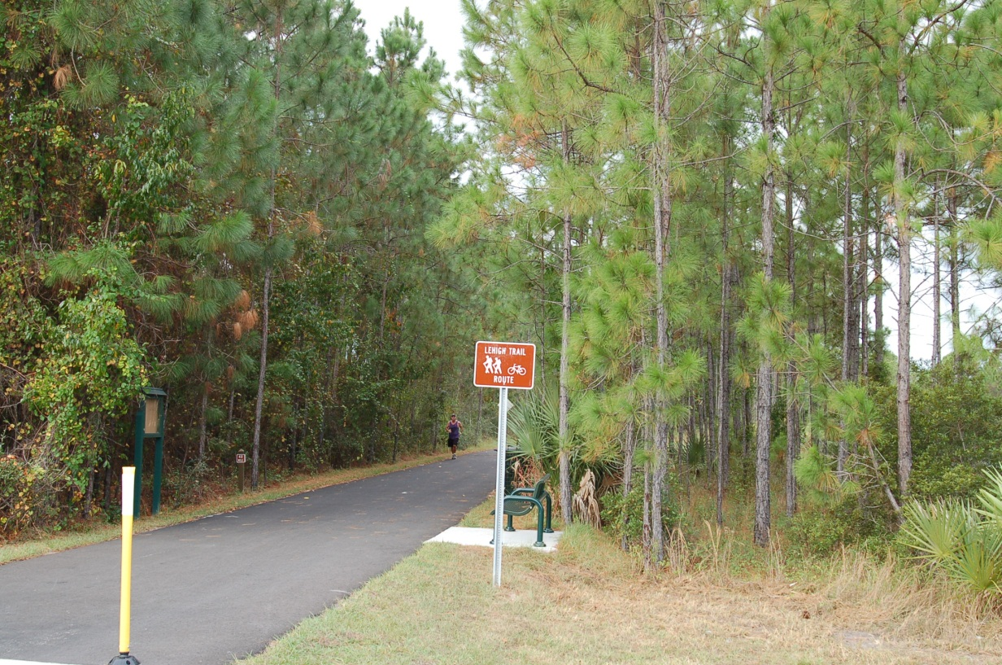
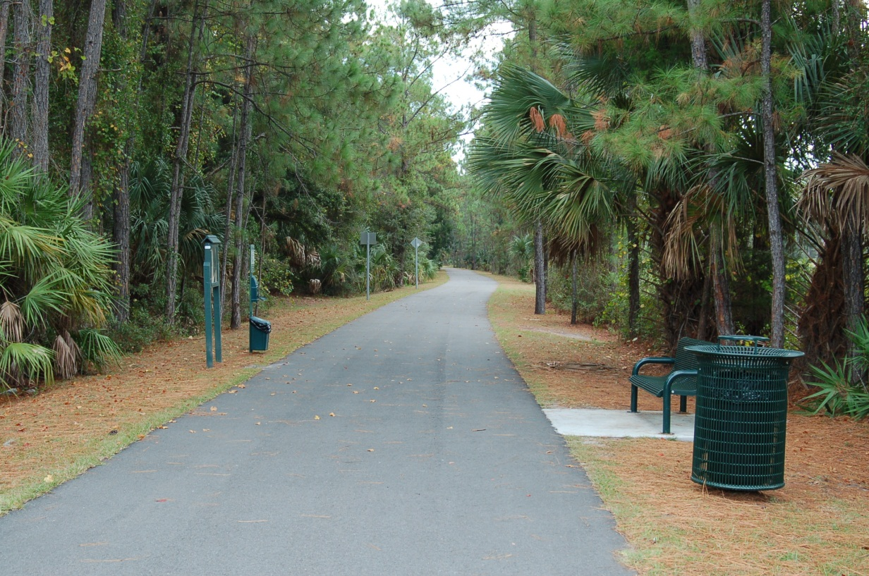
BACKGROUND –
City of Palm Coast
Lehigh Trail

Slide 7
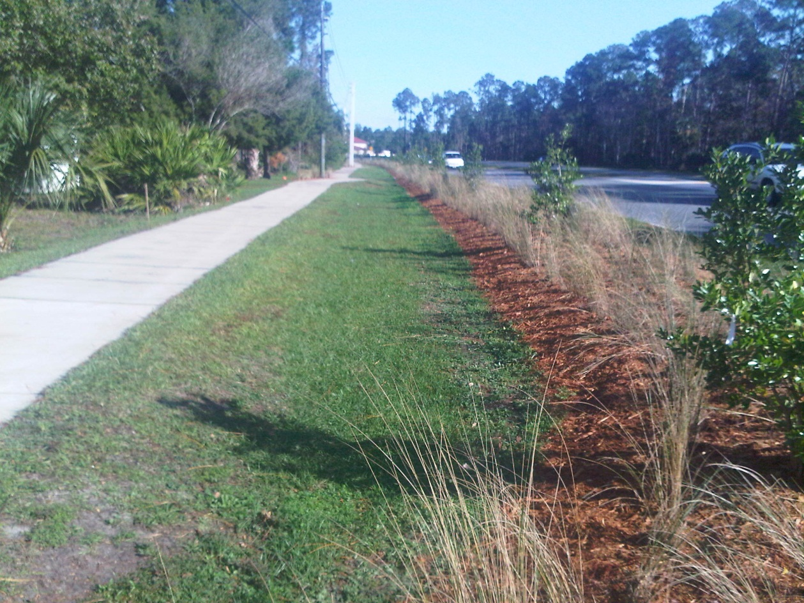
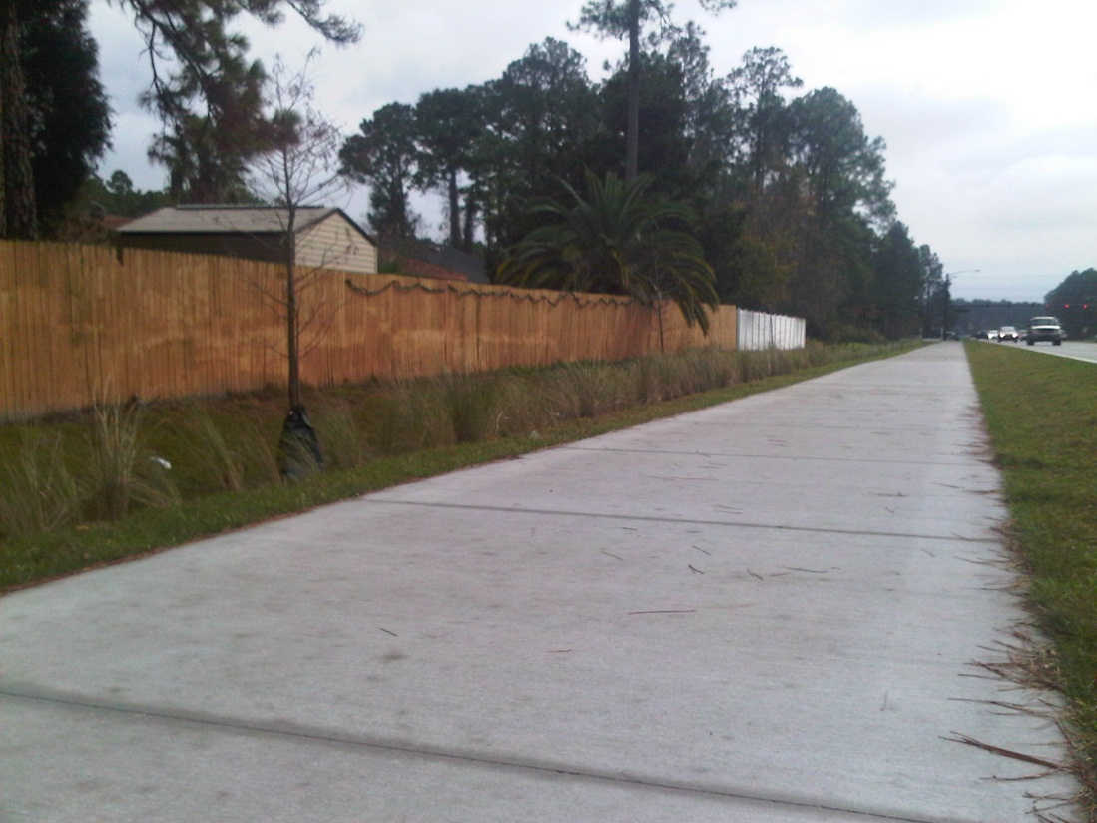
BACKGROUND –
City of Palm Coast
Belle Terre Parkway Multi-Use Path with Landscaping Enhancements

Slide 8
TPO PLANNING AREA
Regional Approach to Transportation Planning
  Coordination of projects on major roadways
  Transit service improvement opportunities
Improve links to regional transportation facilities (Daytona Beach International Airport, Passenger Rail on FEC Corridor, Sun Rail, etc.)
Over 50% of work commuters traveling 10 to 50 miles from Flagler County go to Volusia County

Slide 9
APPROVED TPO PLANNING AREA

Slide 10
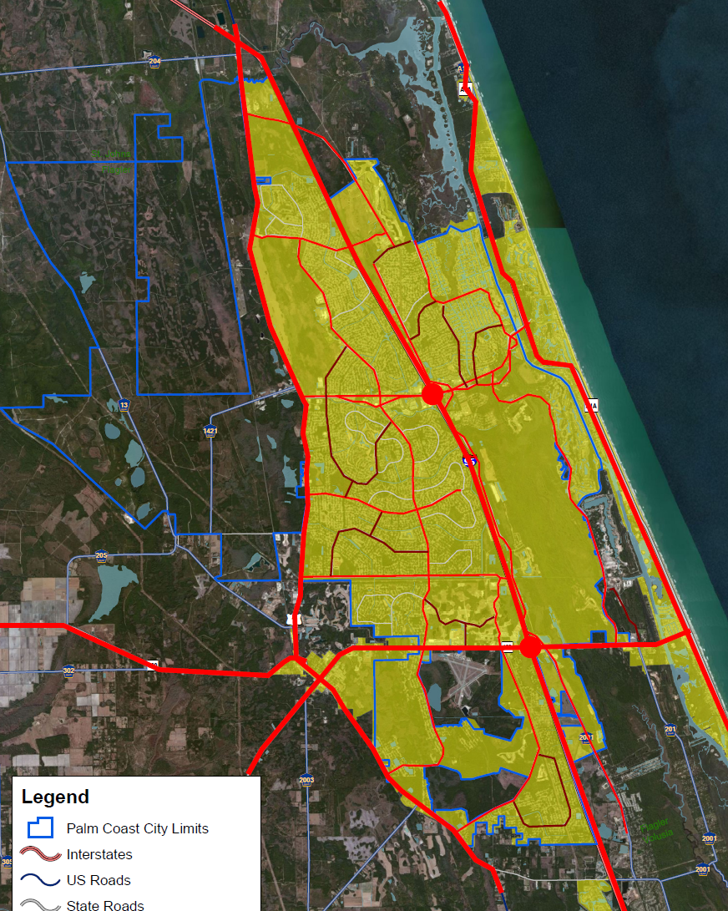

MAJOR ROADWAY NETWORK
Palm Coast Park
Palm Coast Park
Grand Haven
Town Center
JX Properties
OKR South
Approved &
Potential DRI

Slide 11
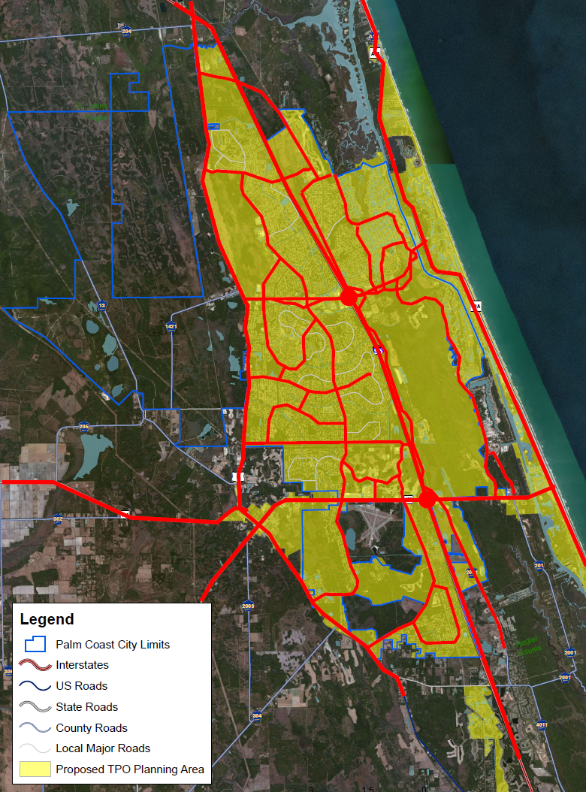

MAJOR ROADWAY NETWORK

Slide 12
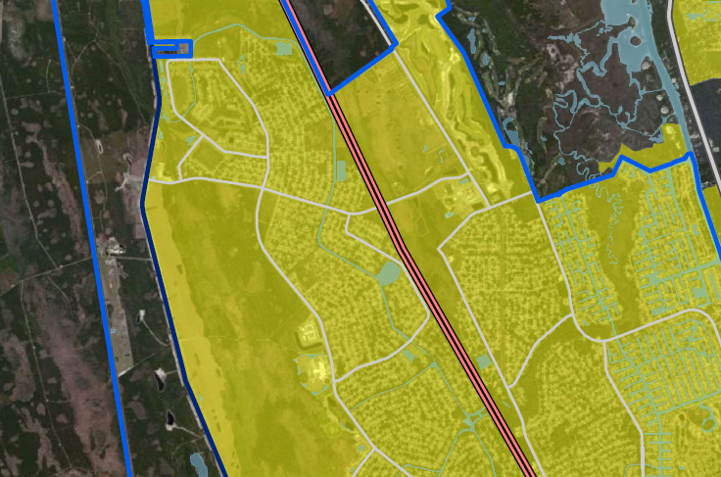

MATANZAS WOODS PARKWAY
&
OLD KINGS ROAD
Serves Urbanized and Urbanizing Areas
Major Roadway Projects in Area
Matanzas Woods Pkwy. Interchange (Construction - FY’14)
Extension & Widening of Old Kings Road (PD&E & Design funded)
Palm Harbor Pkwy. Extension (Design 90%)
Old Kings Rd. Extension & Widening
Matanzas Woods Parkway
Palm Harbor Pkwy. Extension
Interchange (FY’14)
Old Kings Road Widening
Old Kings Rd.

Slide 13
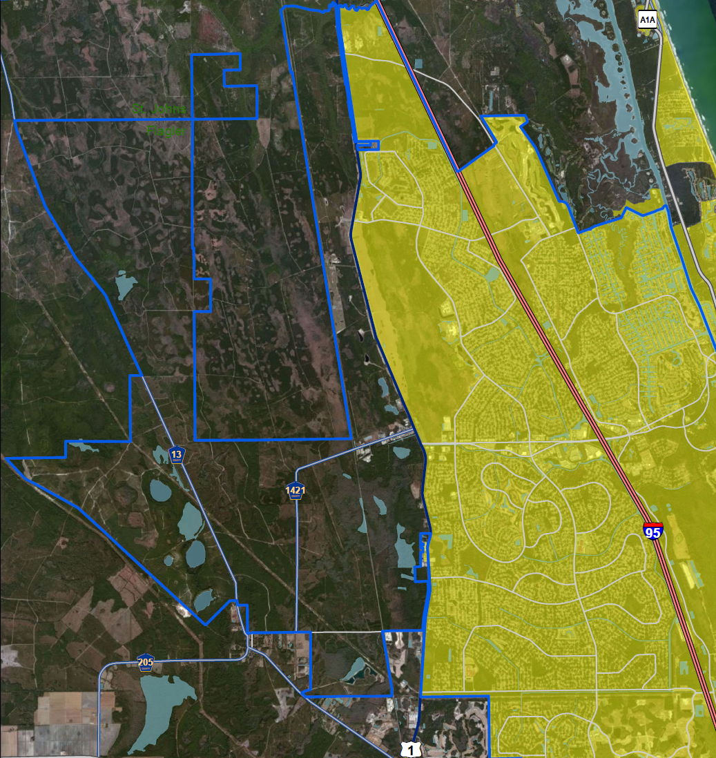

MATANZAS WOODS PARKWAY
&
OLD KINGS ROAD
Improvements are crucial to Palm Coast roadway network
Component of future economic development in Palm Coast (will serve future growth areas)
Matanzas Woods Parkway
Old Kings Road Extension and Widening
Old
Old Brick Township DRI
Palm Coast Park
DRI
New roadway to serve future growth areas
Palm Harbor
Parkway
Extension
Palm Coast Pkwy.

Slide 14
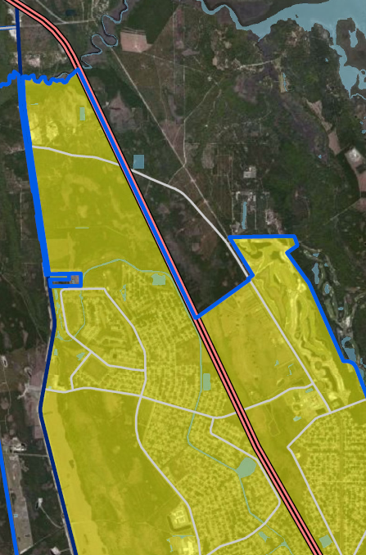
MATANZAS WOODS PARKWAY
&
OLD KINGS ROAD
LEGEND
Residential Uses
Mixed Use or Commercial Uses
Recreation/Open Space Use
Existing & Potential Development
Matanzas High School (83 acres) 1900 Student Capacity
Conservatory PUD (565 acres) 340 residential units 20 acres Commercial
Nottingham Subdivision (55 acres) 21 (5-acre lots), 55 acres commercial
Palm Coast Park DRI – Tract 5 (690 acres) Low-High Density Residential
Palm Coast Park DRI – Tracts south of Matanzas Woods Pkwy., east of US-1 Flexibility of Uses – High Density Residential and Commercial
Princess Place Preserve (1500 acres) Flagler County Recreational Area
Florida Agriculture Museum (370 acres) Tourist Attraction & Recreational Area
Old Kings Road
Matanzas Woods Pkwy.
Belle Terre Pkwy.
Old Kings Road

Slide 15
MAJOR ROADWAY NETWORK

Slide 16
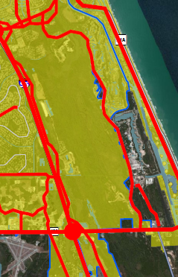
COLBERT LANE & ROBERTS ROAD
Existing & Potential Development
Vacant (8 acres) General Commercial
Daytona State College (98 acres) Existing 43,500 sq. ft. classrooms Additional 225,000 sq. ft. (to 2035)
Grand Livings MPD (71 acres) 216 units, 25,000 sq. ft. non-residential
Grand Haven DRI (1478 acres) 1,901 units, 85,000 sq. ft. non-residential
Graham Swamp (3400 acres) Recreational Area
Palm Coast Plantation (320 acres) 219 Residential Units
Harborview Marina PUD (112 acres) 622 residential units, 45,738 non residential
Northwest Corner of SR 100/Colbert Lane
75 acres General and High Intensity Commercial 137 acres single family residential 156 acre Colbert Landings PUD (250 units)
Northeast Corner of SR 100/Colbert Lane 11 acres General Commercial
Beach Village (38 acres) 106 Multi-family units, 70,000 sq. ft. commercial, 6 vacant commercial lots
Grand Reserve East & West (348 acres) 600 residential units, 25-50% of Grand Reserve West may be commercial
Sea Ray Boat Manufacturing (40 acres) 250-300 employees
Contemporary Machinery (10 acres) 90,000 sq. ft. industrial space
Industrial Corridor
Projected area of significant growth
Palm Coast Pkwy.
Colbert Lane
Roberts Road

Slide 17
MAJOR ROADWAY NETWORK

Slide 18
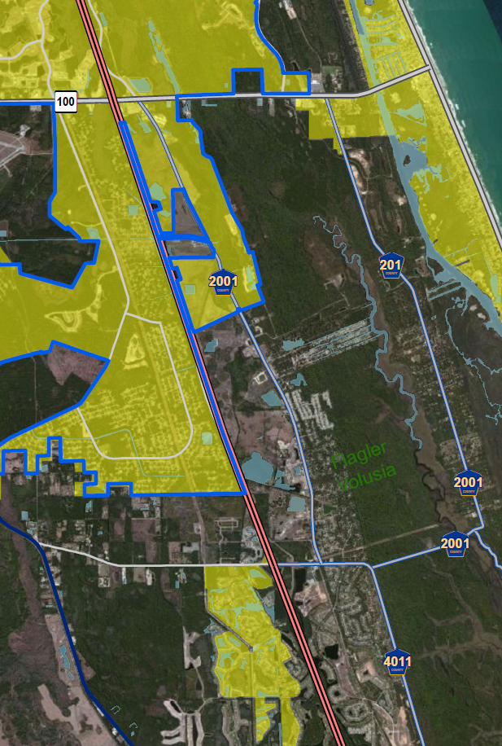
OLD KINGS ROAD (South)
Potential DRI
Targeted Economic Development Area
Old Kings Road
Volusia County

Slide 19
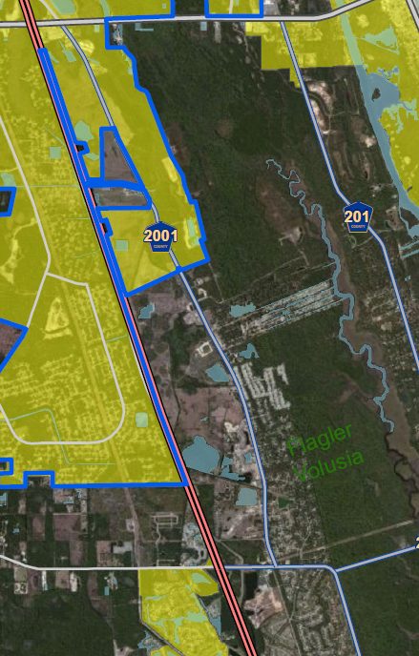
OLD KINGS ROAD (South)
State Road 100 to Flagler/Volusia County Line
LEGEND
Residential Uses
Mixed Use or Commercial Uses
Recreation/Open Space Use
Existing and Potential Development
Flagler Plaza (30 acres) 115,000 sq. ft. commercial uses, 2 hotels (175 units)
Vacant (35 acres) General Commercial
Bulow Creek (798 acres) Potential DRI with 2500 residential units, 2,500,000 sq. ft. non-residential
Old Kings Elementary (16 acres) 1,254 student capacity
Iroquois Property (117 acres) Low Density Residential, Low-intensity Commercial, Conservation
Flagler County Landfill (130 acres)
Old Kings Village PUD (84 acres) 232 residential units, 36,000 sq. ft. commercial
Sweetbottom Plantation PUD (70 acres) Future County Park
Bulow Plantation DRI (320 acres) 1,020 residential units including RV spaces, & commercial uses
Plantation Oaks (115 acres) 377 Manufactured homes
Bulow Plantation Ruins State Park (150 acres)
Eagle Lakes (323 acres) up to 739 residential units
Fairchild Oaks & Sugar Mill Plantation 223 residential units
Old Kings Road
Volusia County

Slide 20
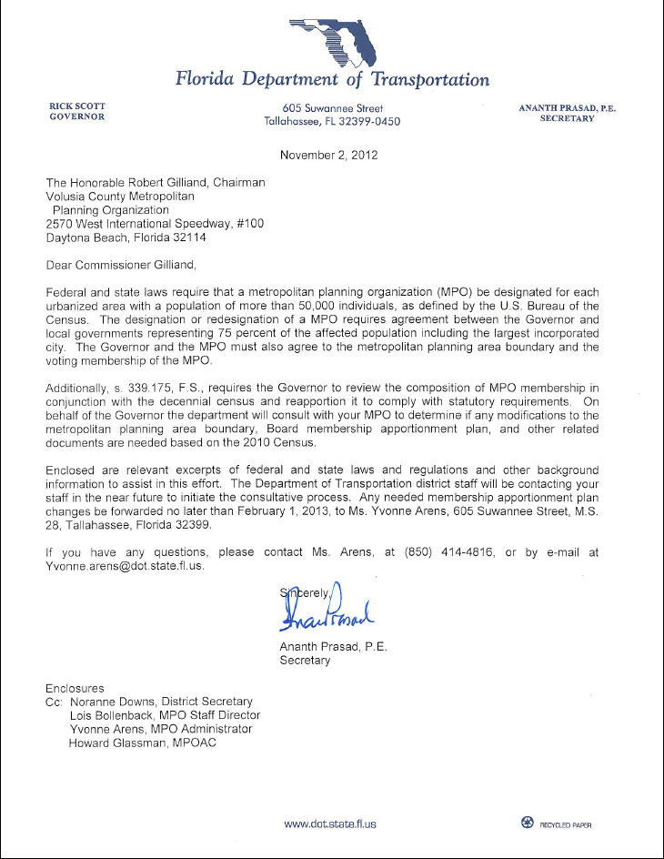
TPO PLANNING AREA
Letter from Governor
Deadline of Feb. 1, 2013 for membership apportionment plan
City is ready to work/assist TPO staff to meet deadline

Slide 21
TPO PLANNING AREA
City supports planning boundaries created by TPO:
  Identifies Palm Coast urbanized and immediate urbanizing areas
    Areas served by roadways will likely urbanize over the next 10 years
  Coordinate land use-transportation planning
    Adjust priorities based on economic development policies, growth, etc.
  Regional Approach to Transportation Planning
  Improves opportunities for transit service
  Availability of new funding opportunities
  Boundaries may be adjusted at a later time

Slide 22
TPO PLANNING AREA
Availability of Additional Funding Sources for Transportation Projects
Important to develop a 10-year transition plan for inclusion of Palm Coast and Flagler County projects into TPO priority list
Inclusion of Palm Coast major road network important to develop a comprehensive 10-year transition plan and maximize funding options

Slide 23
TPO PLANNING AREA
Closing Comments by Mayor Netts

